Slide 1
Uniform Circular Motion and Torque
Physics
Unit 3
Notes:
NAD 2023 Standard F4 (Torque)

Slide 2
Credits
This Slideshow was developed to accompany the textbook
  OpenStax High School Physics
    Available for free at https://openstax.org/details/books/physics
    By Paul Peter Urone and Roger Hinrichs
    2020 edition
Some examples and diagrams are taken from the OpenStax College Physics, Physics, and Cutnell & Johnson Physics 6th ed.
Slides created by
Richard Wright, Andrews Academy
rwright@andrews.edu

Slide 3
3-01 Rotation Angle and Centripetal Acceleration
After this lesson you will…
Define arc length, rotation angle, radius of curvature and angular velocity.
Calculate the angular velocity
Establish the expression for centripetal acceleration.
Notes:
OpenStax High School Physics 6.1, 6.2
OpenStax College Physics 2e 6.1-6.2

Slide 4
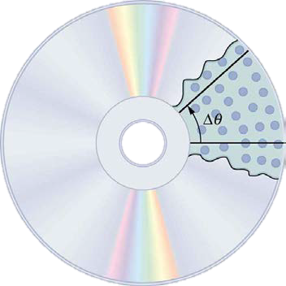
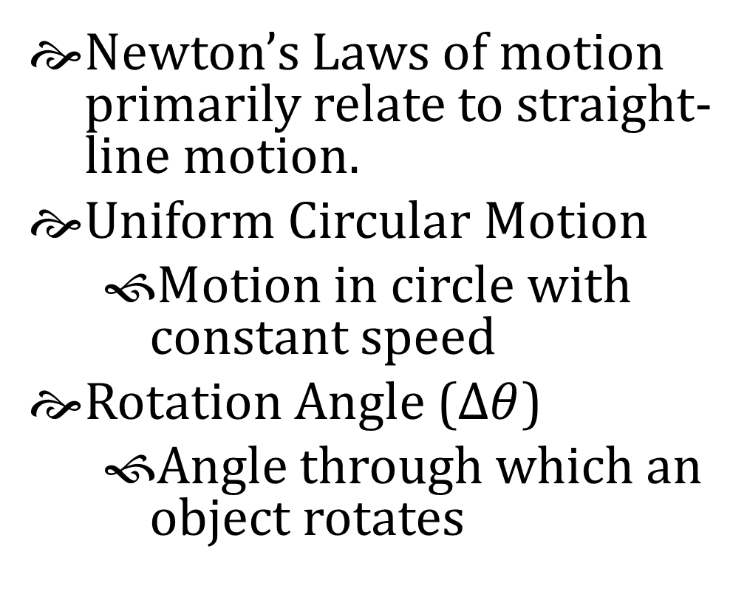
3-01 Rotation Angle and Centripetal Acceleration
Newton’s Laws of motion primarily relate to straight-line motion.
Uniform Circular Motion
  Motion in circle with constant speed
Rotation Angle ($Δθ$)
  Angle through which an object rotates

Slide 5
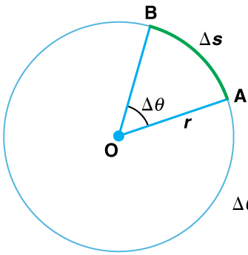
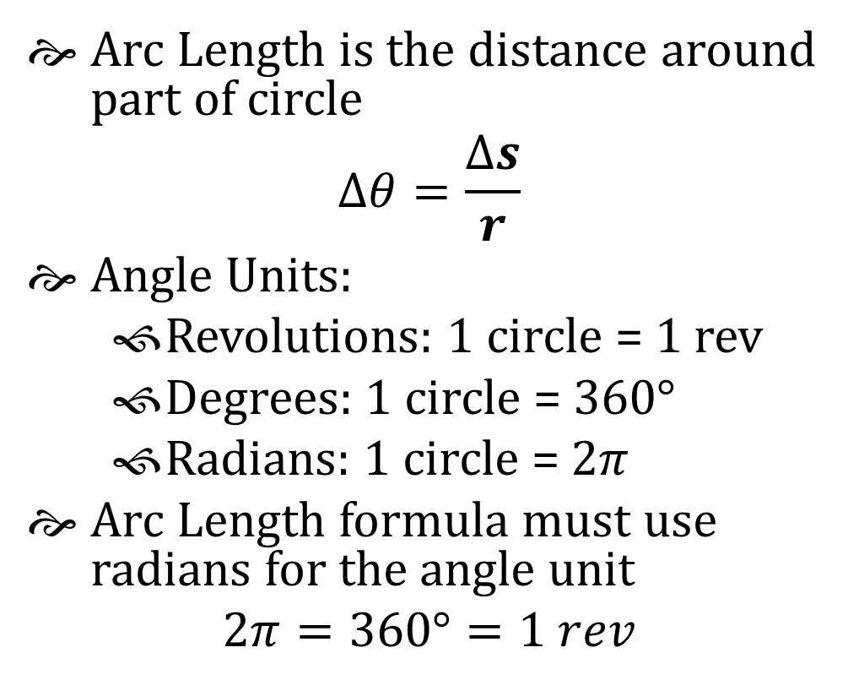
3-01 Rotation Angle and Centripetal Acceleration
Arc Length is the distance around part of circle
$$Δθ=\frac{Δs}{r}$$
Angle Units:
  Revolutions: 1 circle = 1 rev
  Degrees: 1 circle = 360°
  Radians: 1 circle = $2π$
Arc Length formula must use radians for the angle unit
$$2π=360°=1 rev$$

Slide 6
3-01 Rotation Angle and Centripetal Acceleration
Convert 60° to radians
Convert 2 revolutions to radians
Notes:
$$\frac{60°}{}\left(\frac{2π}{360°}\right)=\frac{π}{3}$$
$$\frac{2 rev}{}\left(\frac{2π}{1 rev}\right)=4π$$

Slide 7

3-01 Rotation Angle and Centripetal Acceleration
Angular Velocity ($ω$)
    How fast an object rotates
$$ω=\frac{Δθ}{Δt}$$
Unit: rad/s
  CCW +, CW –
$$v=\frac{Δs}{Δt}$$
$$Δθ=\frac{Δs}{r} →Δs=rΔθ$$
$$v=\frac{rΔθ}{Δt}=rω$$

Slide 8
3-01 Rotation Angle and Centripetal Acceleration
A CD rotates 320 times in 2.4 s. What is its angular velocity in rad/s? What is the linear velocity of a point 5 cm from the center?
Notes:
$$θ=320 rev (2π/1 rev) = 640π rad$$
$$t=2.4s$$
$$=θ/t = 640π rad/2.4s = 838 rad/s$$
$$v=rω$$
$$v=\left(0.05 m\right)\left(838\frac{rad}{s}\right)=41.9 m/s$$

Slide 9
3-01 Rotation Angle and Centripetal Acceleration
Make a hypothesis about what will happen. Which path will an object most closely follow when the centripetal force is removed?
A
B
C

Slide 10
3-01 Rotation Angle and Centripetal Acceleration
Put the plate on a flat surface and put a marble in the ridge.
Push the marble in the ridge so that it travels around the plate and then out of the removed section.
What is providing the centripetal force? i.e. what is keeping the marble traveling in a circle?
Perform the test several times and record your results.
Which of Newton’s Laws explains the results?
This would have been more complicated if the object moved in a vertical circle. Why?
Notes:
3. Rim of the plate
4. Straight line (B)
5. 1st
6. Gravity would have pulled it down

Slide 11
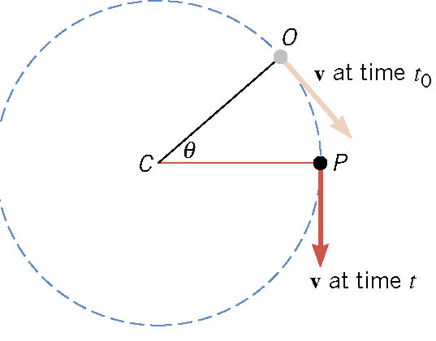
3-01 Rotation Angle and Centripetal Acceleration
Object moves in circular path
At time t₀ it is at point O with a velocity tangent to the circle
At time t, it is at point P with a velocity tangent to the circle
The radius has moved through angle θ

Slide 12
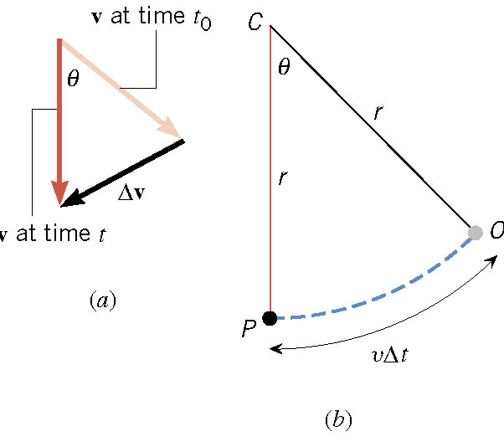
3-01 Rotation Angle and Centripetal Acceleration
Draw the two velocity vectors so that they have the same tails.
The vector connecting the heads is Δv
Draw the triangle made by the change in position and you get the triangle in (b)

Slide 13
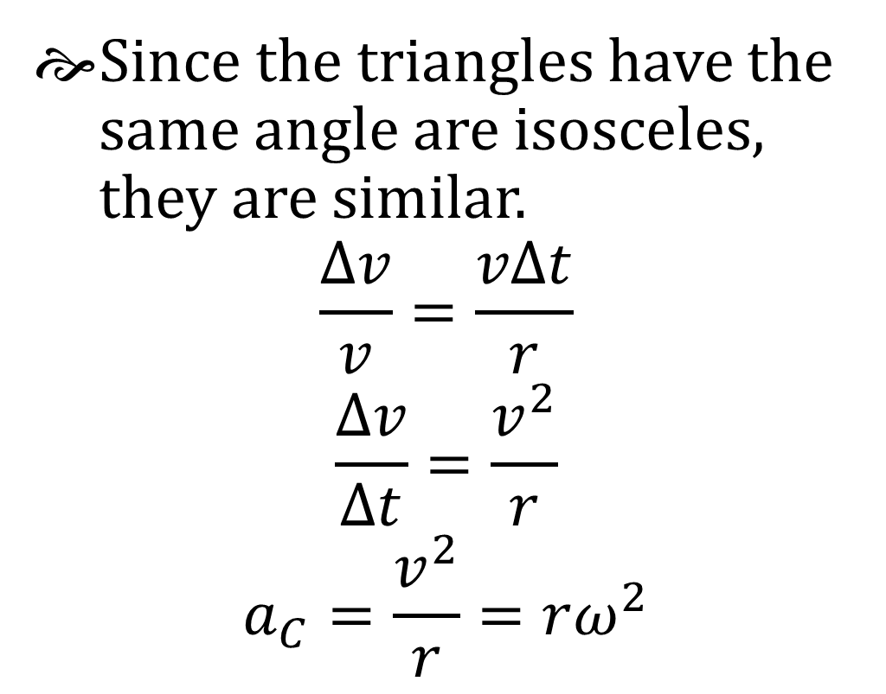
3-01 Rotation Angle and Centripetal Acceleration
Since the triangles have the same angle are isosceles, they are similar.
$$\frac{Δv}{v}=\frac{vΔt}{r}$$
$$\frac{Δv}{Δt}=\frac{v^{2}}{r}$$
$$a_{C}=\frac{v^{2}}{r}=rω^{2}$$

Slide 14
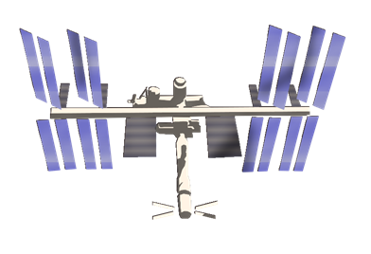
3-01 Rotation Angle and Centripetal Acceleration
At any given moment
  v is pointing tangent to the circle
  a_{c} is pointing towards the center of the circle
If the object suddenly broke from circular motion would travel in line tangent to circle
Notes:
Have a string with something soft on end.
Swing it and let go to illustrate.

Slide 15
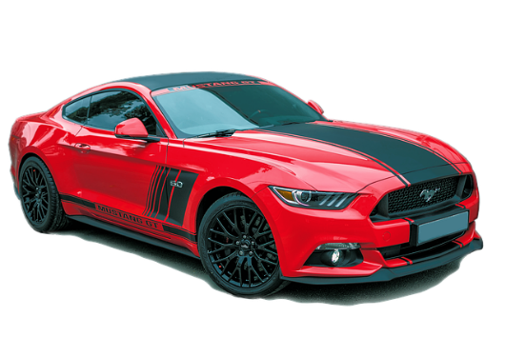
3-01 Rotation Angle and Centripetal Acceleration
Two identical cars are going around two corners at 30 m/s. Each car can handle up to 1 g. The radius of the first curve is 50 m and the radius of the second is 100 m. Do either of the cars make the curve? (hint find the a_{c})
50 m
100 m
Notes:
$$a_{c1}=\frac{v^{2}}{r}→ a_{c1}=\frac{{\left(30 \frac{m}{s}\right)}^{2}}{50 m}→ a_{c1}= 18 \frac{m}{s2}$$
Can’t make it
$$a_{c2}=\frac{{\left(30 \frac{m}{s}\right)}^{2}}{100 m}= 9 \frac{m}{s2}$$
Yes

Slide 16
3-02 Centripetal Force
After this lesson you will…
Apply centripetal force
F = ma
Notes:
OpenStax High School Physics 6.2
OpenStax College Physics 2e 6.3

Slide 17
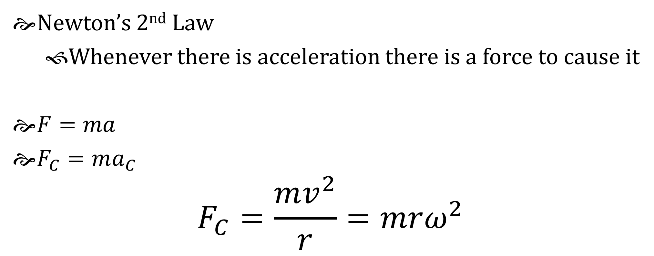
3-02 Centripetal Force
F = ma
Newton’s 2nd Law
  Whenever there is acceleration there is a force to cause it
$F=ma$
$F_{C}=ma_{C}$
$$F_{C}=\frac{mv^{2}}{r}=mrω^{2}$$

Slide 18
3-02 Centripetal Force
F = ma
Centripetal Force is not a new, separate force created by nature!
Some other force creates centripetal force
  Swinging something from a string → tension
  Satellite in orbit → gravity
  Car going around curve → friction

Slide 19
3-02 Centripetal Force
F = ma
A 1.25-kg toy airplane is attached to a string and swung in a circle with radius = 0.50 m. What was the centripetal force for a speed of 20 m/s? What provides the F_{c}?
F_{c} = 1000 N
Tension in the string
Notes:
$$F_{C}=\frac{mv^{2}}{r}$$
$$=\frac{\left(1.25 kg\right){\left(20\frac{m}{s}\right)}^{2}}{0.50 m}$$
$$=1000 N$$

Slide 20
3-02 Centripetal Force
F = ma
What affects F_{c} more: a change in mass, a change in radius, or a change in speed?
A change in speed since it is squared and the others aren’t.

Slide 21
3-02 Centripetal Force
F = ma
Why do objects seem to fly away from circular motion?
They really go in a straight line according to Newton's First Law.

Slide 22
3-02 Centripetal Force
F = ma
How does the spin cycle in a washing machine work?
The drum’s normal forces makes the clothes to travel in a circle. The water can go through the holes, so it goes in a straight line. The water is not spun out, the clothes are moved away from the water.

Slide 23
3-02 Centripetal Force
F = ma
Remember the good old days when cars were big, the seats were vinyl bench seats, and there were no seat belts? Well when a guy would take a girl out on a date and he wanted to get cozy, he would put his arm on the back of the seat then make a right hand turn. The car and the guy would turn since the tires and steering wheel provided the centripetal force. The friction between the seat and the girl was not enough, so the girl would continue in a straight path while the car turned underneath her. She would end up in the guy’s arms.

Slide 24
3-03 Kinematics of Rotational Motion
After this lesson you will…
Describe uniform circular motion.
Calculate angular acceleration of an object.
Observe the link between linear and angular acceleration.
Observe the kinematics of rotational motion.
Derive rotational kinematic equations.
Notes:
OpenStax High School Physics 6.3
OpenStax College Physics 2e 9.1-9.4

Slide 25
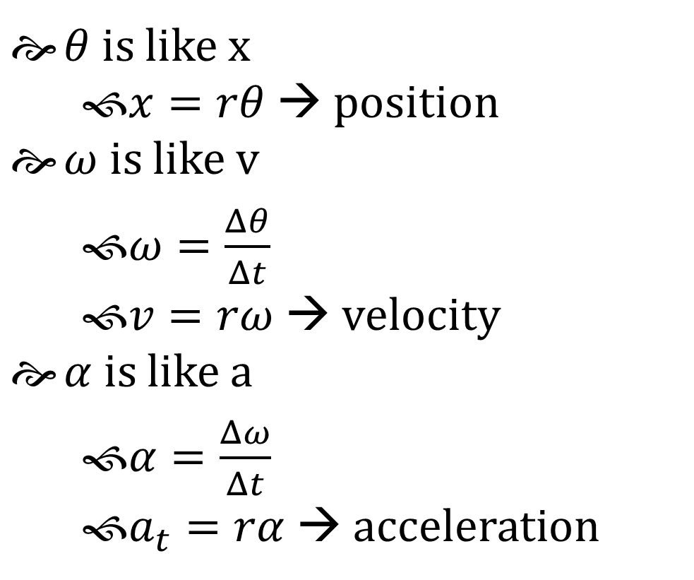
3-03 Kinematics of Rotational Motion
Rotational motion
Describes spinning motion
$θ$ is like x
  $x=rθ$ → position
$ω$ is like v
  $ω=\frac{Δθ}{Δt}$
  $v=rω$ → velocity
$α$ is like a
  $α=\frac{Δω}{Δt}$
  $a_{t}=rα$ → acceleration
Notes:
CCW is +
CW is -

Slide 26
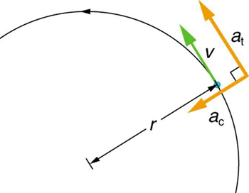
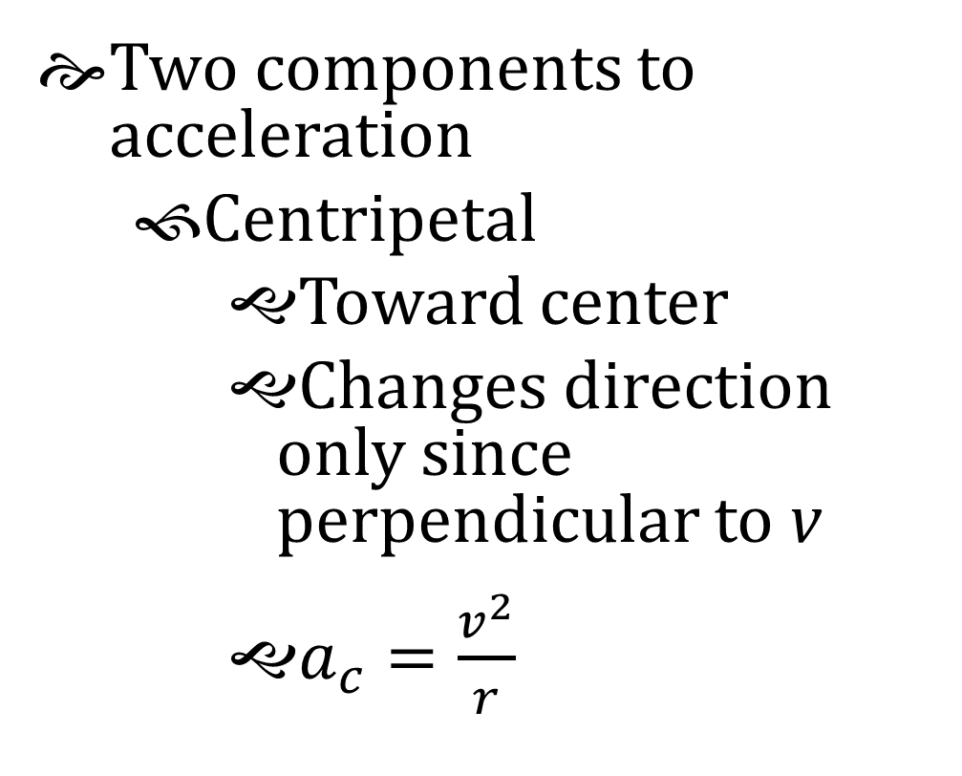
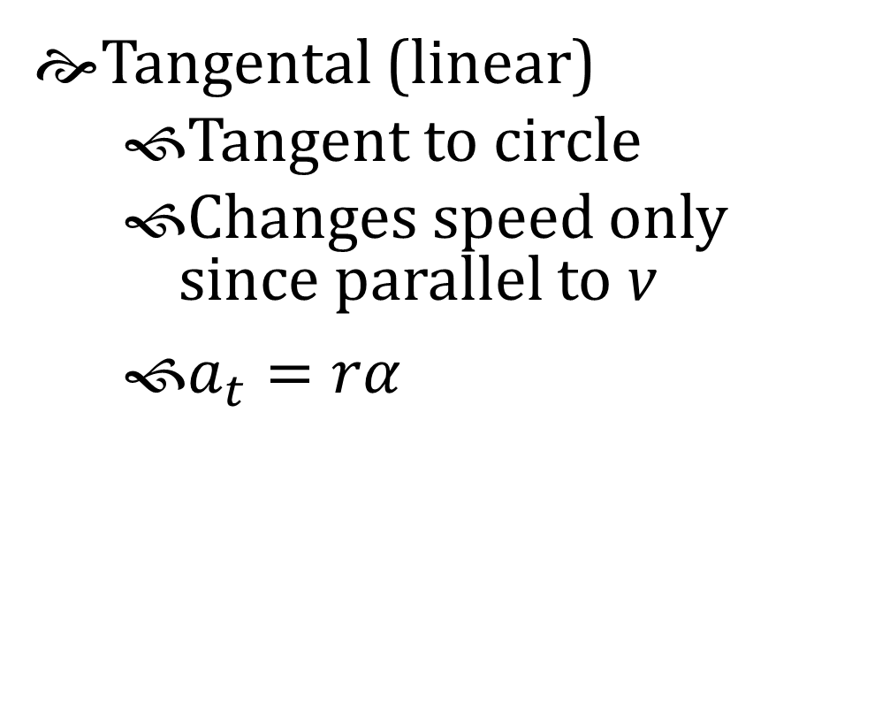
3-03 Kinematics of Rotational Motion
Two components to acceleration
  Centripetal
    Toward center
    Changes direction only since perpendicular to v
    $a_{c}=\frac{v^{2}}{r}$
Tangental (linear)
  Tangent to circle
  Changes speed only since parallel to v
  $a_{t}=rα$

Slide 27
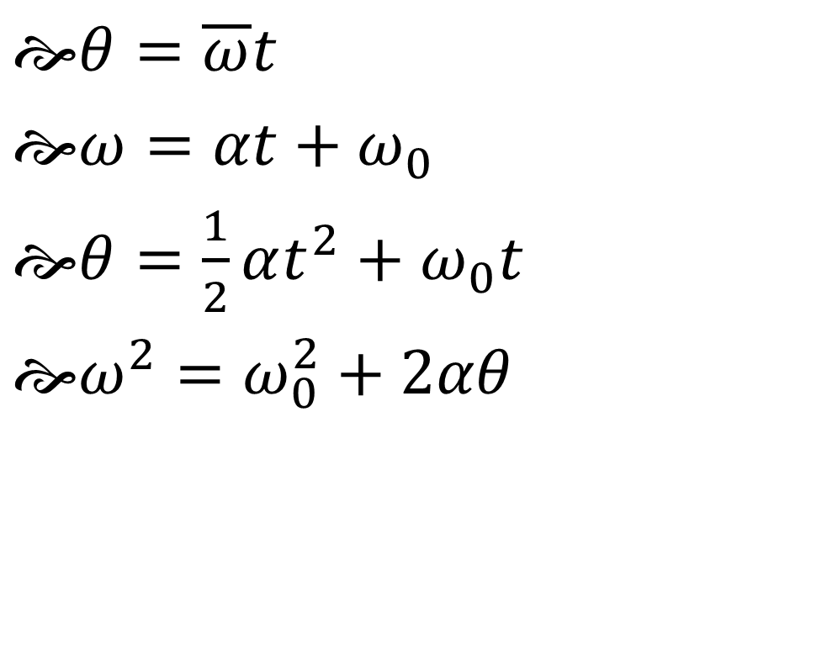
3-03 Kinematics of Rotational Motion
Equations of kinematics for rotational motion are same as for linear motion
$θ=\overline{ω}t$
$ω=αt+ω_{0}$
$θ=\frac{1}{2}αt^{2}+ω_{0}t$
$ω^{2}=ω_{0}^{2}+2αθ$

Slide 28
3-03 Kinematics of Rotational Motion
Reasoning Strategy
Examine the situation to determine if rotational motion involved
Identify the unknowns (a drawing can be useful)
Identify the knowns
Pick the appropriate equation based on the knowns/unknowns
Substitute the values into the equation and solve
Check to see if your answer is reasonable

Slide 29
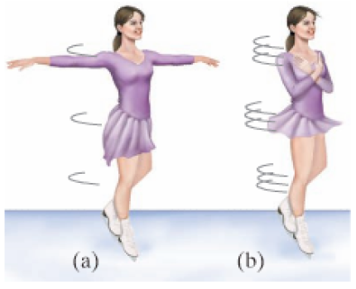
3-03 Kinematics of Rotational Motion
A figure skater is spinning at 0.5 rev/s and then pulls her arms in and increases her speed to 10 rev/s in 1.5 s. What was her angular acceleration?
39.8 rad/s²
Notes:
$$ω_{0}=0.5\frac{rev}{s} \left(\frac{2π rad}{rev}\right)=π\frac{rad}{s}$$
$$ω=10\frac{rev}{s}\left(\frac{\left(2π rad\right)}{rev}\right)=20π\frac{rad}{s}$$
$$t=1.5 s$$
$$ω=ω_{0}+αt$$
$$20π\frac{rad}{s}=π\frac{rad}{s}+α\left(1.5 s\right)$$
$$19π\frac{rad}{s}=α\left(1.5 s\right)$$
$$α=39.8\frac{rad}{s^{2}}$$

Slide 30
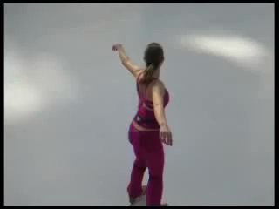

Slide 31
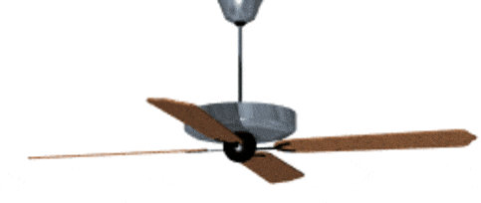
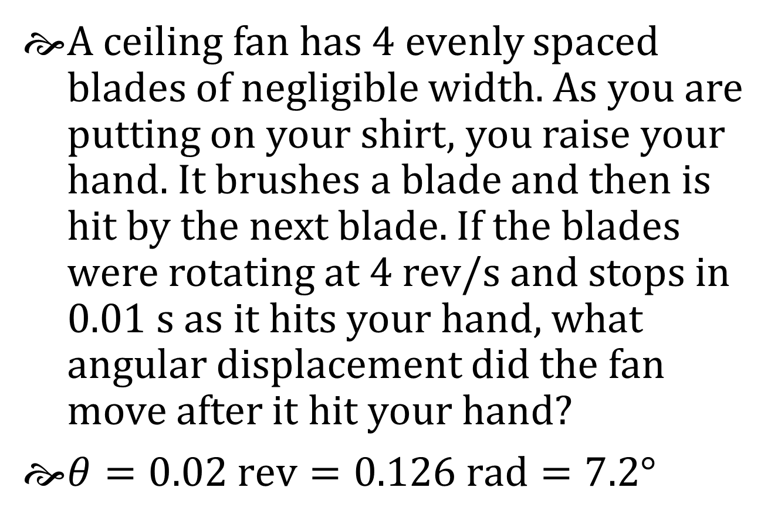
3-03 Kinematics of Rotational Motion
A ceiling fan has 4 evenly spaced blades of negligible width. As you are putting on your shirt, you raise your hand. It brushes a blade and then is hit by the next blade. If the blades were rotating at 4 rev/s and stops in 0.01 s as it hits your hand, what angular displacement did the fan move after it hit your hand?
$θ=0.02 rev=0.126 rad=7.2°$
Notes:
$$ω_{0}=4\frac{rev}{s}, t=0.01 s$$
$$θ=\overline{ω}t$$
$$θ=\left(\frac{ω+ω_{0}}{2}\right)t$$
$$θ=\left(\frac{0+4\frac{rev}{s}}{2}\right)\left(0.01 s\right)=0.02 rev=0.126 rad=7.2°$$

Slide 32
3-04 Torque
After this lesson you will…
Calculate torque
Apply torque to equilibrium problems
τ = rF sin θ
Notes:
OpenStax High School Physics 6.3
OpenStax College Physics 2e 10.1-10.2

Slide 33
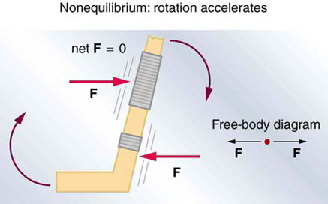
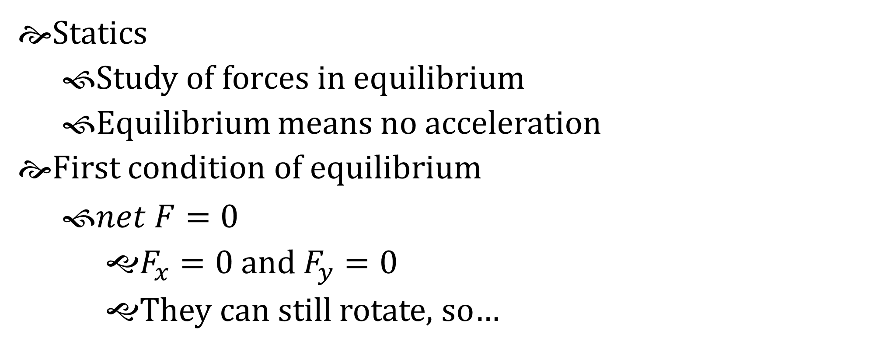
3-04 Torque
τ = rF sin θ
Statics
  Study of forces in equilibrium
  Equilibrium means no acceleration
First condition of equilibrium
  $net F=0$
    $F_{x}=0$ and $F_{y}=0$
    They can still rotate, so…

Slide 34
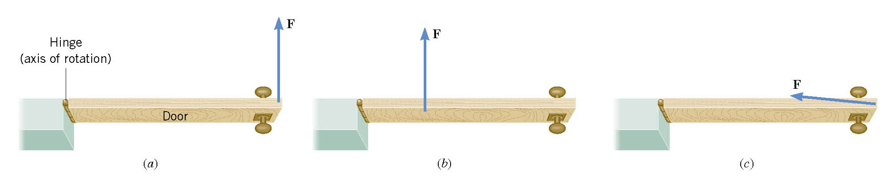
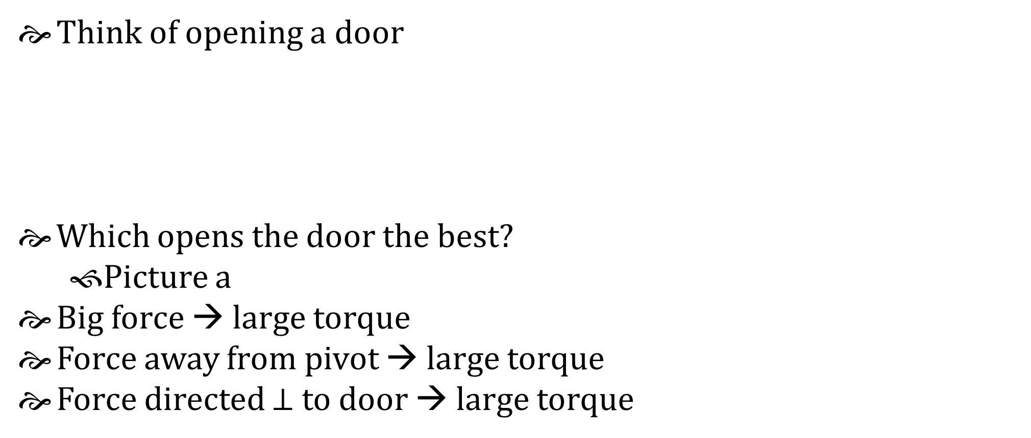
3-04 Torque
τ = rF sin θ
Think of opening a door
Which opens the door the best?
  Picture a
Big force → large torque
Force away from pivot → large torque
Force directed $⊥$ to door → large torque

Slide 35
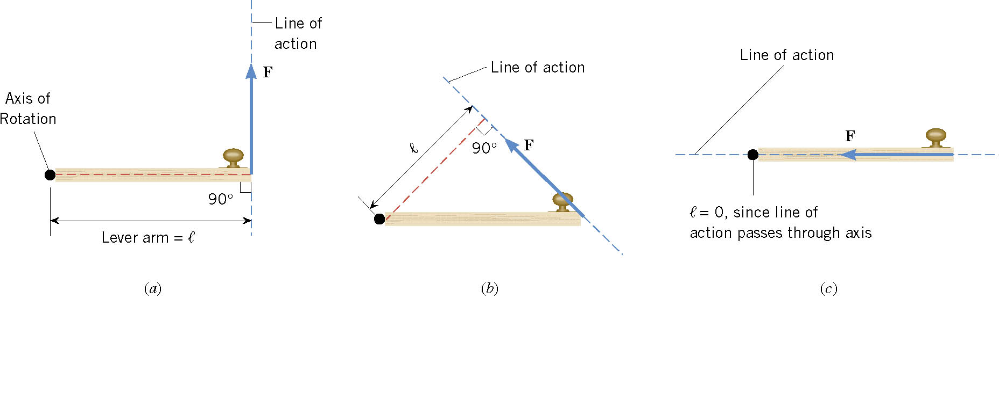
3-04 Torque
τ = rF sin θ
τ = r × F
  This means we use the component of the force that is perpendicular to the lever arm
τ = r F⊥
τ = r F sin θ
  θ is the angle between the force and the radius
Unit: Nm
  CCW → +
  CW → −

Slide 36
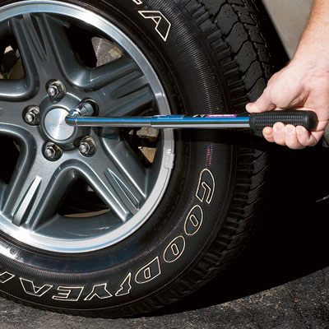
3-04 Torque
τ = rF sin θ
You are meeting the parents of your new “special” friend for the first time. After being at their house for a couple of hours, you walk out to discover the little brother has let all the air out of one of your tires. Not knowing the reason for the flat tire, you decide to change it. You have a 50-cm long lug-wrench attached to a lugnut as shown. If 900 Nm of torque is needed, how much force is needed?
F = 2078 N
Less force required if pushed at 90°
120°
Notes:
$$τ=rF\sin{θ}$$
$$900 Nm=(0.5m)F (\sin{120°})$$
$$F=2078 N$$

Slide 37
3-04 Torque
τ = rF sin θ
Second condition of equilibrium
  Net torque = 0

Slide 38
3-04 Torque
τ = rF sin θ
A 5 m, 10 kg seesaw is balanced by a little girl (25 kg) and her father (80 kg) at opposite ends as shown below. How far from the seesaw’s center of mass must the fulcrum be placed?
  1.20 m
How much force
must the fulcrum
support?
  1130 N
80 kg
25 kg
x m
10 kg
5 m
Notes:
$$∑τ=0$$
$$\left(2.5 m+x\right)\left(25 kg⋅9.8 m/s^{2}\right)+x\left(10 kg⋅9.8 m/s^{2}\right)−\left(2.5 m−x\right)\left(80 kg⋅9.8 m/s^{2}\right)=0$$
$$612.5 Nm+245 N x+98 N x−1960 Nm+784 N x=0$$
$$−1347.5 Nm+1127 N x=0$$
$$1127 N x=1347.5 Nm$$
$$x=1.20 m$$
$$∑F=−W_{g}−W_{f}−W_{b}+F_{f}=0$$
$$−\left(25 kg\right)\left(9.8\frac{m}{s^{2}}\right)−\left(80 kg\right)\left(9.8\frac{m}{s^{2}}\right)−\left(10 kg\right)\left(9.8\frac{m}{s^{2}}\right)+F_{f}=0$$
$$−1127 N+F_{f}=0$$
$$F_{f}=1127 N$$

Slide 39
3-05 Moment of Inertia
After this lesson you will…
Understand how the moment of inertia affects angular acceleration
Apply Newton’s Second Law for torques (τ = I α)
τ = rF sin θ
Notes:
Not in OpenStax High School Physics
OpenStax College Physics 2e 10.3

Slide 40
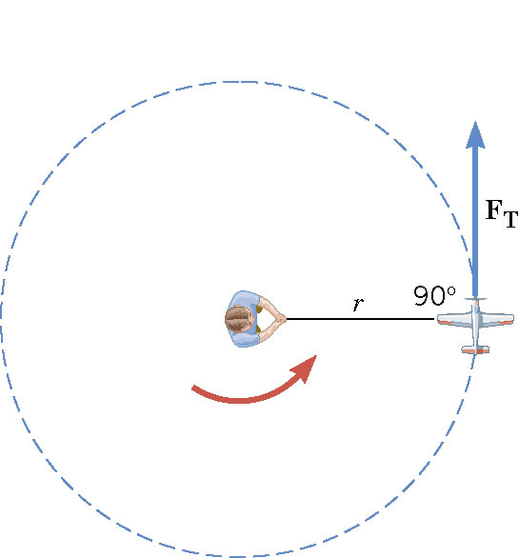
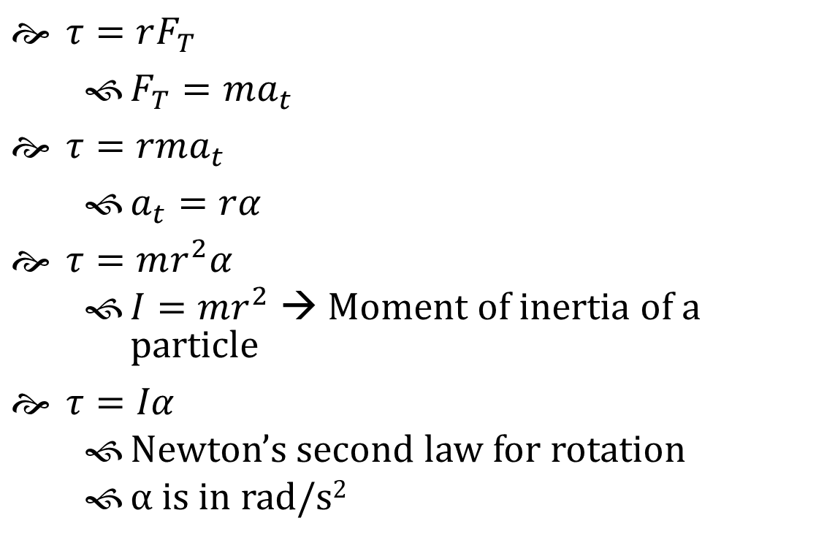
3-05 Moment of Inertia
τ = rF sin θ
$τ=rF_{T}$
  $F_{T}=ma_{t}$
$τ=rma_{t}$
  $a_{t}=rα$
$τ=mr^{2}α$
  $I=mr^{2}$ → Moment of inertia of a particle
$τ=Iα$
  Newton’s second law for rotation
  α is in rad/s²

Slide 41
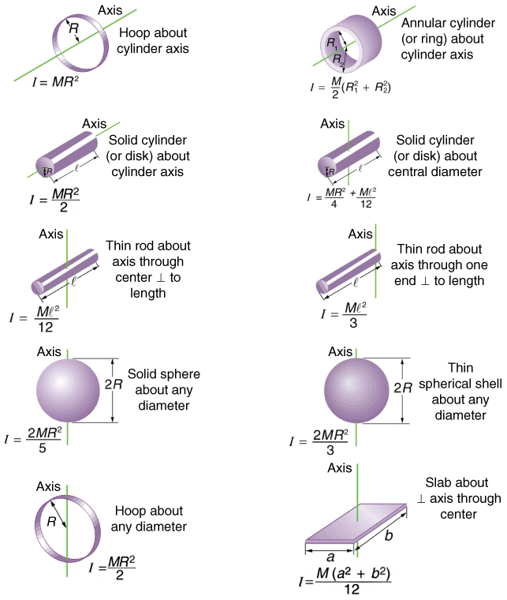
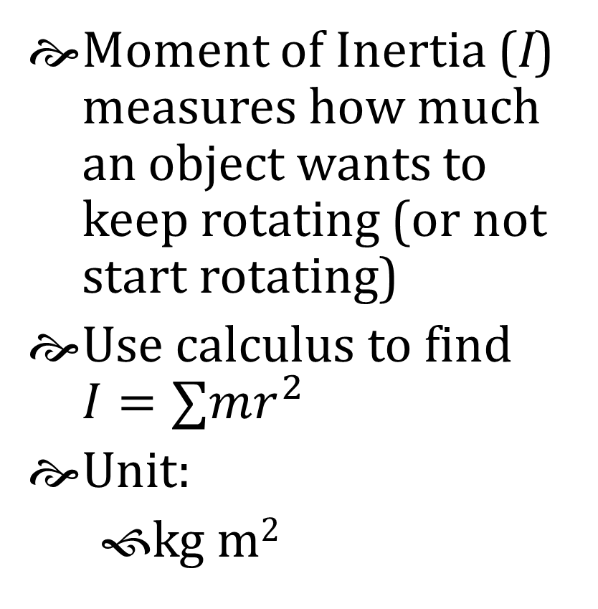
3-05 Moment of Inertia
τ = rF sin θ
Moment of Inertia (I) measures how much an object wants to keep rotating (or not start rotating)
Use calculus to find $I=∑mr^{2}$
Unit:
  kg m²

Slide 42
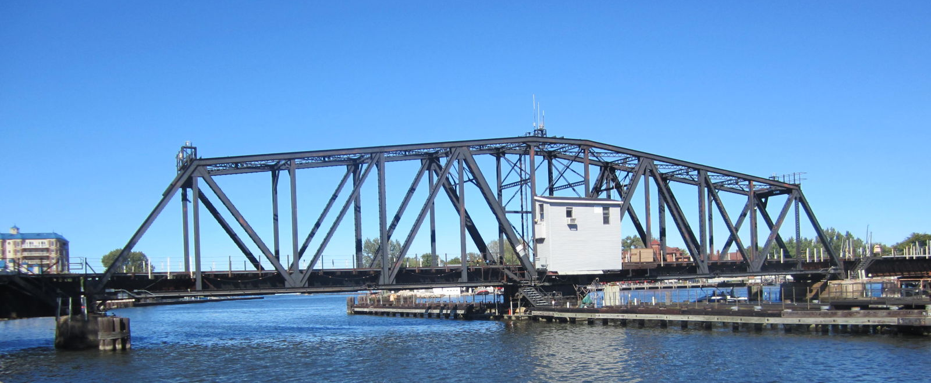
3-05 Moment of Inertia
τ = rF sin θ
The St. Joseph River Swing Bridge in St. Joseph, Michigan has a mass of 300 tons (2.72×10⁵ kg) and is 231 ft (70.4 m) long. If the motor produces 563 kNm of torque and takes 10 s to accelerate the bridge to 0.05 rad/s, what is the bridge’s moment of inertia?
Notes:
Due to its well-balanced construction, the 231-foot, 300-ton bridge can be turned with a single 10-horsepower electric motor. It takes approximately 42 seconds to open.
$$α=\frac{Δω}{Δt}$$
$$α=\frac{0.05 \text{rad}\text{/}\text{s}−0 \text{rad}\text{/}\text{s}}{10 \text{s}}=0.005\frac{rad}{s^{2}}$$
$$τ=Iα$$
$$563×{10}^{3} Nm=I\left(0.005\frac{rad}{s^{2}}\right)$$
$$1.13×{10}^{8} kg·m^{2}=I$$

Slide 43
3-05 Moment of Inertia
τ = rF sin θ
A spinning ride at a carnival is accelerating at 4 rad/s². If the ride is shaped like a hoop, and the motor is exerting 128000 Nm of torque, what is the radius of the 500 kg ride?
Notes:
$$τ=Iα;I=MR^{2}$$
$$128000 Nm=\left(500 kg\right)R^{2}\left(4\frac{rad}{s^{2}}\right)$$
$$128000 Nm=2000\frac{kg}{s^{2}}R^{2}$$
$$64 m^{2}=R^{2}$$
$$8 m=R$$

