Slide 1
Kepler’s Laws and Gravity
Physics
Unit 05
Notes:
NAD 2023 Standards
Gravity G1
Gravity G2

Slide 2
Credits
This Slideshow was developed to accompany the textbook
  OpenStax High School Physics
    Available for free at https://openstax.org/details/books/physics
    By Paul Peter Urone and Roger Hinrichs
    2020 edition
Some examples and diagrams are taken from the OpenStax College Physics, Physics, and Cutnell & Johnson Physics 6th ed.
Slides created by
Richard Wright, Andrews Academy
rwright@andrews.edu

Slide 3
5-01 Kepler’s Laws of Planetary Motion
In this lesson you will…
Predict the motion of orbiting objects in the solar system
Explain Kepler’s Laws of Planetary Motion
Diagram a planets elliptical orbit
Notes:
NAD 2023 Standards
Gravity G2
OpenStax High School Physics 7.1
OpenStax College Physics 2e 6.6

Slide 4
5-01 Kepler’s Laws of Planetary Motion
After studying motion of planets, Kepler came up with his laws of planetary motion
Newton then proved them all using his Universal Law of Gravitation
Assumptions:
  A small mass, m, orbits much larger mass, M, so we can use M as an approximate inertia reference frame
  The system is isolated

Slide 5
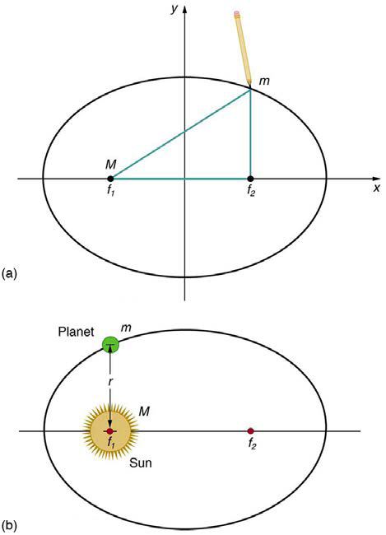
5-01 Kepler’s Laws of Planetary Motion
The orbit of each planet about the Sun is an ellipse with the sun at one focus.
Closest point to sun perihelion
Farthest distance to sun aphelion
Watch video Kepler’s First Law

Slide 6
5-01 Kepler’s Laws of Planetary Motion
Do Kepler’s First Law lab

Slide 7
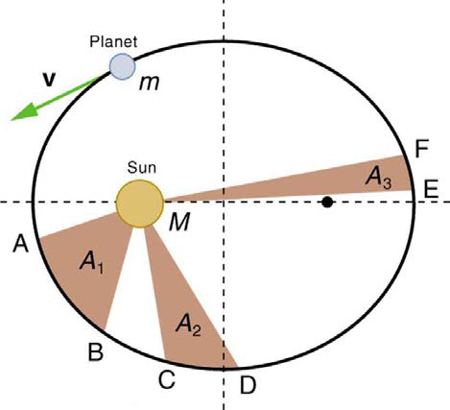
5-01 Kepler’s Laws of Planetary Motion
Each planet moves so that an imaginary line drawn from the sun to the planet sweeps out equal areas in equal times.
Watch video Kepler’s Second Law

Slide 8
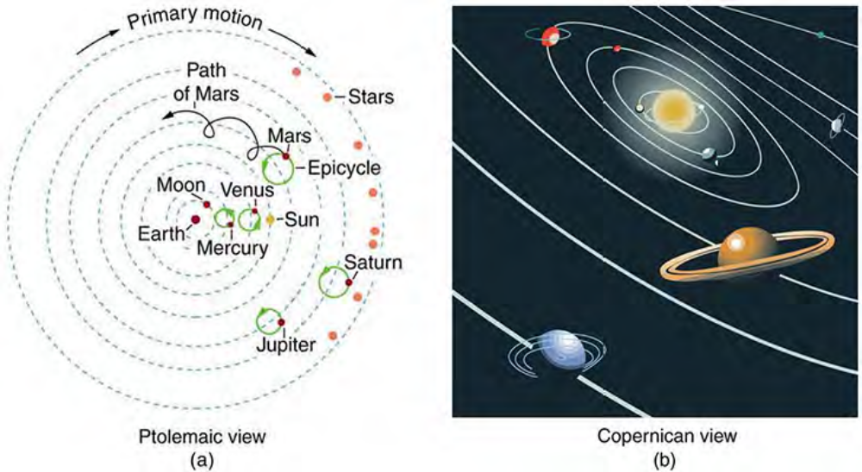

5-01 Kepler’s Laws of Planetary Motion
The ratio of the squares of the periods of any two planets about the sun is equal to the ratio of the cubes of their average distances from the sun.
$$\frac{T_{1}^{2}}{T_{2}^{2}}=\frac{r_{1}^{3}}{r_{2}^{3}}$$
Watch Kepler’s Third Law video
Notes:
T is period and r is average orbital radius

Slide 9
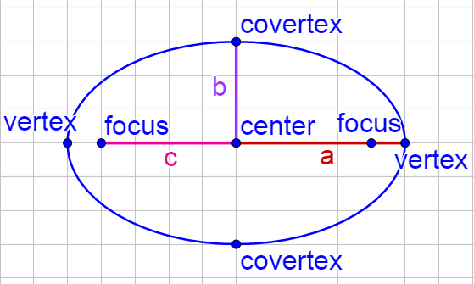


5-01 Kepler’s Laws of Planetary Motion
Parts of an ellipse
  a = semimajor axis (distance from center to vertex)
    $a=\frac{r_{a}+r_{p}}{2}$
  b = semiminor axis (distance from center to covertex)
    $b=\sqrt{r_{a}r_{p}}$
  c = focal length (distance from center to focus)
    $c=r_{a}−a$
Area of ellipse
  $A=πab$
Eccentricity
  Measure of how stretched out an ellipse is
  $e=\frac{c}{a}$
  e = 0 circle, e = 1 line

Slide 10
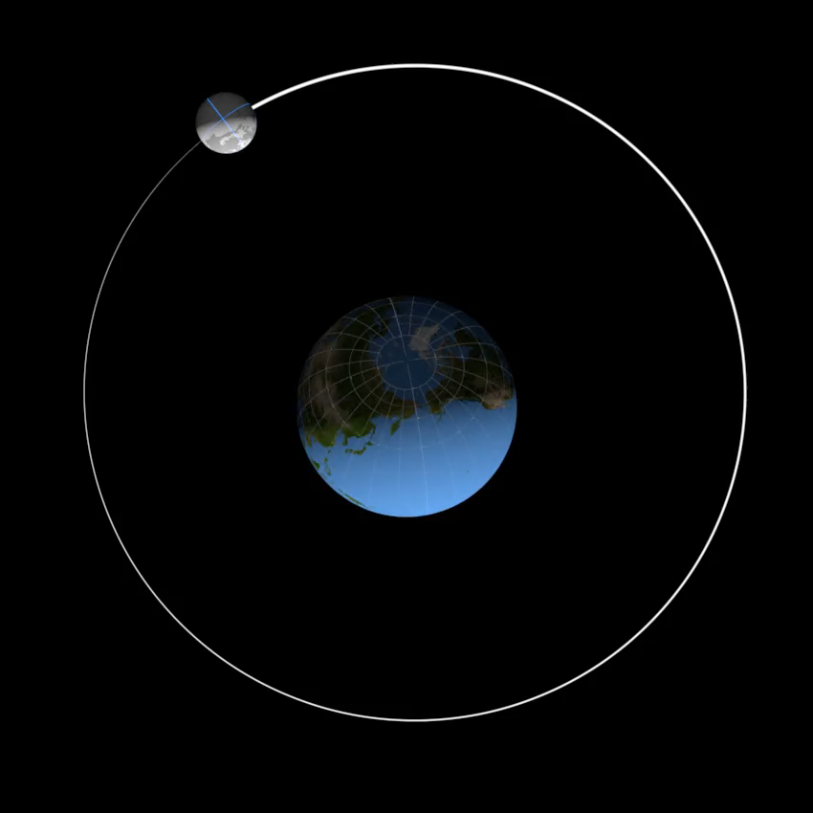
5-01 Kepler’s Laws of Planetary Motion
The perihelion of the moon from earth is 358000 km. Its aphelion is 399000 km. What is the moon’s orbit’s semimajor axis, semiminor axis, focal length, and eccentricity?
Notes:
$$a=\frac{r_{a}+r_{b}}{2}=\frac{3.58×{10}^{8} m+3.99×{10}^{8} m}{2}=3.785×{10}^{8} m$$
$$b=\sqrt{r_{a}r_{b}}=\sqrt{\left(3.58×{10}^{8} m\right)\left(3.99×{10}^{8} m\right)}=3.779×{10}^{8} m$$
$$r_{a}=a+c$$
$$3.99×{10}^{8} m=3.785×{10}^{8} m+c$$
$$c=0.205×{10}^{8} m=2.05×{10}^{7} m$$
$$e=\frac{c}{a}=\frac{2.05×{10}^{7} m}{3.785×{10}^{8} m}=0.054$$

Slide 11
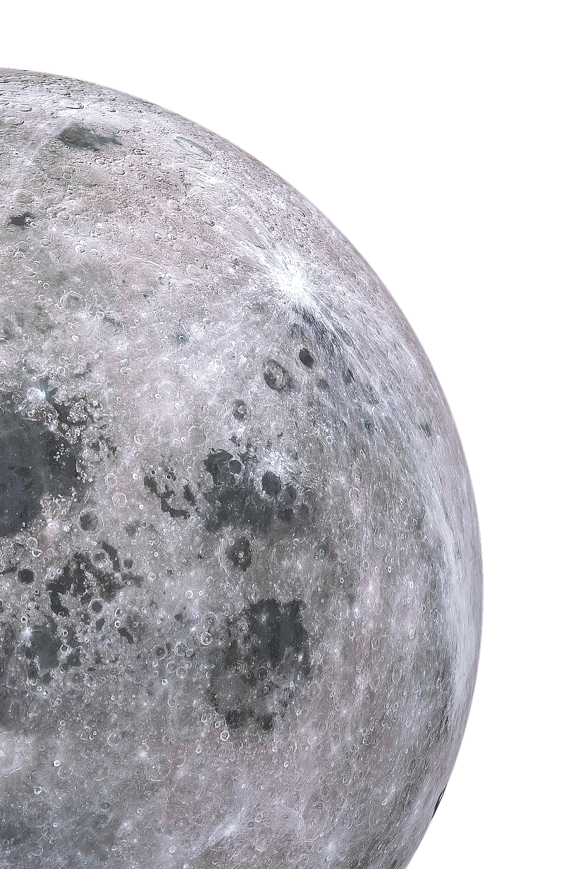
5-01 Kepler’s Laws of Planetary Motion
If it takes 27.3 days for the moon to orbit the earth, how much area does a line from the earth to the moon sweep out every day?
Notes:
$$\frac{Area}{time}$$
$$\frac{πab}{t}$$
$$\frac{π\left(3.785×{10}^{8} m\right)\left(3.779×{10}^{8} m\right)}{27.3 d}=1.65×{10}^{16}\frac{m^{2}}{d}$$

Slide 12
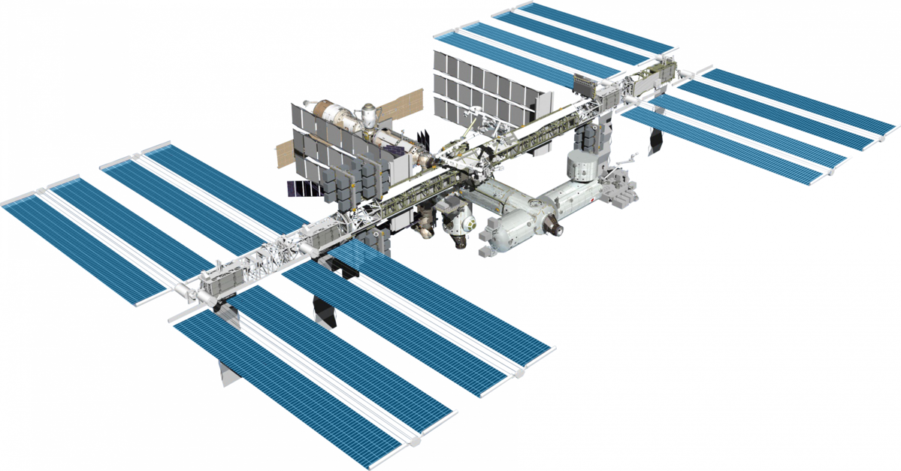
5-01 Kepler’s Laws of Planetary Motion
The moon’s average radius of orbit is 384,399 km and takes 27.322 days to orbit the earth. The International Space Station’s average radius of orbit is 417.5 km above the earth. What is the period of the ISS’s orbit?
Notes:
$$r_{ISS}=417.5 km+6380 km=6797.5 km$$
$$\frac{T_{1}^{2}}{T_{2}^{2}}=\frac{r_{1}^{3}}{r_{2}^{3}}$$
$$\frac{T_{1}^{2}}{{\left(27.322 d\right)}^{2}}=\frac{{\left(6797.5 km\right)}^{3}}{{\left(384399 km\right)}^{3}}$$
$$T_{1}^{2}=\frac{{\left(6797.5 km\right)}^{3}}{{\left(384399 km\right)}^{3}}{\left(27.322 d\right)}^{2}=0.0041279 d^{2}$$
$$T_{1}=0.0642 d=1.54 h$$

Slide 13
5-02 Weight and Gravity
In this lesson you will…
Use Newton’s Law of Gravitation to describe the gravitational forces between objects
Find the acceleration due to gravity for various locations
Notes:
NAD 2023 Standards
Gravity G2
OpenStax High School Physics 7.2
OpenStax College Physics 2e 6.5

Slide 14

5-02 Weight and Gravity
Every particle in the universe exerts a force on every other particle
$$F_{g}=G\frac{mM}{r^{2}}$$
$G = 6.673×{10}^{−11} N m2/kg2$
m and M are the masses of the particles
r = distance between the particles (centers of objects)
Notes:
G is the universal gravitational constant – measured by Henry Cavendish using a very sensitive balance 100 years after Newton proposed the law

Slide 15
5-02 Weight and Gravity
For bodies
Using calculus – apply universal gravitation for bodies
Estimate (quite precisely)
  Assume bodies are particles based at their center of mass
  For spheres assume they are particles located at the center

Slide 16


5-02 Weight and Gravity
What is the gravitational attraction between a 75-kg boy (165 lbs) and the 50-kg girl (110 lbs) seated 1 m away in the next desk?
F_{g} = $2.5×{10}^{−7}$ N
  = $2.6×{10}^{−8}$ lbs of force
Notes:
$$m_{1}=75 kg; m_{2}=50 kg; r=1 m$$
$$F_{g}=\frac{GMm}{r^{2}}$$
$$F=\frac{6.67×{10}^{−11}\frac{Nm^{2}}{kg^{2}}\left(75 kg\right)\left(50 kg\right)}{{\left(1 m\right)}^{2}}=2.5×{10}^{−7} N$$

Slide 17
5-02 Weight and Gravity
Weight is Gravitational Force the earth exerts on an object
Unit: Newton (N)
Remember!!!
  Weight is a Force
Notes:
Eureka #7

Slide 18

5-02 Weight and Gravity
Since weight is the force of gravity
$$W=G\frac{mM}{r^{2}}$$
$$W=mg$$
$$g=G\frac{M}{r^{2}}$$
r is usually R_{E}
  So g = 9.80 m/s²

Slide 19

5-02 Weight and Gravity
Find the acceleration due to gravity at the altitude of the ISS, 417.5 km above the earth.
$g=8.64 m/s^{2}$ not much smaller than $9.8 m/s^{2}$
Notes:
$$r_{ISS}=417.5×{10}^{3} m+6.38×{10}^{6} m=6.7975×{10}^{6} m$$
$$g=\frac{GM}{r^{2}}$$
$$g=\frac{\left(6.673×{10}^{−11}\frac{Nm^{2}}{kg^{2}}\right)\left(5.98×{10}^{24} kg\right)}{{\left(6.7975×{10}^{6} m\right)}^{2}}=8.64 m/s^{2}$$

Slide 20
5-02 Weight and Gravity
The gravitational pull from the moon and sun causes tides
  Water is pulled in the direction of the moon and sun
Gravitational pull from satellites causes the main body to move slightly
  Moon causes earth to move
  Planets cause sun/star to move

Slide 21
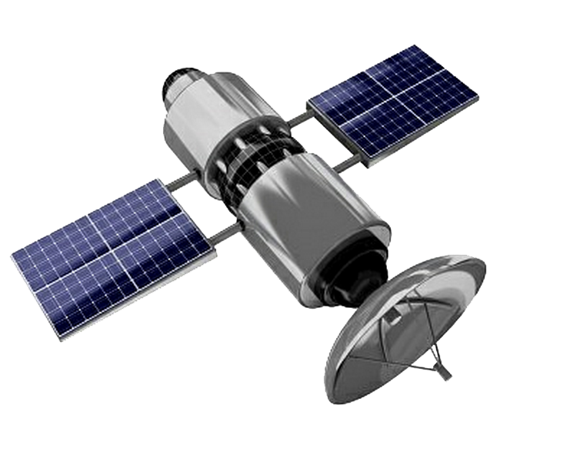
5-03 Satellites
In this lesson you will…
Use Newton’s 2nd law of motion, Newton’s law of gravitation, and centripetal force to find the speed of the orbit of a satellite
Determine the period of an object in orbit
Notes:
NAD 2023 Standards
Gravity G2
Not in OpenStax High School Physics
OpenStax College Physics 2e 6.6

Slide 22

5-03 Satellites
Satellites
  Any object orbiting another object only under the influence of gravity
  One way to find the speed of a satellite in a circular orbit
  $v=\frac{d}{t}$
  $v=\frac{2πr}{T}$
    Where r = orbital radius, T = period of orbit

Slide 23

5-03 Satellites
Gravity provides the centripetal force
There is only one speed that a satellite can have if the satellite is to remain in an orbit with a fixed radius.
Why only one speed?
$F_{c}=\frac{mv^{2}}{r}$ $F_{g}=\frac{GMm}{r^{2}}$
$\frac{mv^{2}}{r}=\frac{GMm}{r^{2}}$
$$v=\sqrt{\frac{GM}{r}}$$
  r is measured from the center of the earth

Slide 24

5-03 Satellites
$$v=\sqrt{\frac{GM}{r}}$$
Since 1/r
  As r decreases, v increases
Mass of the satellite is not in the equation, so speed of a massive satellite = the speed of a tiny satellite

Slide 25
5-03 Satellites
Calculate the speed of a satellite 500 km above the earth’s surface.
Notes:
$$r=500000 m+6.38×{10}^{6} m=6.88×{10}^{6} m$$
$$G=6.67×{10}^{−11}\frac{Nm^{2}}{kg^{2}}$$
$$M=5.98×{10}^{24} kg$$
$$v=\sqrt{\frac{GM}{r}}$$
$$v=\sqrt{\frac{\left(6.67×{10}^{−11}\frac{Nm^{2}}{kg^{2}}\right)\left(5.98×{10}^{24} kg\right)}{6.88×{10}^{6} m}}=7614 m/s$$

Slide 26
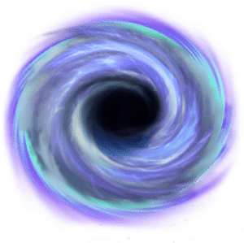

5-03 Satellites
Find the mass of a black hole where the matter orbiting it at r = $2.0×{10}^{20}$ m move at speed of 7,520,000 m/s.
Notes:
$$v=\sqrt{\frac{GM}{r}}$$
$$7520000 \frac{m}{s}=\sqrt{\frac{\left(6.67×\frac{{10}^{−11}Nm^{2}}{kg^{2}}\right)M}{2.0×{10}^{20} m}}$$
$$5.655×{10}^{13}\frac{m^{2}}{s^{2}}=\frac{\left(6.67×{10}^{−11}\frac{Nm^{2}}{kg^{2}}\right)M}{2.0×{10}^{20} m}$$
$$1.131×{10}^{34}\frac{m^{3}}{s^{2}}=\left(6.67×{10}^{−11}\frac{Nm^{2}}{kg^{2}}\right)M$$
$$M=1.70×{10}^{44} kg$$

Slide 27


5-03 Satellites
Centripetal force is provided by gravity
$$\frac{mv^{2}}{r}=\frac{GmM}{r^{2}}$$
Cancelling the m's and a factor of r gives
$$v^{2}=\frac{GM}{r}$$
Speed is distance over time
$$v=\frac{2πr}{T}$$
$${\left(\frac{2πr}{T}\right)}^{2}=\frac{GM}{r}$$
$$\frac{4π^{2}r^{2}}{T^{2}}=\frac{GM}{r}$$
Re-arranging gives Kepler's Third Law
$$\frac{T^{2}}{r^{3}}=\frac{4π^{2}}{GM}$$
For circular orbits
$$T^{2}=\frac{4π^{2}}{GM}r^{3}$$
Notes:
T is period and r is average orbital radius

Slide 28
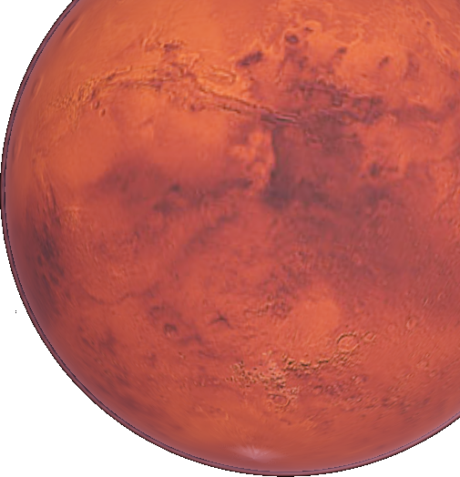

5-03 Satellites
Use the data of Mars to find the mass of sun.
Mars, $r=2.279×{10}^{8}$ km, $T=1.881$ y
Notes:
$$\frac{T^{2}}{r^{3}}=\frac{4π^{2}}{GM}$$
$$r=2.279×{10}^{8} km=2.279×{10}^{11} m, T=1.881 y=59359845.6 s$$
$$\frac{{\left(59359845.6 s\right)}^{2}}{{\left(2.279×{10}^{11} m\right)}^{3}}=\frac{4π^{2}}{\left(6.673×{10}^{−11}\frac{Nm^{2}}{kg^{2}}\right)M}$$
$$235129.2\frac{m^{3}}{kg} M=4.6730×{10}^{35} m^{3}$$
$$M=1.99×{10}^{30} kg$$

Slide 29
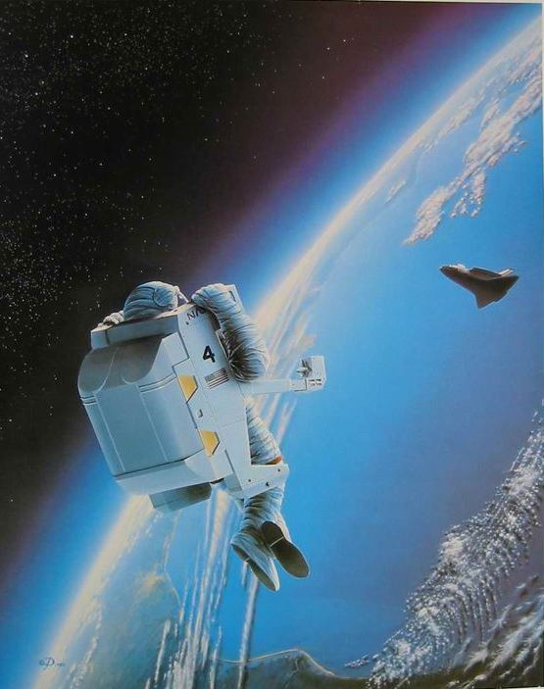
5-03 Satellites
Since satellites are moving only under the influence of gravity, and the acceleration points towards earth, satellites are in freefall
Astronauts in the space shuttles and international space station seem to float
They appear weightless
They are really falling
  Acceleration is about g towards earth

Slide 30
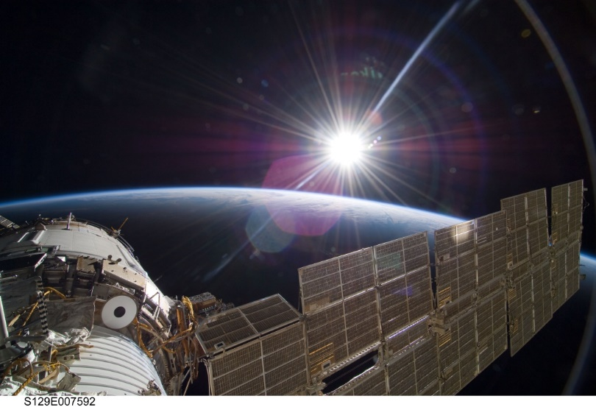
5-03 Satellites
… they were finally able to close and repressurize the hatch. Several months later a new team of cosmonauts returned and found the hatch impossible to permanently repair. Instead they attached a set of clamps to secure it in place.
It is this set of clamps that Linenger and Tsibliyev are staring at uneasily seven years later. To his relief, the commander opens the hatch Without incident and crawls outside onto an adjoining ladder just after nine o’clock. Linenger begins to follow. Outside the Sun is rising. The Russians have planned the EVA at a sunrise so as to get the longest period of light. But because of that, Linenger’s first view of space is straight into the blazing Sun. “The first view I got was just blinding rays coming at me,” Linenger told his postflight debriefing session. “Even with my gold visor down, it was just blinding. [I] was basically unable to see for the first three or four minutes going out the hatch.”
Notes:
From Dragonfly: NASA and the Crisis Aboard Mir by Bryan Burrough

Slide 31
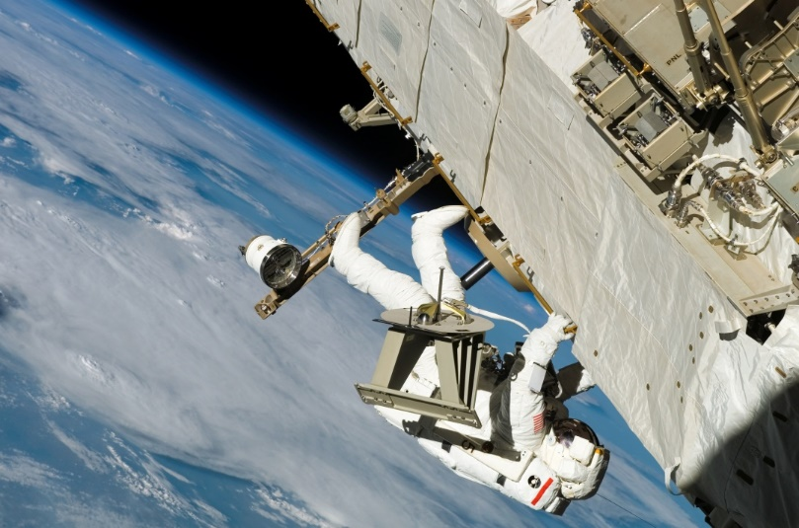
5-03 Satellites
The situation only gets worse once his eyes clear. Exiting the airlock, Linenger climbs out onto a horizontal ladder that stretches out along the side of the module into the darkness. Glancing about, trying in vain to get his bearings, he is suddenly hit by an overwhelming sense that he is falling, as if from a cliff. Clamping his tethers onto the handrail, he fights back a wave of panic and tightens his grip on the ladder. But he still can’t shake the feeling that he is plummeting through space at eighteen thousand miles an hour. His mind races.
You’re okay. You’re okay. You’re not going to fall. The bottom is way far away.
Notes:
From Dragonfly: NASA and the Crisis Aboard Mir by Bryan Burrough

Slide 32
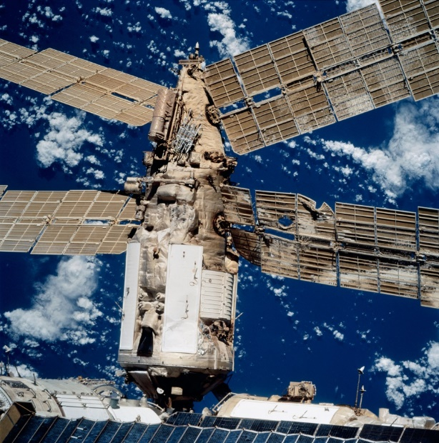
5-03 Satellites
And now a second, even more intense feeling washes over him: He’s not just plunging off a cliff. The entire cliff is crumbling away. “It wasn’t just me falling, but everything was falling, which gave [me] even a more unsettling feeling,” Linenger told his debriefers. “So, it was like you had to overcome forty years or whatever of life experiences that [you] don’t let go when everything falls. It was a very strong, almost overwhelming sensation that you just had to control. And I was able to control it, and I was glad I was able to control it. But I could see where it could have put me over the edge.”
Notes:
From Dragonfly: NASA and the Crisis Aboard Mir by Bryan Burrough

Slide 33
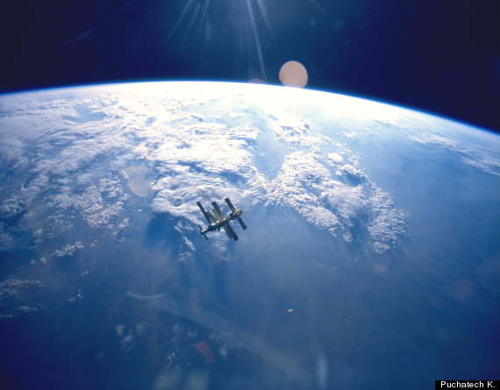
5-03 Satellites
The disorientation is paralyzing. There is no up, no down, no side. There is only three-dimensional space. It is an entirely different sensation from spacewalking on the shuttle, where the astronauts are surrounded on three sides by a cargo bay. And it feels nothing—nothing—like the Star City pool. Linenger is an ant on the side of a falling apple, hurtling through space at eighteen thousand miles an hour, acutely aware what will happen if his Russian-made tethers break. As he clings to the thin railing, he tries not to think about the handrail on Kvant that came apart during a cosmonaut’s spacewalk in the early days of Mir. Loose bolts, the Russians said.
Loose bolts.
Notes:
From Dragonfly: NASA and the Crisis Aboard Mir by Bryan Burrough

