Slide 1
Energy
Physics
Unit 06

Slide 2
Credits
This Slideshow was developed to accompany the textbook
  OpenStax High School Physics
    Available for free at https://openstax.org/details/books/physics
    By Paul Peter Urone and Roger Hinrichs
    2020 edition
Some examples and diagrams are taken from the OpenStax College Physics, Physics, and Cutnell & Johnson Physics 6th ed.
Slides created by
Richard Wright, Andrews Academy
rwright@andrews.edu

Slide 3
6-01 Work and Power
In this lesson you will…
Define work.
Define power.
Notes:
NAD 2022 Standards
ECV1: Energy Conservation
OpenStax High School Physics 9.1
OpenStax College Physics 2e 7.1, 7.7

Slide 4
6-01 Work and Power
Which of the following is NOT work?
  Pushing a Stalled Car
  Pulling a Wagon
  Climbing stairs
  Falling Down
  Carrying a Heavy Backpack Down the Hall

Slide 5
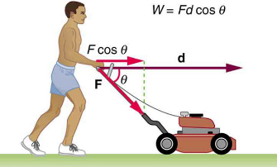
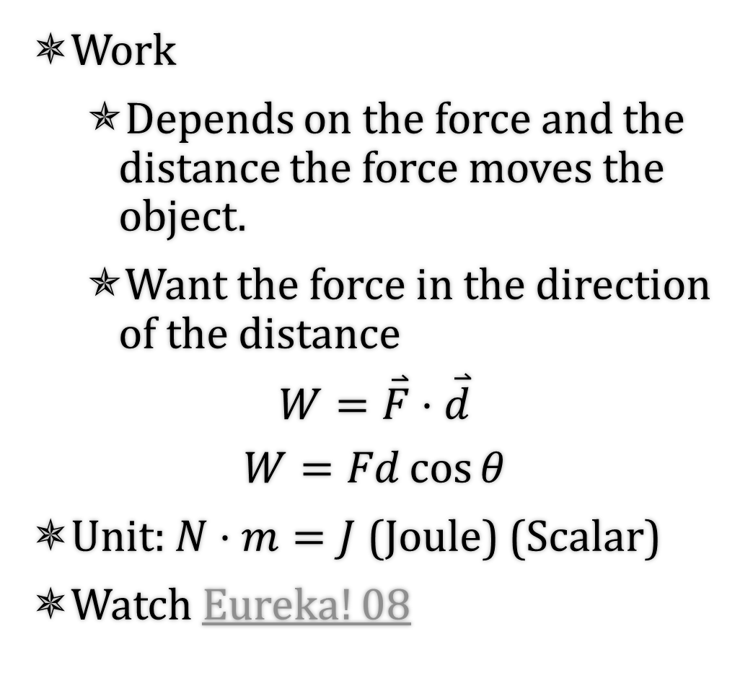
6-01 Work and Power
Work
  Depends on the force and the distance the force moves the object.
  Want the force in the direction of the distance
$$W=\overset{⃑}{F}⋅\overset{⃑}{d}$$
$$W=Fd\cos{θ}$$
Unit: $N⋅m=J$ (Joule) (Scalar)
Watch Eureka! 08
Notes:
$$J=\frac{kg⋅m^{2}}{s^{2}}$$

Slide 6
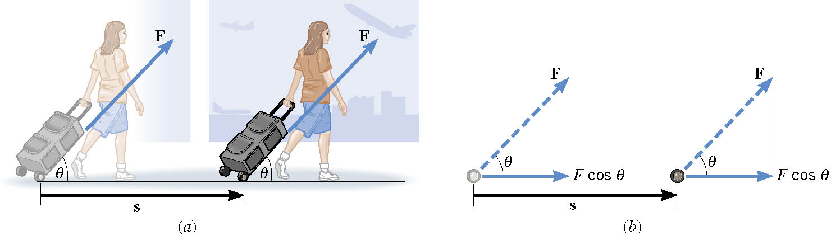
6-01 Work and Power
Marcy pulls a backpack on wheels down the 100-m hall. The 60-N force is applied at an angle of 30° above the horizontal. How much work is done by Marcy?
W = 5200 J
Notes:
$$W=Fd\cos{θ}$$
$$W=\left(60 N\right)\left(100 m\right)\cos{30°}=5196 J$$

Slide 7

6-01 Work and Power
Drew is carrying books (200 N) down the 100-m hall. How much work is Drew doing on the books?
W = 0 J
The force is vertical
displacement is horizontal.
Notes:
$$W=Fd\cos{θ}$$
$$W=\left(200 N\right)\left(100 m\right)\cos{90°}=0 J$$

Slide 8
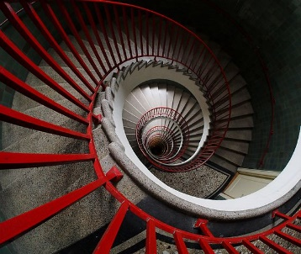
6-01 Work and Power
You carry some books (200 N) while walking down stairs height 2 m and length 3 m. How much work do you do?
W = −400 J
Notes:
F = 200 N (lift up)
d = 2 m (down)
$$W=Fd\cos{θ}=\left(200 N\right)\left(2 m\right)\cos{180°}=−400 J$$

Slide 9
6-01 Work and Power
A suitcase is hanging straight down from your hand as you ride an escalator. Your hand exerts a force on the suitcase, and this force does work. Which one of the following is correct?
The W is negative when you ride up and positive when you ride down
The W is positive when you ride up and negative when you ride down
The W is positive
The W is negative

Slide 10
6-01 Work and the Work-Energy Theorem
Do work means → W = Fd
    F = ma
So work by a net force gives an object some acceleration
Acceleration means the velocity changes

Slide 11
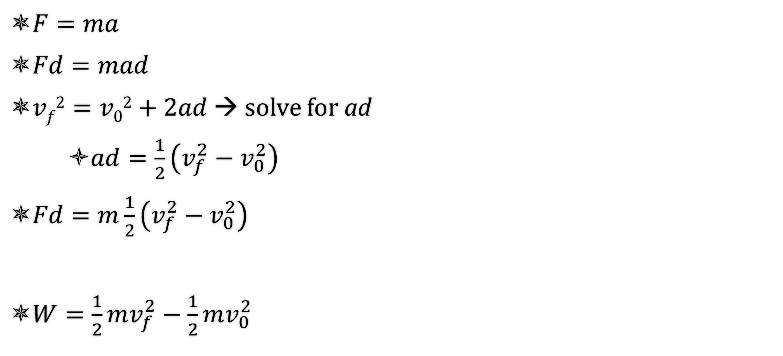
6-01 Work and the Work-Energy Theorem
$F=ma$
$Fd=mad$
$vf2=v02+2ad$ → solve for ad
    $ad=\frac{1}{2}\left(v_{f}^{2}−v_{0}^{2}\right)$
$Fd=m\frac{1}{2}\left(v_{f}^{2}−v_{0}^{2}\right)$
$W=\frac{1}{2}mv_{f}^{2}−\frac{1}{2}mv_{0}^{2}$

Slide 12

6-01 Work and the Work-Energy Theorem
Work Energy Theorem
Work of Net external force = change in kinetic energy
$$W=\frac{1}{2}mv_{f}^{2}−\frac{1}{2}mv_{0}^{2}$$
$$W=KE_{f}−KE_{0}$$

Slide 13
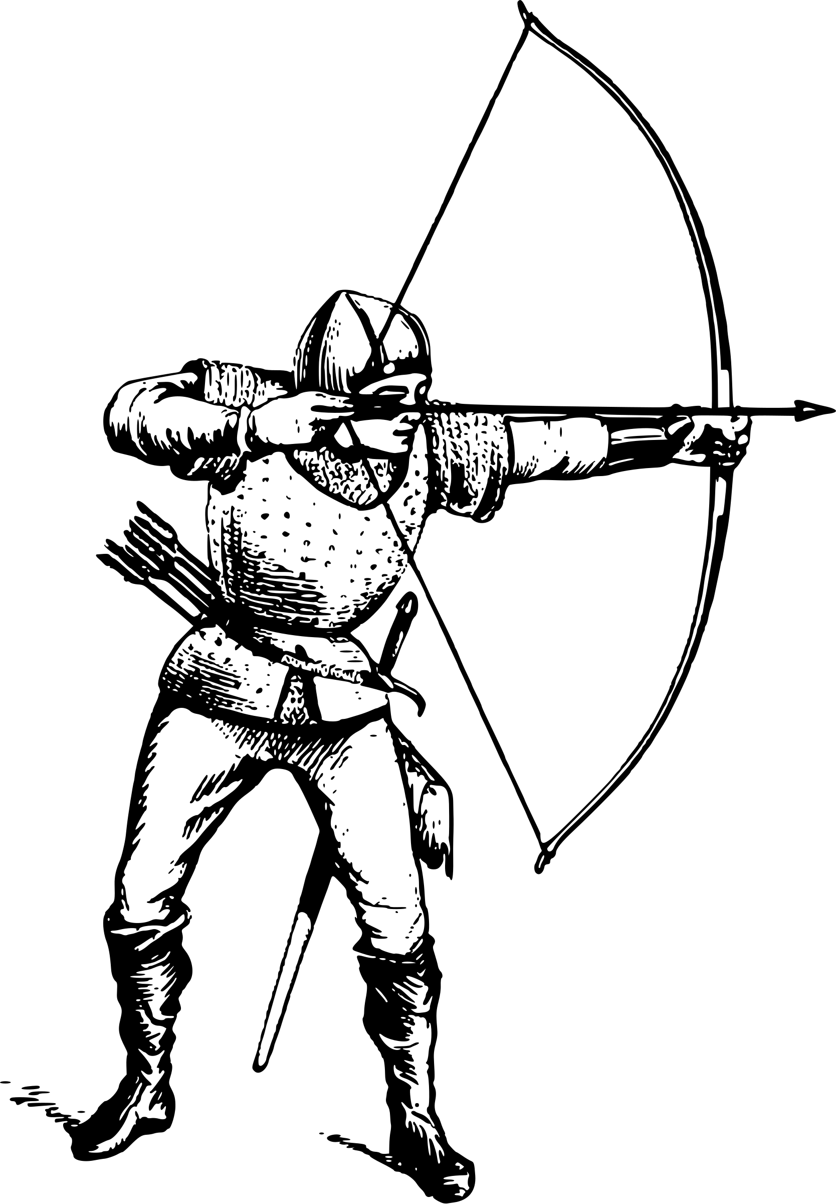
6-01 Work and the Work-Energy Theorem
A 0.075-kg arrow is fired horizontally. The bowstring exerts a force on the arrow over a distance of 0.90 m. The arrow leaves the bow at 40 m/s. What average force does the bow apply to arrow?
Notes:
$$m=0.075 kg, s=0.90 m, v_{0}=0\frac{m}{s}, v_{f}=40\frac{m}{s}$$
$$W=KE_{f}−KE_{0}$$
$$F\left(0.90 m\right)=\frac{1}{2}\left(0.075 kg\right){\left(40\frac{m}{s}\right)}^{2}−\frac{1}{2}\left(0.075 kg\right){\left(0\frac{m}{s}\right)}^{2}$$
$$F\left(0.90 m\right)=60 J$$
$$F=66.7 N$$

Slide 14
6-02 Power
In this lesson you will…
Define work.
Define power.
Notes:
NAD 2022 Standards
ECV1: Energy Conservation
OpenStax High School Physics 9.1

Slide 15
6-01 Work and Power
Two cars with the same mass do the same amount of work to get to 100 km/h.
Which car is better
    Takes 8.0 s
    Takes 6.2 s
Sometimes the time taken to do the work is important

Slide 16

6-01 Work and Power
Rate that work is done
$$P=\frac{W}{t}$$
Unit: joule/s = watt (W)
Notes:
Unit named after James Watt who invented the steam engine
In the American system, horsepower is often used
One horsepower is moving 550 pounds 1 foot in 1 second

Slide 17
6-01 Work and Power
Since work changes the amount of energy in an object
Power is the rate that energy is changing
Notes:
Power in the human body would be how quickly calories are being burned
Look at the table on page 166 to compare the power with the activity

Slide 18
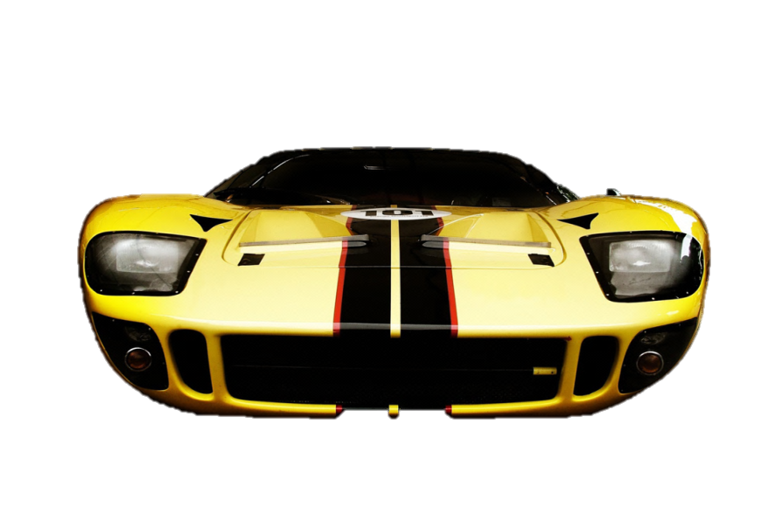
6-01 Work and Power
A 1000 kg car accelerates from 0 to 100 km/h in 3.2 s on a level road. Find the average power of the car.
P = 121000 W
    162 horsepower
Notes:
v₀ = 0
v_{f} = 100 km/h = 27.78 m/s
t = 3.2 s
m = 500 kg
$$P=\frac{W}{t}$$
$$P=\frac{Fd}{t}$$
$$P=\frac{mad}{t}$$
$$v^{2}=v_{0}^{2}+2a\left(x−x_{0}\right)$$
$$v^{2}−v_{0}^{2}=2ad$$
$$\frac{v^{2}−v_{0}^{2}}{2}=ad$$
$$P=\frac{\frac{m\left(v^{2}−v_{0}^{2}\right)}{2}}{t}$$
$$P=\frac{\frac{\left(1000 kg\right)\left({\left(27.78\frac{m}{s}\right)}^{2}−0^{2}\right)}{2}}{3.2 s}=121000 W$$

Slide 19
6-01 Work and Power
Electrical Energy
  Often measured in kWh because Pt = W
If it costs $0.10 per kWh, how much will it cost to run a 1000 W microwave for 2 minutes?
Notes:
$$P=1000 W=1 kW, t=2 min=\frac{1}{30}h$$
$$P=\frac{W}{t}$$
$$1 kW=\frac{W}{\frac{1}{30} h}$$
$$W=\frac{1}{30} kWh$$
$$cost=\frac{1}{30}kWh\left(\$0.10\right)=\$0.0033$$

Slide 20
6-01 Practice Work
Power through these problems.
Read
  OpenStax College Physics 2e 7.2-7.4
  OR
  OpenStax High School Physics 9.2

Slide 21
6-02 Types of Energy
In this lesson you will…
Find kinetic energy.
Find potential energy.
Notes:
NAD 2022 Standards
ECV1: Energy Conservation
OpenStax High School Physics 9.2
OpenStax College Physics 2e 7.2-7.4

Slide 22

6-02 Types of Energy
Energy is the ability to do work
Kinetic Energy - Energy due to motion
  If something in motion hits an object, it will move it some distance
$KE=\frac{1}{2}mv^{2}$
  Scalar
  Unit is joule (J)
  Watch Eureka! 09

Slide 23
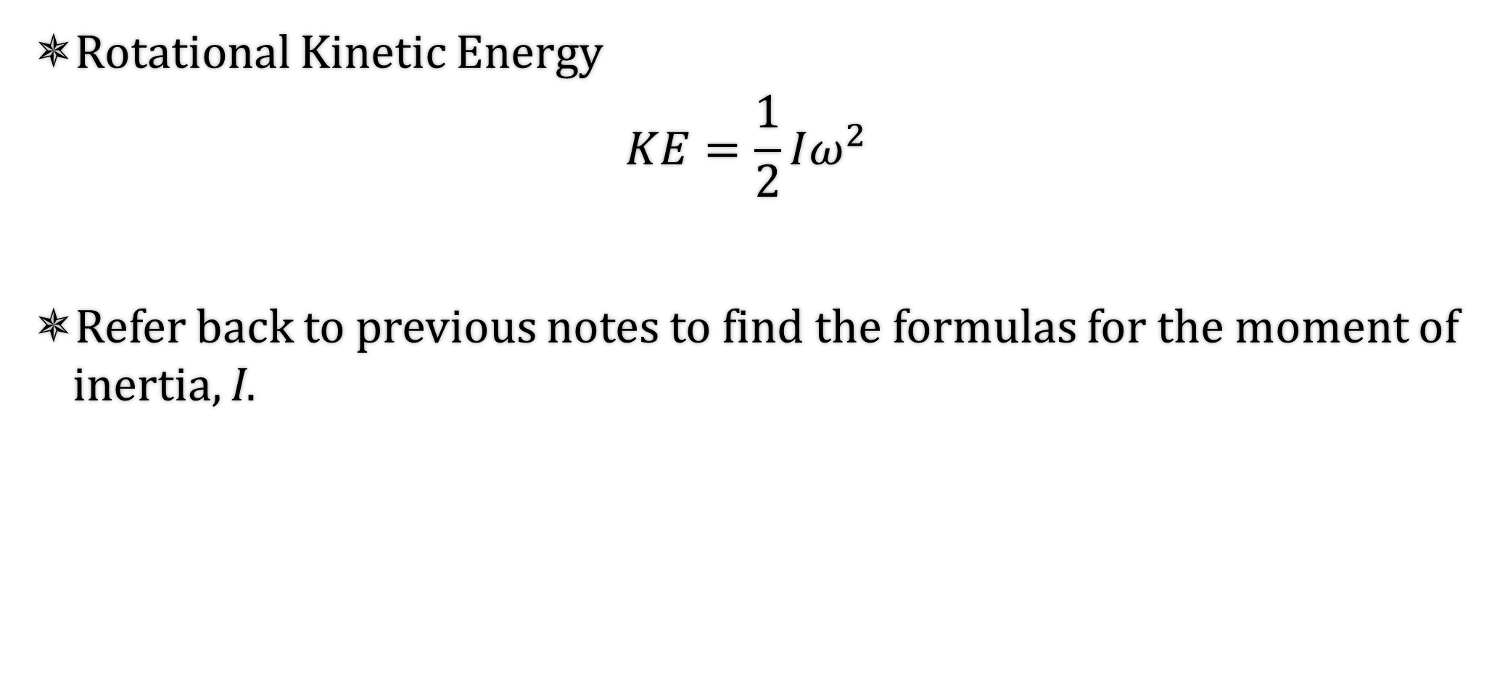
6-02 Types of Energy
Rotational Kinetic Energy
$$KE=\frac{1}{2}Iω^{2}$$
Refer back to previous notes to find the formulas for the moment of inertia, I.

Slide 24
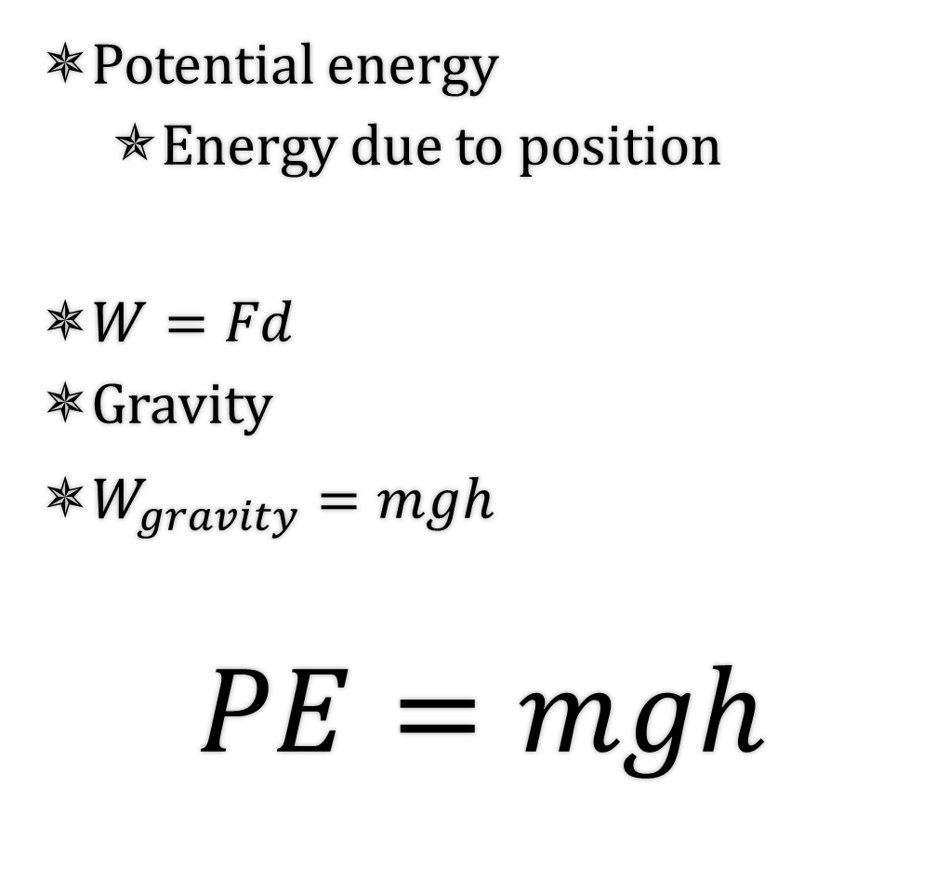
6-02 Types of Energy
Potential energy
  Energy due to position
$W=Fd$
Gravity
$W_{gravity}=mgh$
$$PE=mgh$$
Since the force of gravity is down
  We only worry about the vertical distance
Potential Energy is not absolute
  It is a difference
The path the object takes doesn’t matter, just the vertical distance
h is measured from any chosen point. Just be consistent

Slide 25

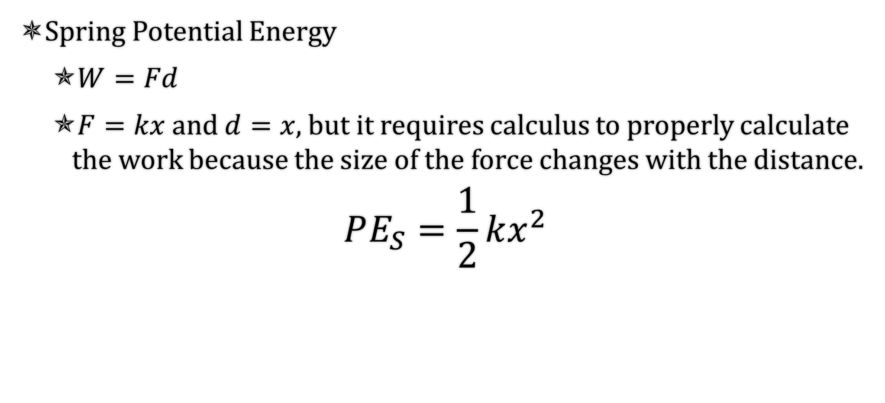
6-02 Types of Energy
Spring Potential Energy
  $W=Fd$
  $F=kx$ and $d=x$, but it requires calculus to properly calculate the work because the size of the force changes with the distance.
$$PE_{S}=\frac{1}{2}kx^{2}$$
Notes:
$$W=Fd$$
$$PE_{S}=\left(average from 0 to kx by Hooke^{′}s Law\right)x$$
$$PE_{S}=\frac{1}{2}kx⋅x$$
$$PE_{S}=\frac{1}{2}kx^{2}$$

Slide 26
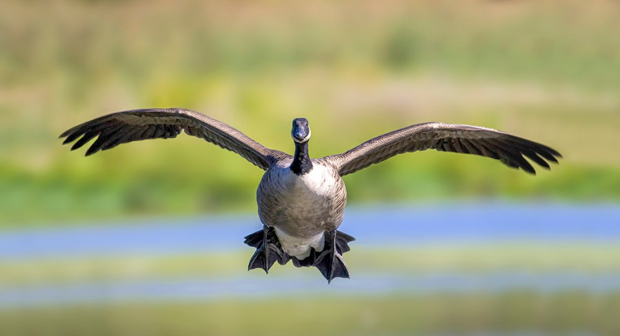
6-02 Types of Energy
A 5.2-kg Canada goose is flying towards you at 18 m/s and a height of 3 m. What is its (a) kinetic energy and (b) potential energy?
Notes:
$KE=\frac{1}{2}mv^{2}$
$KE=\frac{1}{2}\left(5.2 kg\right){\left(18\frac{m}{s}\right)}^{2}=840 J$
$PE=mgh$
$PE=\left(5.2 kg\right)\left(9.8\frac{m}{s^{2}}\right)\left(3 m\right)=150 J$

Slide 27
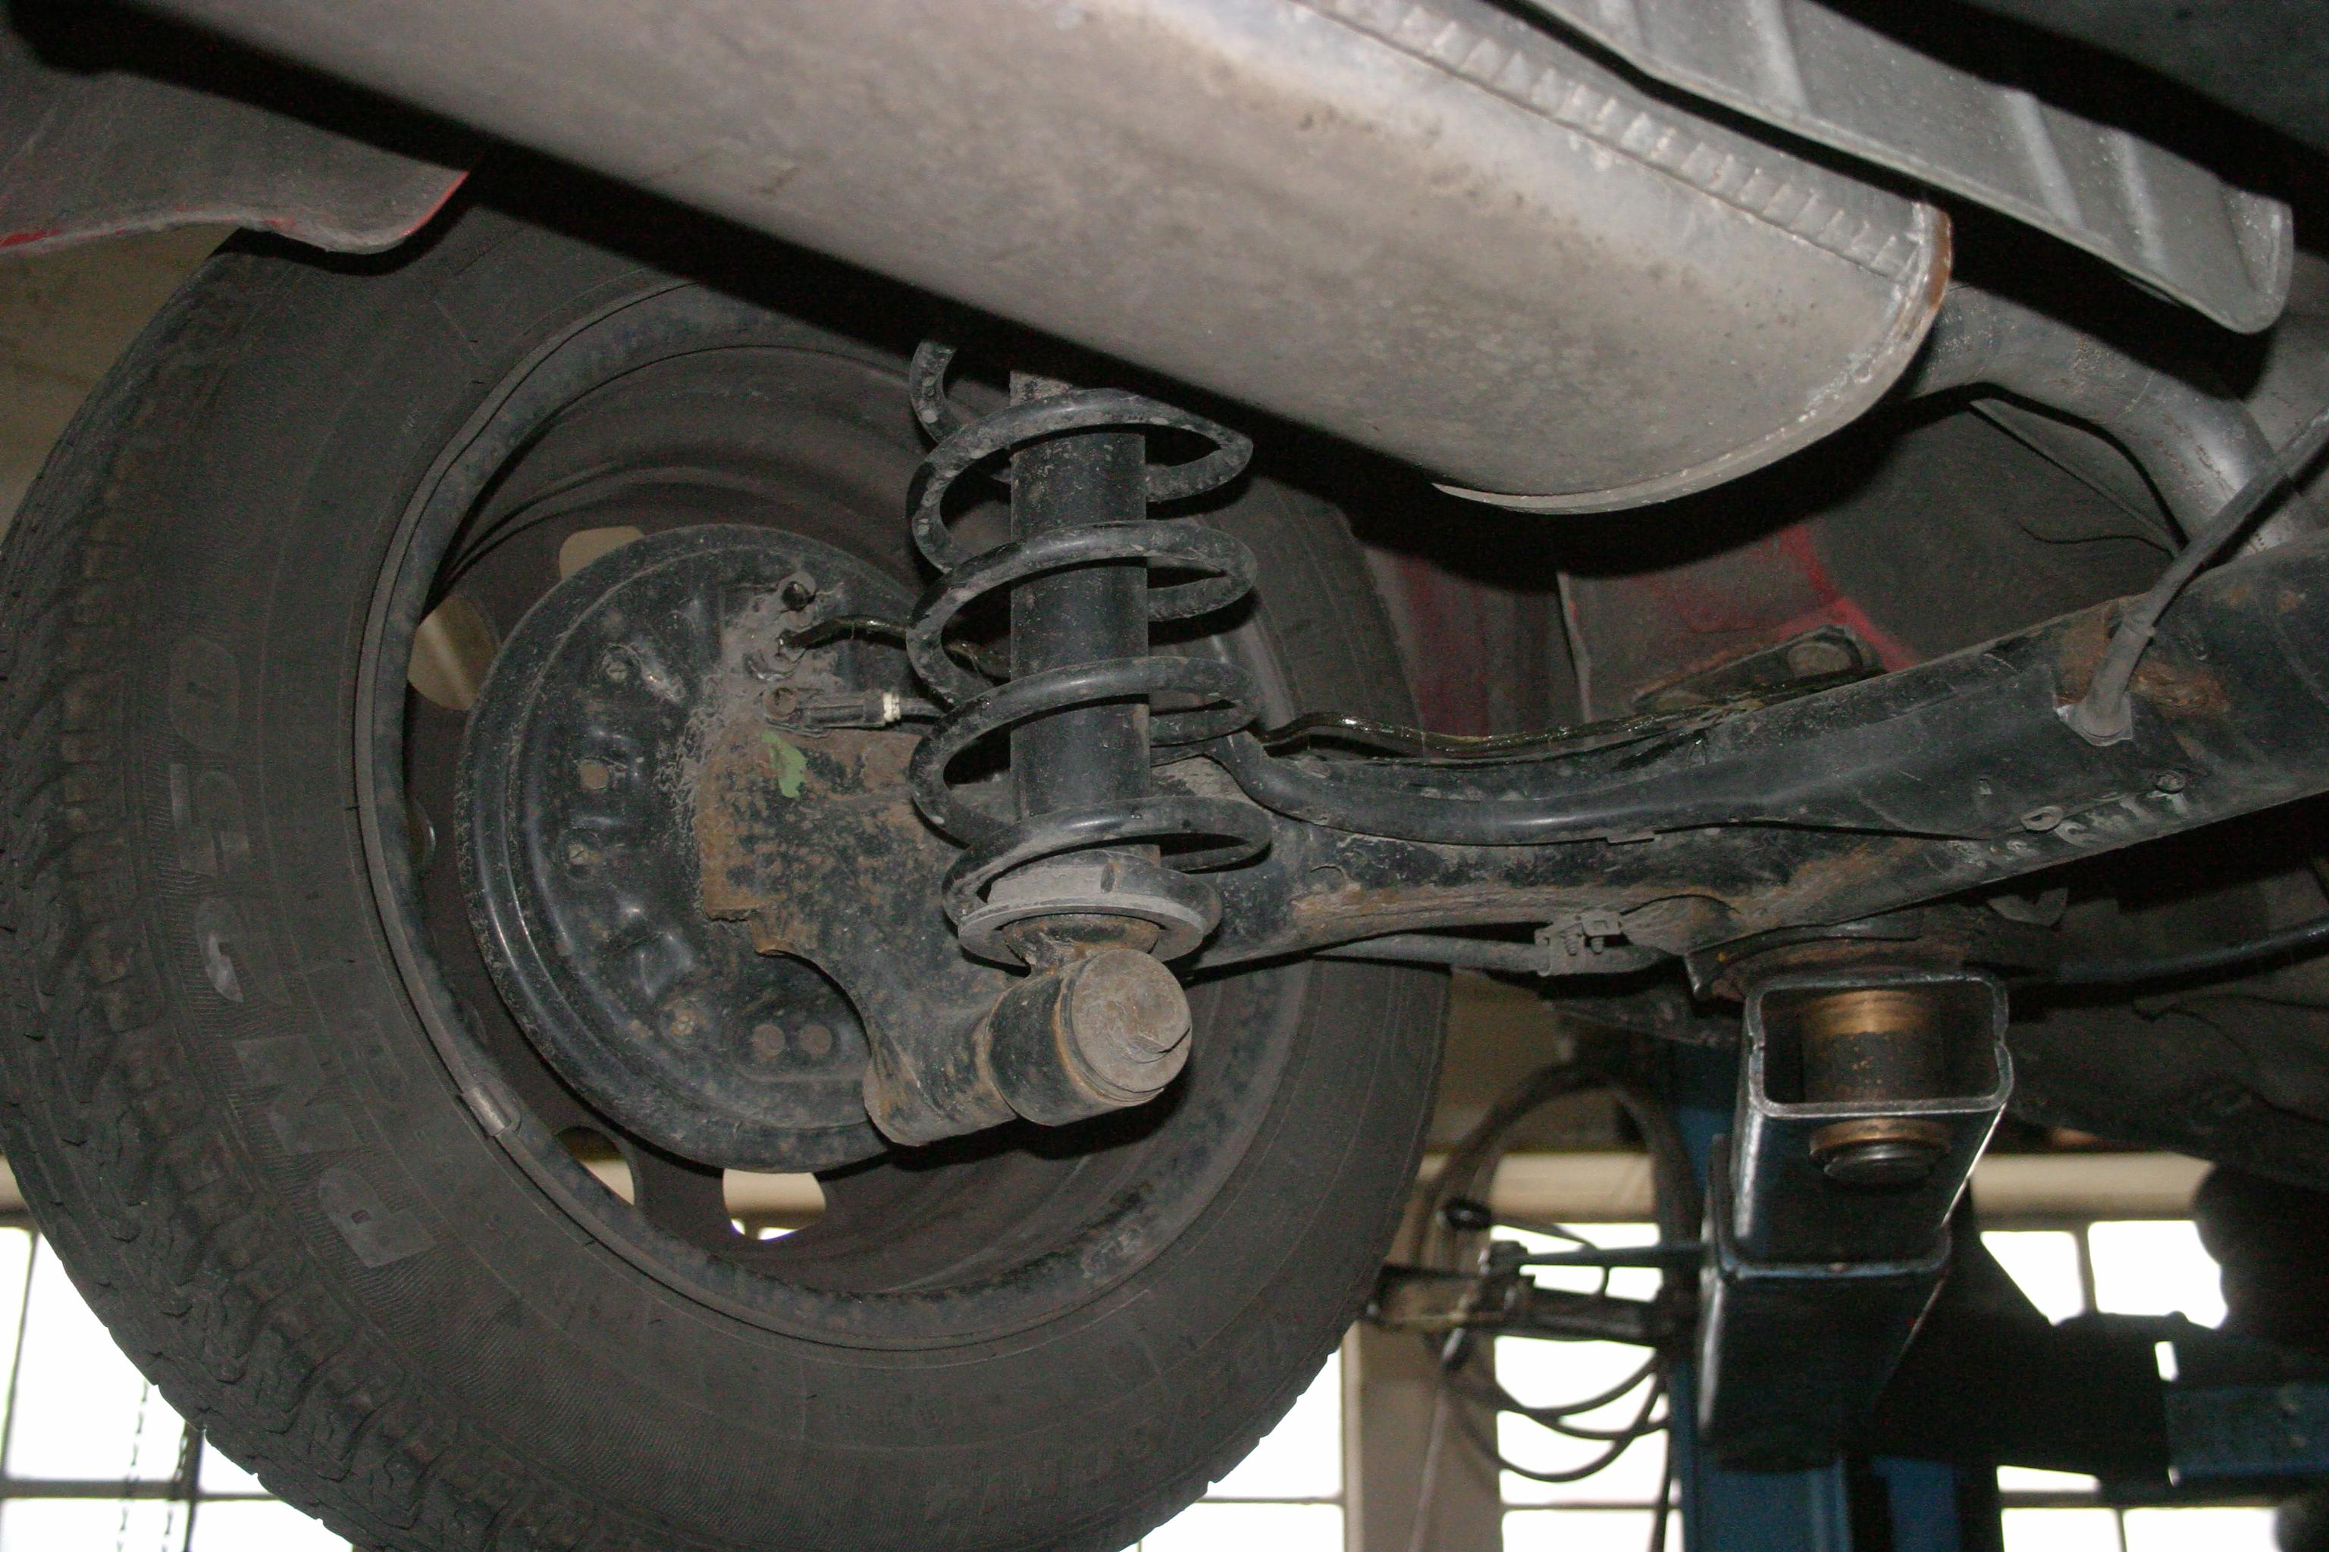
6-02 Types of Energy
Let’s say a coil suspension spring on a car is compressed 9.0 cm after it is installed in a car. If it has a spring constant of 33000 N/m, what is the potential energy stored in the spring?
This Photo by Unknown Author is licensed under CC BY-SA
Notes:
$$PE_{S}=\frac{1}{2}kx^{2}$$
$$PE_{S}=\frac{1}{2}\left(33000\frac{N}{m}\right){\left(0.09m\right)}^{2}$$
$$PE_{S}=130 J$$

Slide 28
6-02 Practice Work
Increase your potential while practicing with these problems.
Read
  OpenStax College Physics 2e 7.4
  OR
  OpenStax High School Physics 9.2

Slide 29
6-03 Mechanical Energy Conservation
In this lesson you will…
Convert energy from one form to another
Notes:
NAD 2022 Standards
ECV1: Energy Conservation
OpenStax High School Physics 9.2
OpenStax College Physics 2e 7.4

Slide 30
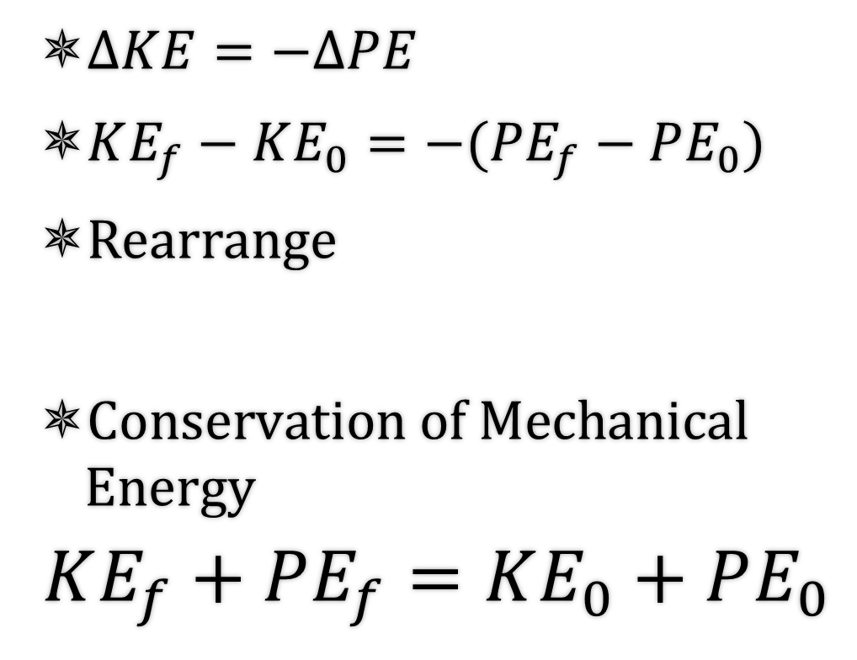
6-03 Mechanical Energy Conservation
Potential energy can be converted into Kinetic energy and back
Think of an object thrown up
Bottom → 0 PE, high KE
Top → high PE, 0 KE
$ΔKE=−ΔPE$
$KE_{f}−KE_{0}=−(PE_{f}−PE_{0})$
Rearrange
$\text{Conservation} \text{of} \text{Mechanical} \text{Energy}$
$$KE_{f}+PE_{f}=KE_{0}+PE_{0}$$

Slide 31
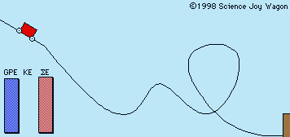
6-03 Mechanical Energy Conservation
If there is only kinetic and potential energy
Total mechanical energy is constant
KE₀ + PE₀ = KE_{f} + PE_{f}

Slide 32
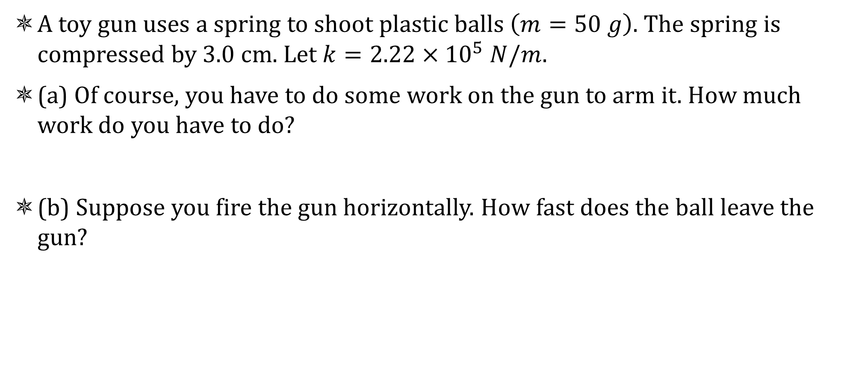
6-03 Mechanical Energy Conservation
A toy gun uses a spring to shoot plastic balls $\left(m=50 g\right)$. The spring is compressed by 3.0 cm. Let $k=2.22×{10}^{5} N/m$.
(a) Of course, you have to do some work on the gun to arm it. How much work do you have to do?
(b) Suppose you fire the gun horizontally. How fast does the ball leave the gun?
Notes:
$$a) W=Fd$$
$$W=\frac{1}{2}kx^{2}$$
$$W=\frac{1}{2}\left(2.22×{10}^{5}\frac{N}{m}\right){\left(0.03 m\right)}^{2}=99.9 J$$
$$b) KE_{f}+PE_{f}=KE_{0}+PE_{0}$$
$$\frac{1}{2}mv_{f}^{2}+\frac{1}{2}kx_{f}^{2}=\frac{1}{2}mv_{0}^{2}+\frac{1}{2}kx_{0}^{2}$$
$$\frac{1}{2}\left(0.050 kg\right)v_{f}^{2}+0=0+\frac{1}{2}\left(2.22×{10}^{5}\frac{N}{m}\right){\left(0.03 m\right)}^{2}$$
$$0.025 kg v_{f}^{2}=99.9 J$$
$$v_{f}^{2}=3996\frac{m^{2}}{s^{2}}$$
$$v_{f}=63.2\frac{m}{s}$$

Slide 33
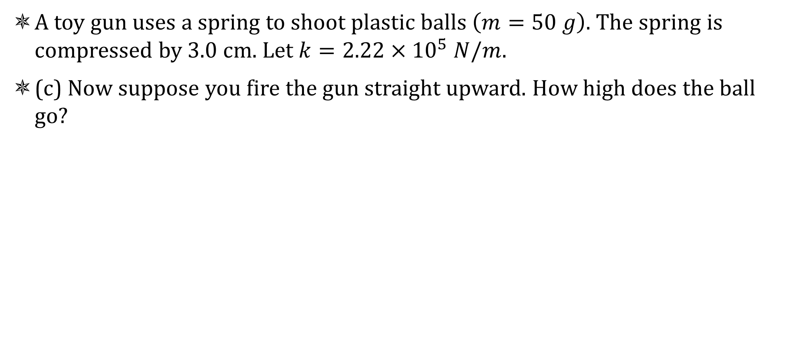
6-03 Mechanical Energy Conservation
A toy gun uses a spring to shoot plastic balls $\left(m=50 g\right)$. The spring is compressed by 3.0 cm. Let $k=2.22×{10}^{5} N/m$.
(c) Now suppose you fire the gun straight upward. How high does the ball go?
Notes:
$$c) KE_{f}+PE_{Gf}+{PE}_{Sf}=KE_{0}+PE_{G0}+PE_{S0}$$
At end of barrel
$$\frac{1}{2}mv_{f}^{2}+mgh_{f}+0=0+0+\frac{1}{2}kx_{0}^{2}$$
$$\frac{1}{2}\left(0.050 kg\right)v_{f}^{2}+\left(0.050 kg\right)\left(9.80\frac{m}{s^{2}}\right)\left(0.03 m\right)=\frac{1}{2}\left(2.22×{10}^{5}\frac{N}{m}\right){\left(0.03 m\right)}^{2}$$
$$0.025 kg v_{f}^{2}+0.0147 J=99.9 J$$
$$0.025 kg v_{f}^{2}=99.8853 J$$
$$v_{f}^{2}=3995.412\frac{m^{2}}{s^{2}}$$
$$v_{f}=63.2\frac{m}{s}$$
At top of path
$$KE_{f}+PE_{Gf}=KE_{0}+PE_{G0}$$
$$\frac{1}{2}mv_{f}^{2}+mgh_{f}=\frac{1}{2}mv_{0}^{2}+mgh_{0}$$
$$0+\left(0.050 kg\right)\left(9.80\frac{m}{s^{2}}\right)h_{f}=\frac{1}{2}\left(0.050 kg\right){\left(63.2\frac{m}{s}\right)}^{2}+0$$
$$\left(0.49 kg⋅\frac{m}{s^{2}}\right)h_{f}=99.9 J$$
$$h_{f}=204 m$$

Slide 34
6-03 Mechanical Energy Conservation
A 1500-kg car is driven off a 50-m cliff during a movie stunt. If it was going 20 m/s as it went off the cliff, how fast is it going as it hits the ground?
Notes:
$$PE_{0}+KE_{0}=PE_{f}+KE_{f}$$
$$mgh_{0}+\frac{1}{2}mv_{0}^{2}=mgh_{f}+\frac{1}{2}{mv}_{f}^{2}$$
$$\left(1500 kg\right)\left(9.8\frac{m}{s^{2}}\right)\left(50 m\right)+\frac{1}{2}\left(1500 kg\right){\left(20\frac{m}{s}\right)}^{2}=0+\frac{1}{2}\left(1500 kg\right)v_{f}^{2}$$
$$v_{f}=37.1 m/s$$

Slide 35
6-03 Practice Work
Don’t try to conserve energy. Actually do the work.
Read
  OpenStax College Physics 2e 7.5-7.6
  OR
  OpenStax High School Physics 9.2

Slide 36
6-04 Work and Conservation of Energy
In this lesson you will…
Convert energy from one form to another with work
Notes:
NAD 2022 Standards
ECV1: Energy Conservation
OpenStax High School Physics 9.2
OpenStax College Physics 2e 7.5-7.6

Slide 37
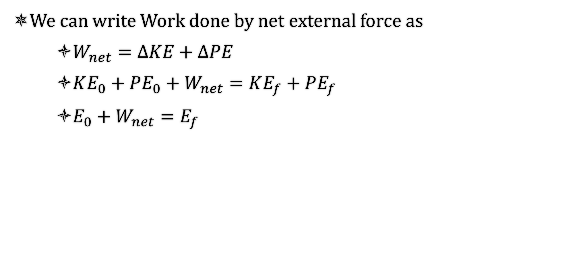
6-04 Work and Conservation of Energy
We can write Work done by net external force as
    $W_{net}=ΔKE+ΔPE$
    $KE_{0}+PE_{0}+W_{net}=KE_{f}+PE_{f}$
    $E_{0}+W_{net}=E_{f}$

Slide 38
6-04 Work and Conservation of Energy
Law of Conservation of Energy
  The total energy is constant in any process. It may change form or be transferred from one system to another, but the total remains the same
Energy is transformed from one form to another
  Box sliding down incline
    PE transformed to KE
    KE transformed to Heat and Sound
  Engine
    Chemical to KE and Heat

Slide 39

6-04 Work and Conservation of Energy
A rocket starts on the ground at rest. Its final speed is 500 m/s and height is 5000 m. If the mass of the rocket stays approximately 200 kg. Find the work done by the rocket engine.
W = 3.48 x 10⁷ J
Notes:
$$E_{0}+W_{nc}=E_{f}$$
$$\frac{1}{2}mv_{0}^{2}+mgh_{0}+W_{nc}=\frac{1}{2}mv_{f}^{2}+mgh_{f}$$
$$\frac{1}{2}\left(200 kg\right){\left(0\right)}^{2}+\left(200 kg\right)\left(9.8\frac{m}{s^{2}}\right)\left(0\right)+W_{nc}=\frac{1}{2}\left(200 kg\right){\left(500\frac{m}{s}\right)}^{2}+\left(200 kg\right)\left(9.8\frac{m}{s^{2}}\right)\left(5000 m\right)$$
$$W_{nc}=2.50×{10}^{7} J+9.80×{10}^{6} J$$
$$W_{nc}=3.48×{10}^{7} J$$

Slide 40
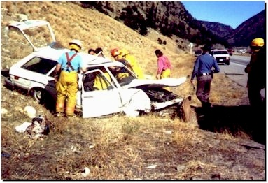
6-04 Work and Conservation of Energy
A 1500-kg car’s brakes failed and it coasts down a hill from rest. The hill is 10 m high and the car has a speed of 12 m/s at the bottom of the hill. How much work did friction do on the car?
W_{f} = −39000 J
Notes:
$$E_{0}+W_{nc}=E_{f}$$
$$\frac{1}{2}mv_{0}^{2}+mgh_{0}+W_{nc}=\frac{1}{2}mv_{f}^{2}+mgh_{f}$$
$$0+\left(1500 kg\right)\left(9.8\frac{m}{s^{2}}\right)\left(10 m\right)+W_{nc}=\frac{1}{2}\left(1500 kg\right){\left(12\frac{m}{s}\right)}^{2}+0$$
$$W_{nc}=−39000 J$$

Slide 41
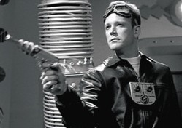
6-04 Work and Conservation of Energy
Captain Proton’s rocket pack provides 800,000 J of work to propel him from resting on his ship which is near the earth to 50 m above it. Captain Proton’s mass is 90 kg. What is his final velocity?
v = 130 m/s
Notes:
$$E_{0}+W_{nc}=E_{f}$$
$$\frac{1}{2}mv_{0}^{2}+mgh_{0}+W_{nc}=\frac{1}{2}mv_{f}^{2}+mgh_{f}$$
$$0+0+800000 J=\frac{1}{2}\left(90 kg\right)v_{f}^{2}+\left(90 kg\right)\left(9.8\frac{m}{s^{2}}\right)\left(50 m\right)$$
$$129.6\frac{m}{s}=v_{f}$$

Slide 42
6-04 Practice Work
How much work do you do while you convert energy into solutions.
Read
  OpenStax College Physics 2e 9.5
  OR
  OpenStax High School Physics 9.3

Slide 43
6-05 Simple Machines
In this lesson you will…
Solve problems involving simple machines.
Notes:
NAD 2022 Standards
ECV1: Energy Conservation
OpenStax High School Physics 9.3
OpenStax College Physics 2e 9.5

Slide 44
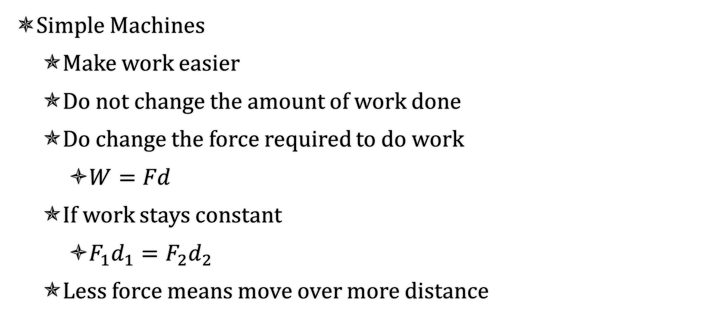
6-05 Simple Machines
Simple Machines
  Make work easier
  Do not change the amount of work done
  Do change the force required to do work
    $W=Fd$
  If work stays constant
    $F_{1}d_{1}=F_{2}d_{2}$
  Less force means move over more distance

Slide 45
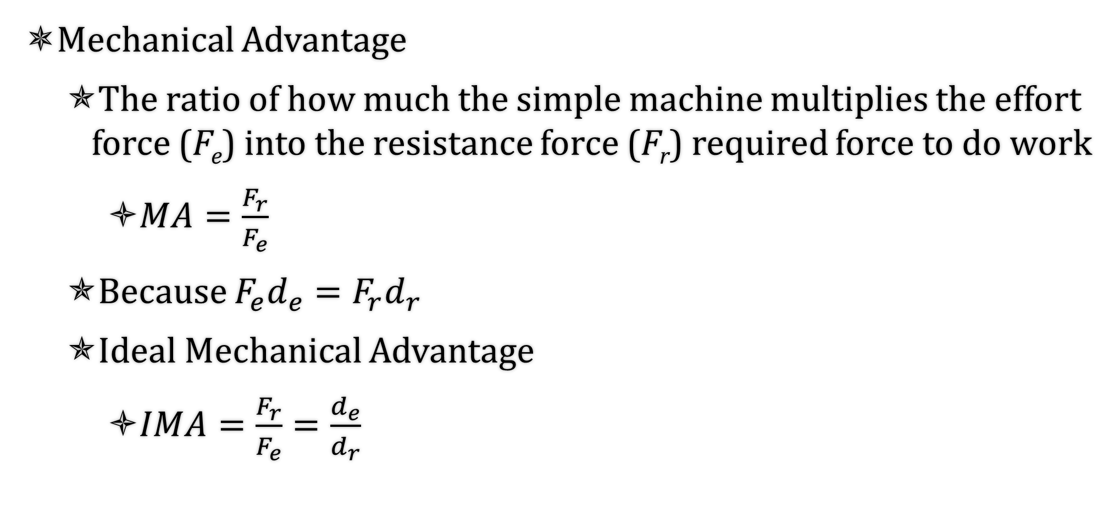
6-05 Simple Machines
Mechanical Advantage
  The ratio of how much the simple machine multiplies the effort force (F_{e}) into the resistance force (F_{r}) required force to do work
    $MA=\frac{F_{r}}{F_{e}}$
  Because $F_{e}d_{e}=F_{r}d_{r}$
  Ideal Mechanical Advantage
    $IMA=\frac{F_{r}}{F_{e}}=\frac{d_{e}}{d_{r}}$

Slide 46
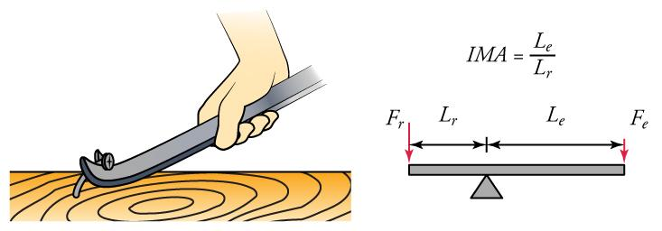
6-05 Simple Machines
Lever
  The rotation point is called the fulcrum

Slide 47
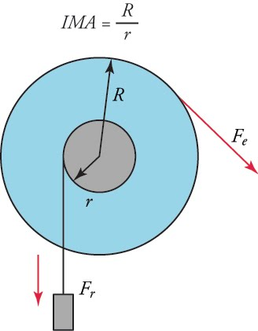
6-05 Simple Machines
Wheel and Axle
  Actually a lever where effort arm can rotate completely around the fulcrum
d_{e} is the radius of the wheel R
d_{r} is the radius of the axle r

Slide 48
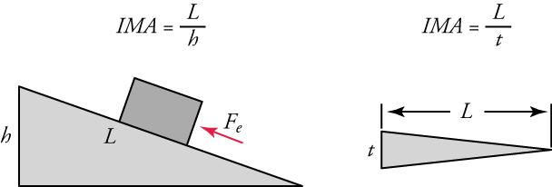
6-05 Simple Machines
Inclined Plane
Wedge
Sloped surface such as a ramp
d_{e} = Length
d_{r} = height
Two inclined planes put together
d_{e} = Length
d_{r} = thickness

Slide 49
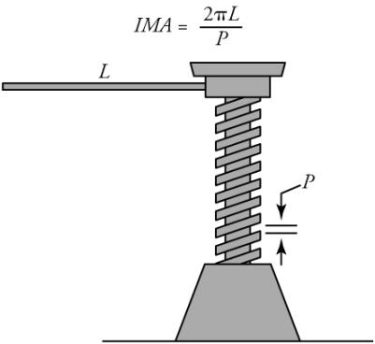
6-05 Simple Machines
Screw
  Inclined plane wrapped around a wheel and axle
  Lever attached to circular inclined plane
  d_{e} = circumference of screwdriver (2πL)
  d_{r} = distance between treads (pitch, p)

Slide 50
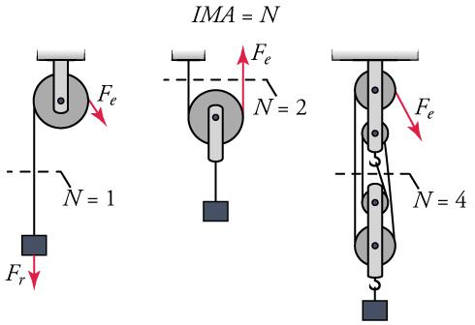
6-05 Simple Machines
Pulley
  Rope wrapped around a wheel and axle
    Which was a lever
  d_{e} = distance the rope is pulled
  d_{r} = distance the weight is lifted
  When a 2nd rope supports the weight, then the distance it travels is halved
  MA = number of ropes supporting the weight

Slide 51
6-05 Simple Machines
Find the ideal mechanical advantage of a ramp of length 10 m and height 3 m.
Find the ideal mechanical advantage of a 3 m lever whose fulcrum is 50 cm from one end with the load.
Notes:
$$IMA=\frac{L}{h}$$
$$IMA=\frac{10 m}{3 m}=3.33$$
$$IMA=\frac{L_{e}}{L_{r}}$$
$$IMA=\frac{2.5 m}{0.5 m}=5$$

Slide 52
6-05 Simple Machines
What is the ideal mechanical advantage of a pulley that is supporting the load by 4 ropes?
How much rope needs to be pulled to lift the load 2 m?
If the load’s mass is 120 kg, how much force is required to lift the load?
Notes:
$$IMA=N=4$$
$$IMA=\frac{d_{e}}{d_{r}}$$
$$4=\frac{d_{e}}{2 m}$$
$$8 m=d_{e}$$
$$IMA=\frac{F_{r}}{F_{e}}$$
$$4=\frac{120 kg·9.8\frac{m}{s^{2}}}{F_{e}}$$
$$4F_{e}=1176 N$$
$$F_{e}=294 N$$

Slide 53
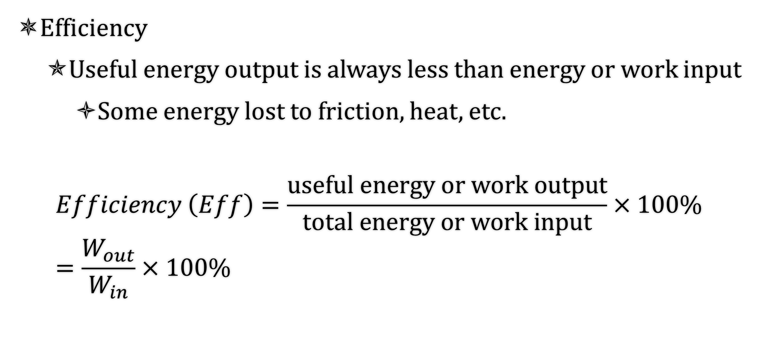
6-05 Simple Machines
Efficiency
  Useful energy output is always less than energy or work input
    Some energy lost to friction, heat, etc.
  $$Efficiency \left(Eff\right)=\frac{\text{useful} \text{energy} \text{or} \text{work} \text{output}}{\text{total} \text{energy} \text{or} \text{work} \text{input}}×100\%=\frac{W_{out}}{W_{in}}×100\%$$

Slide 54
6-05 Simple Machines
The actual efficiency of a screw is 94%. The screwdriver handle has a radius of 1.25 cm, and the screw has a pitch of 1 mm and radius of 1.2 mm. If it takes 9 N of force on the screwdriver to screw it in, what is the frictional force resisting the screw?
Notes:
$$IMA=\frac{2πL}{P}=\frac{2π\left(1.25 cm\right)}{0.1 cm}=25π$$
Ideal resistive force
$$IMA=\frac{F_{r}}{F_{e}}$$
$$25π=\frac{F_{r}}{9 N}$$
$$F_{r}=225π N$$
Effort distance for 1 rotation
$$C=2πr=2π\left(0.0125 m\right)=0.025π m$$
Resistance distance for 1 rotation (pitch)
$$d_{r}=0.001 m$$
Find actual resistance distance
$$efficiency=\frac{W_{o}}{W_{i}}×100\%$$
$$94\%=\frac{F_{r}\left(0.001 m\right)}{\left(9 N\right)\left(0.025 π m\right)}×100\%$$
$$0.94=F_{r}\left(0.00141\frac{}{N}\right)$$
$$664 N=F_{r}$$
Friction force = ideal F_{r} − actual F_{r}
$$F_{f}=225π N−664 N=42.4 N$$

Slide 55
6-05 Practice Work
What simple machines do you use to do homework? (Your pencil is a lever…)
Read
  OpenStax College Physics 2e 7.8-7.9
  OR
  Not in OpenStax High School Physics

Slide 56
06-06 Energy in Humans and the World
In this lesson you will…
See how the human body uses energy.
See where the world gets its energy from.
Explore a way to store energy.
Notes:
NAD 2022 Standards
ECV1: Energy Conservation
Not in OpenStax High School Physics
OpenStax College Physics 2e 7.8-7.9

Slide 57
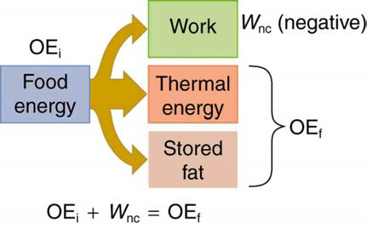
06-06 Energy in Humans and the World
Human bodies (all living bodies) convert energy
Rate of food energy use is metabolic rate
Basal metabolic rate (BMR)
  Total energy conversion at rest
  Highest: liver and spleen
  See table 7.4
Table 7.5 shows energy consumed for various activities

Slide 58
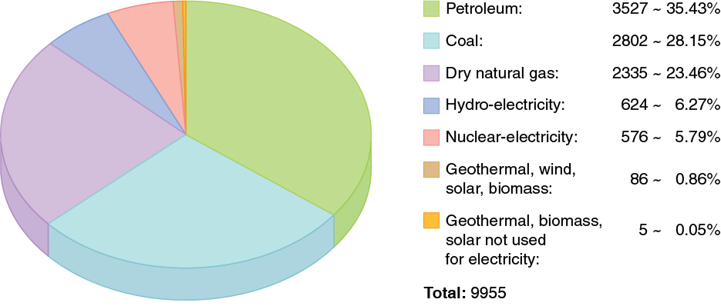
06-06 Energy in Humans and the World
Energy is required to do work
World wide, the most common source of energy is oil
Notes:
From 2008 units are billions of kWh

Slide 59
06-06 Energy in Humans and the World
USA has 4.5% of world population, but uses 24% of world’s oil
World energy consumption continues to increase quickly
  Growing economies in China and India
  Fossil Fuels are very polluting
  Many countries trying to develop renewable energy like wind and solar
Generally, higher energy use per capita = better standard of living

Slide 60
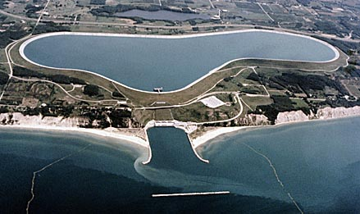
06-06 Energy in Humans and the World
Ludington Pumped Storage Power Plant
It consists of a reservoir 110 feet (34 m) deep, 2.5 miles (4.0 km) long, and one mile (1.6 km) wide which holds 27 billion US gallons (100 Gl) of water. The 1.3-square-mile (3.4 km²) reservoir is located on the banks of Lake Michigan.
The power plant consists of six reversible turbines that can each generate 312 megawatts of electricity for a total output of 1,872 megawatts.
At night, during low demand for electricity, the turbines run in reverse to pump water 363 feet (111 m) uphill from Lake Michigan into the reservoir.
During periods of peak demand water is released to generate power. Electrical generation can begin within two minutes with peak electric output of 1872 MW achieved in under 30 minutes. Maximum water flow is over 33 million US gallons (120,000 m³) per minute.
This process was designed to level the load of nearby nuclear power plants on the grid. It also replaces the need to build natural gas peak power plants used only during high demand.

Slide 61
6-06 Practice Work
Energy is what makes the world go ‘round.

