Slide 1
Circuits
Physics
Unit 8
Notes:
NAD 2023 Standard EM2 (Electric Circuits)

Slide 2
Credits
This Slideshow was developed to accompany the textbook
  OpenStax High School Physics
    Available for free at https://openstax.org/details/books/physics
    By Paul Peter Urone and Roger Hinrichs
    2020 edition
Some examples and diagrams are taken from the OpenStax College Physics, Physics, and Cutnell & Johnson Physics 6th ed.
Slides created by
Richard Wright, Andrews Academy
rwright@andrews.edu

Slide 3
8-01 Ohm’s Law
In this lesson you will…
Define current.
Explore the relationship between electric potential, current, and resistance.
Notes:
OpenStax High School Physics 19.1
OpenStax College Physics 2e 20.1-20.2

Slide 4
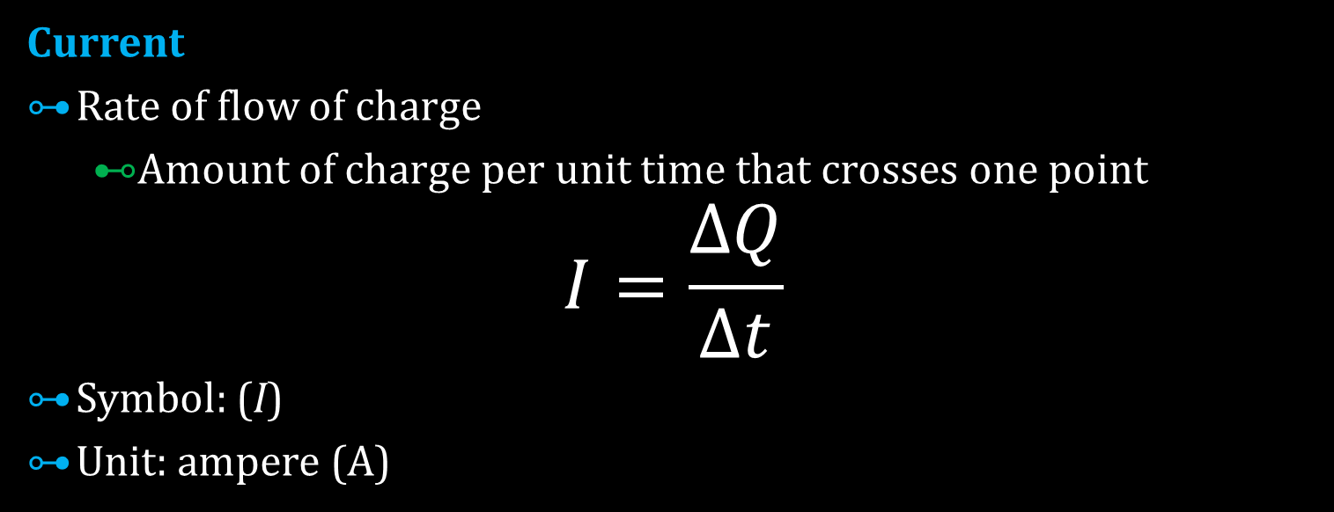
8-01 Ohm’s Law
Current
Rate of flow of charge
  Amount of charge per unit time that crosses one point
$$I=\frac{ΔQ}{Δt}$$
Symbol: (I)
Unit: ampere (A)

Slide 5
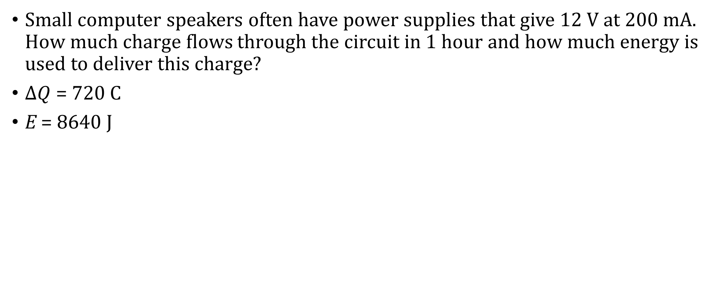
8-01 Ohm’s Law
Small computer speakers often have power supplies that give 12 V at 200 mA. How much charge flows through the circuit in 1 hour and how much energy is used to deliver this charge?
$ΔQ$ = 720 C
E = 8640 J
Notes:
Charge in 1 hour:
$$I=ΔQ/Δt → ΔQ=IΔt=\left(.2 A\right)\left(3600 s\right)=720 C$$
Energy:
$$EPE=qV=\left(720 C\right)12 V=8640 J$$
The speakers usually don’t draw that much current. They only draw that much current at their maximum volume.

Slide 6
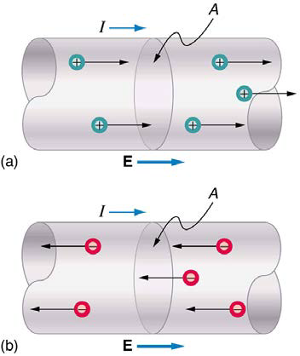
8-01 Ohm’s Law
Conventional Current
Electrons are the charge that flows through wires
Historically thought positive charges move
Conventional current → imaginary flow of positive charges
  Flows from positive terminal and into negative terminal
  Real current flows the opposite way

Slide 7
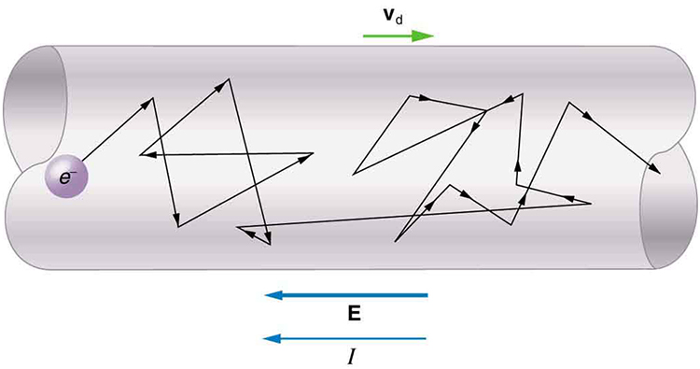
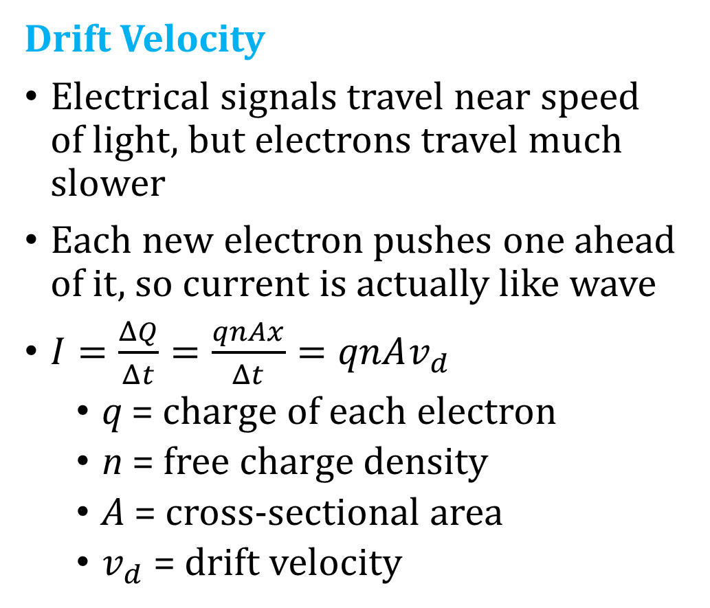
8-01 Ohm’s Law
Drift Velocity
Electrical signals travel near speed of light, but electrons travel much slower
Each new electron pushes one ahead of it, so current is actually like wave
$I=\frac{ΔQ}{Δt}=\frac{qnAx}{Δt}=qnAv_{d}$
  q = charge of each electron
  n = free charge density
  A = cross-sectional area
  $v_{d}$ = drift velocity

Slide 8
8-01 Ohm’s Law
Think of water pumps
  Bigger pumps → more water flowing
  Skinny pipes (more resistance) → less water flow
Electrical Circuits
  Bigger battery voltage → more current
  Big electrical resistance → less current

Slide 9
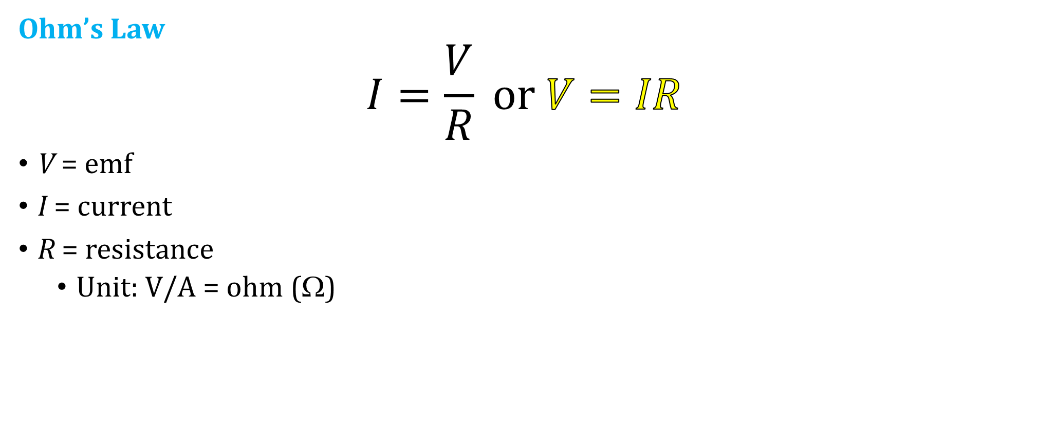
8-01 Ohm’s Law
Ohm’s Law
$$I=\frac{V}{R} or V=IR$$
V = emf
I = current
R = resistance
  Unit: V/A = ohm (Ω)

Slide 10
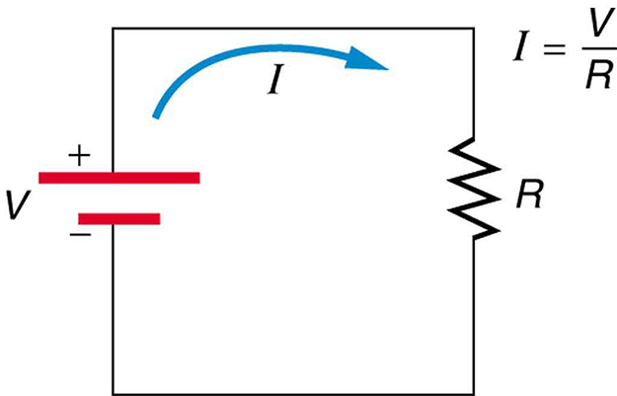
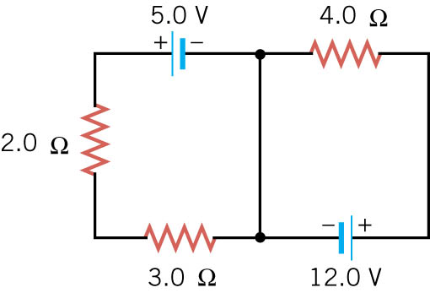
8-01 Ohm’s Law
Resistors
Device that offers resistance to flow of charges
Copper wire has very little resistance
Symbols used for
  Resistor →
  Wire →

Slide 11
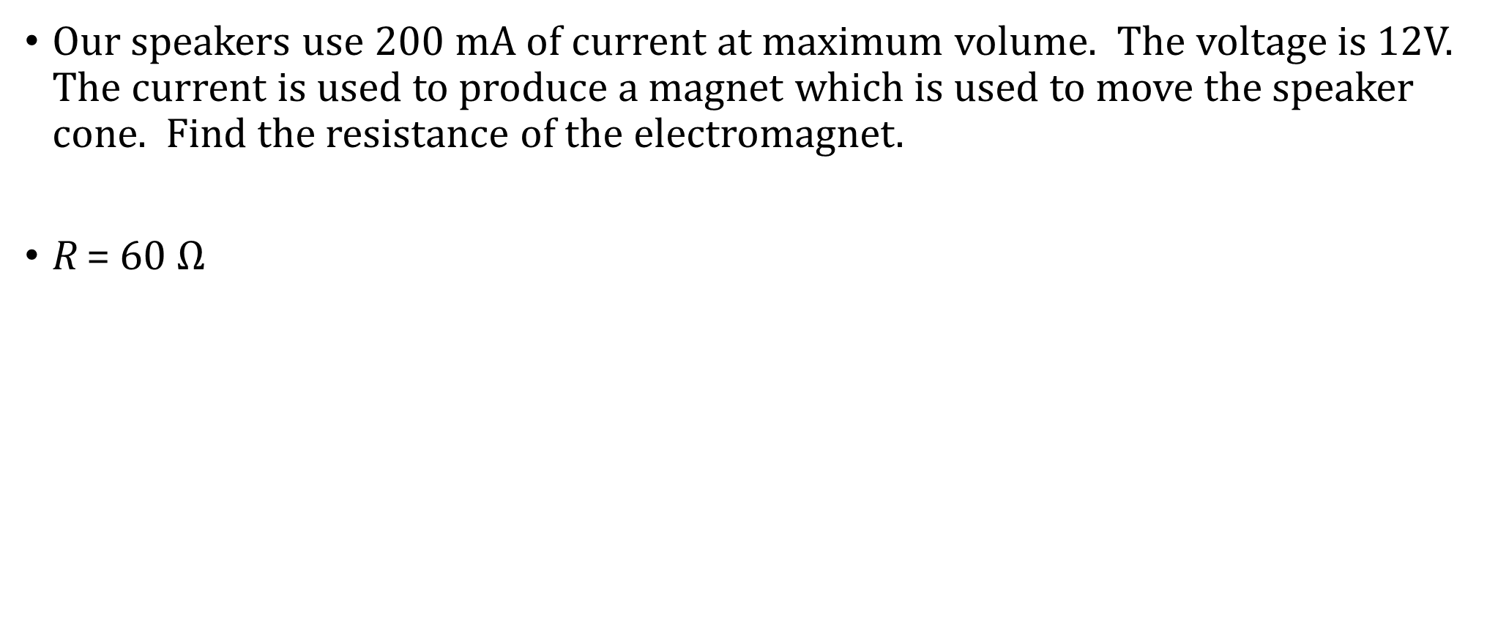
8-01 Ohm’s Law
Our speakers use 200 mA of current at maximum volume. The voltage is 12V. The current is used to produce a magnet which is used to move the speaker cone. Find the resistance of the electromagnet.
R = 60 $Ω$
Notes:
$$V=IR→12 V=\left(0.20 A\right)R→60 Ω=R$$

Slide 12
08-01 Homework
Hopefully these circuit problems won’t have you running around in circles
Read
  OpenStax College Physics 2e 21.1
  OR
  OpenStax High School Physics 19.2

Slide 13
8-02 Series Circuits
In this lesson you will…
Calculate equivalent resistance in series.
Find the current, voltage, or resistance of a circuit in series.
Notes:
OpenStax High School Physics 19.2
OpenStax College Physics 2e 21.1

Slide 14
8-02 Series Circuits
Electric circuit
Must be a complete loop
The electric potential at battery is high
The electric charges flow (current) down to the low potential
Along the way, the electric potential energy is used by the devices on the circuit
When the charges reach the low potential, there is no potential left. It has all been used.
Without a complete loop, there is no low potential for the charges to be attracted to

Slide 15
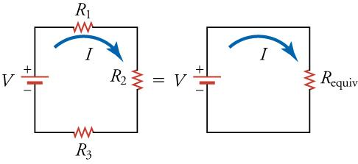
8-02 Series Circuits
Battery: Long side is positive, short side is negative
Provides the potential to make the current flow
Current flows from positive side to negative side
Resistor: Uses the potential to do work

Slide 16
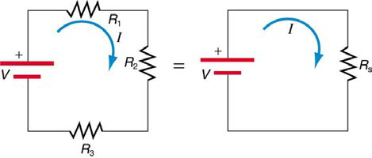
8-02 Series Circuits
Series Wiring
More than one device on circuit
Same current through each device
Break in device means no current
Form one “loop”
The resisters divide the voltage between them

Slide 17
8-02 Series Circuits
V divide among resistors
V = V₁ + V₂ + V₃
V = IR
V = IR₁ + IR₂ + IR₃
V = I(R₁ + R₂ +R₃)
V = IR_{S}
R_{S} = R₁ + R₂ + R₃ + …
Notes:
R_{s} is the equivalent resistance in Series

Slide 18
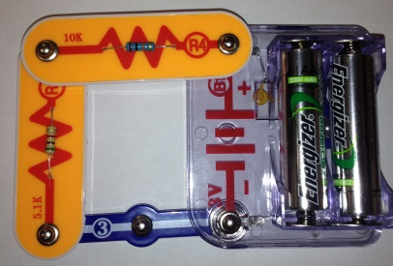
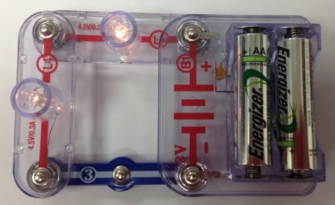
8-02 Series Circuits
A 5.17 kΩ resistor and a 10.09 kΩ resistor are connected in series. What is the equivalent resistance?
15.26 kΩ
Notes:
Circuit board and multimeter to measure
5.17 kΩ + 10.09 kΩ = 15.26 kΩ

Slide 19
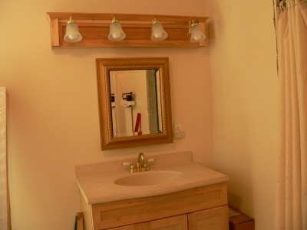
8-02 Series Circuits
Bathroom vanity lights are occasionally wired in series. V = 120 V and you install 3 bulbs with R = 8Ω and 1 bulb with R = 12Ω. What is the current and voltage of each bulb?
I = 3.33 A
V = 26.7 V, 40 V
Notes:
$$R_{S}=3\left(8 Ω\right)+12 Ω=36 Ω$$
$$V=IR→120 V=I\left(36 Ω\right) → I=3.33 A$$
$$V=IR → V=\left(3.33 A\right)\left(8 Ω\right)=26.7 V$$
$$→ V=\left(3.33 A\right)\left(12 Ω\right)=40 V$$

Slide 20
08-02 Homework
This is series-ous practice.
Read
  OpenStax College Physics 2e 21.1
  OR
  OpenStax High School Physics 19.3

Slide 21
8-03 Parallel Circuits
In this lesson you will…
Find equivalent resistance for resistors in parallel.
Find current, voltage, or resistance for circuits in parallel.
Notes:
OpenStax High School Physics 19.3
OpenStax College Physics 2e 21.1

Slide 22
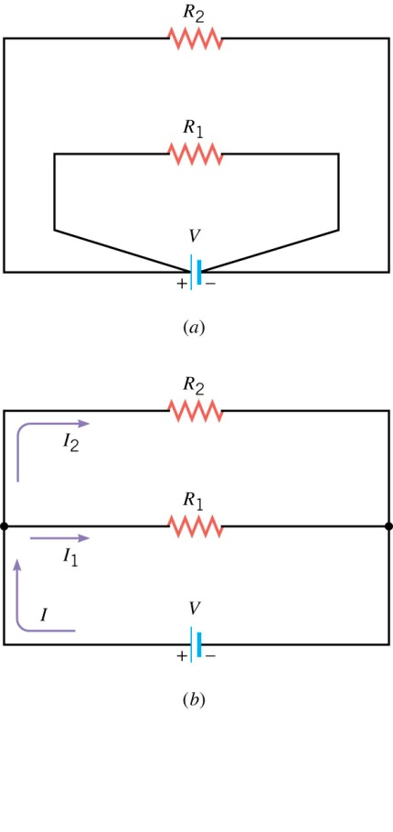
8-03 Parallel Circuits
Parallel Wiring
Same voltage across several devices
Typical house wiring
Break in device has no effect on current
Resistors divide current

Slide 23
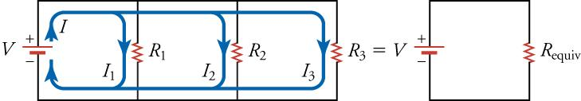
8-03 Parallel Circuits
Derivation
Each branch draws current as if the other wasn’t there
Each branch draws less current than the power supply gives
R = V / I
Overall circuit: Large I → Small R
  Smaller resistance than either branch

Slide 24
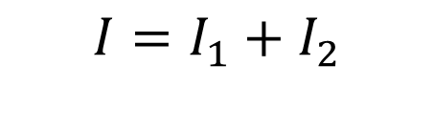
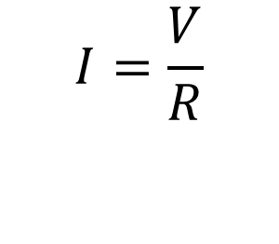

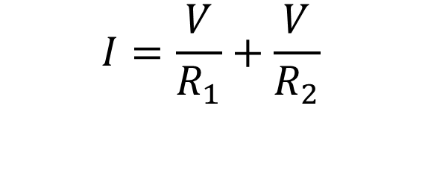
8-03 Parallel Circuits
$$I=I_{1}+I_{2}$$
$$I=\frac{V}{R}$$
$$I=\frac{V}{R_{1}}+\frac{V}{R_{2}}$$
$$I=V\left(\frac{1}{R_{1}}+\frac{1}{R_{2}}\right)=V\left(\frac{1}{R_{P}}\right)$$

Slide 25
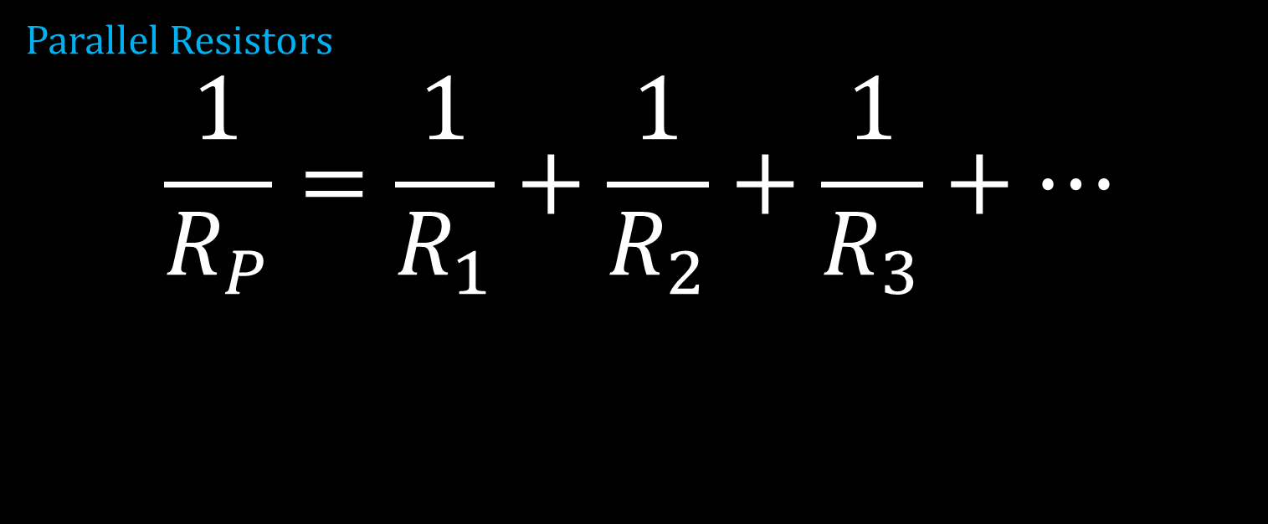
8-03 Parallel Circuits
Parallel Resistors
$$\frac{1}{R_{P}}=\frac{1}{R_{1}}+\frac{1}{R_{2}}+\frac{1}{R_{3}}+⋯$$

Slide 26
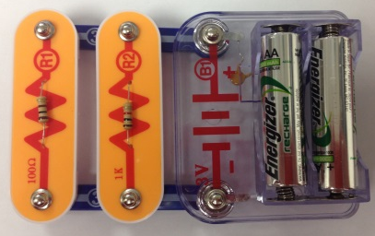
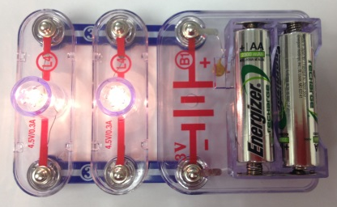
8-03 Parallel Circuits
A 1004 Ω resistor and a 101 Ω resistor are connected in parallel. What is the equivalent resistance?
91.8 Ω
If they were connected to a 3 V battery, how much total current would the battery supply?
32.7 mA
How much current through each resistor?
3.0 mA and 29.7 mA
Notes:
$$\frac{1}{R_{P}}=\frac{1}{R_{1}}+\frac{1}{R_{2}}$$
$$1/R_{P}=\frac{1}{1004 Ω}+\frac{1}{101 Ω}=0.000996/Ω+0.00990/Ω=0.010897/Ω$$
$$R_{P}=\frac{1}{0.010897/Ω}=91.8 Ω$$
$$V=IR→3 V=I\left(91.8 Ω\right) → I=0.0327 A=32.7 mA$$
$$V=IR → 3 V=I\left(1004 Ω\right) → I=0.0030 A$$
$$V=IR → 3 V=I\left(101 Ω\right) → I=0.0297 A$$
$$Add them together → 0.0327 A$$

Slide 27
08-03 Homework
These problems parallel the lesson.
Read
  OpenStax College Physics 2e 21.1
  OR
  OpenStax High School Physics 19.3

Slide 28
8-04 Circuits in Parallel and Series
In this lesson you will…
Find equivalent resistance for circuits a combination of parallel and series.
Find current or voltage over various parts of the circuit.
Notes:
OpenStax High School Physics 19.3
OpenStax College Physics 2e 21.1

Slide 29
8-04 Circuits in Parallel and Series
Circuits Wired Partially in Series and Partially in Parallel
Simplify any series portions of each branch
Simplify the parallel circuitry of the branches
If necessary, simplify any remaining series

Slide 30
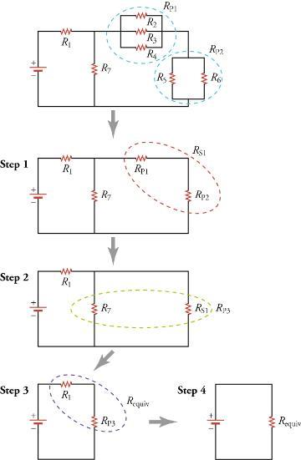
8-04 Circuits in Parallel and Series

Slide 31
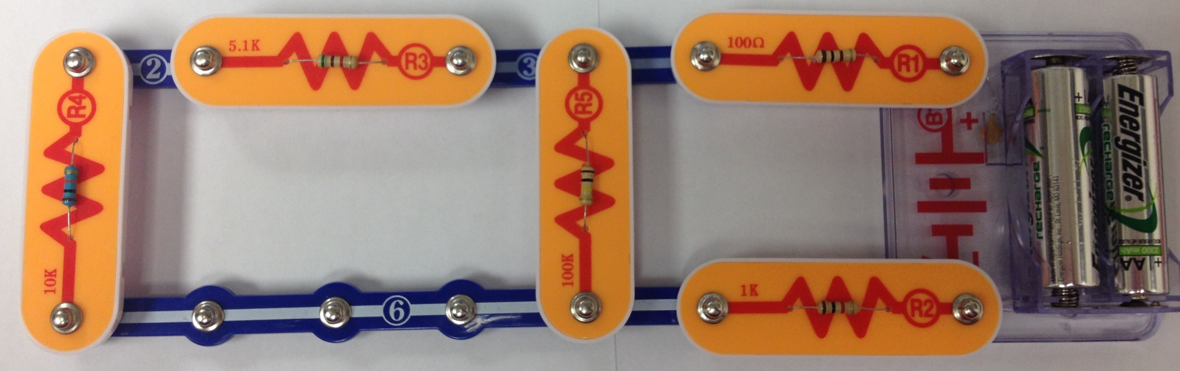
8-04 Circuits in Parallel and Series
Find the equivalent resistance and the total current of the following circuit.
5.17 kΩ
101 Ω
3 V
10.09 kΩ
100.9 kΩ
1004 Ω
101 Ω
5.17 kΩ
3 V
100.9 kΩ
10.09 kΩ
1004 Ω
Notes:
$$Combine far left branch \left(series\right)→10090 Ω +5170 Ω =15260 Ω$$
$$Combine left two branches \left(parallel\right)→\frac{1}{R}=\frac{1}{15260 Ω}+\frac{1}{100900 Ω}→\frac{1}{R}=7.54×{10}^{−5}\frac{}{Ω}→R=13255 Ω$$
$$The rest is series→13255 Ω+1004 Ω+101 Ω=14360 Ω$$
$$V=IR→3 V=I\left(14360 Ω\right)→I=2.09×{10}^{−4} A=209 mA$$

Slide 32
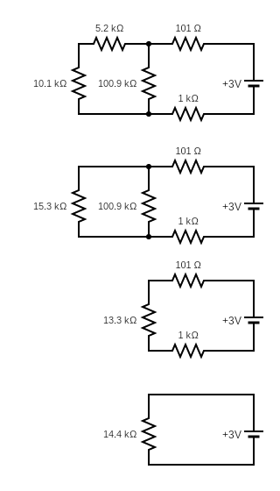
8-04 Circuits in Parallel and Series
Notes:
$$Combine far left branch \left(series\right)→10090 Ω +5170 Ω =15260 Ω$$
$$Combine left two branches \left(parallel\right)→\frac{1}{R}=\frac{1}{15260 Ω}+\frac{1}{100900 Ω}→\frac{1}{R}=7.54×{10}^{−5}\frac{}{Ω}→R=13255 Ω$$

Slide 33
8-04 Circuits in Parallel and Series
Notes:
$$The rest is series→13255 Ω+1004 Ω+101 Ω=14360 Ω$$
$$V=IR→3 V=I\left(14360 Ω\right)→I=2.09×{10}^{−4} A=209 μA$$

Slide 34
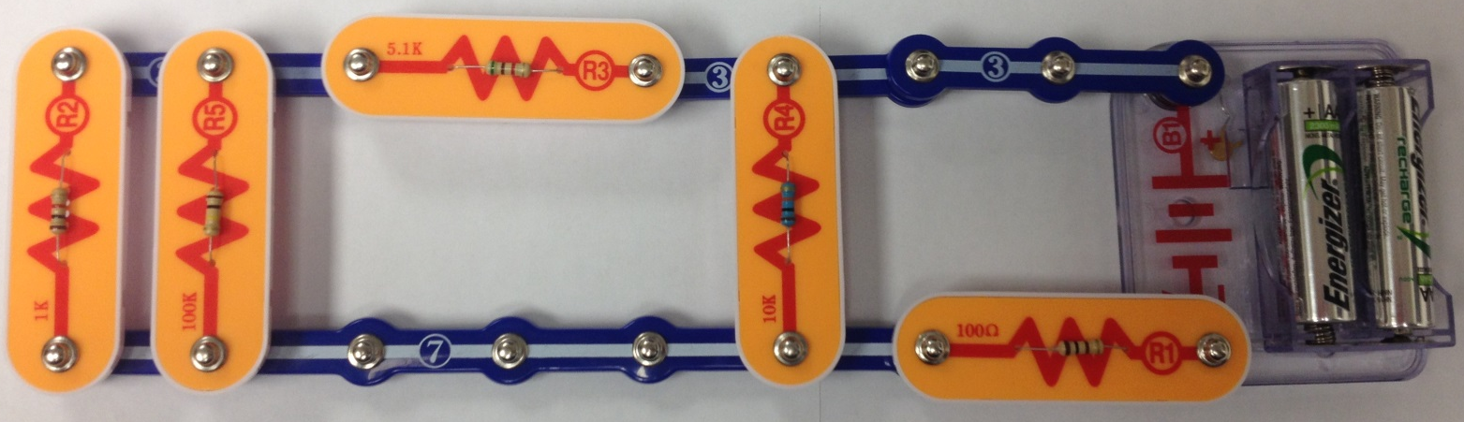
8-04 Circuits in Parallel and Series
Find the equivalent resistance.
5.17 kΩ
10.09 kΩ
3 V
100.9 kΩ
1004 Ω
101 Ω
2 Ω
1 Ω
20 Ω
1.5 V
5 Ω
4 Ω
15 Ω
3 Ω
2.5 Ω
Notes:
Far left two branches (parallel): $\frac{1}{R}=\frac{1}{1004 Ω}+\frac{1}{100900 Ω}→R=994.1 Ω$
Combine series: $R=994.1 Ω+5170 Ω=6164.1 Ω$
Combine parallel: $\frac{1}{R}=\frac{1}{6164.1 Ω}+\frac{1}{10090 Ω}→R=3826.5 Ω$
Combine series: $R=3826.5 Ω+101 Ω=3927 Ω$

Slide 35
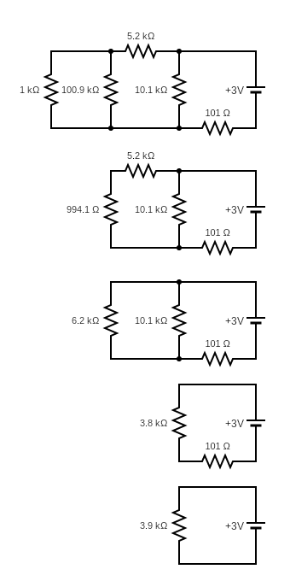
8-04 Circuits in Parallel and Series
Notes:
Far left two branches (parallel): $\frac{1}{R}=\frac{1}{1004 Ω}+\frac{1}{100900 Ω}→R=994.1 Ω$
Combine series: $R=994.1 Ω+5170 Ω=6164.1 Ω$

Slide 36
8-04 Circuits in Parallel and Series
Notes:
Combine parallel: $\frac{1}{R}=\frac{1}{6164.1 Ω}+\frac{1}{10090 Ω}→R=3826.5 Ω$
Combine series: $R=3826.5 Ω+101 Ω=3927 Ω$

Slide 37
08-04 Homework
I cannot think of a joke currently…
Read
  OpenStax College Physics 2e 21.4
  OR
  Read about voltmeters and ammeters

Slide 38
8-05 Voltmeters and Ammeters
In this lesson, you will…
Know how to measure volts with a voltmeter.
Know how to measure current with an ammeter.
Notes:
Not in OpenStax High School Physics
OpenStax College Physics 2e 21.4

Slide 39
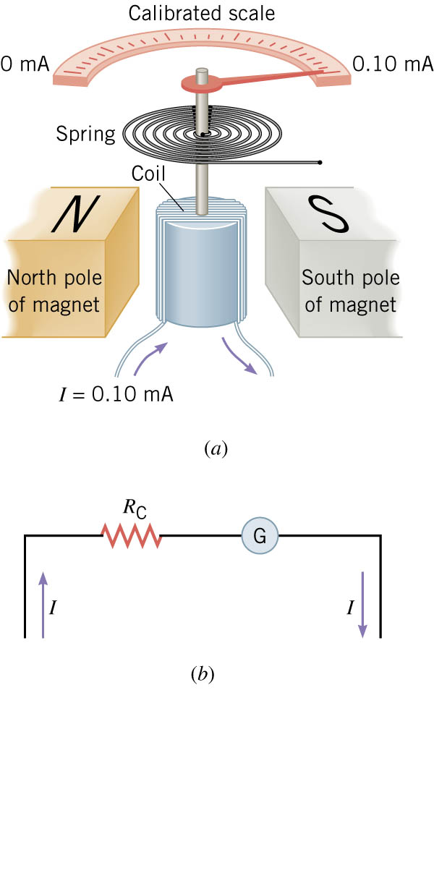
8-05 Voltmeters and Ammeters
Analog (non-digital) meters
Main component → galvanometer
Notes:
Made of magnets, wire coil, spring, pointer and calibrated scale.
Current flowing through the coil makes it magnetic, so it wants to move. The stronger the current the more the coil will rotate.

Slide 40
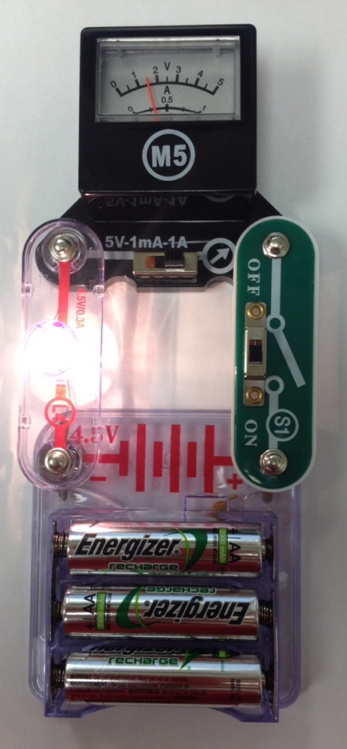
8-05 Voltmeters and Ammeters
Ammeters
Measures current
Inserted into circuit so current passes through it
  Connected in series

Slide 41
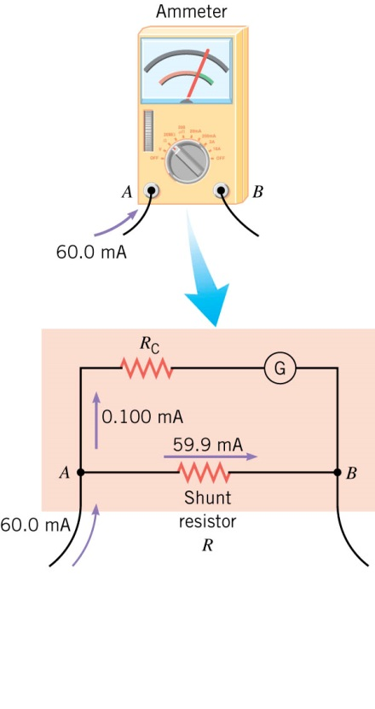
8-05 Voltmeters and Ammeters
Coil usually measures only little current
Has shunt resistors connected in parallel to galvanometer so excess current can bypass
  A knob lets you select which shunt resistor is used
Notes:
Example of Shunt resistors
Want to measure 100 mA, but meter’s coil only reads 0.100 mA.
Have shunt resistor take 99.9 mA and the coil only gets .1 mA
To know how big to make the shunt resistors, the resistance of the coil needs to be known.

Slide 42
8-05 Voltmeters and Ammeters
Problems with Ammeters
  The resistance of the coil and shunt resistors add to the resistance of the circuit
  This reduces the current in the circuit
  Ideal ammeter has no resistance
    Real-life good ammeters have small resistance so as only cause a negligible change in current

Slide 43
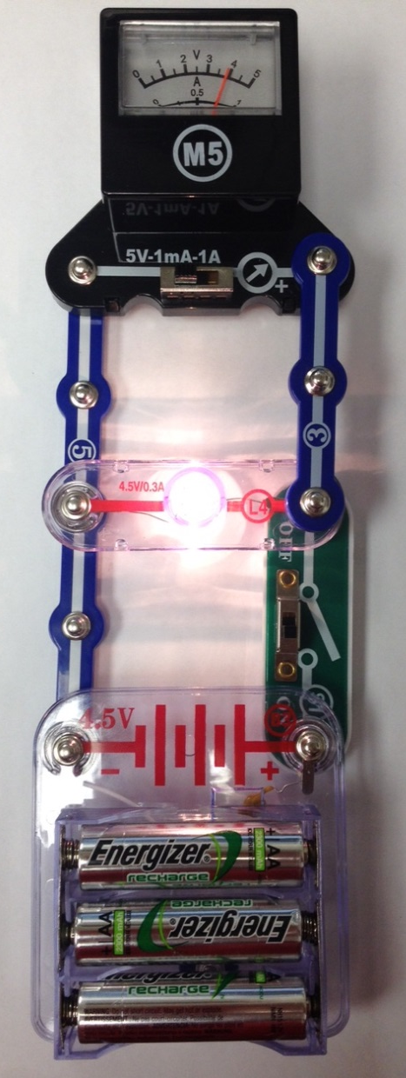
8-05 Voltmeters and Ammeters
Voltmeters
Connected in parallel to circuit since parallel has same voltage
The coil works just like in the ammeter
Given the current and the resistance of the coil → V = IR
To give more range, a large resistor is connected in series with the coil
Notes:
Large resistor is added because if V is constant Big R means small I

Slide 44
8-05 Voltmeters and Ammeters
Problems with Voltmeters
  The voltmeter takes some the voltage out of the circuit
  Ideal voltmeter would have infinitely large resistance as to draw tiny current
  Good voltmeter has large enough resistance as to make the current draw (and voltage drop) negligible

Slide 45
08-05 Homework
See if you measure up to these meter problems
Read
  OpenStax College Physics 2e 20.4-20.5
  OR
  OpenStax High School Physics 19.4

Slide 46
8-06 Electric Power and AC/DC Currents
In this lesson, you will…
Find electric power.
Understand AC and DC current.
Notes:
OpenStax High School Physics 19.4
OpenStax College Physics 2e 20.4-20.5

Slide 47
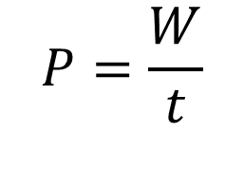
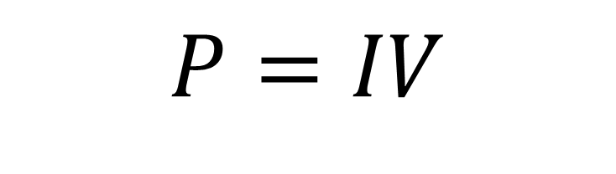
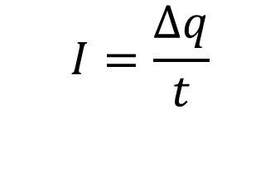
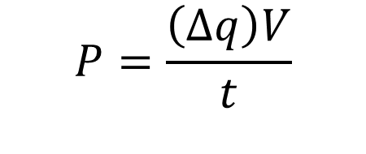

8-06 Electric Power and AC/DC Currents
$$P=\frac{W}{t}$$
$$W=ΔEPE=\left(Δq\right)V$$
$$P=\frac{\left(Δq\right)V}{t}$$
$$I=\frac{Δq}{t}$$
$$P=IV$$

Slide 48
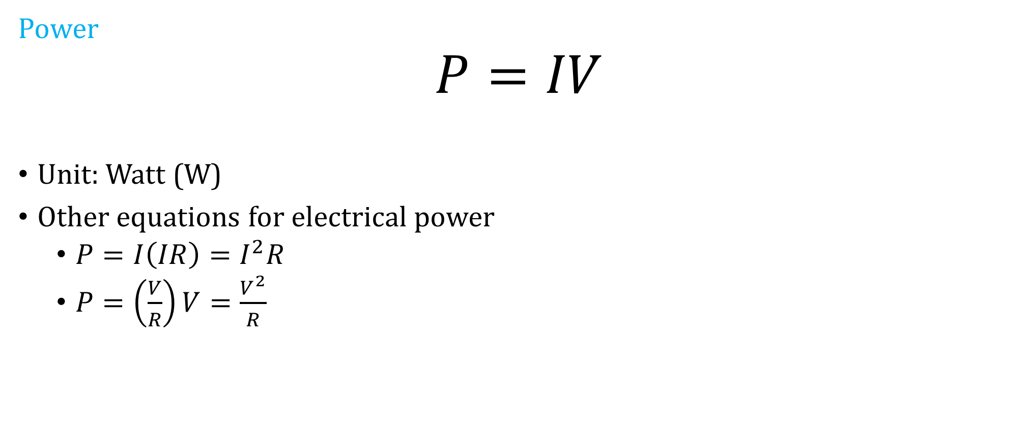
8-06 Electric Power and AC/DC Currents
Power
$$P=IV$$
Unit: Watt (W)
Other equations for electrical power
  $P=I\left(IR\right)=I^{2}R$
  $P=\left(\frac{V}{R}\right)V=\frac{V^{2}}{R}$
Notes:
V=IR → I = V/R

Slide 49
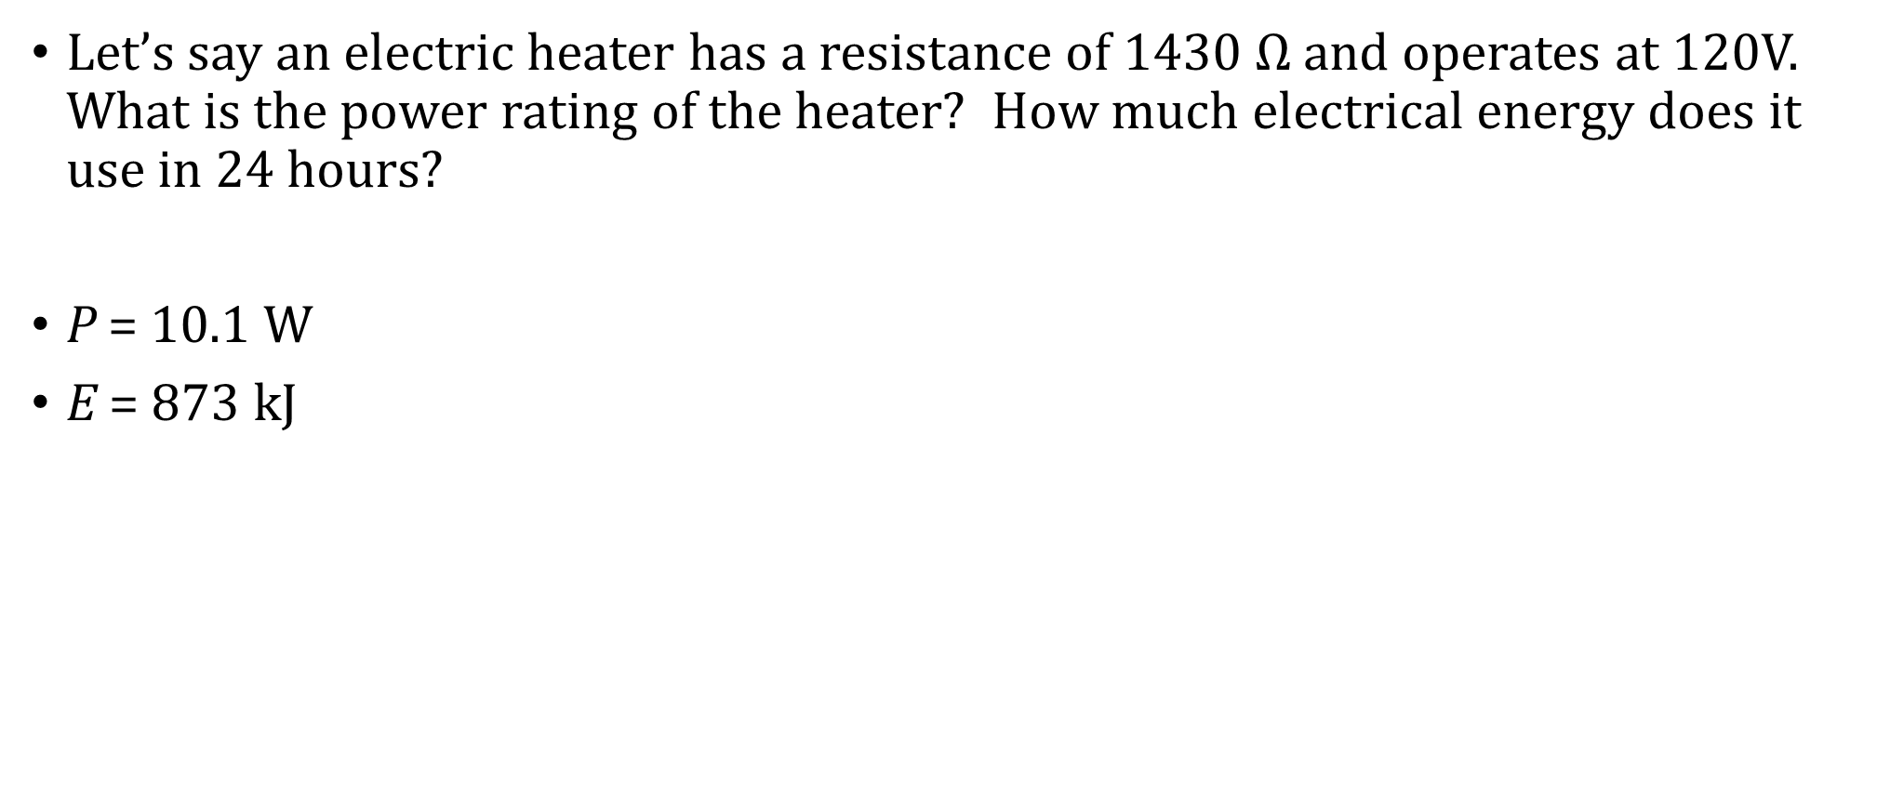
8-06 Electric Power and AC/DC Currents
Let’s say an electric heater has a resistance of 1430 $Ω$ and operates at 120V. What is the power rating of the heater? How much electrical energy does it use in 24 hours?
P = 10.1 W
E = 873 kJ
Notes:
Power
$$P=\frac{V^{2}}{R}=\frac{{\left(120 V\right)}^{2}}{1430 Ω}=10.1 W$$
Energy use
$$P=\frac{W}{t} → W=Pt=\left(10.1 W\right)\left(86400 s\right)=872640 J$$

Slide 50
8-06 Electric Power and AC/DC Currents
Kilowatt hours
Electrical companies charge you for the amount of electrical energy you use
Measured in kilowatt hours (kWh)
If electricity costs $0.15 per kWh how much does it cost to operate the previous heater (P = 10.1 W) for one month?
$1.09
Notes:
$$E=\left(0.0101 kW\right)\left(720 h\right)=7.272 kWh$$
$$Cost=\left(7.272 kWh\right)\left(\$0.15\right)=\$1.09$$

Slide 51
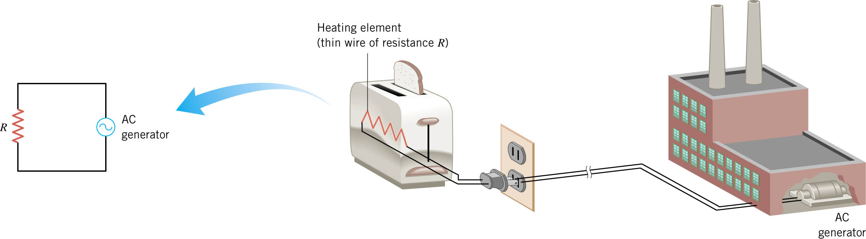
8-06 Electric Power and AC/DC Currents
Alternating Current
Charge flow reverses direction periodically
Due to way that power plants generate power
Simple circuit

Slide 52
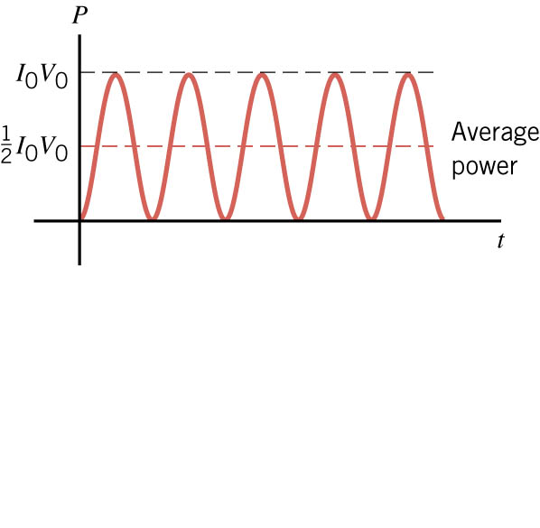
8-06 Electric Power and AC/DC Currents
Periodicity
Voltage, Current, and Power fluctuate with time
So we usually talk about the averages

Slide 53
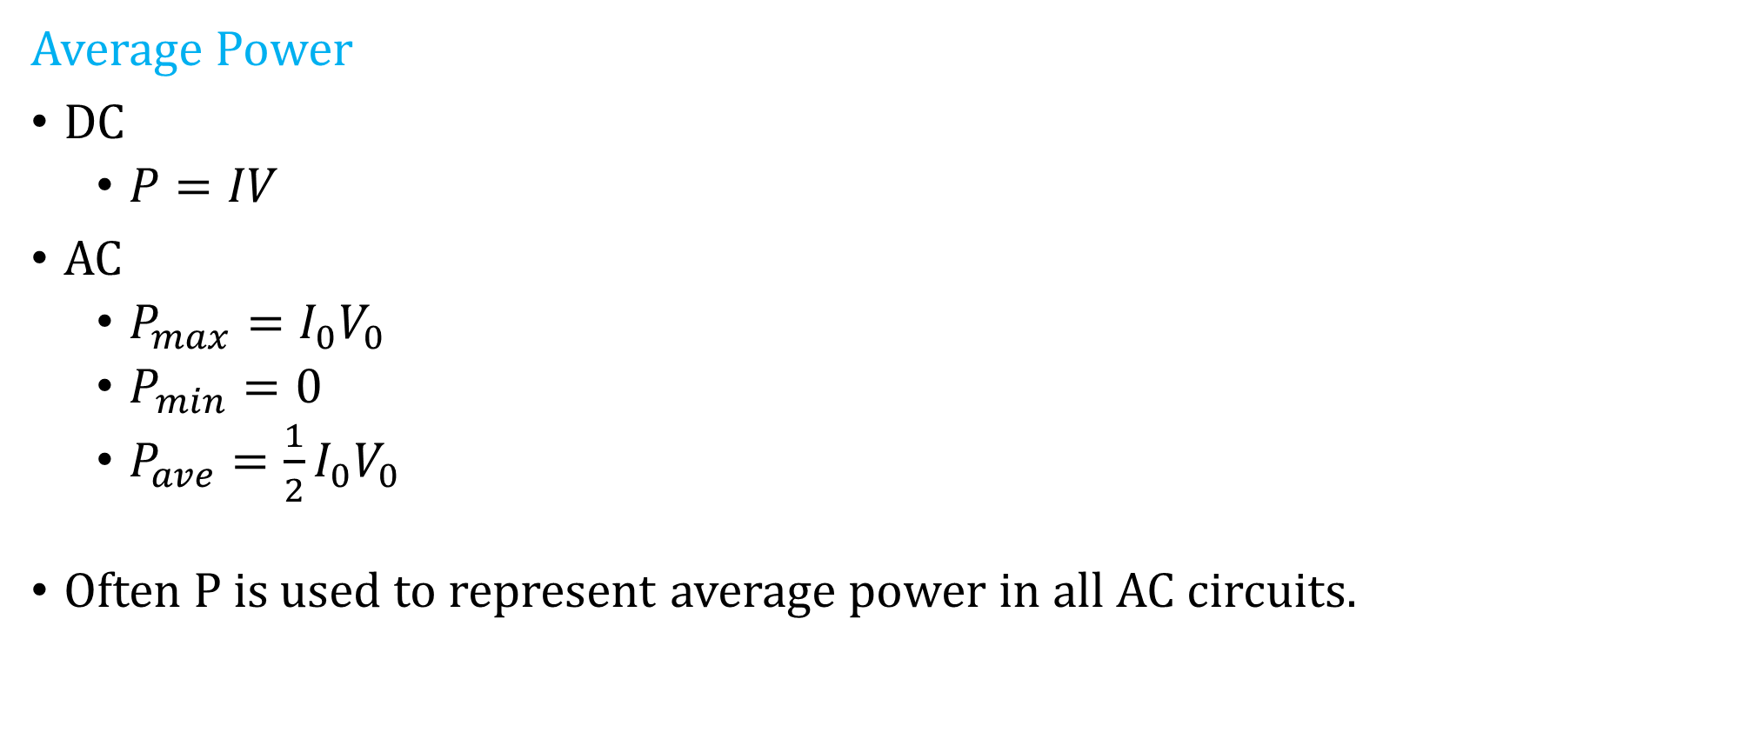
8-06 Electric Power and AC/DC Currents
Average Power
DC
  $P=IV$
AC
  $P_{max}=I_{0}V_{0}$
  $P_{min}=0$
  $P_{ave}=\frac{1}{2}I_{0}V_{0}$
Often P is used to represent average power in all AC circuits.
Notes:
I₀ and V₀ stand for the maximum value

Slide 54
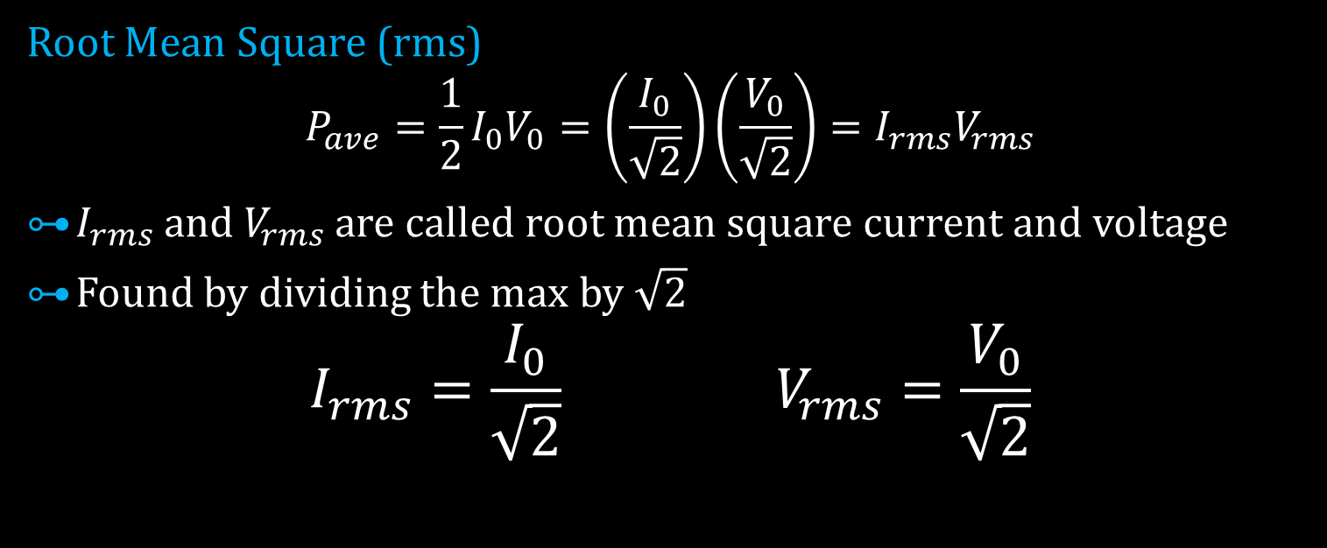
8-06 Electric Power and AC/DC Currents
Root Mean Square (rms)
$$P_{ave}=\frac{1}{2}I_{0}V_{0}=\left(\frac{I_{0}}{\sqrt{2}}\right)\left(\frac{V_{0}}{\sqrt{2}}\right)=I_{rms}V_{rms}$$
$I_{rms}$ and $V_{rms}$ are called root mean square current and voltage
Found by dividing the max by $\sqrt{2}$
$$I_{rms}=\frac{I_{0}}{\sqrt{2}} V_{rms}=\frac{V_{0}}{\sqrt{2}}$$

Slide 55
8-06 Electric Power and AC/DC Currents
Convention in USA
V₀ = 170 V
V_{rms} = 120 V
Most electronics specify 120 V, so they really mean V_{rms}
We will always (unless noted) use average power, and root mean square current and voltage
Thus, all previously learned equations work!

Slide 56
8-06 Electric Power and AC/DC Currents
A 60 W light bulb operates on a peak voltage of 156 V. Find the V_{rms}, I_{rms}, and resistance of the light bulb.
V_{rms} = 110 V
I_{rms} = 0.55 A
R = 202 Ω
Notes:
$$V_{rms}=\frac{156 V}{\sqrt{2}}=110 V$$
$$I_{rms}: P=IV→60 W=I\left(110 V\right)→I_{rms}=0.55 A$$
$$P=\frac{V^{2}}{R}→60 W=\frac{{\left(110 V\right)}^{2}}{R}→R=\frac{{\left(110 V\right)}^{2}}{60 W}→202 Ω$$

Slide 57
8-06 Electric Power and AC/DC Currents
Why are you not supposed to use extension cords for devices that use a lot of power like electric heaters?
P = IV
  P is large so I is large
The wire has some resistance
The large current and little resistance can cause heating
If wire gets too hot, the plastic insulation melts
Notes:
Wire resistance varies directly with L and inversely with A
If you use an extension cord, use one with thick wires and short length to reduce resistance
Remember small gauge means big wires

Slide 58
08-06 Homework
Don’t write down just answers. Alternatively show your work, too.
Read
  OpenStax College Physics 2e 20.6
  Or
  Read about electrical safety

Slide 59
08-07 Electricity and the Human Body
In this lesson you will…
• Define thermal hazard, shock hazard, and short circuit.
• Explain what effects various levels of current have on the human body.
Notes:
Not in OpenStax High School Physics
OpenStax College Physics 2e 20.6

Slide 60
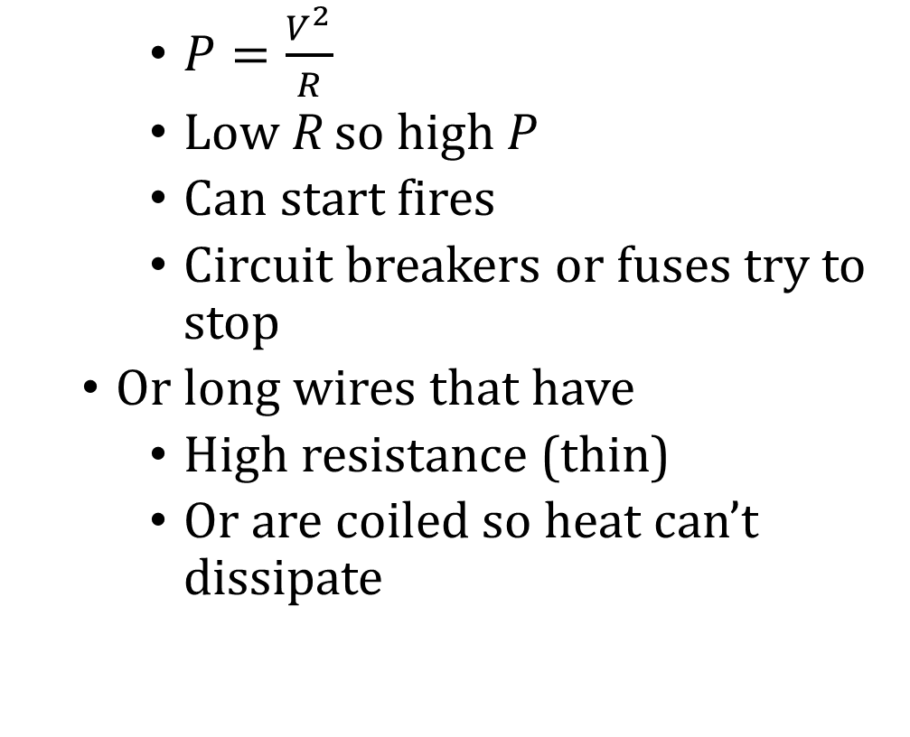
08-07 Electricity and the Human Body
Thermal Hazards
  Electric energy converted to thermal energy faster than can be dissipated
  Happens in short circuits
    Electricity jumps between two parts of circuits bypassing the main load
    $P=\frac{V^{2}}{R}$
    Low R so high P
    Can start fires
    Circuit breakers or fuses try to stop
  Or long wires that have
    High resistance (thin)
    Or are coiled so heat can’t dissipate
Notes:
Thin wires have higher R than thick wires
Heat can’t escape from coiled wires and they melt

Slide 61
08-07 Electricity and the Human Body
Shock Hazards
  Factors
    Amount of Current
    Path of current
    Duration of shock
    Frequency of current
Human body mainly water, so decent conductor
Muscles are controlled by electrical impulses in nerves
A shock can cause muscles to contract
  Cause fist to close around wire (muscles to close, stronger than to open)
Can cause heart to stop
Body most sensitive to 50-60 Hz

Slide 62
08-07 Homework
Don’t let these problems shock you.

