Slide 1
Electromagnetic Rays
High School Physics
Unit 11
Notes:
NAD 2023 Standard ER2 (Electromagnetic Radiation)

Slide 2
Credits
This Slideshow was developed to accompany the textbook
  OpenStax High School Physics
    Available for free at https://openstax.org/details/books/physics
    By Paul Peter Urone and Roger Hinrichs
    2020 edition
Some examples and diagrams are taken from the OpenStax College Physics, Physics, and Cutnell & Johnson Physics 6th ed.
Slides created by
Richard Wright, Andrews Academy
rwright@andrews.edu

Slide 3
11-01 Electromagnetic Spectrum and Behavior
In this lesson you will…
Explain the electromagnetic spectrum
Explain emission and aborption spectrums
Notes:
OpenStax High School Physics 15.1, 15.2, 22.1
OpenStax College Physics 2e 24.2-24.3, 30.3, 30.6

Slide 4
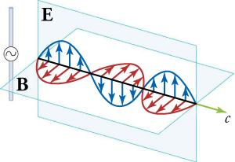
11-01 Electromagnetic Spectrum and Behavior
How to create electromagnetic (EM) waves
  Move a charge (current)
  This creates an electric field
  Also creates a magnetic field
  These are 90° to each other

Slide 5
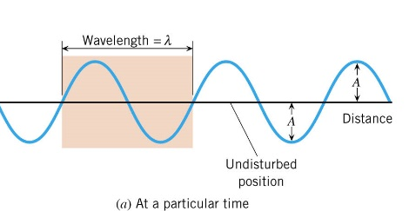
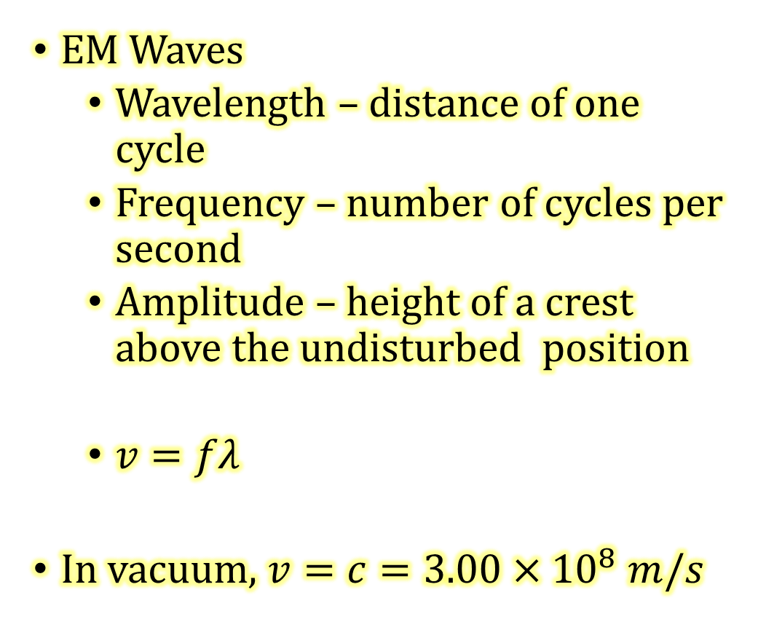
11-01 Electromagnetic Spectrum and Behavior
EM Waves
  Wavelength – distance of one cycle
  Frequency – number of cycles per second
  Amplitude – height of a crest above the undisturbed position
  $v=fλ$
In vacuum, $v=c=3.00×{10}^{8} m/s$

Slide 6
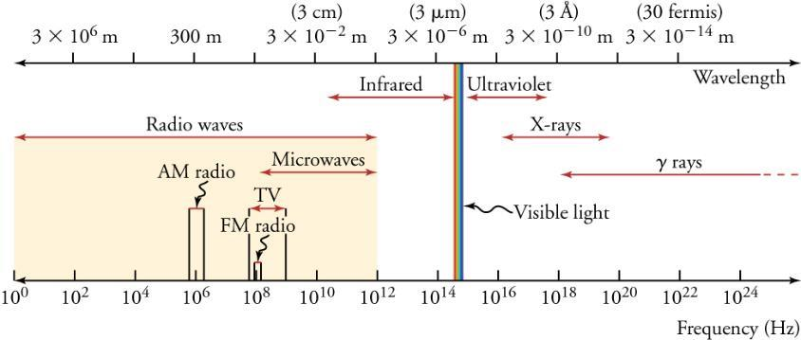
11-01 Electromagnetic Spectrum and Behavior
Types of EM radiation
  Based on the frequency
Notes:
X-rays come from outside the nucleus
Gamma rays come from inside the nucleus

Slide 7
Types of EM Wave | Production | Applications | Life Sciences Aspect | Issues
Radio / TV | Accelerating charges | Communications, remote control | MRI | Requires controls for band use
Microwaves | Accelerating charges & thermal agitation | Communications, cooking, radar | Deep heating | Cell phone use
Infrared | Thermal agitation & electronic transitions | Thermal imaging, heating | Absorption by atmosphere | Greenhouse effect
Visible Light | Thermal agitation & electronic transitions | All pervasive | Photosynthesis, vision
Ultraviolet | Thermal agitation & electronic transitions | Sterilization, slowing abnormal growth of cells | Vitamin D production | Ozone depletion, causes cell damage
X-rays | Inner electronic transitions & fast collisions | Medial, security | Medical diagnosis, cancer therapy | Causes cell damage
Gamma Rays | Nuclear decay | Nuclear medicine, security | Medical diagnosis, cancer therapy | Causes cell damage, radiation damage

Slide 8
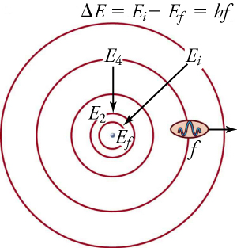
11-01 Electromagnetic Spectrum and Behavior
Electron transitions
  Bohr model of the atom
  Electrons orbit the nucleus
  When an electron gains energy it gets excited, it jump out to a higher orbital
    Electrons gain energy when they are struck by a photon
    Photons are particles of light
    Too much energy and electron completely removed from atom, ionizes, allows chemical reactions
  When the excited electron falls back down to its orbital, it releases energy as a photon
  The energy released is based on the distance between the orbitals
  The frequency (and wavelength) of the released photon is based on the energy released
  So only a few certain frequencies are emitted
  Higher frequency means higher energy

Slide 9
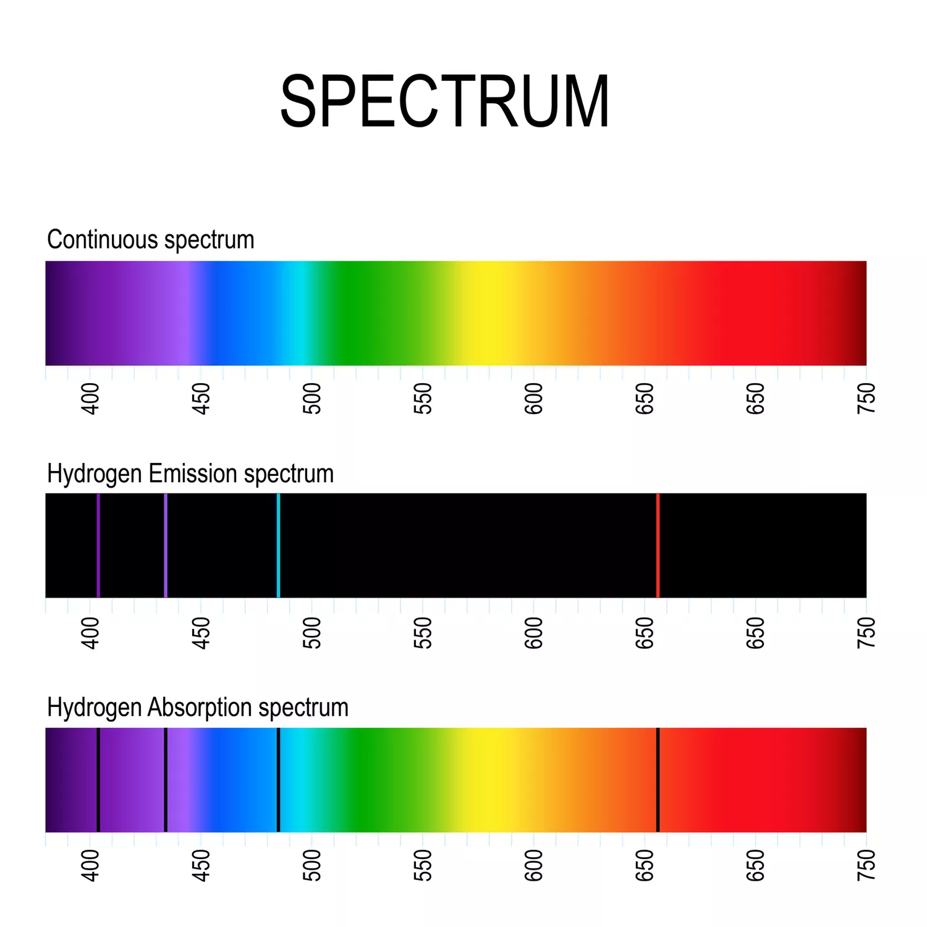
11-01 Electromagnetic Spectrum and Behavior
Emission spectrum
  Shows the wavelengths (or frequencies) of the emitted light
Absorption spectrum
  Shows the wavelengths (or frequencies) of the absorbed light
They are negatives of each other
  The frequencies emitted = the frequencies absorbed

Slide 10
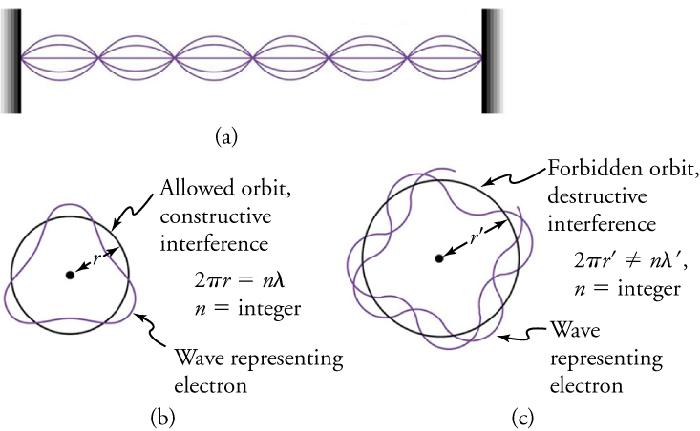
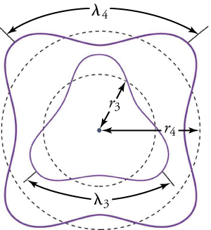
11-01 Electromagnetic Spectrum and Behavior
The Bohr model only works for hydrogen
De Broglie model
  Electrons behave like waves with a set wavelength
  Each electron orbits the nucleus in standing waves
  This allows for orbitals in more complicated atoms

Slide 11
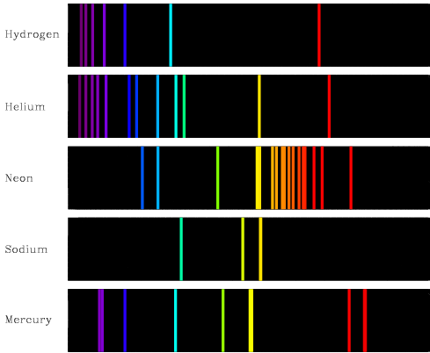
11-01 Electromagnetic Spectrum and Behavior
Each element has its own spectrum
Astronomers can look at the spectrum from a star (emission spectrum) and determine the atoms that the star is made of
  Or they can look at light coming through the atmosphere of a planet and look at the absorption spectrum to see what it is made of

Slide 12
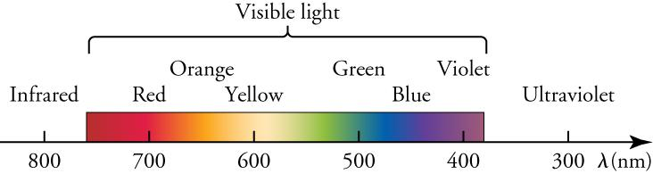
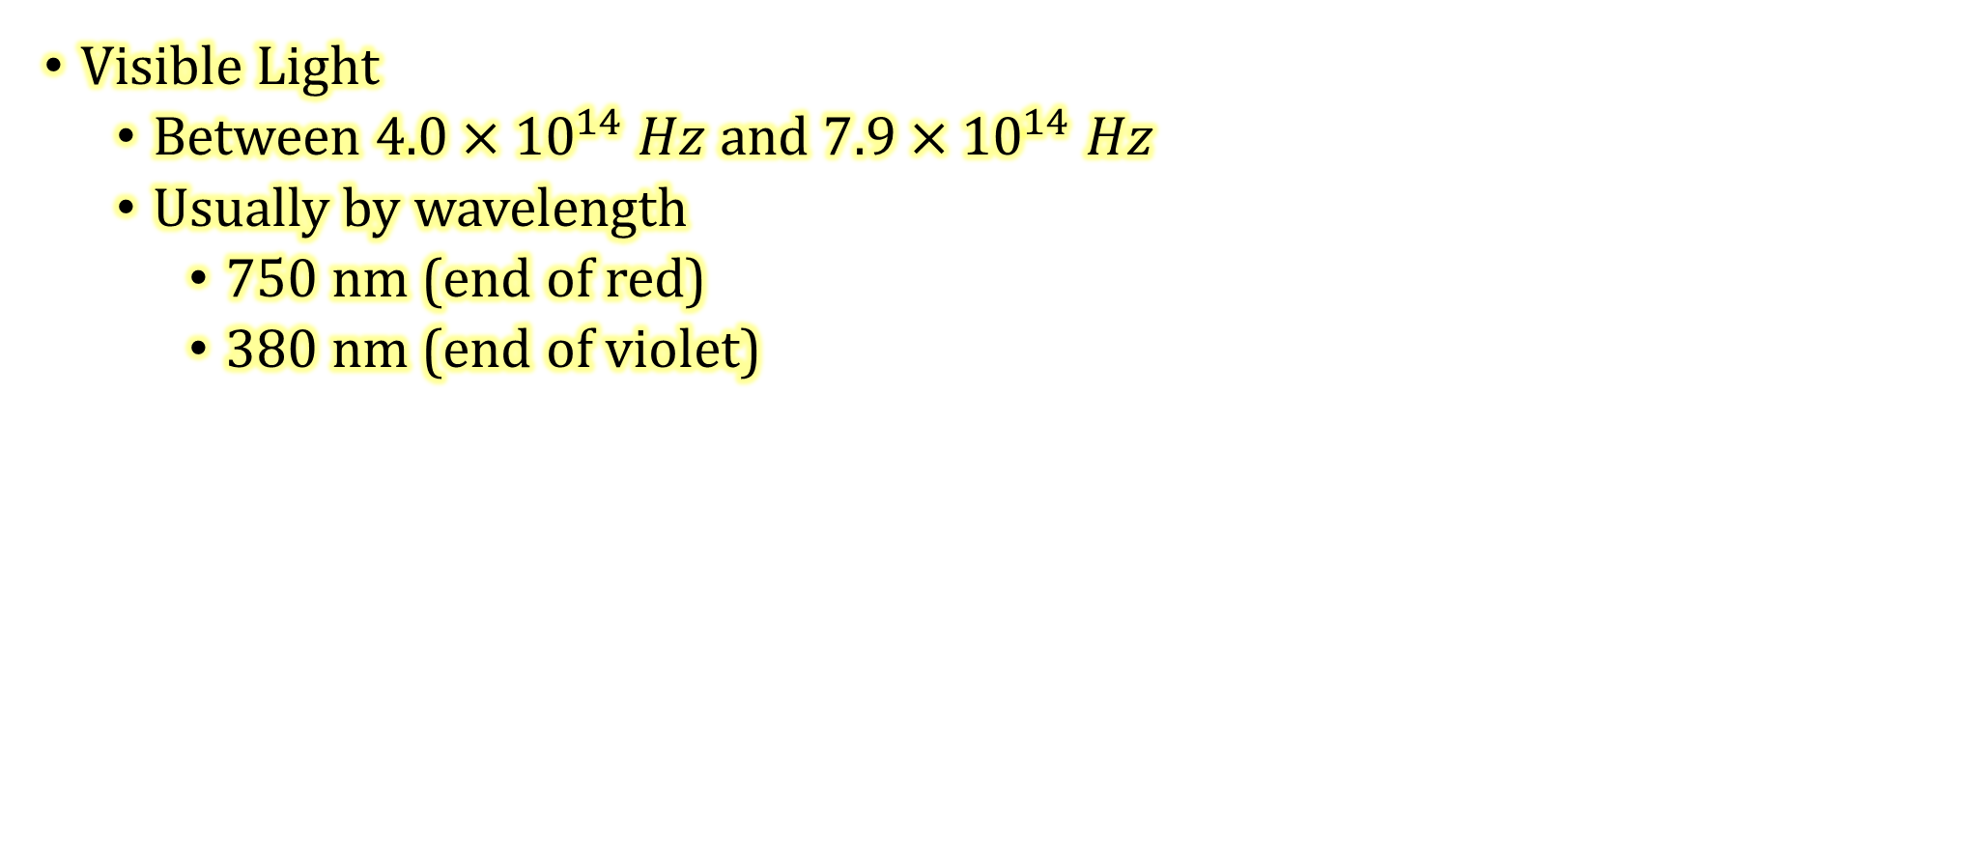
11-01 Electromagnetic Spectrum and Behavior
Visible Light
  Between $4.0×{10}^{14} Hz$ and $7.9×{10}^{14} Hz$
  Usually by wavelength
    750 nm (end of red)
    380 nm (end of violet)

Slide 13
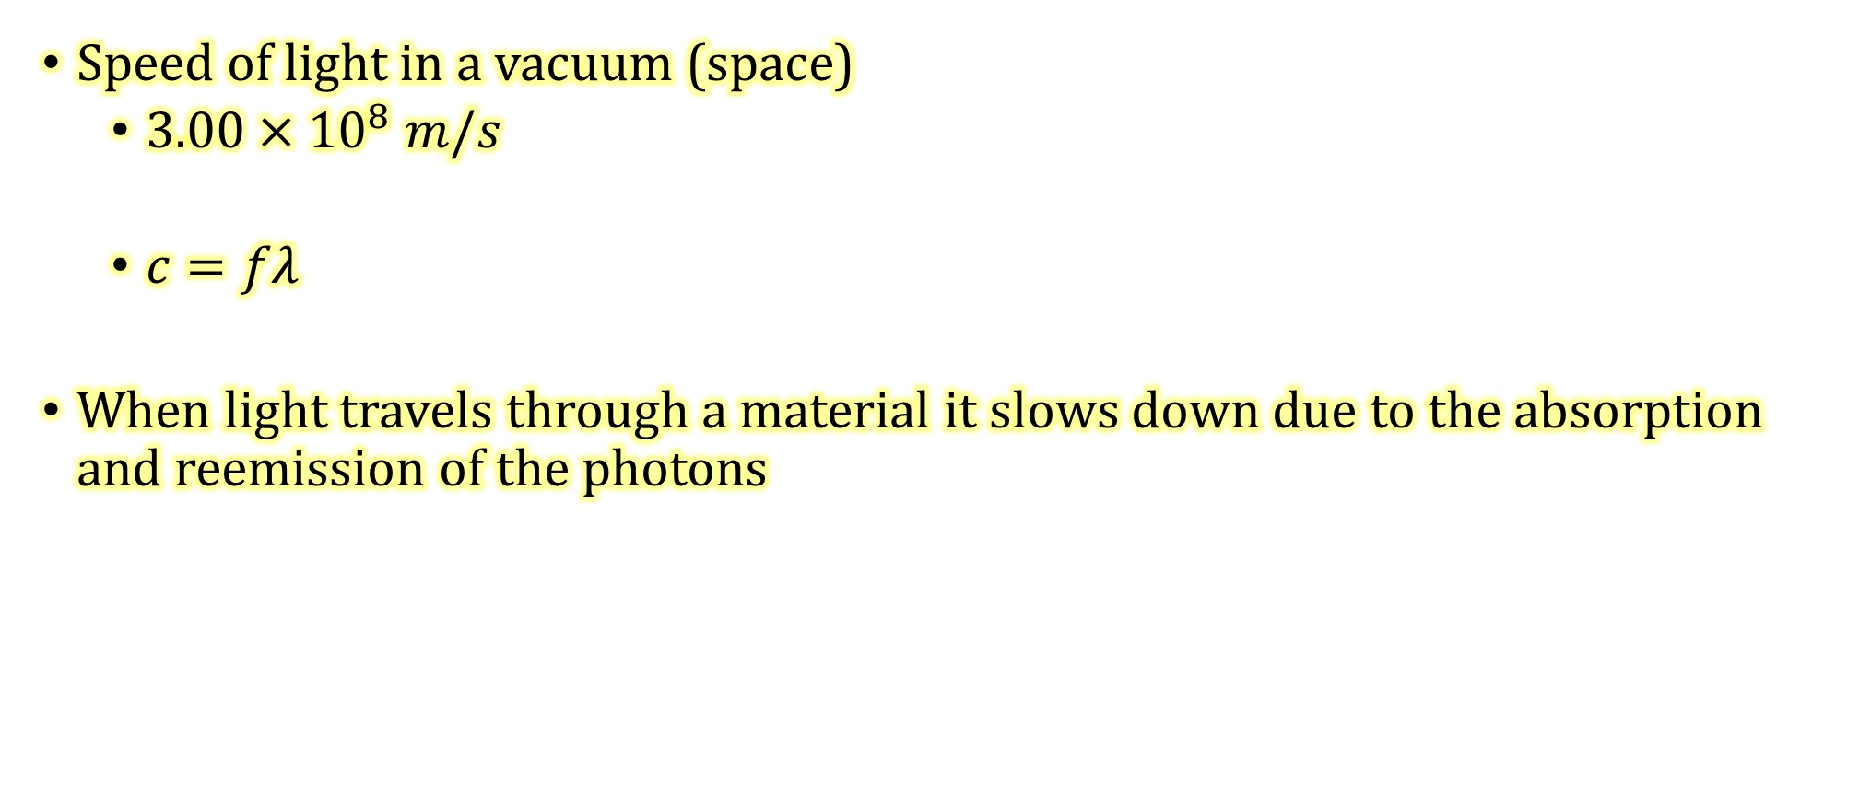
11-01 Electromagnetic Spectrum and Behavior
Speed of light in a vacuum (space)
  $3.00×{10}^{8} m/s$
  $c=fλ$
When light travels through a material it slows down due to the absorption and reemission of the photons

Slide 14
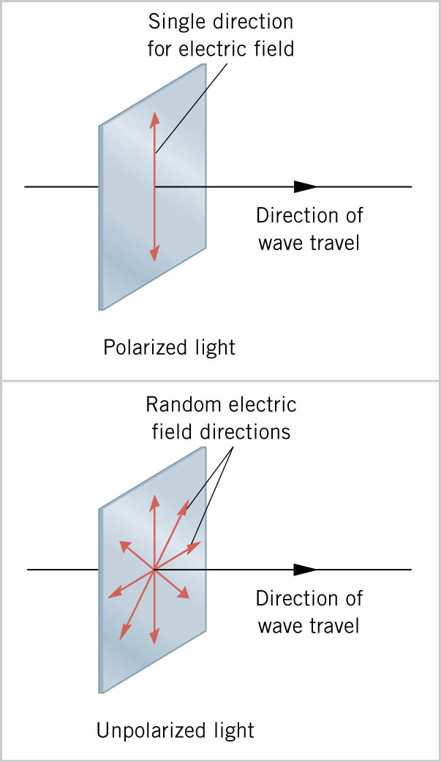
11-01 Electromagnetic Spectrum and Behavior
Linearly polarized light vibrates in only one direction
Common non-polarized light vibrates in all directions perpendicular to the direction of travel.

Slide 15
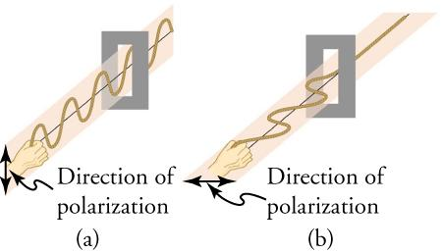
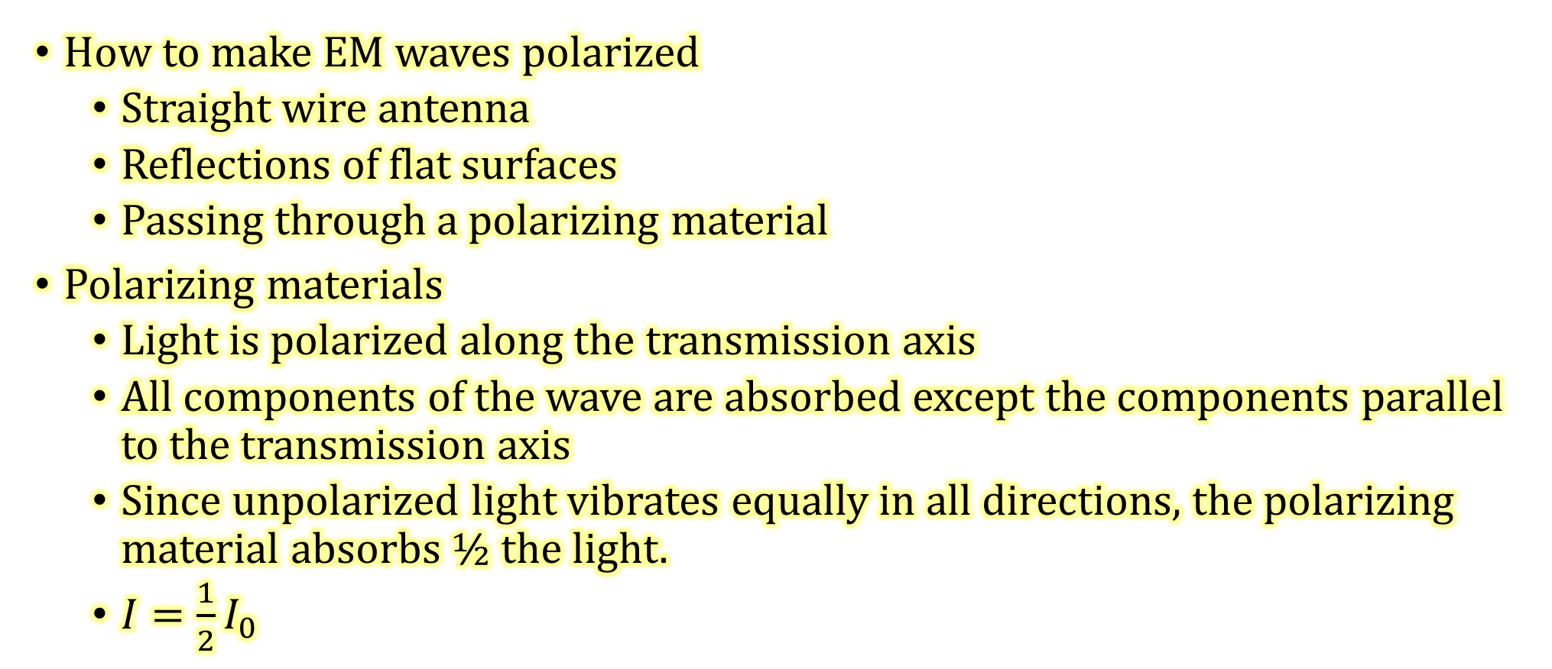
11-01 Electromagnetic Spectrum and Behavior
How to make EM waves polarized
  Straight wire antenna
  Reflections of flat surfaces
  Passing through a polarizing material
Polarizing materials
  Light is polarized along the transmission axis
  All components of the wave are absorbed except the components parallel to the transmission axis
  Since unpolarized light vibrates equally in all directions, the polarizing material absorbs ½ the light.
  $I=\frac{1}{2}I_{0}$
Notes:
Have some polarizing filters
I = intensity of light

Slide 16
11-01 Electromagnetic Spectrum and Behavior
Uses of polarization
  Sunglasses
    Automatically cuts light intensity in half
    Often the sunlight is reflected off of flat surfaces like water, roads, car windshields, etc. With the correct polarization, the sunglasses can eliminate most of those waves.
  3-D movies
    Cameras are side-by-side.
    The movies is projected by two projectors side by side, but polarized at 90°.
    The audience wears glasses that have the same polarization so the right eye only sees the right camera and the left eye only sees the left camera.
  LCD
    Voltage changes the direction of the LCD polarization. The pixels turned on are transmitted (parallel), the pixel turned off are not transmitted (perpendicular).

Slide 17
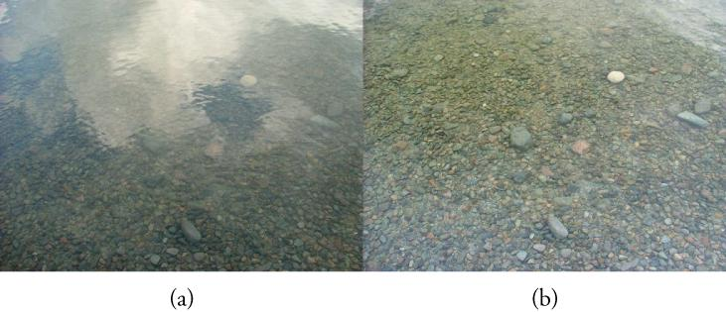
11-01 Electromagnetic Spectrum and Behavior
Polarizing filter on a camera can removed the reflected polarized light glare.
(a) without polarizing filter (b) with polarizing filter

Slide 18
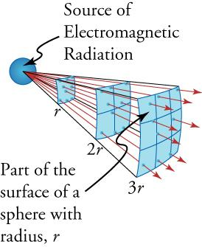
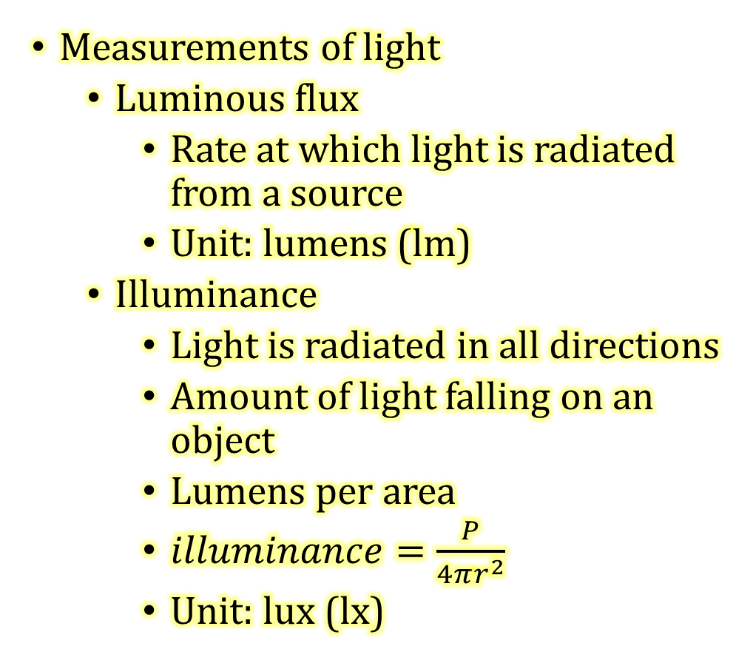
11-01 Electromagnetic Spectrum and Behavior
Measurements of light
  Luminous flux
    Rate at which light is radiated from a source
    Unit: lumens (lm)
  Illuminance
    Light is radiated in all directions
    Amount of light falling on an object
    Lumens per area
    $illuminance=\frac{P}{4πr^{2}}$
    Unit: lux (lx)

Slide 19
11-01 Practice Work
Let your light shine before others, that they may see your good deeds and glorify your Father in heaven.
- Matthew 5:16
Read
  OpenStax College Physics 2e 25.1-25.2, 25.7
  OR
  OpenStax High School Physics 16.1

Slide 20
11-02 Reflection
In this lesson you will…
Use the law of reflection with plane mirrors.
Use spherical mirrors.
Use the mirror equation.
Notes:
OpenStax High School Physics 16.1
OpenStax College Physics 2e 25.1-25.2, 25.7

Slide 21
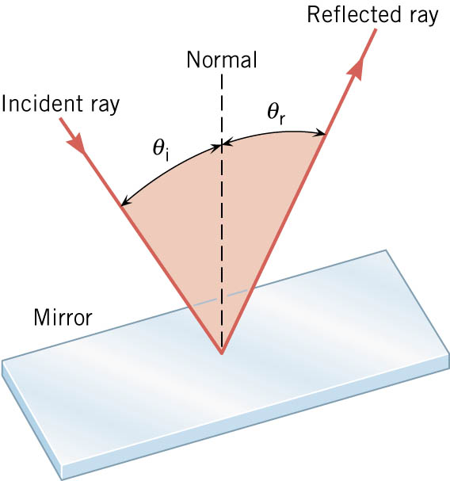
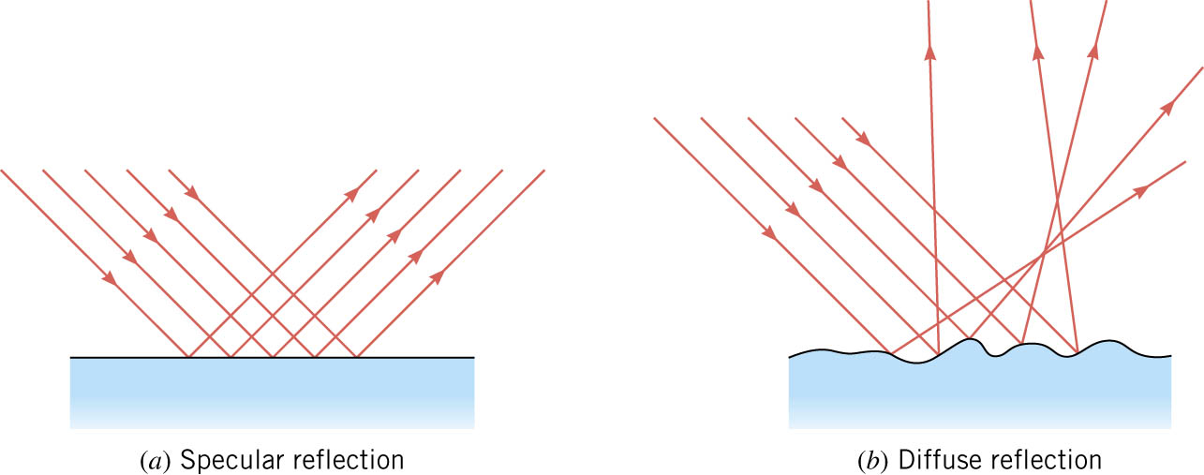
11-02 Reflection
Law of Reflection: θ_{r} = θ_{i}
Specular Reflection
  Parallel light rays are reflected parallelly
Diffuse Reflection
  Parallel light rays are scattered by irregularities in the surface.

Slide 22
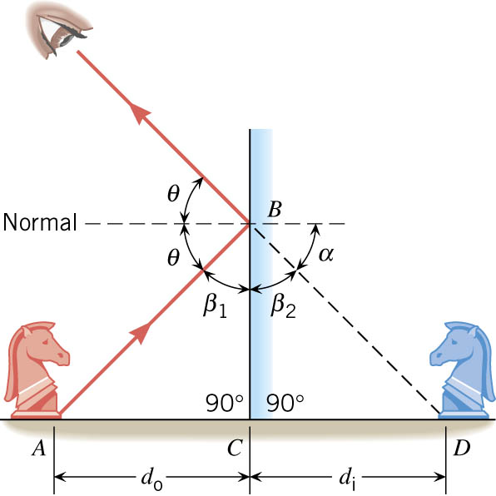
11-02 Reflection
Plane Mirror
Image is upright
Image is same size
Image is located as far behind the mirror as you are in front of it

Slide 23
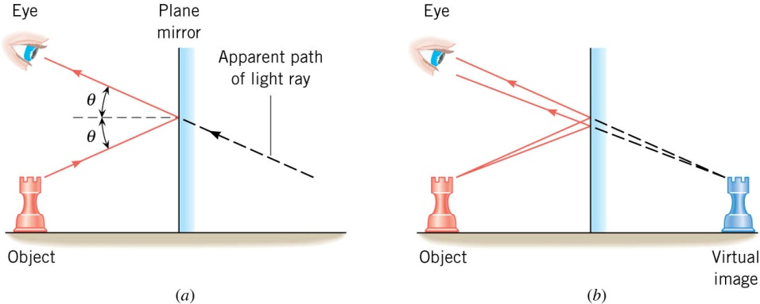
11-02 Reflection
Since light rays appear to come from behind mirror, the image is called a virtual image.
If light rays appear to come from a real location, the image is called a real image.
  Real images can be projected on a screen, virtual images cannot.
Plane mirrors only produce virtual images.

Slide 24
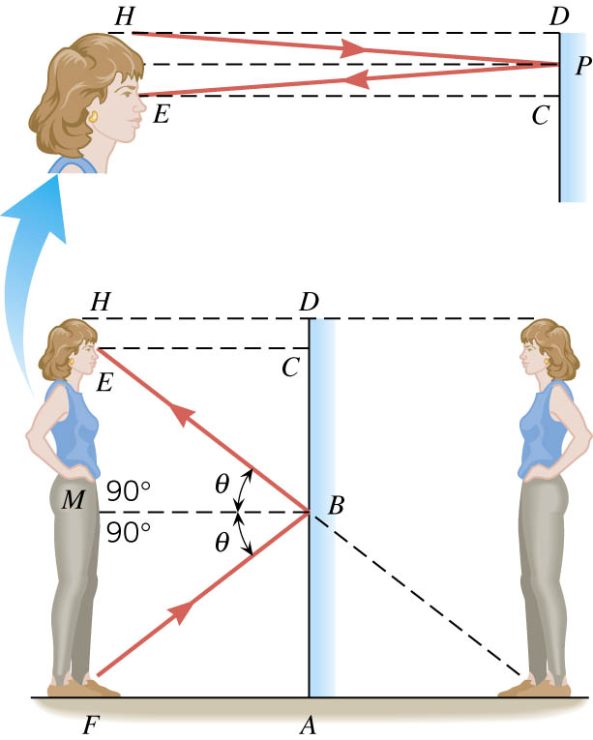
11-02 Reflection
How long must a plane mirror be to see your whole reflection?
From halfway between your eyes and floor to halfway between your eyes and the top of your head.

Slide 25
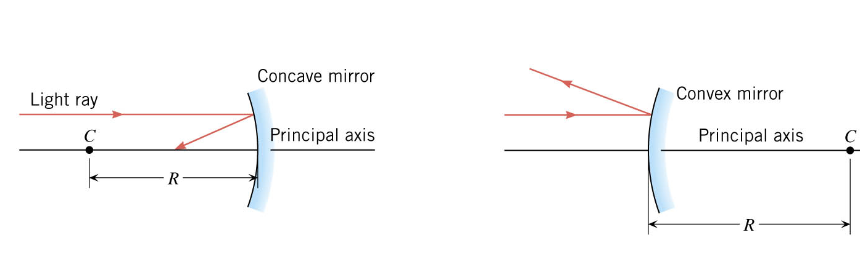
11-02 Reflection
Spherical Mirrors
Concave: bends in
Convex: bends out
Notes:
Remember concave because it makes a small cave

Slide 26
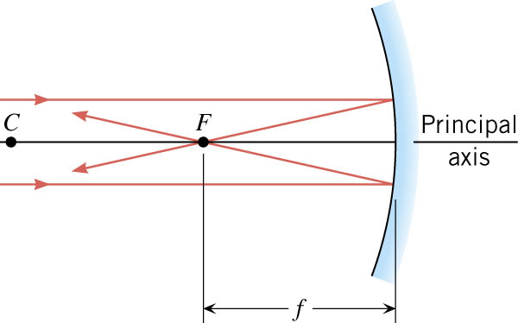
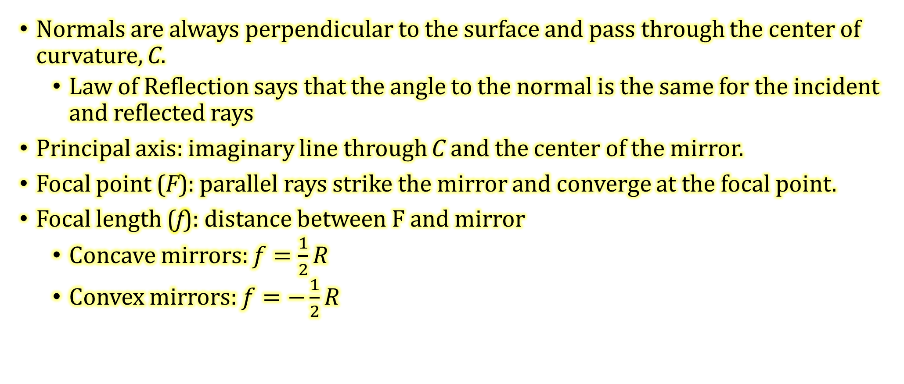
11-02 Reflection
Normals are always perpendicular to the surface and pass through the center of curvature, C.
  Law of Reflection says that the angle to the normal is the same for the incident and reflected rays
Principal axis: imaginary line through C and the center of the mirror.
Focal point (F): parallel rays strike the mirror and converge at the focal point.
Focal length (f): distance between F and mirror
  Concave mirrors: $f=\frac{1}{2}R$
  Convex mirrors: $f=−\frac{1}{2}R$
Notes:
R = radius of curvature

Slide 27
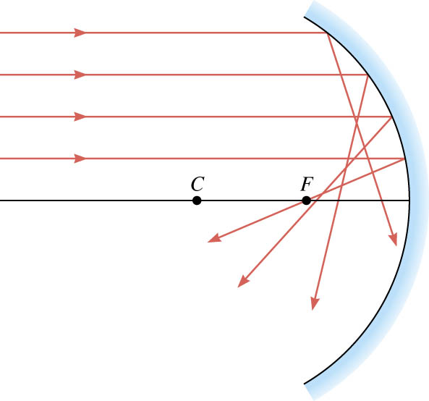
11-02 Reflection
Spherical aberration
  Rays far from the principal axis actually cross between F and the mirror.
  Fix this by using a parabolic mirror.

Slide 28
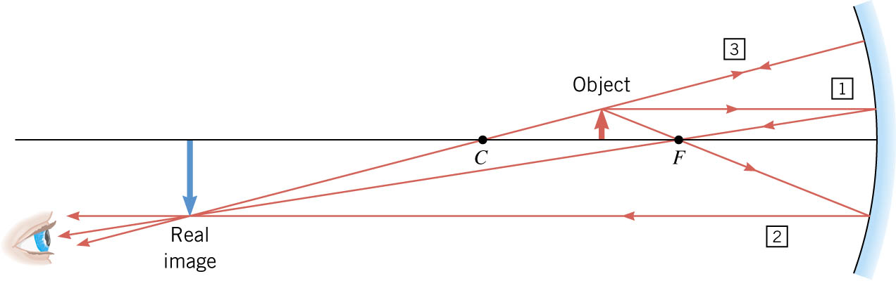
11-02 Reflection
Ray tracing diagram: Diagram used to find the location and type of image produced.
Notice the rays start at the top of the object.

Slide 29
11-02 Reflection
Concave Mirror
  Ray 1 – Parallel to principal axis, strikes mirror and reflects through F
  Ray 2 – Through F, strikes mirror and reflects parallel to principal axis
  Ray 3 – Through C, strikes mirror and reflects back through C
  Object beyond C – image is real, inverted and smaller between C and F
Object
C
F
Image
Notes:
Like a telescope

Slide 30
11-02 Reflection
Object between C and F
Image inverted, real, and larger beyond C
Image
C
Object
F
Notes:
Like a projector

Slide 31
11-02 Reflection
Object between F and mirror
Image upright, virtual, larger behind mirror
C
F
Object
Image
Notes:
Like a makeup mirror

Slide 32
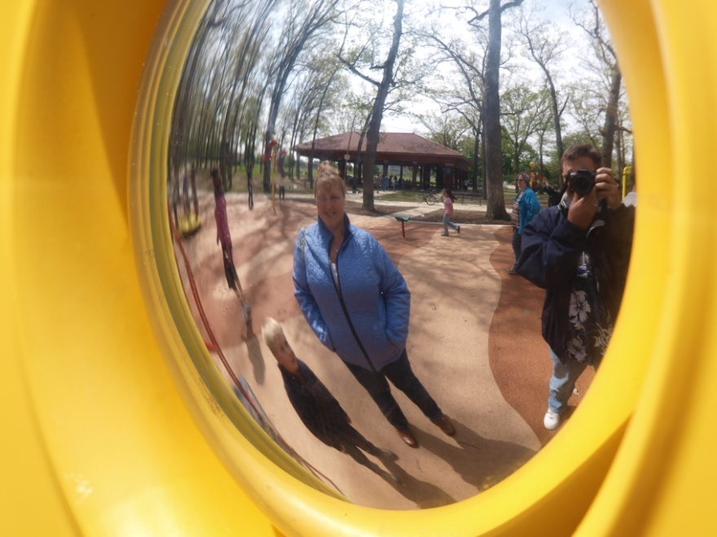
11-02 Reflection
Convex Mirrors
Image upright, virtual, smaller behind mirror between F and mirror
Object
Image
F
C
Notes:
Like passenger side view mirror

Slide 33
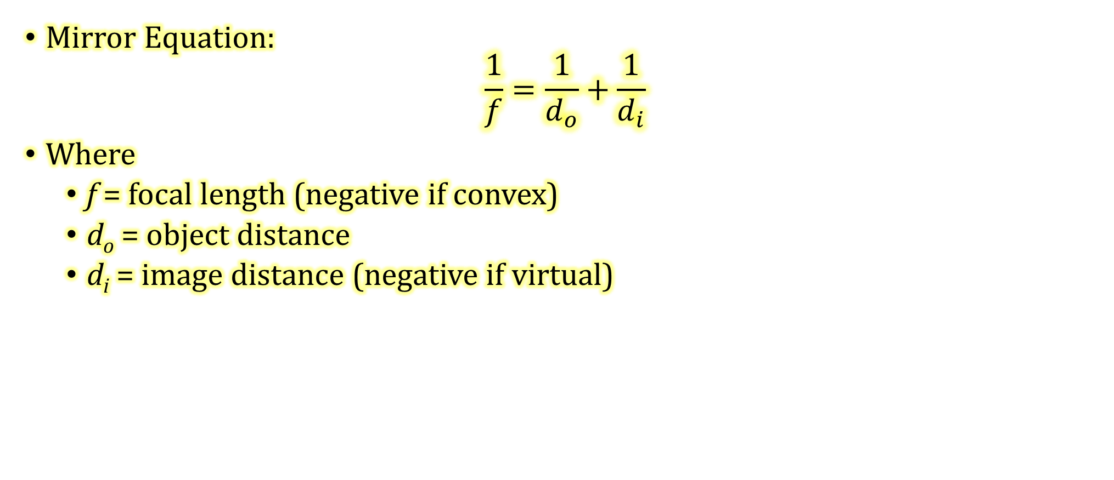
11-02 Reflection
Mirror Equation:
$$\frac{1}{f}=\frac{1}{d_{o}}+\frac{1}{d_{i}}$$
Where
  f = focal length (negative if convex)
  d_{o} = object distance
  d_{i} = image distance (negative if virtual)
Notes:
f= distance between F and mirror
d₀ = distance between object and mirror
d_{i} = distance between image and mirror
These were discovered through the use of geometry and similar triangles.

Slide 34
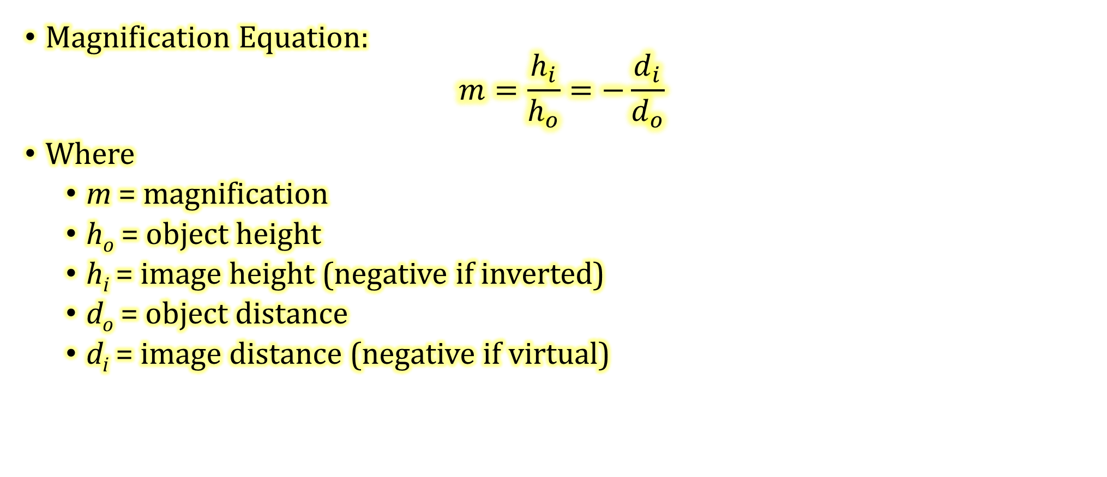
11-02 Reflection
Magnification Equation:
$$m=\frac{h_{i}}{h_{o}}=−\frac{d_{i}}{d_{o}}$$
Where
  m = magnification
  h_{o} = object height
  h_{i} = image height (negative if inverted)
  d_{o} = object distance
  d_{i} = image distance (negative if virtual)

Slide 35
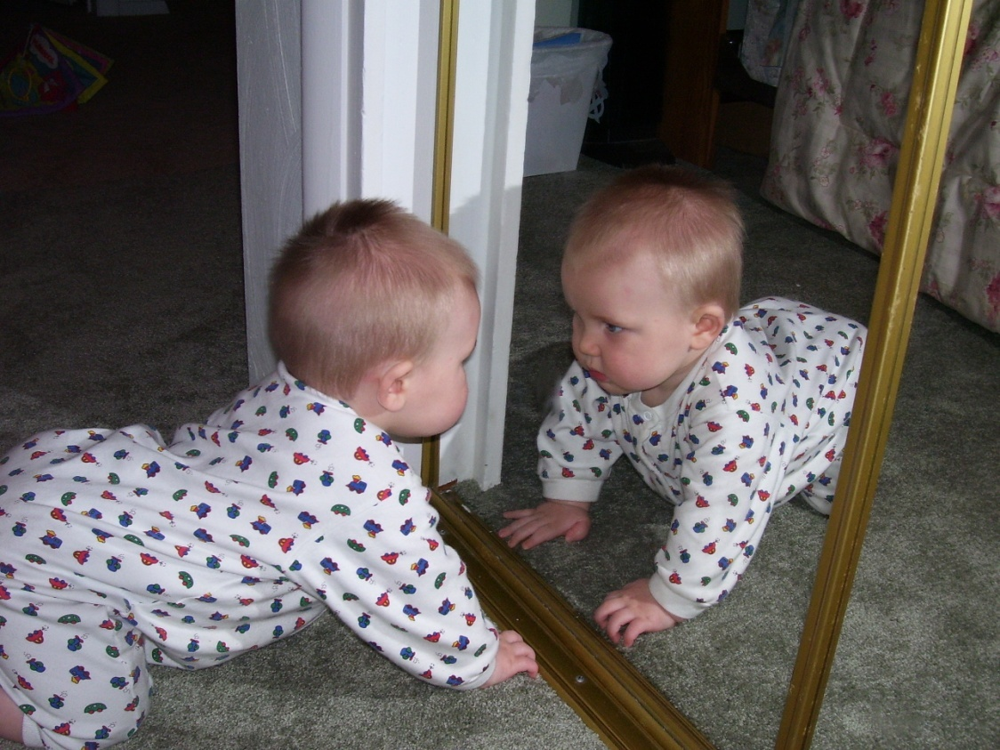
11-02 Reflection
A 0.5-m high toddler is playing 10 m in front of a concave mirror with radius of curvature of 7 m.
  What is the location of his image?
    d_{i} = 5.38 m
  What is the height of his image?
    h_{i} = −0.269 m
Notes:
$$f=\frac{1}{2}R=\frac{1}{2}(7 m)=3.5 m$$
$$\frac{1}{f}=\frac{1}{d_{o}}+\frac{1}{d_{i}}→\frac{1}{3.5}=\frac{1}{10}+\frac{1}{d_{i}}→\frac{1}{3.5}−\frac{1}{10}=\frac{1}{d_{i}}→\frac{1}{d_{i}}=0.1857→d_{i}=5.38 m$$
$$m = −\frac{d_{i}}{d_{o}} =\frac{h_{i}}{h_{o}}→ −\frac{5.38}{10}=\frac{h_{i}}{0.5}→h_{i}=−0.269m$$

Slide 36
11-02 Reflection
A 0.5-m high toddler is playing 10 m in front of a convex mirror with radius of curvature of 7 m.
  What is the location of his image?
    d_{i} = -2.59 m
  What is the height of his image?
    h_{i} = 0.130 m
Notes:
$$f=−\frac{1}{2}R=−\frac{1}{2}(7 m)=−3.5 m$$
$$\frac{1}{f}=\frac{1}{d_{o}}+\frac{1}{d_{i}}→\frac{1}{−3.5}=\frac{1}{10}+\frac{1}{d_{i}}→\frac{1}{−3.5}−\frac{1}{10}=\frac{1}{d_{i}}→\frac{1}{d_{i}}=−0.3857→d_{i}=−2.59 m$$
$$m=−\frac{d_{i}}{d_{o}}=\frac{h_{i}}{h_{o}}→\frac{2.59}{10}=\frac{h_{i}}{0.5}→h_{i}=0.130 m$$

Slide 37
11-02 Practice Work
Let your life reflect the love of God to others.
Read
  OpenStax College Physics 2e 25.3-25.5
  OR
  OpenStax High School Physics 16.2

Slide 38
11-03 Refraction
In this lesson you will…
Use the Snell’s Law of Refraction.
Understand internal reflection and its uses.
Explain how dispersion creates a rainbow.
Notes:
OpenStax High School Physics 16.2
OpenStax College Physics 2e 25.3-25.5

Slide 39
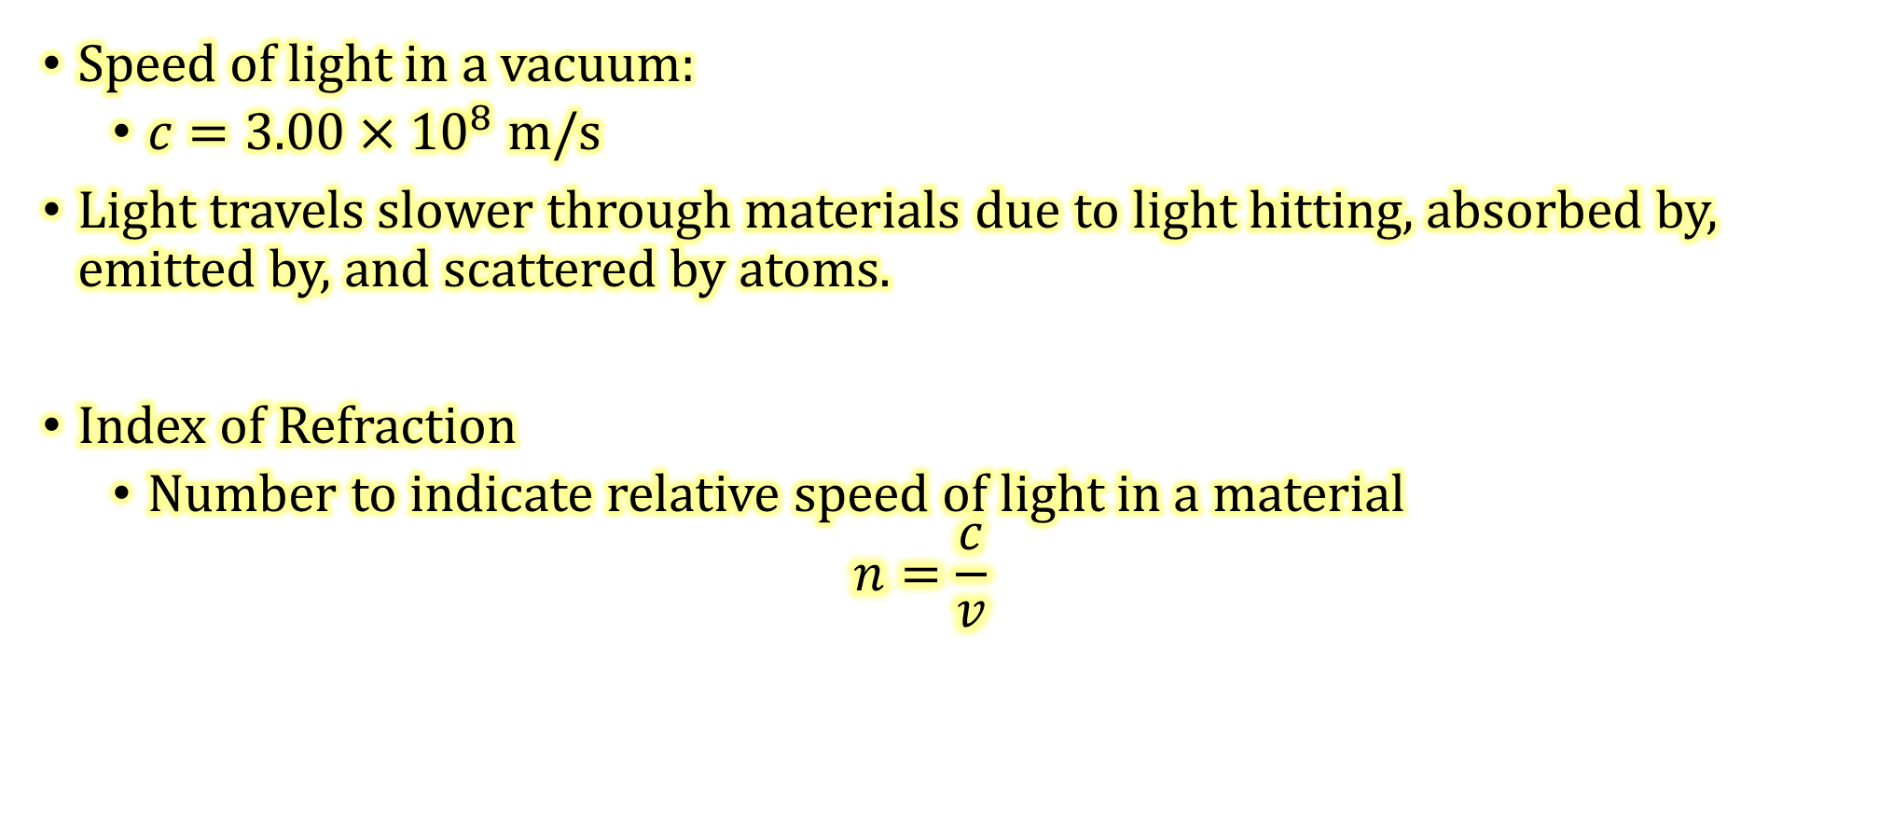
11-03 Refraction
Speed of light in a vacuum:
  $c=3.00×{10}^{8}$ m/s
Light travels slower through materials due to light hitting, absorbed by, emitted by, and scattered by atoms.
Index of Refraction
  Number to indicate relative speed of light in a material
  $$n=\frac{c}{v}$$
Notes:
n = index of refraction
c = speed of light in vacuum
v = speed of light in material

Slide 40
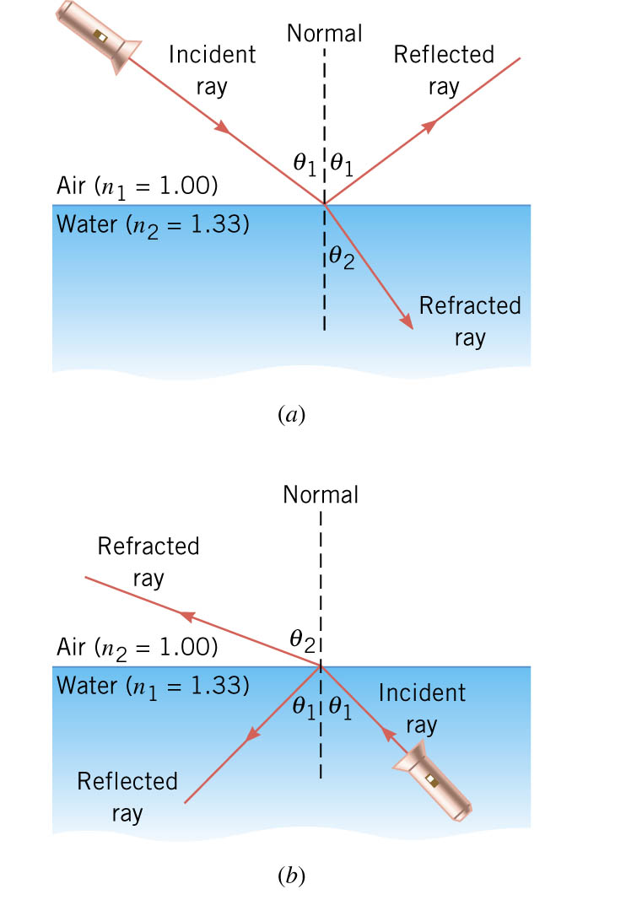
11-03 Refraction
When light hits the surface of a material part of it is reflected
The other part goes into the material
The transmitted part is bent (refracted)

Slide 41
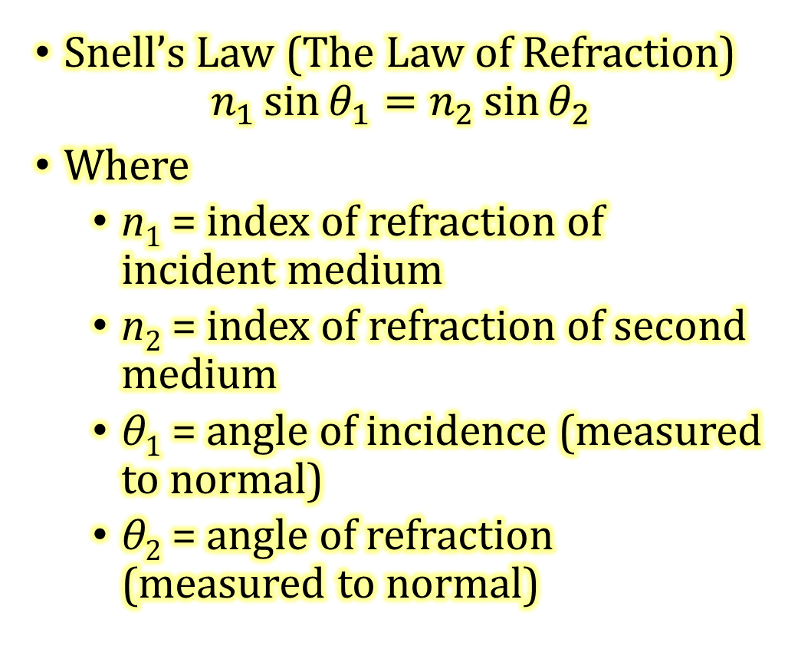
11-03 Refraction
Snell’s Law (The Law of Refraction)
$$n_{1}\sin{θ_{1}}=n_{2}\sin{θ_{2}}$$
Where
  n₁ = index of refraction of incident medium
  n₂ = index of refraction of second medium
  θ₁ = angle of incidence (measured to normal)
  θ₂ = angle of refraction (measured to normal)
Notes:
To go from less optically dense to more optically dense, the ray is bent towards normal.
To go from more optically dense to less optically dense, the ray is bent away from the normal.
When the light goes from one material to another, it bends towards the slower material.

Slide 42
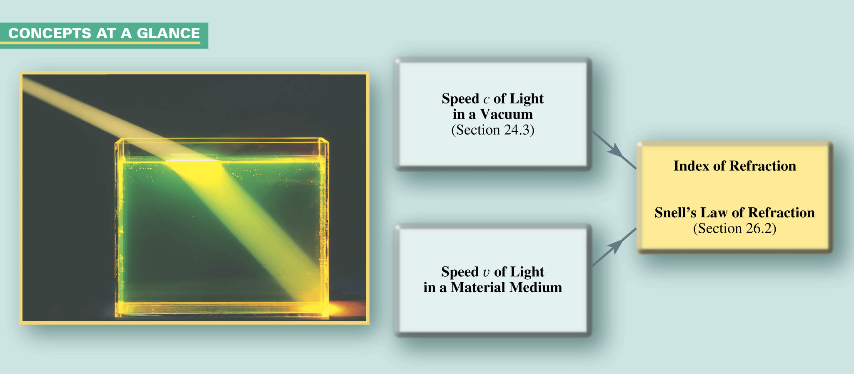
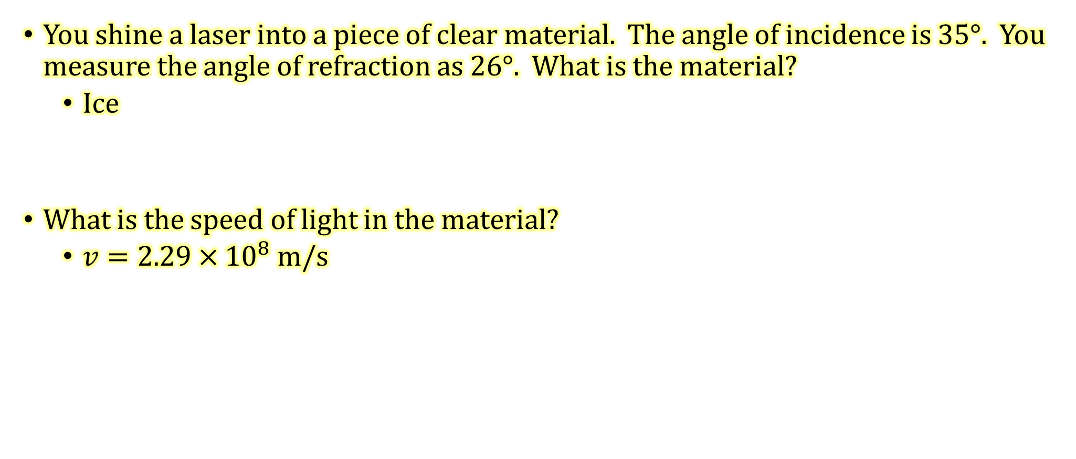
11-03 Refraction
You shine a laser into a piece of clear material. The angle of incidence is 35°. You measure the angle of refraction as 26°. What is the material?
  Ice
What is the speed of light in the material?
  $v=2.29×{10}^{8}$ m/s
Notes:
$$n_{1}\sin{θ_{1}}= n_{2}\sin{θ_{2}}$$
$$1.00\sin{35°}=n\sin{26°}→n=1.308$$
$$Table says this should be ice.$$
$$n=\frac{c}{v}→1.308=\frac{3.00×{10}^{8}\frac{m}{s}}{v}→v=2.29×{10}^{8} m/s$$

Slide 43
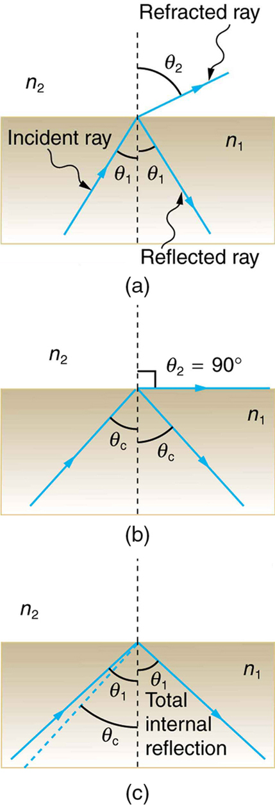
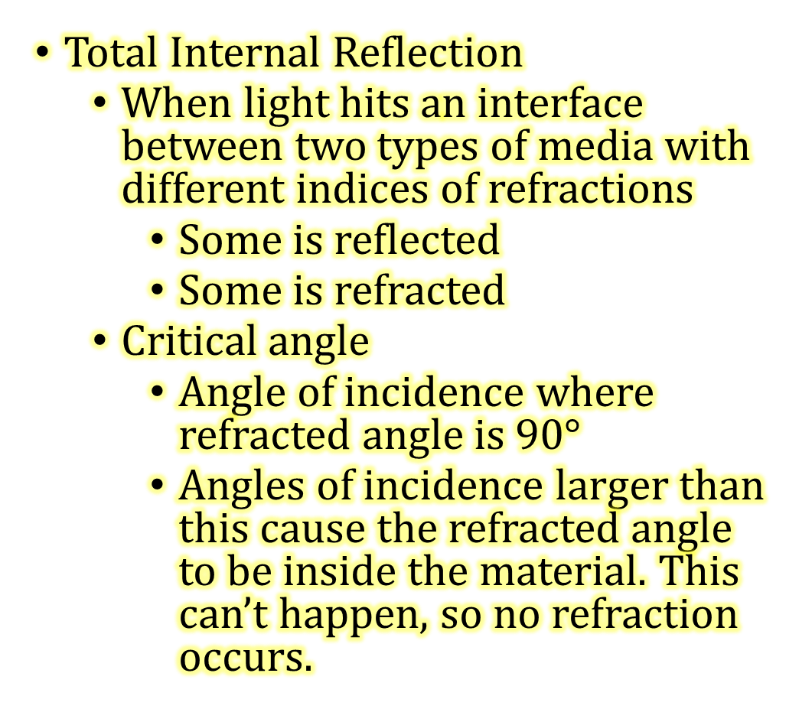
11-03 Refraction
Total Internal Reflection
  When light hits an interface between two types of media with different indices of refractions
    Some is reflected
    Some is refracted
  Critical angle
    Angle of incidence where refracted angle is 90$°$
    Angles of incidence larger than this cause the refracted angle to be inside the material. This can’t happen, so no refraction occurs.

Slide 44

11-03 Refraction
Critical angle
  $θ_{2}=90°$
  $n_{1}\sin{θ_{1}}=n_{2}\sin{θ_{2}}$
  $n_{1}\sin{θ_{c}}=n_{2}\sin{90°}$
  $θ_{c}=\sin^{−1}{\frac{n_{2}}{n_{1}}}$
    Where $n_{1}>n_{2}$

Slide 45

11-03 Refraction
What is the critical angle from cubic zirconia (n=2.16) to air? Will an angle of $25°$ produce total internal reflection?
27.7$°$
No
Notes:
$$θ_{c}=\sin^{−1}{\frac{n_{2}}{n_{1}}}$$
$$θ_{c}=\sin^{−1}{\frac{1.000293}{2.15}}$$
$$θ_{c}=27.7°$$

Slide 46
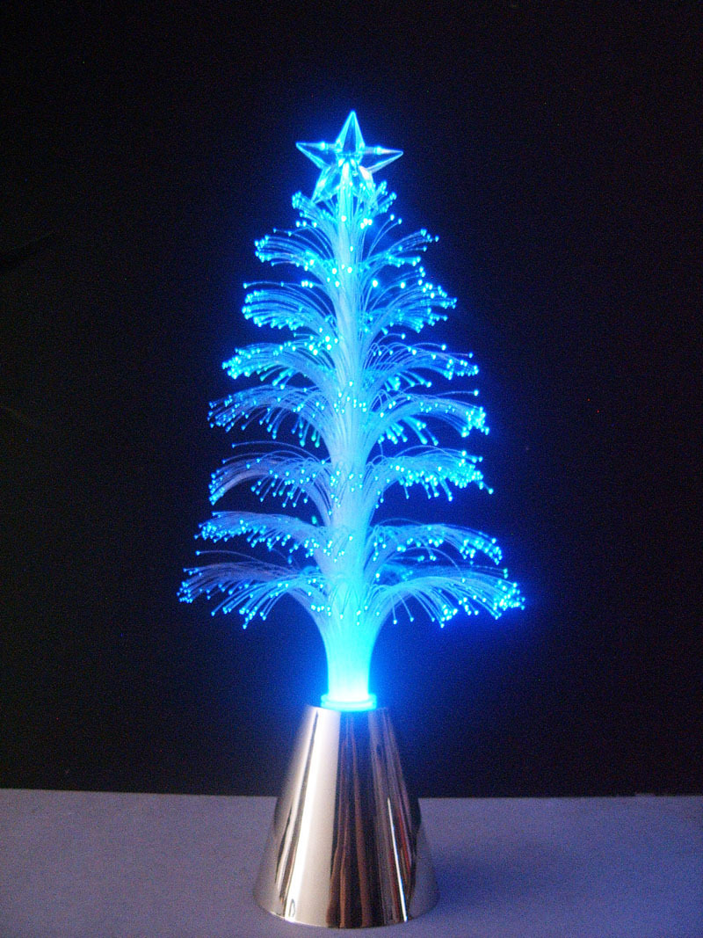
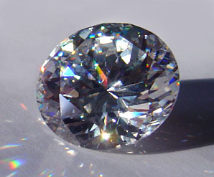
11-03 Refraction
Uses of total internal reflection
  Fiber optics for
    Endoscopes
    Telecommunications
    Decorations
  Binoculars/telescopes
    Makes them shorter
  Reflectors
  Gemstones
    Cut so that light only exits at certain places

Slide 47
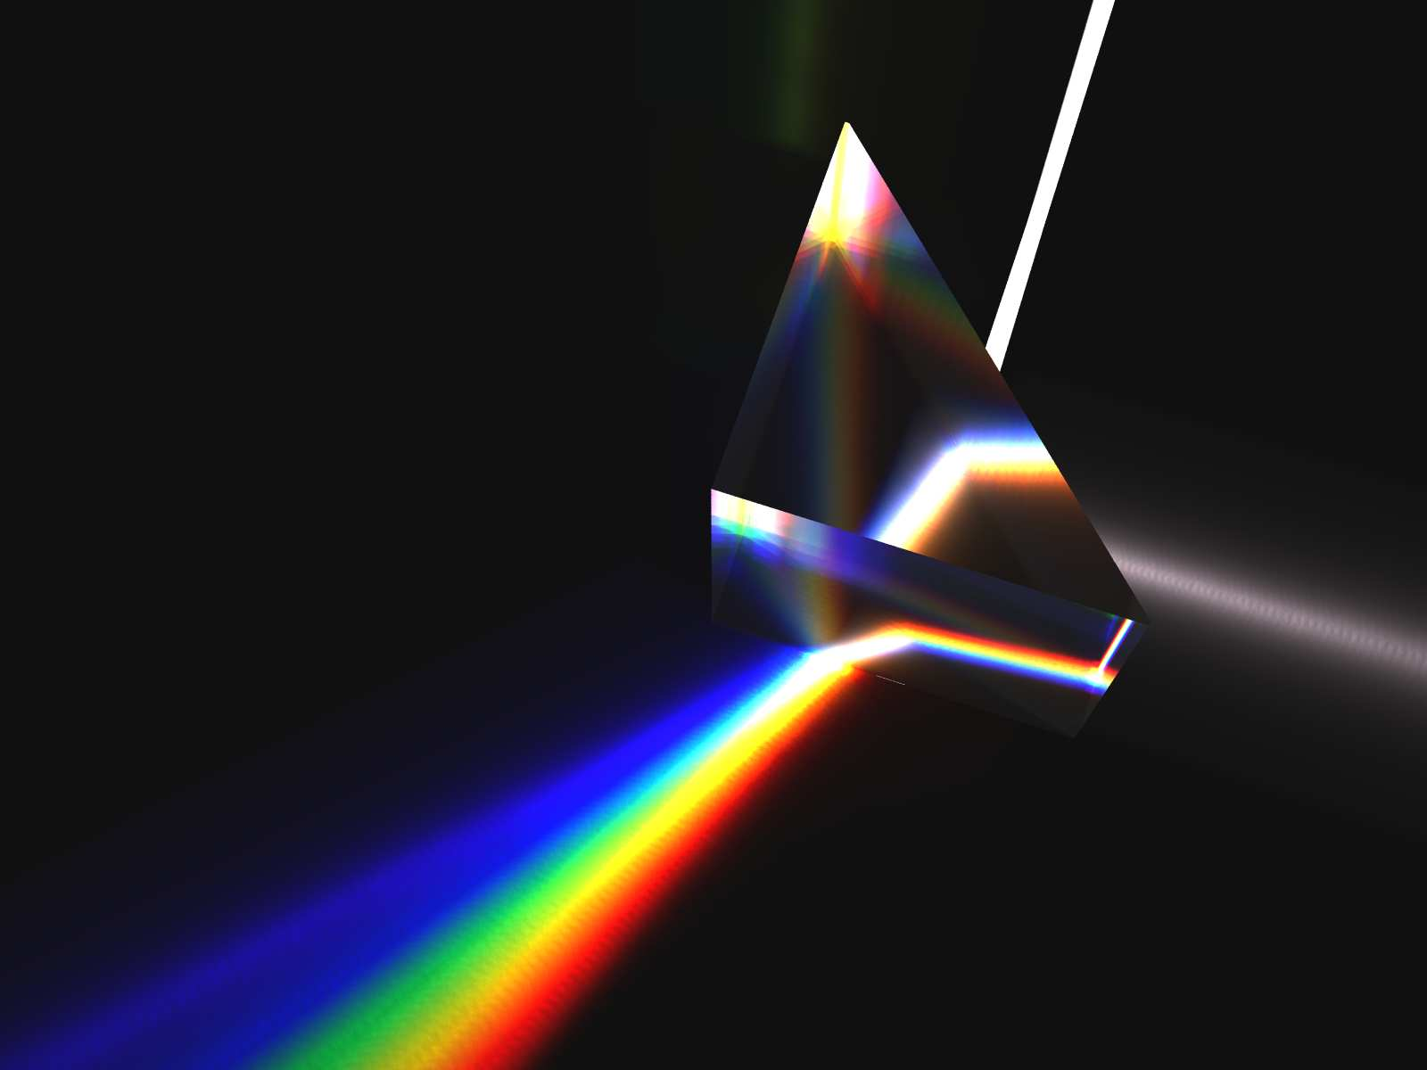
11-03 Refraction
Dispersion
  Each wavelength of light has a different index of refraction
  Red — lowest
  Violet — highest
  When light is refracted, the violet bends more than red, which splits the colors

Slide 48
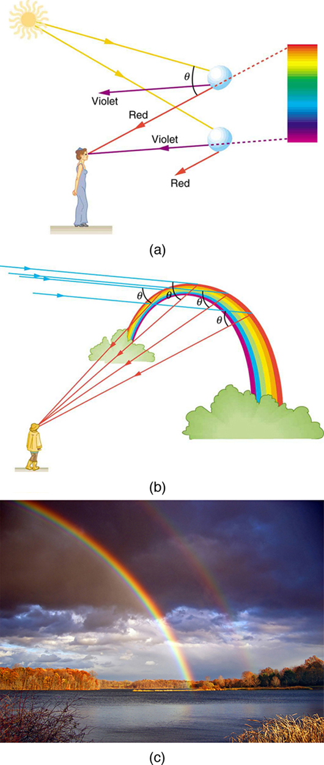
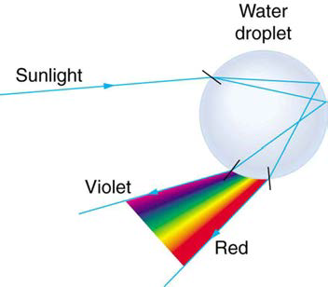
11-03 Refraction
Rainbows
  Dispersion by refraction with internal reflection

Slide 49


Slide 50
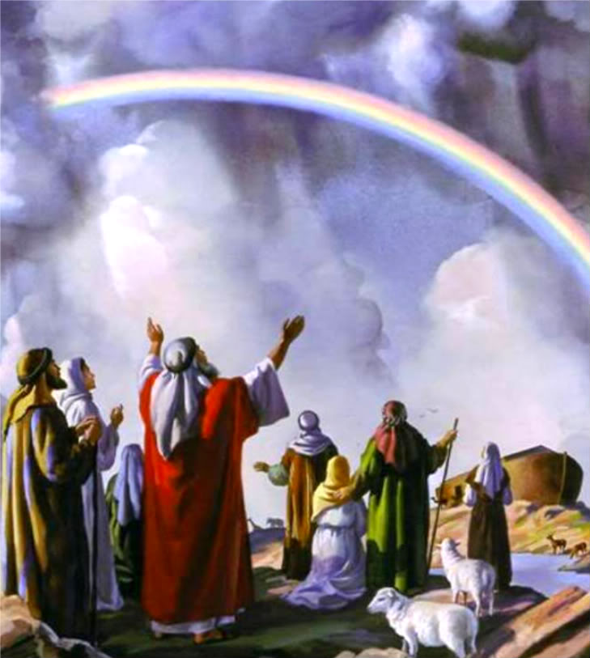
11-03 Practice Work
“I have set my rainbow in the clouds, and it will be the sign of the covenant between me and the earth.” Genesis 9:13
Read
  OpenStax College Physics 2e 25.6
  OR
  OpenStax High School Physics 16.3

Slide 51
11-04 Lenses
In this lesson you will…
Use lenses to describe an image.
Use the thin-lens equation.
Explain how the eye works.
Notes:
OpenStax High School Physics 16.3
OpenStax College Physics 2e 25.6, 26.1-26.3

Slide 52
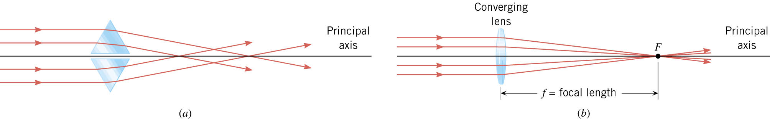
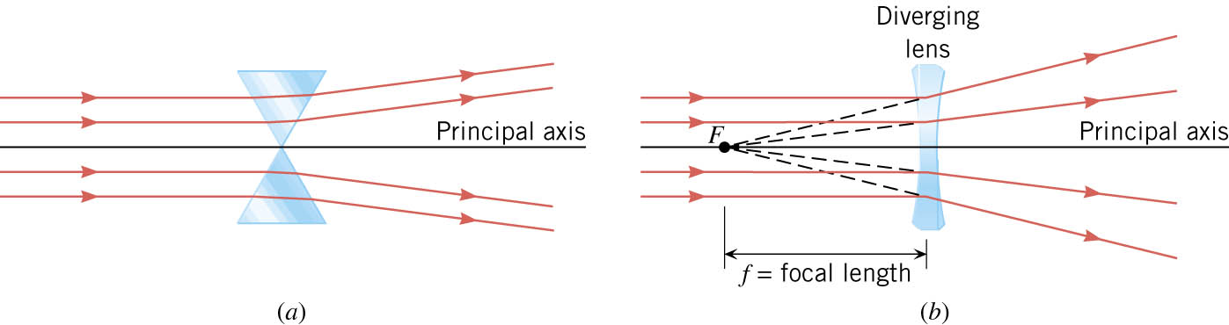
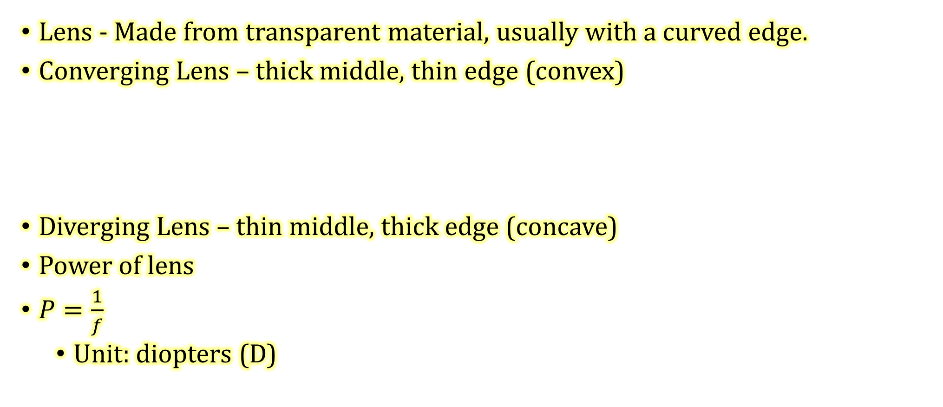
11-04 Lenses
Lens - Made from transparent material, usually with a curved edge.
Converging Lens – thick middle, thin edge (convex)
Diverging Lens – thin middle, thick edge (concave)
Power of lens
$P=\frac{1}{f}$
  Unit: diopters (D)

Slide 53
11-04 Lenses
Ray Diagrams - Converging Lenses
  Ray 1 – Parallel to principal axis, bends through F
  Ray 2 – Through F, bends parallel to principal axis
  Ray 3 – Goes through center of lens, does not bend
  Object beyond 2F,
  Image inverted, real, smaller between F and 2F
Object
2F
F
F
2F
Image
Notes:
Like camera

Slide 54
11-04 Lenses
Object between 2F and F
Image real, inverted, larger beyond 2F
Image
2F
F
F
2F
Object
Notes:
projector

Slide 55
11-04 Lenses
Object between F and lens
Image virtual, upright, between 2F and F on side with object
2F
F
F
2F
Image
Object
Notes:
Like magnifying glass

Slide 56
11-04 Lenses
Ray 1 now bends away from axis so that it looks like it came from F
Ray 2 starts by aiming at far F
Ray 3 same as before
Diverging Lens
Image virtual, upright, smaller between F and lens
2F
Object
F
Image
F
2F
Notes:
Ray 1 now bends away from axis so that it looks like it came from F
Ray 2 starts by aiming at far F
Ray 3 same as before
Like some glasses

Slide 57
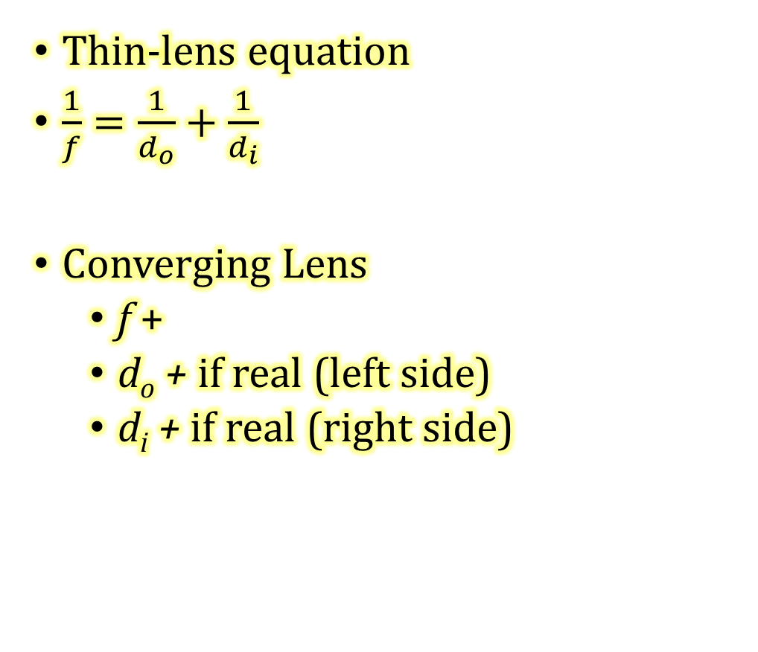
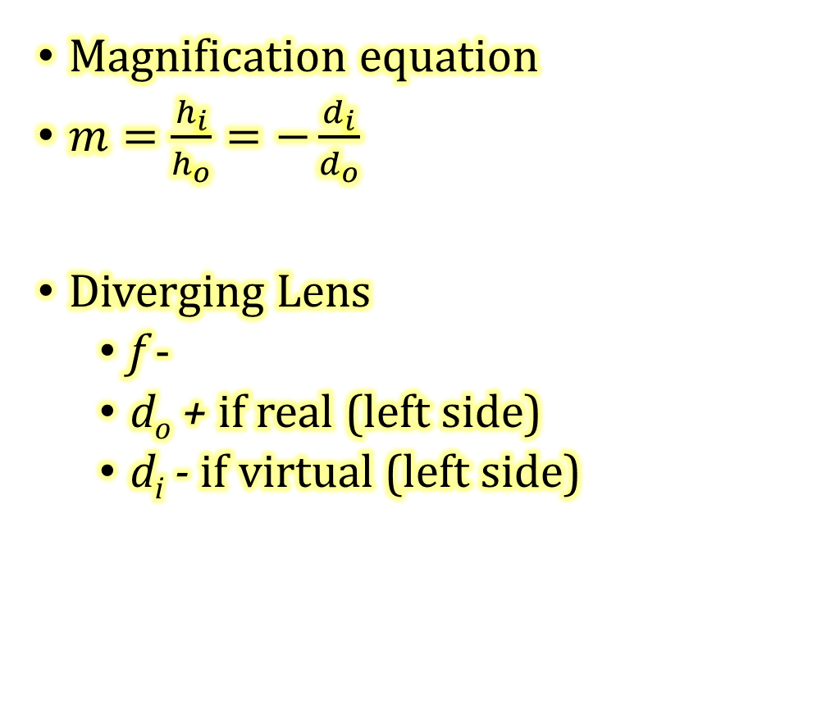
11-04 Lenses
Thin-lens equation
$\frac{1}{f}=\frac{1}{d_{o}}+\frac{1}{d_{i}}$
Converging Lens
  f +
  d_{o} + if real (left side)
  d_{i} + if real (right side)
Magnification equation
$m=\frac{h_{i}}{h_{o}}=−\frac{d_{i}}{d_{o}}$
Diverging Lens
  f -
  d_{o} + if real (left side)
  d_{i} - if virtual (left side)
Notes:
Lenses can be put in combination where a real image from the first lens is the object of the second lens. This is done in a microscope and telescope.
Lab idea: make a telescope or microscope on optics bench.

Slide 58
11-04 Lenses
Lens Reasoning Strategy
  Examine the situation to determine that image formation by a lens is involved.
  Determine whether ray tracing, the thin lens equations, or both are to be employed. A sketch is very useful even if ray tracing is not specifically required by the problem. Write symbols and values on the sketch.
  Identify exactly what needs to be determined in the problem (identify the unknowns).
  Make a list of what is given or can be inferred from the problem as stated (identify the knowns). It is helpful to determine whether the situation involves a case 1, 2, or 3 image. While these are just names for types of images, they have certain characteristics that can be of great use in solving problems.
  If ray tracing is required, use the ray tracing rules listed near the beginning of this section.
  Most quantitative problems require the use of the thin lens equations. These are solved in the usual manner by substituting knowns and solving for unknowns. Several worked examples serve as guides.
  Check to see if the answer is reasonable: Does it make sense? If you have identified the type of image (case 1, 2, or 3), you should assess whether your answer is consistent with the type of image, magnification, and so on.

Slide 59
11-04 Lenses
A child is playing with a pair of glasses with diverging lenses. The focal length is 20 cm from the lens and his eye is 5 cm from the lens. A parent looks at the child’s eye in the lens. If the eye is the object, where is the image located?
  4 cm behind the lens
If his eye is really 3 cm across, how big does it appear?
  h_{i} = 2.4 cm
Notes:
$$\frac{1}{f}=\frac{1}{d_{o}}+\frac{1}{d_{i}}→\frac{1}{−20 cm}=\frac{1}{5 cm}+\frac{1}{d_{i}}→\frac{1}{−20}−\frac{1}{5}=\frac{1}{d_{i}}→\frac{1}{d_{i}}=−0.25→−4 cm$$
$$\frac{h_{i}}{h_{o}}=−\frac{d_{i}}{d_{o}}→\frac{h_{i}}{3 cm}= −\frac{−4 cm}{5 cm}→h_{i} = 2.4 cm$$
This is like “Coke bottle” lenses.

Slide 60
11-04 Practice Work
Form an image in your mind of doing well.
Read
  OpenStax College Physics 2e 26.1-26.3

Slide 61
11-05 Vision
In this lesson you will…
Explain how the eye works.
Notes:
OpenStax High School Physics N/A
OpenStax College Physics 2e 26.1-26.3

Slide 62

11-05 Vision
Cornea/Lens act as single thin lens
To see something in focus the image must be on the retina at back of eye
Lens can change shape to focus objects from different object lengths

Slide 63

11-05 Vision
Near-sightedness
  Myopia
  Image in front of retina
  Correct with diverging lens
Far-sightedness
  Hyperopia
  Image behind retina
  Correct with converging lens

Slide 64


11-05 Vision
Myopia – Near-sighted
Hyperopia – Far-sighted

Slide 65
11-05 Vision
What power of spectacle lens is needed to correct the vision of a nearsighted person whose far point is 20.0 cm? Assume the spectacle (corrective) lens is held 1.50 cm away from the eye by eyeglass frames.
-5.41 D
Notes:
You want this nearsighted person to be able to see very distant objects clearly. That means the spectacle lens must produce an image 20.0 cm
from the eye for an object very far away. An image 20.0 cm from the eye will be 18.5 cm to the left of the spectacle lens (see Figure 26.6).
Therefore, we must get $d_{i}=−18.5$ cm when $d_{o}≈∞$. The image distance is negative, because it is on the same side of the spectacle as the object.
Solution
Since $d_{i}$ and $d_{o}$ are known, the power of the spectacle lens can be found using $P=\frac{1}{f}=\frac{1}{d_{o}}+\frac{1}{d_{i}}$ as written earlier:
$$P=\frac{1}{∞}+\frac{1}{−0.185}$$
Since $\frac{1}{∞}=0$ , we obtain:
$$P=0−5.405 /m=−5.41 D$$

Slide 66
11-05 Vision
Color Vision
  Photoreceptors in Eye
    Rods
      Very sensitive (see in dark)
      No color info
      Peripheral vision
    Cones
      Centered in center of retina
      Work in only in bright light
      Give color info
      Essentially three types each picking up one primary color
Notes:
Color vision is actually much more complicated
And they say this just “happened”

Slide 67

11-05 Vision
Color
  Non-light producing
    The color we see is the color that reflects off the object
    The object absorbs all the other colors
  Light-producing
    The color we see is the color produced

Slide 68

11-05 Vision
If you have normal color vision, you'll see a 42.
Red colorblind people will see a 2.
Green colorblind people will only see a 4.

Slide 69

11-05 Vision
If you have normal color vision, you see a 73 above.
If you are colorblind you will not see a number above.

Slide 70

11-05 Vision
If you have normal color vision you'll see a 74 above.
If you are red green colorblind, you'll see a 21.
If you are totally colorblind you will not see a number above.

Slide 71

11-05 Vision
If you have normal color vision you'll see a 26.
If you are red colorblind you will see a 6, if you're mildly red colorblind you'll see a faint 2 as well.
If you are green colorblind you'll see the a 2, and if you're mildly green colorblind a faint 6 as well.

Slide 72

11-05 Vision
If you have normal color vision you'll see a 12.
If you do not see 12 you are a liar. Everyone can see this one!

Slide 73
11-05 Practice Work
Isn’t it amazing how the eye works?

