Slide 1
Special Relativity
Unit 14
Notes:
Physics Unit 12

Slide 2
This Slideshow was developed to accompany the textbook
  OpenStax Physics
    Available for free at https://openstaxcollege.org/textbooks/college-physics
  By OpenStax College and Rice University
  2013 edition
Some examples and diagrams are taken from the textbook.
Slides created by
Richard Wright, Andrews Academy
rwright@andrews.edu

Slide 3
14-01 Einstein’s Postulates and Time Dilation
In this lesson you will…
• State and explain both of Einstein’s postulates.
• Explain what an inertial frame of reference is.
• Describe simultaneity.
• Describe time dilation.
• Calculate γ.
• Compare proper time and the observer’s measured time.

Slide 4
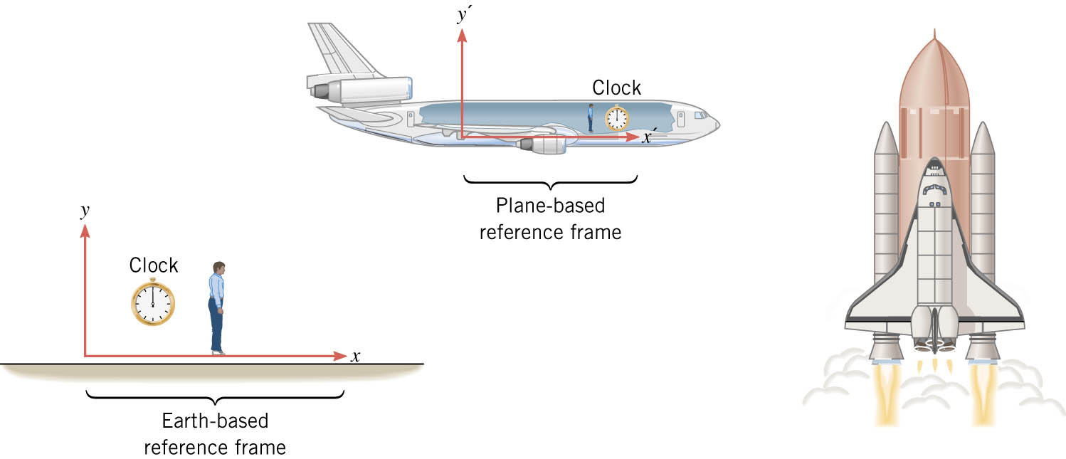
14-01 Einstein’s Postulates and Time Dilation
Event
  Physical happening in a certain place at a certain time.
Reference Frame
  Coordinate system (x, y, z) and clock
  i.e. earth, airplane
Notes:
Objectives: Students will correctly answer conceptual questions about the postulates of special relativity.
Students will correctly answer questions about the proper time and dilated time.
Students will correctly solve problems involving time dilation.
Focus: Einstein wondered what he would see if her were to ride a beam of light. On earth, if you travel at the same speed as a wave, the wave appears to be still relative to you. So if you were on a beam of light, you would be traveling the same speed as the wave and you would observe everything to still relative to you. That means you could see anything since no new light would come to you. Einstein didn’t like that. One day while talking with a friend about how long it takes light to arrive from various clocks in the city, Einstein solved the problem. He decided that if the speed of light was the fastest anything could travel, then all this problems were solved.
In the picture: Earth based reference frame and airplane based reference frame for observing the event of a shuttle launch

Slide 5
14-01 Einstein’s Postulates and Time Dilation
Inertial Reference Frame
  Reference frame where Newton’s Law of Inertia is valid
  No acceleration
  No rotation
Notes:
Newton’s Law of Inertia is Newton’s First Law of Motion - Objects at rest stay at rest and objects in motion stay in motion on a straight line unless acted on by a force.

Slide 6
14-01 Einstein’s Postulates and Time Dilation
Einstein built theory of special relativity on these postulates.
The Relativity Postulate
  The laws of physics are the same in every inertial reference frame.
The Speed of Light Postulate
  The speed of light in a vacuum, measured in any inertial reference frame, always has the same value of c, no matter how fast the source of light and the observer are moving relative to each other.

Slide 7
14-01 Einstein’s Postulates and Time Dilation
Consequences of Relativity Postulate
  Any inertial reference frame is as good as any other.
  You can’t say any reference frame is truly at rest.
  There is no absolute velocity or rest, only velocity relative to the reference frame.

Slide 8
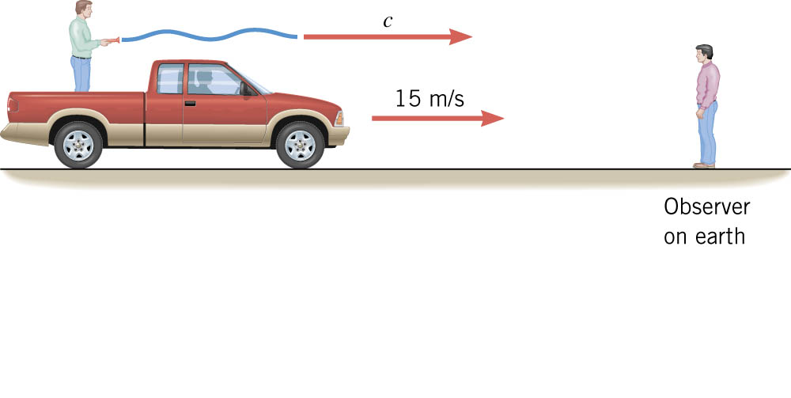
14-01 Einstein’s Postulates and Time Dilation
Explanation of Speed of Light Postulate
  The observer on the truck measures speed of light to be c since he is holding the light.
  Logic says the observer on the ground measures the speed of light to be c + 15, but he doesn’t.
  The observer on the ground measures speed of light to be c also.
  Verified by experiment many times.

Slide 9
14-01 Einstein’s Postulates and Time Dilation
Simultaneous
  Just because two events appear simultaneous to one observer does not mean all observes see the events simultaneously

Slide 10
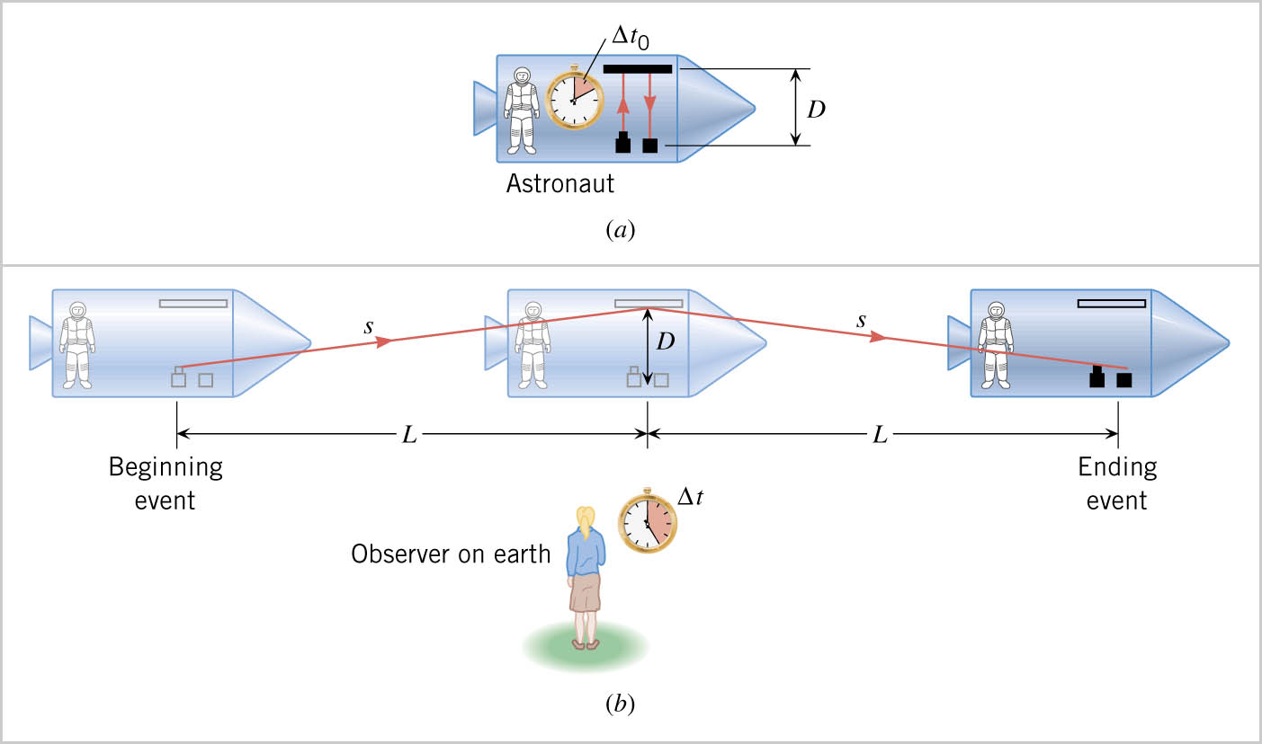
14-01 Einstein’s Postulates and Time Dilation
Astronaut measures time by aiming a laser at a mirror. The light reflects from the mirror and hits a detector.
The person on earth says that the time of the event must be longer because she sees the laser beam go farther.

Slide 11

14-01 Einstein’s Postulates and Time Dilation
Derivation of Time Dilation
$s=\sqrt{D^{2}+L^{2}}$ $L=\frac{vΔt}{2}$ $2s=cΔt$
$$cΔt=2\sqrt{D^{2}+{\left(\frac{vΔt}{2}\right)}^{2}}$$

Slide 12

14-01 Einstein’s Postulates and Time Dilation
Squaring and solving for Δt gives
$$Δt=\frac{2D}{c}\frac{1}{\sqrt{1−\frac{v^{2}}{c^{2}}}}$$
But the time the astronaut measured is
$$Δt_{0}=\frac{2D}{c}$$

Slide 13


14-01 Einstein’s Postulates and Time Dilation
Time Dilation
$$Δt=γΔt_{0}$$
Where
  Δt₀ = proper time measured in a reference frame at rest relative to the event
  Δt = dilated time measured in a reference frame moving relative to the event
$$γ=\frac{1}{\sqrt{1−\frac{v^{2}}{c^{2}}}}$$
Where
  v = relative speed between the observers
  c = speed of light in a vacuum
Notes:
While we don’t move at relativistic velocities (speeds that are a large fraction of c), time dilation can cause problems. For example, it would make clocks on GPS satellites out of synch with earth clocks and throw off the position.

Slide 14
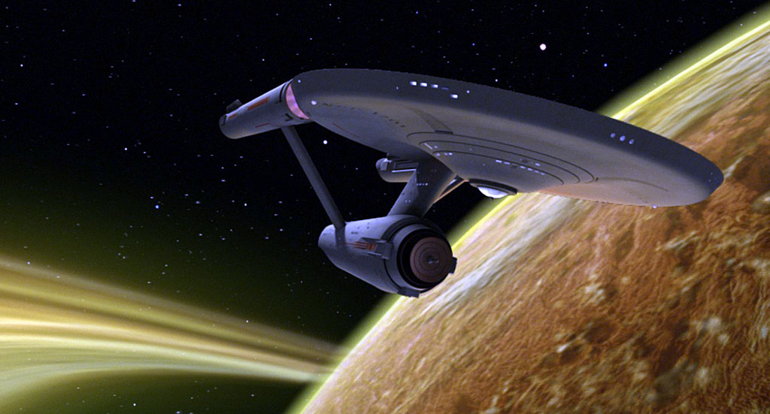
14-01 Einstein’s Postulates and Time Dilation
Let’s say the USS Enterprise’s 1/3 impulse speed is one-quarter the speed of light. If Spock, in the ship, says the planet will blow up in 10 minutes, how long does the away team have to beam up?
9.68 minutes
Notes:
$$Δt=10 minutes, v=0.25c$$
$$Δt=\frac{Δt_{0}}{\sqrt{1−\left(\frac{v^{2}}{c^{2}}\right)}}$$
$$10 minutes=\frac{Δt_{0}}{\sqrt{1−\left(\frac{{\left(0.25c\right)}^{2}}{c^{2}}\right)}}→Δt_{0}=10\min{\sqrt{1−\left(0.0625\right)}}=9.682458 min=580.9 s$$

Slide 15
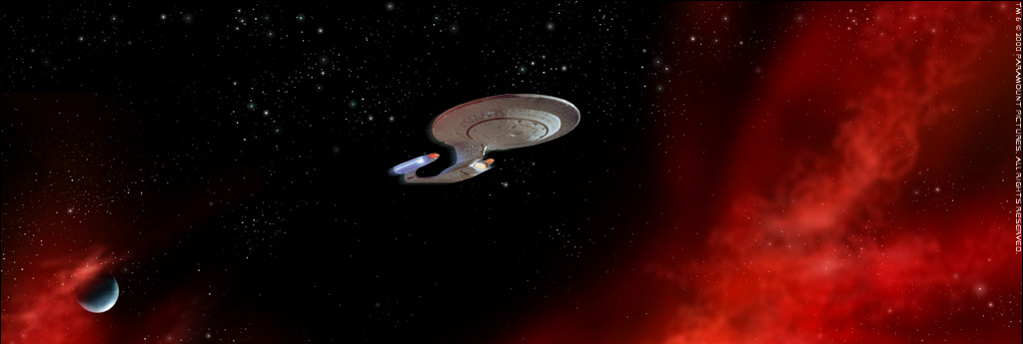
14-01 Einstein’s Postulates and Time Dilation
Picard is on Rigel 7 and needs to go to Earth 776.6 light-years away, but the Enterprise’s warp drive is broken. If full impulse is ¾ the speed of light, how long will a Rigelian think it will take the Enterprise to get to Earth?
  Δt = 1035.47 yrs
How long will the Enterprise’s crew think it will take?
  Δt₀ = 684.90 yrs
Notes:
1 light–year is the distance light will travel in a year.
$Δt=\frac{776.6 ly}{0.75}=1035.47 years$ (the Rigelian measures dilated time because the events of leaving and arriving are at rest to the starship – they both happen outside the starship’s windows)
$Δt=\frac{Δt_{0}}{\sqrt{1−\left(\frac{v^{2}}{c^{2}}\right)}}→1035.47 yrs=\frac{Δt_{0}}{\sqrt{1−\left(\frac{{\left(0.75c\right)}^{2}}{c^{2}}\right)}}→Δt_{0}=1035.47 yrs \sqrt{1−0.5625}=684.90 yrs$

Slide 16
14-01 Einstein’s Postulates and Time Dilation
Time dilation was confirmed by J.C. Hafele and R.E. Keating in 1971 by taking two very accurate atomic clocks.
One was still on earth and the other was flown around the world on commercial jets for 45 hours.
Afterwards the clocks were compared, and the predicted difference was found.

Slide 17
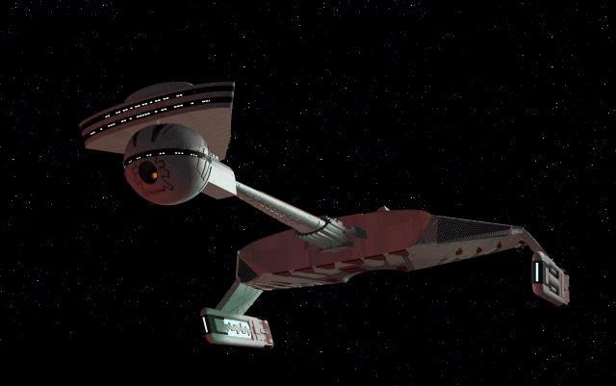
14-01 Practice Work
If you work really fast, it will seem like you took less time than an outside observer measures.
Read 28.3

Slide 18
14-02 Length Contraction
In this lesson you will…
• Describe proper length.
• Calculate length contraction.
• Explain why we don’t notice these effects at everyday scales.

Slide 19
14-02 Length Contraction
Since the observer moving with the event measures a different time than the observer not moving with the event, are the lengths different?
Notes:
Objectives: Students will correctly distinguish between contracted length and proper length.
Students will correctly solve problems involving length contraction.
Focus: Answer questions on previous assignment. See this slide. (Since the observer moving with the event measures a different time than the observer not moving with the event, are the lengths different?)

Slide 20

14-02 Length Contraction
$x=vt$
Both observers agree on $v$
$t$ is different by $\frac{1}{\sqrt{1−\frac{v^{2}}{c^{2}}}}$
So $x$ must be different by $\frac{1}{\sqrt{1−\frac{v^{2}}{c^{2}}}}$ also

Slide 21

14-02 Length Contraction
The distance measured by a person at rest with the event is shorter than that measured by person at rest with respect to the endpoints.
$L=L_{0}\sqrt{1−\frac{v^{2}}{c^{2}}}=\frac{L_{0}}{γ}$
$L_{0}=$ proper length
  Length between 2 points as measured by person at rest with the points.

Slide 22
14-02 Length Contraction
Length only contracts along the direction of motion, the others stay the same
Rest
Moving→
Notes:
If you moved near the speed of light you would be the same height, but very thin.
This is as observed by the person moving with the event.

Slide 23
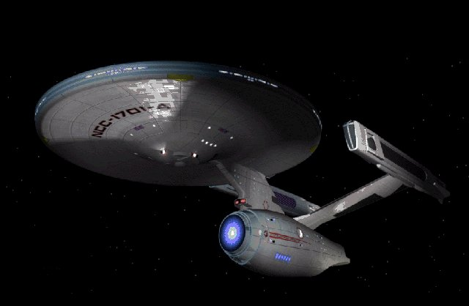
14-02 Length Contraction
When the Starship Enterprise travels at impulse (v = 0.7c), a ground-based observer measures the ship as 707 ft long. How long does the crew measure the ship?
990 ft
Notes:
$$707 ft=L_{0}\sqrt{1−\frac{{\left(0.7c\right)}^{2}}{c^{2}}}$$
$$L_{0}=990 ft$$
Of course all the measuring devices are shortened as well, so the measurements would be the same.

Slide 24
14-02 Pratice Work
Don’t stretch these problems out too long.
Read 28.4

Slide 25
14-03 Relativistic Addition of Velocities
In this lesson you will…
• Calculate relativistic velocity addition.
• Explain when relativistic velocity addition should be used instead of classical addition of velocities.
• Calculate relativistic Doppler shift.

Slide 26
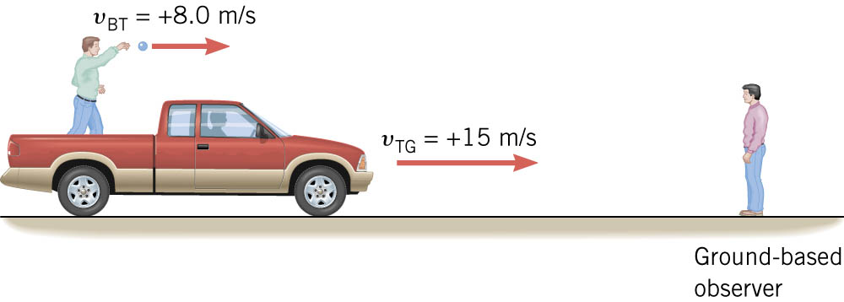

14-03 Relativistic Addition of Velocities
$v_{BT}+v_{TG}=v_{BG}$
$v_{BT}=−v_{TB}$
Notes:
Objectives: Students will correctly distinguish between when relativistic addition of velocities is used and when nonrelativistic addition is used.
Students will correctly solve problems involving relativistic addition of velocities.
Students will correctly solve problems involving nonrelativistic addition of velocities.
Focus: Answer questions on previous assignment. Review nonrelativistic addition of velocities.
Velocity of Ball to Truck + Velocity of Truck to Ground = Velocity of Ball to Ground
Subscripts show the order

Slide 27
14-03 Relativistic Addition of Velocities
What if the combination of the truck and the ball added to be more than the speed of light?
The ground-based observer would observe the ball to travel faster than light.
This cannot happen.

Slide 28
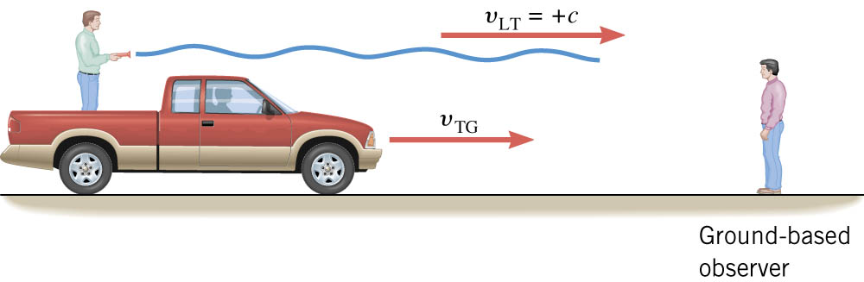

14-03 Relativistic Addition of Velocities
Relativistic Addition of Velocity
$$v_{LG}=\frac{v_{LT}+v_{TG}}{1+\frac{v_{LT}v_{TG}}{c^{2}}}$$

Slide 29

14-03 Relativistic Addition of Velocities
At what speed does the ground based observer see the light travel?
$v_{LG}=c$
Notes:
$$v_{LG}=\frac{v_{LT}+v_{TG}}{1+\frac{v_{LT}v_{TG}}{c^{2}}}=\frac{c+v_{TG}}{1+\frac{cv_{TG}}{c^{2}}}=\frac{c+v_{TG}}{1+\frac{v_{TG}}{c}}=\frac{c+v_{TG}}{\frac{c}{c}+\frac{v_{TG}}{c}}=\frac{c+v_{TG}}{\frac{c+v_{TG}}{c}}=\frac{\left(c+v_{TG}\right)c}{c+v_{TG}}=c$$

Slide 30


14-03 Relativistic Addition of Velocities
Doppler shift for relative velocity
$$λ_{obs}=λ_{s}\sqrt{\frac{1+\frac{u}{c}}{1−\frac{u}{c}}}$$
u is relative velocity of source to observer
  Positive if moving away
$$f_{obs}=f_{s}\sqrt{\frac{1−\frac{u}{c}}{1+\frac{u}{c}}}$$

Slide 31
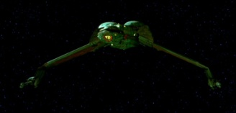

14-03 Relativistic Addition of Velocities
The starship Enterprise moves at 0.9c relative to the earth and a Klingon Bird-of-Prey moves the same directions at 0.7c relative to the earth. What does the navigator of the Bird-of-Prey report for the speed of the Enterprise?
$v_{EntK}=0.541c$
Notes:
$$v_{EntE}=0.9c, v_{KE}=0.7c$$
$$v_{EntK}=\frac{v_{EntE}+v_{EK}}{1+\frac{v_{EntE}v_{EK}}{c^{2}}}$$
$$v_{EntK}=\frac{\left(0.9c±0.7c\right)}{1+\frac{\left(0.9c\right)\left(−0.7c\right)}{c^{2}}}$$
$$v_{EntK}=0.541c$$

Slide 32

14-03 Relativistic Addition of Velocities
The starship Enterprise moves at 0.9c relative to the earth and a Klingon Bird-of-Prey moves the same directions at 0.7c relative to the earth. If the Enterprise has blue ($λ$ = 475 nm) lights, what wavelength does the Klingon ship see as it leaves?
$λ_{obs}=870 nm$, infrared
Notes:
$$λ_{obs}=λ_{s}\sqrt{\frac{1+\frac{u}{c}}{1−\frac{u}{c}}}$$
$$λ_{obs}=\left(475 nm\right)\sqrt{\frac{1+\frac{0.541c}{c}}{1−\frac{0.541c}{c}}}=870 nm$$

Slide 33
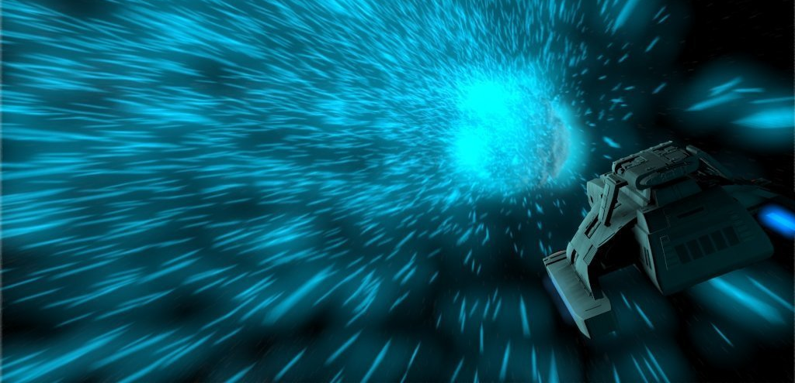
14-03 Homework
You can do these problems relatively quickly.
Read 28.5

Slide 34
14-04 Relativistic Momentum
In this lesson you will…
• Calculate relativistic momentum.
• Explain why the only mass it makes sense to talk about is rest mass.

Slide 35

14-04 Relativistic Momentum
Law of Conservation of Momentum
  The total momentum of a closed system does not change.
  $p=mv$
  However, when v approaches c, we must adjust the formula
  $p=\frac{mv}{\sqrt{1−\frac{v^{2}}{c^{2}}}}$
Notes:
Objectives: Students will correctly solve problems involving relativistic momentum.
Focus: Answer questions on previous assignment. Review what the law of conservation of momentum is.

Slide 36

14-04 Relativistic Momentum
Relativistic momentum is always higher than nonrelativistic momentum because
$\sqrt{1−\frac{v^{2}}{c^{2}}}<1$
Since we divide by the radical in the formula, the result is a larger number.

Slide 37
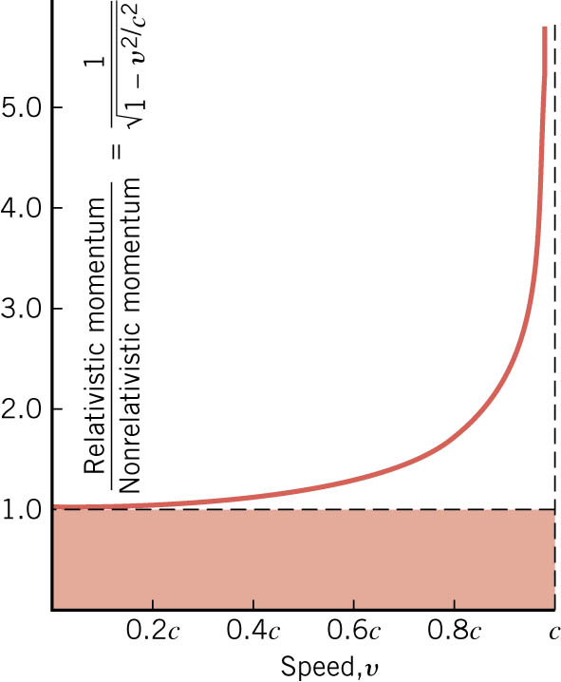
14-04 Relativistic Momentum
Notice that when the speed is near 0, the relativistic momentum is near the nonrelativistic.
When the speed is near c, the relativistic momentum increases exponentially.

Slide 38
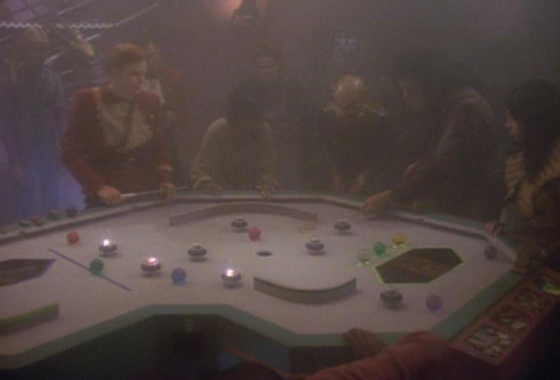
14-04 Relativistic Momentum
In a game of Dom’Jot, a small ball (0.5 kg) is hit across a table. If the ball moving at 3 m/s and the speed of light in a vacuum is 4 m/s, what is the relativistic momentum of the ball?
  p = 2.27 kg m/s
The nonrelativistic momentum?
  p = 1.5 kg m/s
Notes:
$$p=\frac{0.5 kg⋅3\frac{m}{s}}{\sqrt{1−\frac{{\left(3\frac{m}{s}\right)}^{2}}{{\left(4\frac{m}{s}\right)}^{2}}}}=2.27 kg\frac{m}{s}$$
$$p=\left(0.5 kg⋅3\frac{m}{s}\right)=1.5 kg\frac{m}{s}$$
Dom’Jot is a game is Star Trek similar to pool or billards.

Slide 39
14-04 Homework
Build some momentum as you attempt these problems.
Read 28.6

Slide 40
14-05 Relativistic Energy
In this lesson you will…
• Compute total energy of a relativistic object.
• Compute the kinetic energy of a relativistic object.
• Describe rest energy, and explain how it can be converted to other forms.
• Explain why massive particles cannot reach c.

Slide 41

14-05 Relativistic Energy
The total energy of an object
$E=\frac{mc^{2}}{\sqrt{1−\frac{v^{2}}{c^{2}}}}$
If the object is not moving, the rest energy is
$E_{0}=mc^{2}$
Notes:
Objectives: Students will correctly solve problems involving energy of objects.
Students will correctly solve problems involving kinetic energy at relativistic speeds.
Students will correctly answer conceptual problems about the mass-energy relationship.
Focus: Answer questions about previous assignment. Everybody knows that Einstein discovered that $E=mc^{2}$ but there is more to it.
Discovered by Einstein

Slide 42

14-05 Relativistic Energy
How much energy is in a 5-gram pen at rest?
  $E_{0}=4.5×{10}^{14}J$
How long will that run a 60-W light bulb?
  $t=7.5×{10}^{12} s$
  $= 237665 yr 9 months$
Notes:
$$E=\left(0.005 kg\right){\left(3.00×{10}^{8}\frac{m}{s}\right)}^{2}=4.5×{10}^{14} J$$
$$P=\frac{W}{t}→60 W=4.5×{10}^{14} \frac{J}{t}→t=7.5×{10}^{12} s=237665 yr 9 months$$

Slide 43

14-05 Relativistic Energy
If the object is moving, then the total energy is $E=E_{0}+KE$
$\frac{mc^{2}}{\sqrt{1−\frac{v^{2}}{c^{2}}}}=mc^{2}+KE$
$KE=mc^{2}\left(\frac{1}{\sqrt{1−\frac{v^{2}}{c^{2}}}}−1\right)$
Notes:
KE = kinetic energy
At speeds far less than c, this becomes about $\frac{1}{2}mv^{2}$

Slide 44
14-05 Relativistic Energy
Mass and energy are the same
A change in one, means a change in the other.
For example, you pick up your backpack and increase its gravitational potential energy.
  Since the energy increases, the mass must increase.
  So when you carry your backpack, it is actually heavier than when it is on the ground.
Notes:
Yes, the change in mass is incredibly small.

Slide 45

14-05 Relativistic Energy
The sun radiates electromagnetic energy at $3.92×{10}^{26}$ W. How much mass does the sun lose in 1 year?
  $1.37×{10}^{17}$ kg
This is only a tiny fraction of the sun’s mass ($6.9×{10}^{−14}$)
Notes:
$$P=\frac{W}{t}→3.92×{10}^{26} W=\frac{E}{31557600 s}→E=1.237×{10}^{34} J$$
$$E=mc^{2}→1.237×{10}^{34} J=m{\left(3.00×{10}^{8}\frac{m}{s}\right)}^{2}→m=1.37×{10}^{17} kg$$

Slide 46
14-05 Relativistic Energy
A final consequence
Objects with mass cannot reach the speed of light.
This is because it would take an infinite amount of energy.
Notes:
The denominator of the KE formula would go to zero, which means value of the fraction goes to infinity.

Slide 47
14-05 Homework
You have less mass if you use energy.

