Slide 1
Functions and Graphs
Precalculus
Chapter 1

Slide 2
This Slideshow was developed to accompany the textbook
  Precalculus
  By Richard Wright
  https://www.andrews.edu/~rwright/Precalculus-RLW/Text/TOC.html
Some examples and diagrams are taken from the textbook.
Slides created by
Richard Wright, Andrews Academy
rwright@andrews.edu

Slide 3
1-01 The Cartesian Plane
In this section, you will:
Plot points in the cartesian coordinate system.
Find the distance between two points.
Find the midpoint between two points.

Slide 4
1-01 The Cartesian Plane
Cartesian Plane
  Four quadrants
Point is (x, y)
Graph A(3, 2)
Graph B(-1, 4)

Slide 5
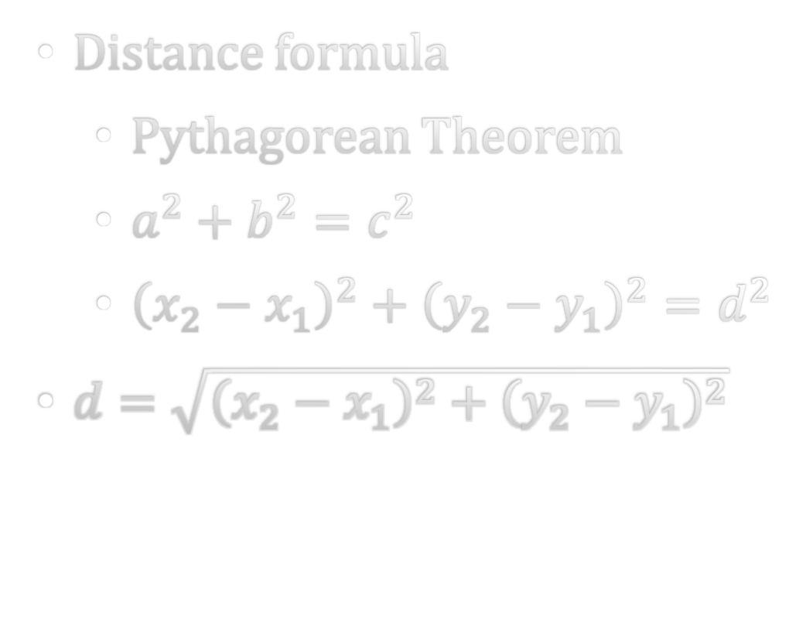
1-01 The Cartesian Plane
Distance formula
  Pythagorean Theorem
  $a^{2}+b^{2}=c^{2}$
  ${\left(x_{2}−x_{1}\right)}^{2}+{\left(y_{2}−y_{1}\right)}^{2}=d^{2}$
$d=\sqrt{{\left(x_{2}−x_{1}\right)}^{2}+{\left(y_{2}−y_{1}\right)}^{2}}$

Slide 6
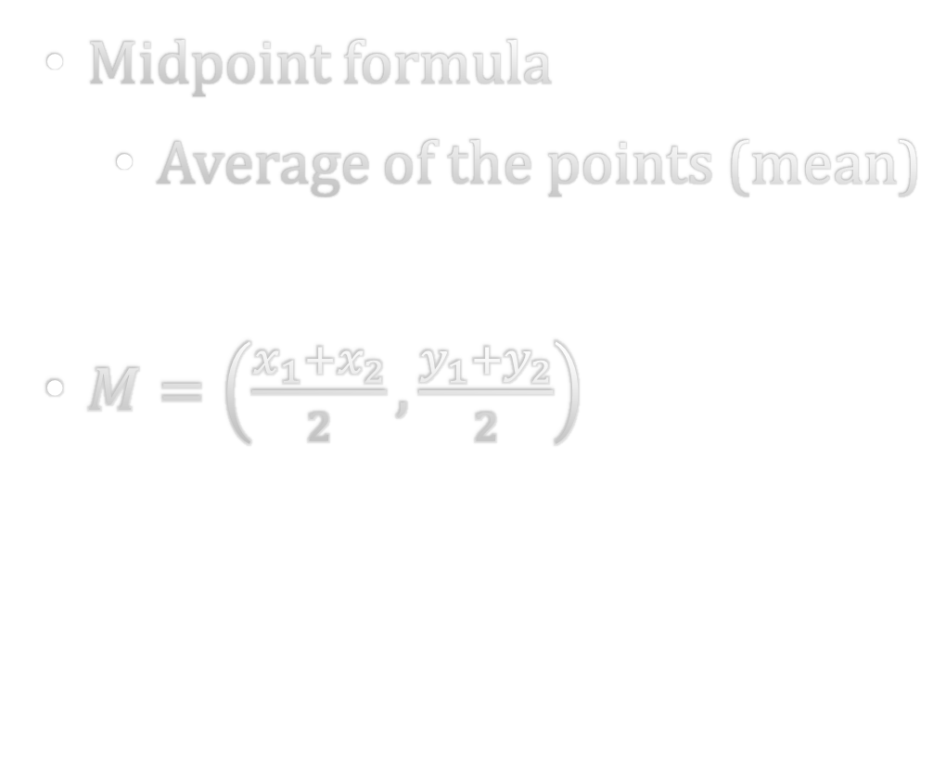
1-01 The Cartesian Plane
Midpoint formula
  Average of the points (mean)
$M=\left(\frac{x_{1}+x_{2}}{2},\frac{y_{1}+y_{2}}{2}\right)$

Slide 7
1-01 The Cartesian Plane
Find the (a) distance and (b) midpoint between (-1, 3) and (2, -5)
Notes:
$$d=\sqrt{{\left(x_{2}−x_{1}\right)}^{2}+{\left(y_{2}−y_{1}\right)}^{2}}$$
$$d=\sqrt{{\left(2−\left(−1\right)\right)}^{2}+{\left(−5−3\right)}^{2}}$$
$$d=\sqrt{3^{2}+{\left(−8\right)}^{2}}$$
$$d=\sqrt{9+64}$$
$$d=\sqrt{73}$$
$$M=\left(\frac{x_{1}+x_{2}}{2},\frac{y_{1}+y_{2}}{2}\right)$$
$$M=\left(\frac{−1+2}{2},\frac{3+\left(−5\right)}{2}\right)$$
$$M=\left(\frac{1}{2}, −\frac{2}{2}\right)$$
$$M=\left(\frac{1}{2}, −1\right)$$

Slide 8
1-02 Graphs
In this section, you will:
Graph equations by plotting points.
Graph equations with a graphing utility.
Find the x- and y-intercepts.
Graph circles.

Slide 9
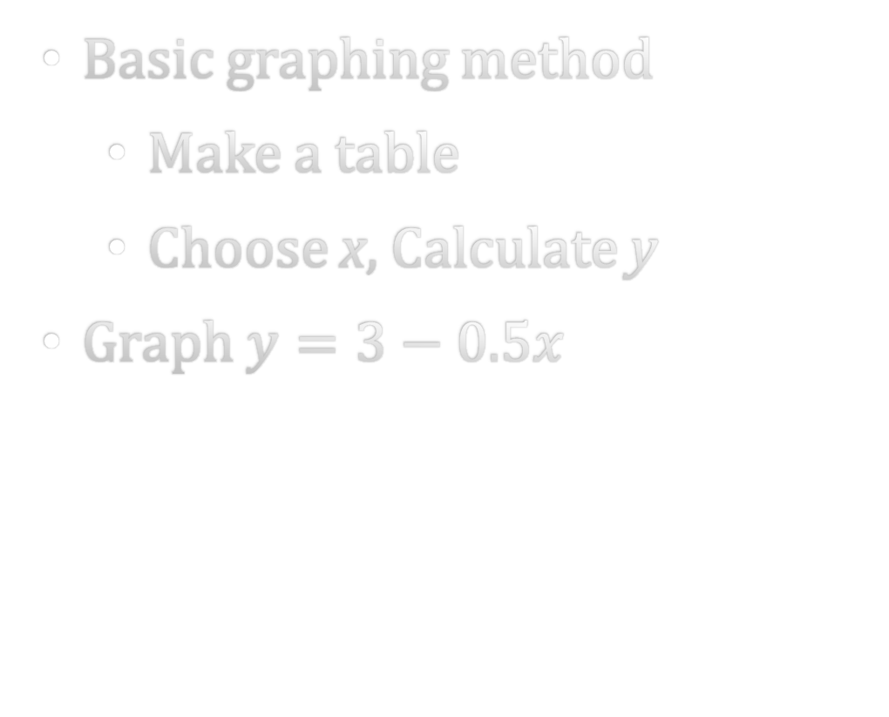
1-02 Graphs
Basic graphing method
  Make a table
  Choose x, Calculate y
Graph $y=3−0.5x$
Notes:
(x, y)
(-2, 4)
(-1, 3.5)
(0, 3)
(1, 2.5)
(2, 2)

Slide 10
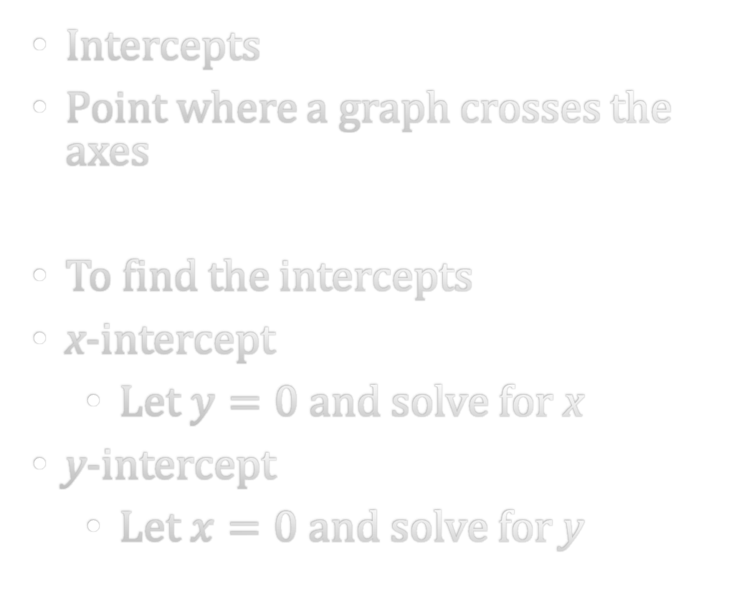
1-02 Graphs
Intercepts
Point where a graph crosses the axes
To find the intercepts
x-intercept
  Let $y=0$ and solve for x
y-intercept
  Let $x=0$ and solve for y

Slide 11

1-02 Graphs
Find the intercepts of $y=2x^{2}+2$
Notes:
No real x-int
y-int: (0, 2)

Slide 12
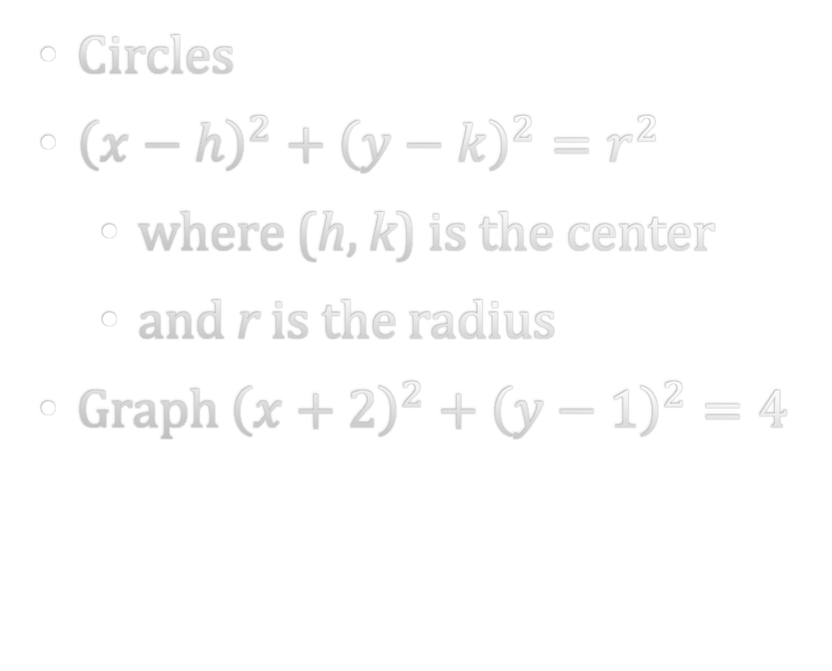
1-02 Graphs
Circles
${\left(x−h\right)}^{2}+{\left(y−k\right)}^{2}=r^{2}$
  where (h, k) is the center
  and r is the radius
Graph ${\left(x+2\right)}^{2}+{\left(y−1\right)}^{2}=4$

Slide 13
1-03 Linear Equations in Two Variables
In this section, you will:
Calculate and interpret slope.
Write linear equations.
Graph linear functions.

Slide 14
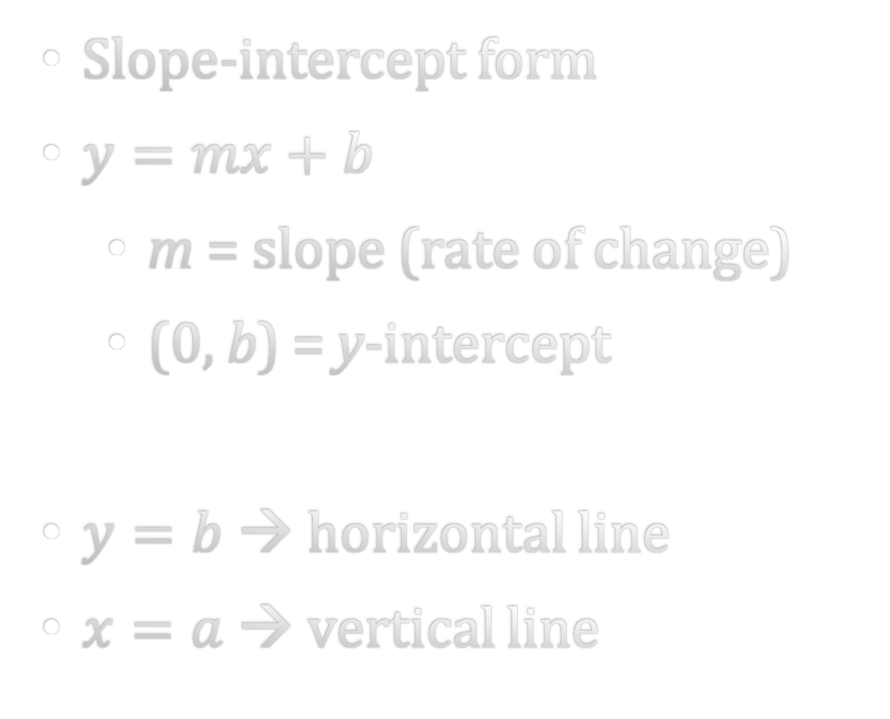
1-03 Linear Equations in Two Variables
Slope-intercept form
$y=mx+b$
  m = slope (rate of change)
  (0, b) = y-intercept
$y=b$ → horizontal line
$x=a$ → vertical line
To graph a line (shortcut)
Plot y-intercept
Follow the slope to get a couple more points
Draw a line through the points

Slide 15

1-03 Linear Equations in Two Variables
Find the slope and y-int and graph $y=3x−4$
Notes:
m=3
b=-4

Slide 16
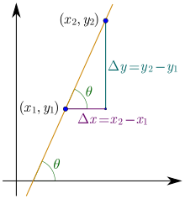
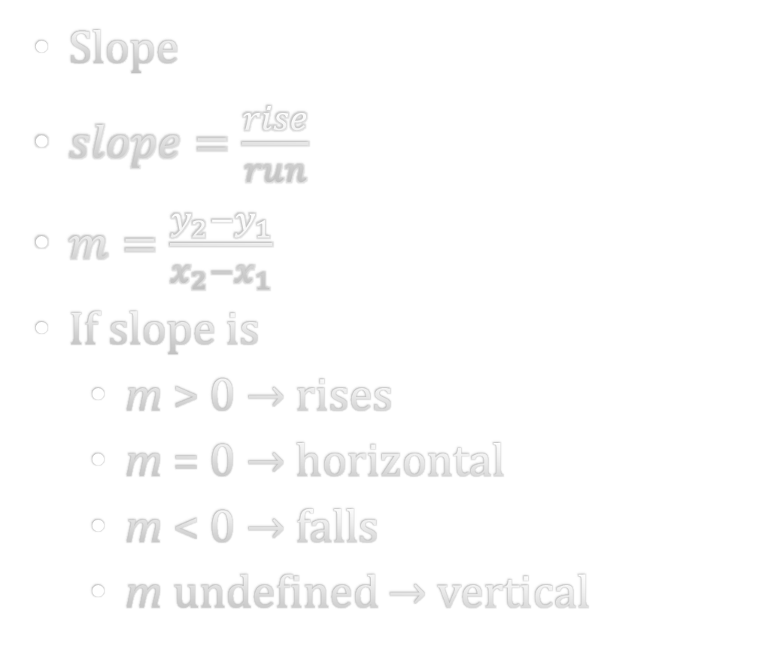
1-03 Linear Equations in Two Variables
Slope
$slope=\frac{rise}{run}$
$m=\frac{y_{2}−y_{1}}{x_{2}−x_{1}}$
If slope is
  m > 0 → rises
  m = 0 → horizontal
  m < 0 → falls
  m undefined → vertical

Slide 17
1-03 Linear Equations in Two Variables
Find the slope of the line passing through (-3, -2) and (1, 6)
Notes:
$$m=\frac{6−\left(−2\right)}{1−\left(−3\right)}$$
$$m=\frac{8}{4}=2$$

Slide 18
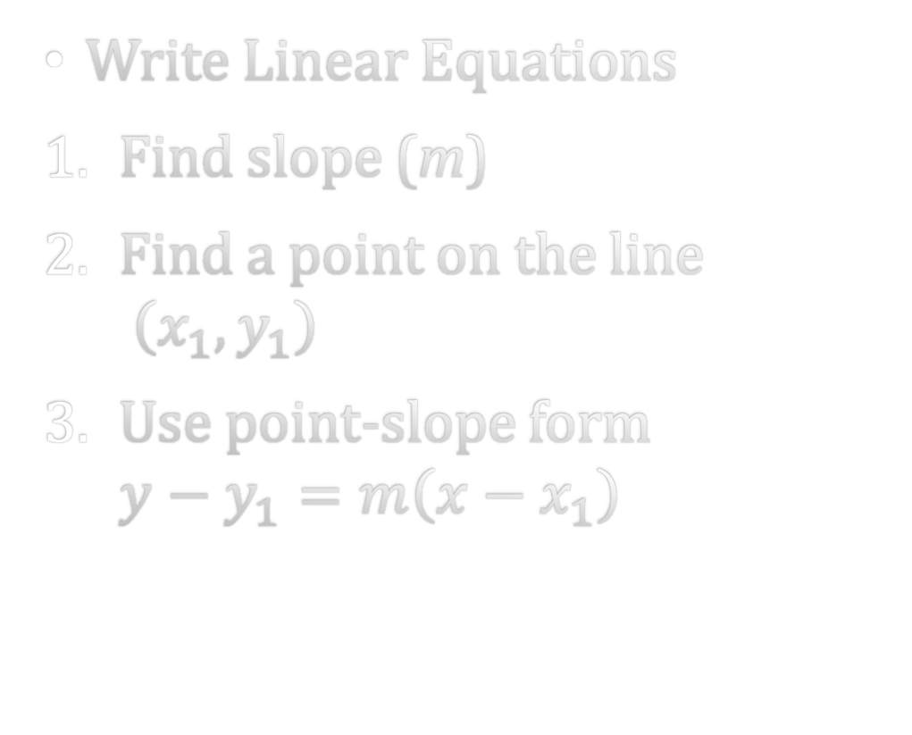
1-03 Linear Equations in Two Variables
Write Linear Equations
Find slope (m)
Find a point on the line
$\left(x_{1},y_{1}\right)$
Use point-slope form
$y−y_{1}=m\left(x−x_{1}\right)$
Find slope-intercept form of the line passing through (0, -2) with m = 3.
Notes:
y=3x-2

Slide 19
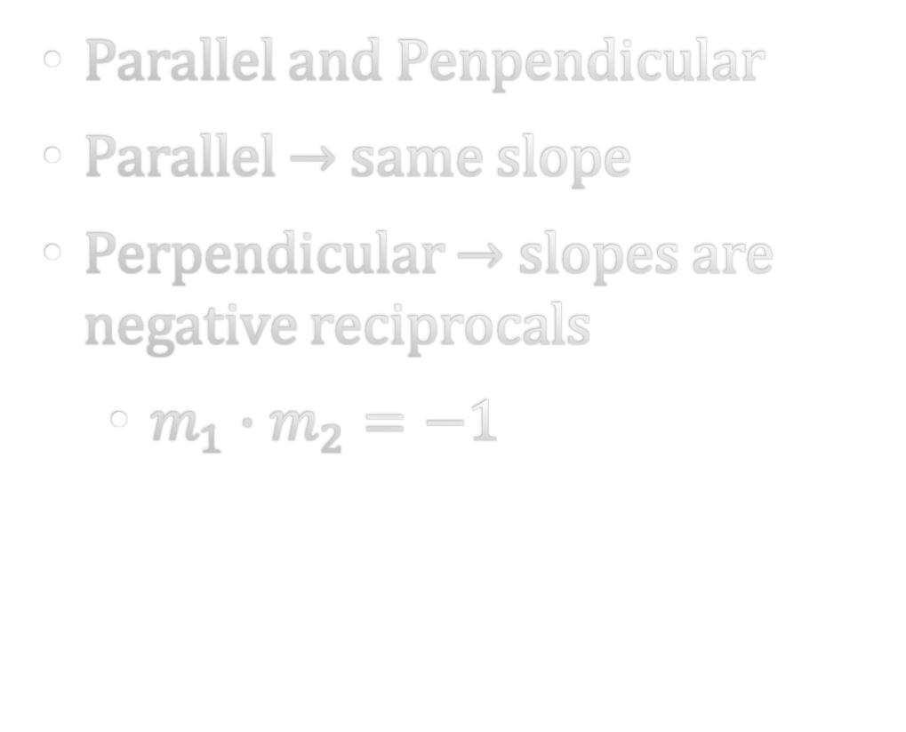

1-03 Linear Equations in Two Variables
Parallel and Penpendicular
Parallel → same slope
Perpendicular → slopes are negative reciprocals
  $m_{1}∙m_{2}=−1$
Find the equation of the line passing through (2, 1) and perpendicular to $4x−2y=3$.
Notes:
$$y=−\frac{1}{2}x+2$$

Slide 20
1-04 Functions and Functional Notation
In this section, you will:
Determine whether a relation represents a function.
Find input and output values of a function.
Find the domain of a function.
Evaluate piecewise functions.

Slide 21
1-04 Functions and Functional Notation
Relation
  Rule that relates 2 quantities
Function
  Special relation
  A function f from set A to set B is a relation that assigns each element x in set A to exactly one element in set B
  Set A: input domain
  Set B: output range

Slide 22

1-04 Functions and Functional Notation
Is this a function?
$x^{2}+y=4$
$x+y^{2}=16$
x | -2 | -1 | 0 | 1 | 2
y | -8 | -1 | 0 | 1 | 8
Notes:
Yes, each x is matched to exactly one y
Yes, each x gives exactly one y-value $y=−x^{2}+4$
No, some x give two y-values $y=±\sqrt{−x+16}$

Slide 23

1-04 Functions and Functional Notation
Functional Notation
Evaluate
$f\left(y\right)=3−\sqrt{y}$
$f\left(4\right)$
$f\left(4x^{2}\right)$

Slide 24
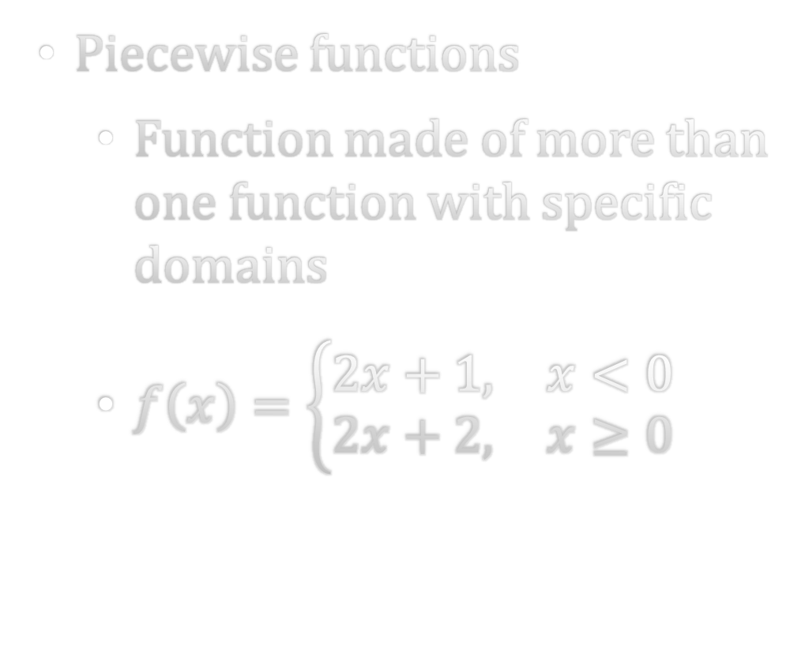

1-04 Functions and Functional Notation
Piecewise functions
  Function made of more than one function with specific domains
  $f\left(x\right)=\left\{\begin{matrix}2x+1, & x<0 \\ 2x+2, & x≥0\end{matrix}\right.$
Evaluate
$f\left(−1\right)$
$f\left(2\right)$
Notes:
f(-1)=-1
f(2)=6

Slide 25
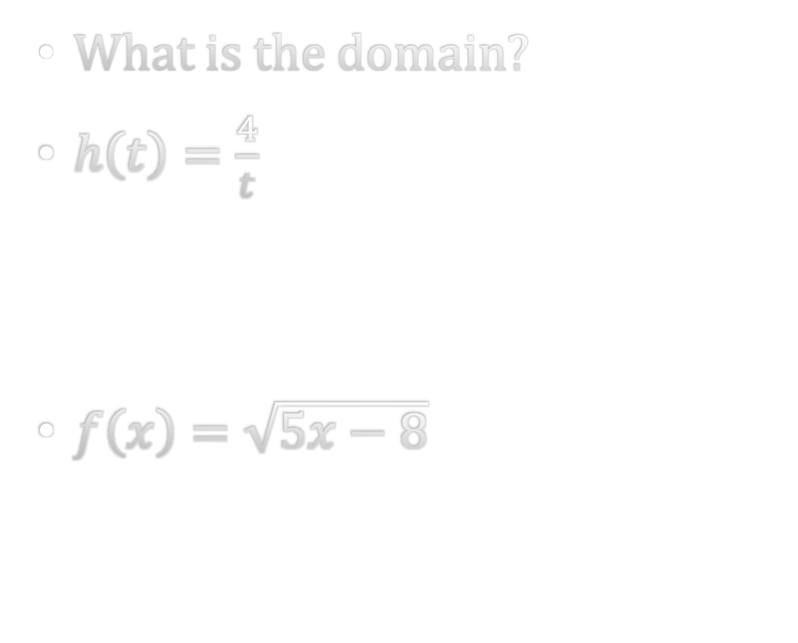
1-04 Functions and Functional Notation
Domain of a function
  Implied domain - all real numbers for which the expression is defined
Interval notation
  [ ] means =
  ( ) means ≠
  (2, 7] means 2 < x ≤ 7
What is the domain?
$h\left(t\right)=\frac{4}{t}$
$f\left(x\right)=\sqrt{5x−8}$
Notes:
t≠0, (-∞,0) ∪ (0,∞)
x≥8/5, [8/5, ∞)

Slide 26
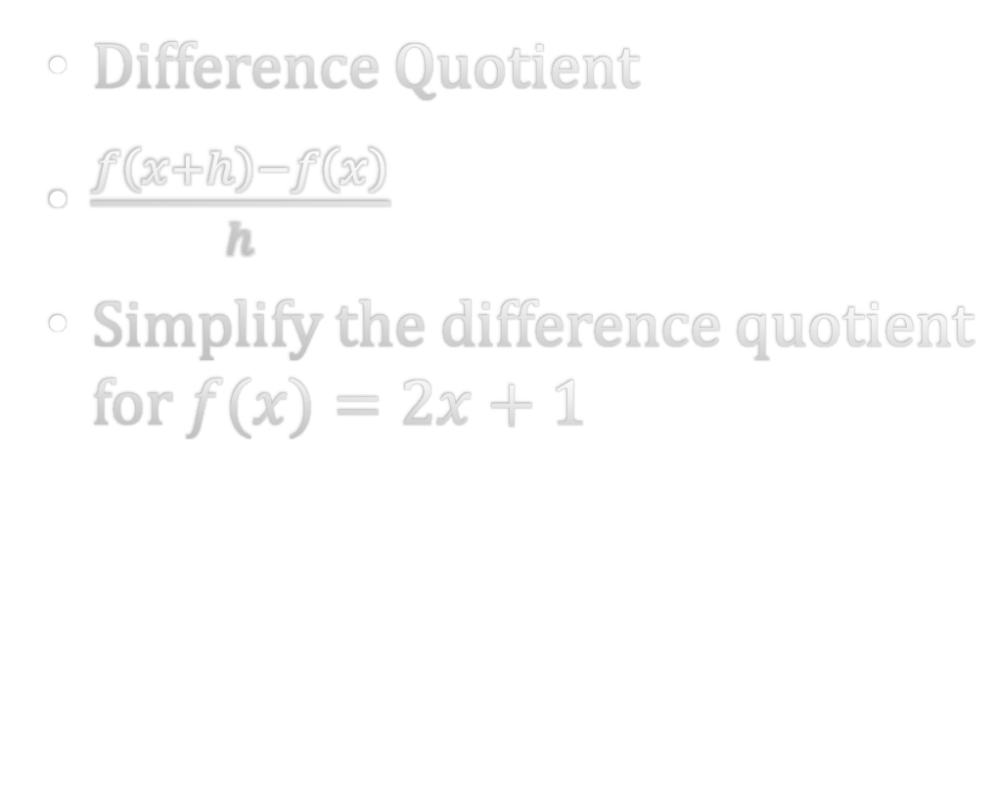
1-04 Functions and Functional Notation
Difference Quotient
$\frac{f\left(x+h\right)−f\left(x\right)}{h}$
Simplify the difference quotient for $f(x)=2x+1$
Notes:
2

Slide 27
1-05 Graphs of Functions
In this section, you will:
Find domain and range from graphs.
Determine whether graphs represent functions.
Find zeros of functions.
Find the average rate of change of a function.
Analyze graphs to determine when the graph is increasing, decreasing, or constant.

Slide 28
1-05 Graphs of Functions
Find the domain and range from a graph
Domain: part of x-axis covered by graph
Range: part of y-axis covered by graph

Slide 29
1-05 Graphs of Functions
Vertical Line Test
A graph represents a function if no vertical line can touch 2 points on the graph
Notes:
Function
Not function

Slide 30
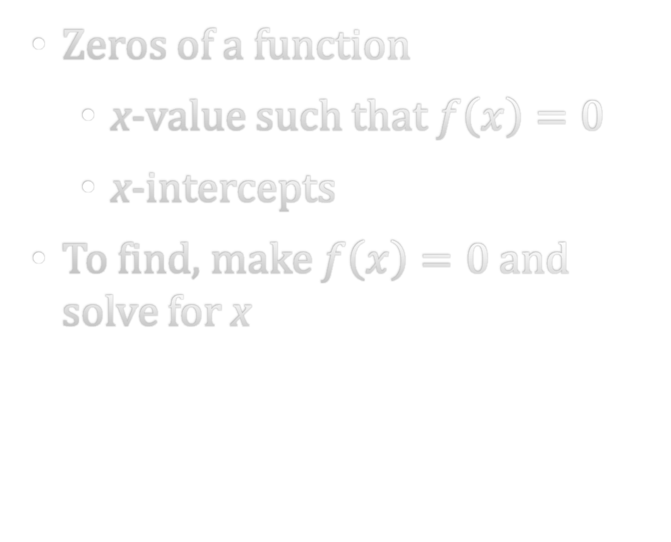

1-05 Graphs of Functions
Zeros of a function
  x-value such that $f\left(x\right)=0$
  x-intercepts
To find, make $f\left(x\right)=0$and solve for x
Find the zeros of
$f\left(x\right)=2x^{2}−7x−30$
Notes:
-5/2, 6

Slide 31
1-05 Graphs of Functions
Increasing (rises from left to right)
Decreasing (falls from left to right)
Constant (horizontal)
Relative minimum (lowest point in area)
Relative maximum (highest point in area)
Notes:
Increasing (-∞,-2) ∪ (2, ∞)
Decreasing (-2, 2)
Minimum (2, -16)
Maximum (-2 16)

Slide 32
1-05 Graphs of Functions
Rate of Change
Average rate of change = slope between 2 points

Slide 33
1-06 Graphs of Parent Functions
In this section, you will:
Identify the graphs of parent functions.
Graph piecewise functions.

Slide 34
1-06 Graphs of Parent Functions
constant function f(x) = c,
Domain is all real numbers.
Range is the set {c} that contains this single element.
Neither increasing or decreasing.
Symmetric over the y-axis

Slide 35
1-06 Graphs of Parent Functions
identity function f(x) = x,
Domain is all real numbers.
Range is all real numbers.
Increases from (−∞, ∞).
Symmetric about the origin.

Slide 36
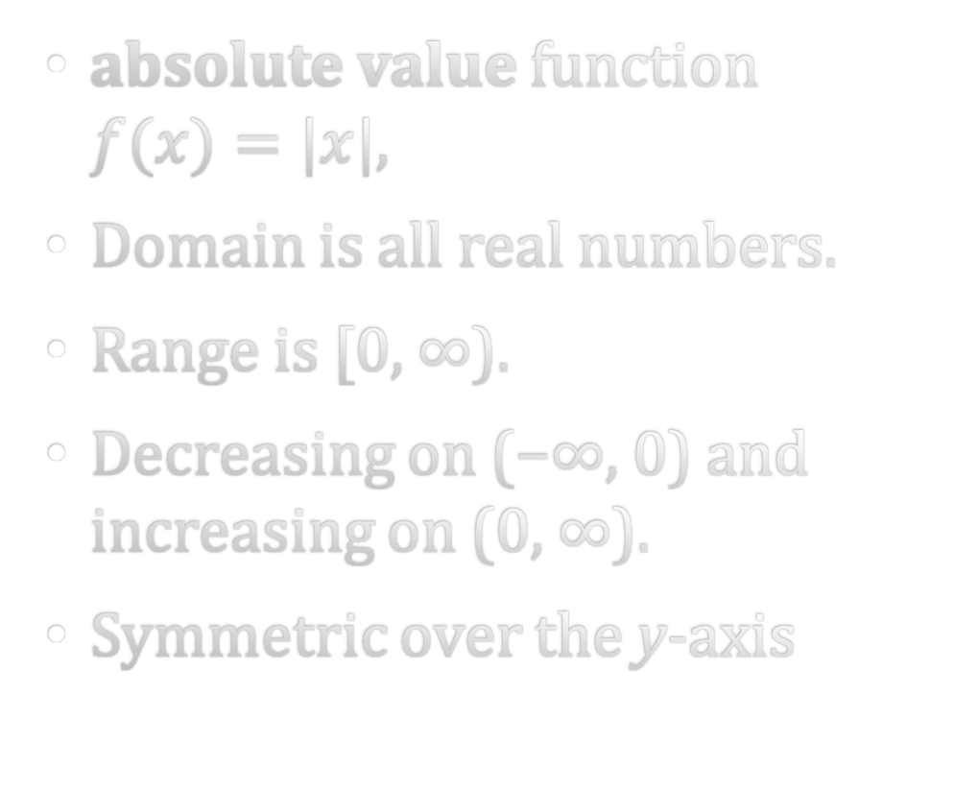
1-06 Graphs of Parent Functions
absolute value function
$f(x)=|x|$,
Domain is all real numbers.
Range is [0, ∞).
Decreasing on (−∞, 0) and increasing on (0, ∞).
Symmetric over the y-axis

Slide 37
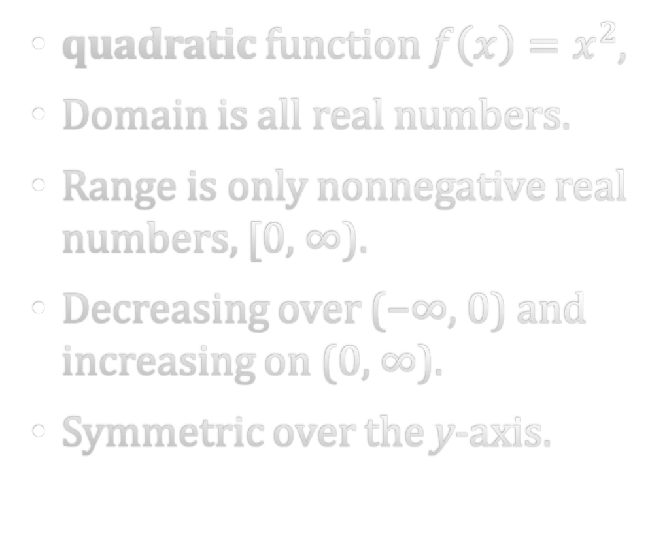
1-06 Graphs of Parent Functions
quadratic function $f\left(x\right)=x^{2}$,
Domain is all real numbers.
Range is only nonnegative real numbers, [0, ∞).
Decreasing over (−∞, 0) and increasing on (0, ∞).
Symmetric over the y-axis.

Slide 38
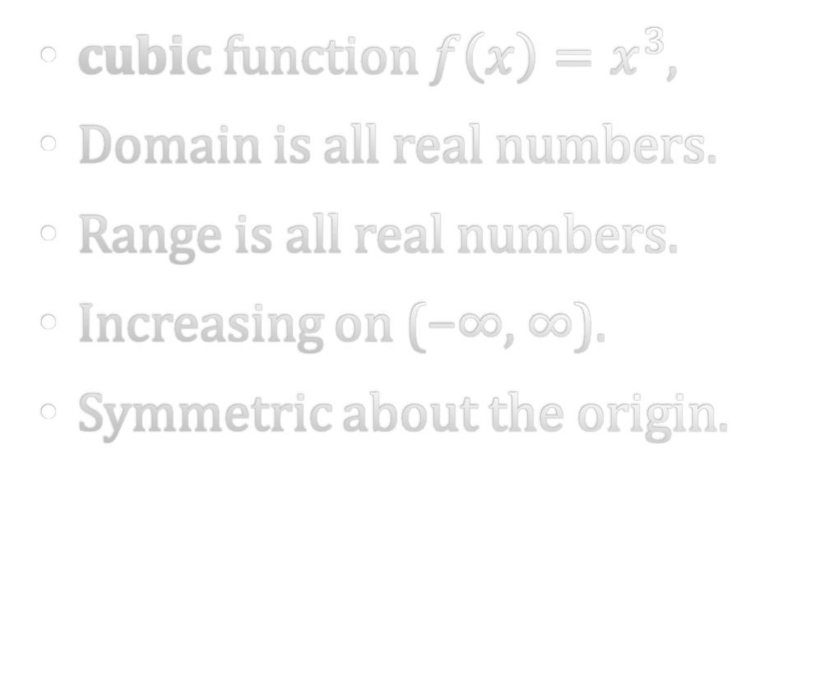
1-06 Graphs of Parent Functions
cubic function $f\left(x\right)=x^{3}$,
Domain is all real numbers.
Range is all real numbers.
Increasing on (−∞, ∞).
Symmetric about the origin.

Slide 39
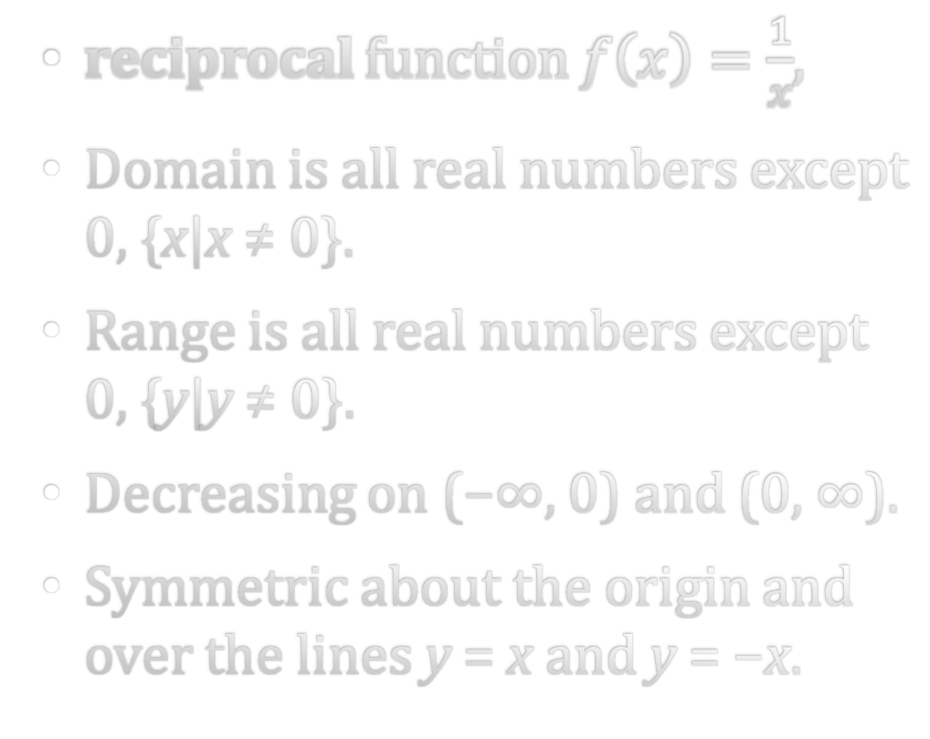
1-06 Graphs of Parent Functions
reciprocal function $f\left(x\right)=\frac{1}{x}$,
Domain is all real numbers except 0, {x|x ≠ 0}.
Range is all real numbers except 0, {y|y ≠ 0}.
Decreasing on (−∞, 0) and (0, ∞).
Symmetric about the origin and over the lines y = x and y = −x.

Slide 40
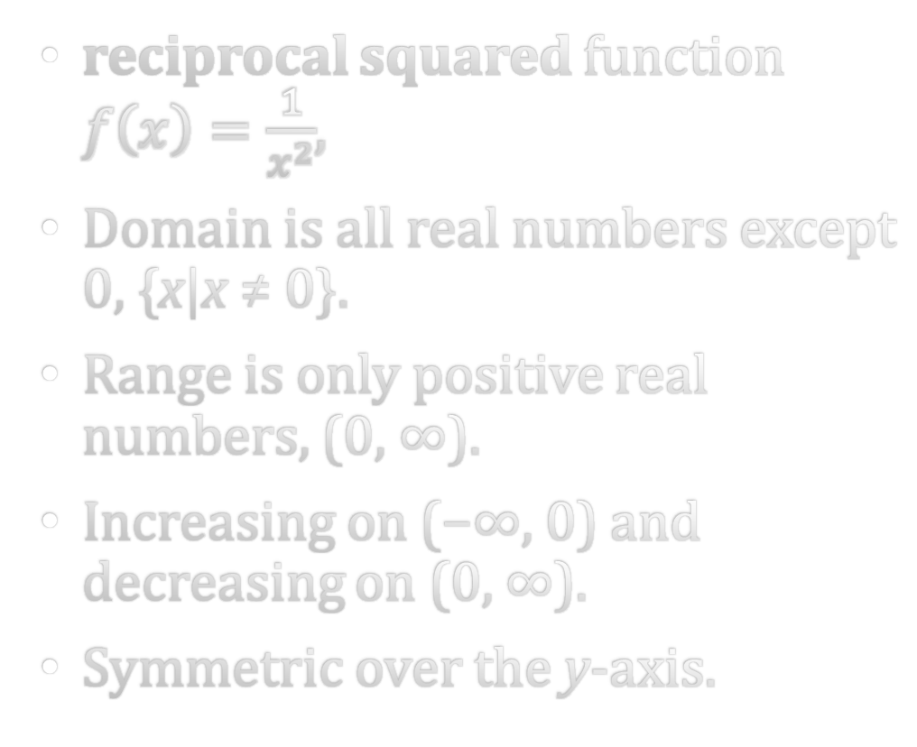
1-06 Graphs of Parent Functions
reciprocal squared function $f\left(x\right)=\frac{1}{x^{2}}$,
Domain is all real numbers except 0, {x|x ≠ 0}.
Range is only positive real numbers, (0, ∞).
Increasing on (−∞, 0) and decreasing on (0, ∞).
Symmetric over the y-axis.

Slide 41
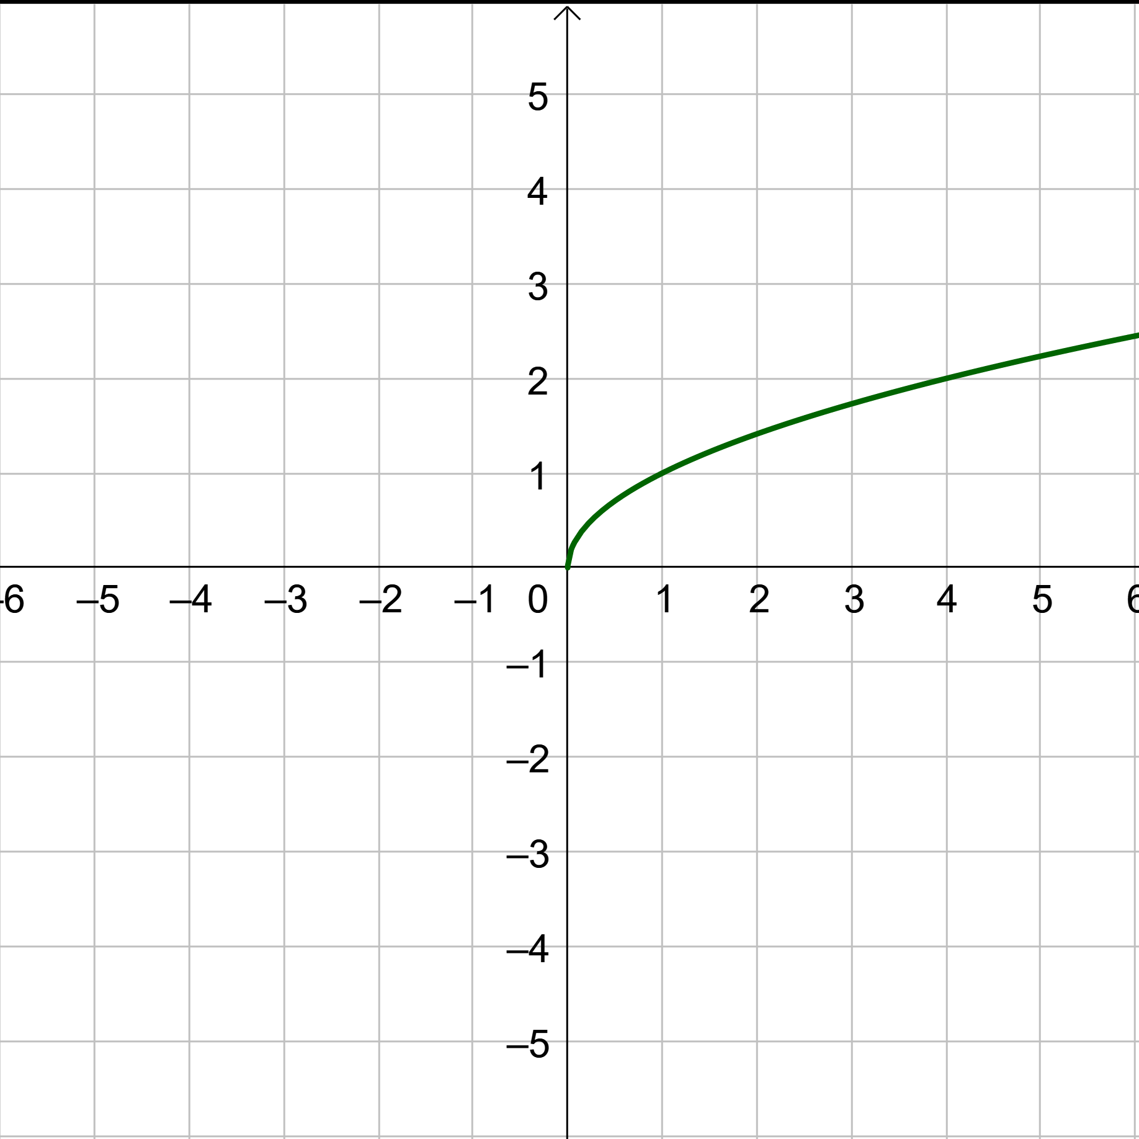
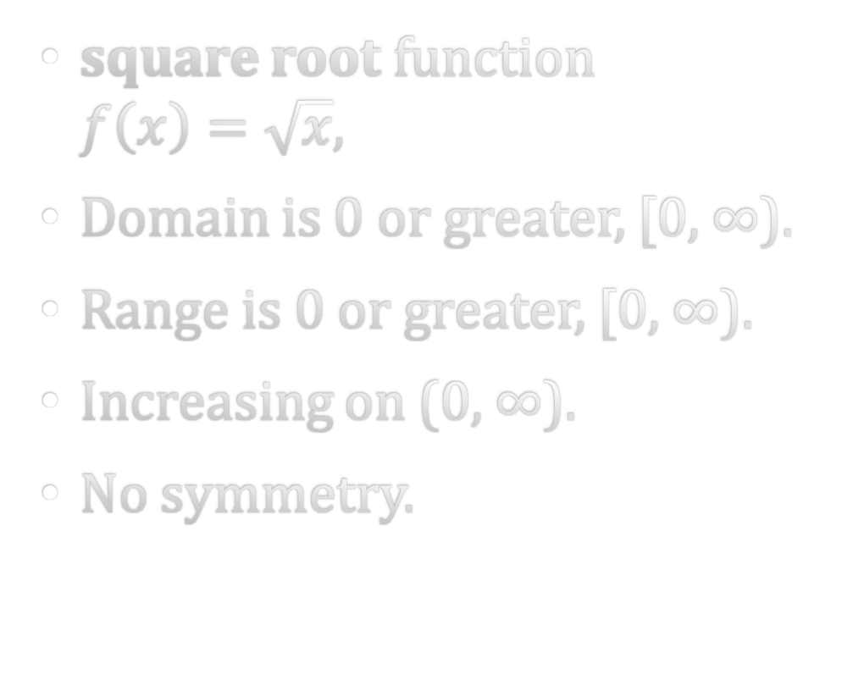
1-06 Graphs of Parent Functions
square root function
$f\left(x\right)=\sqrt{x}$,
Domain is 0 or greater, [0, ∞).
Range is 0 or greater, [0, ∞).
Increasing on (0, ∞).
No symmetry.

Slide 42
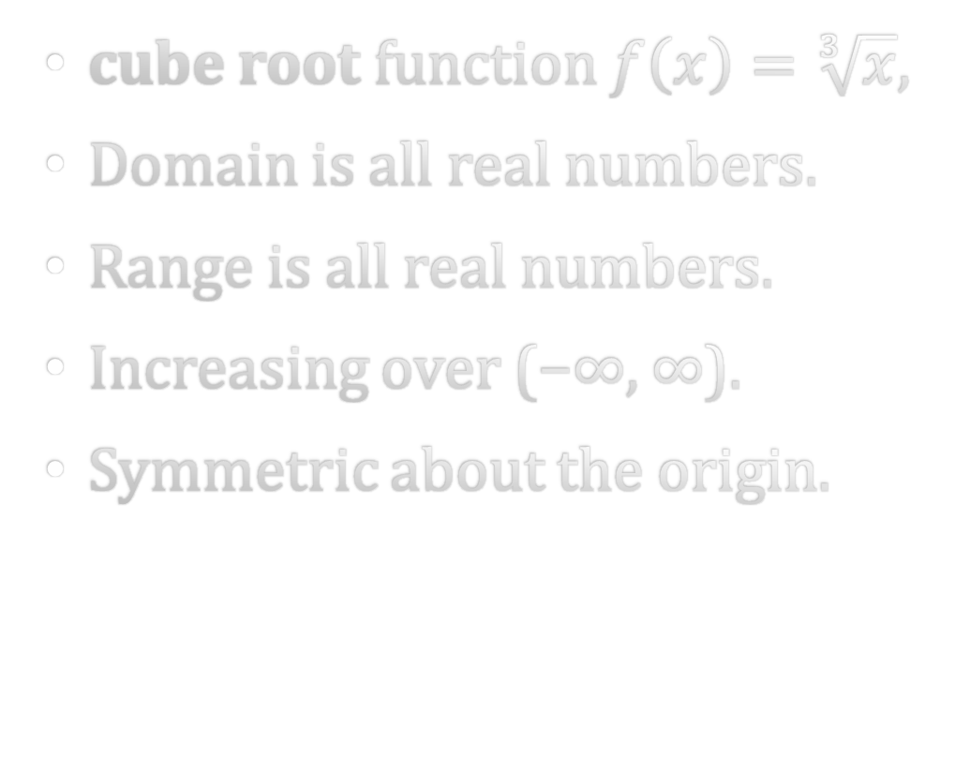
1-06 Graphs of Parent Functions
cube root function $f\left(x\right)=\sqrt[3]{x}$,
Domain is all real numbers.
Range is all real numbers.
Increasing over (−∞, ∞).
Symmetric about the origin.

Slide 43
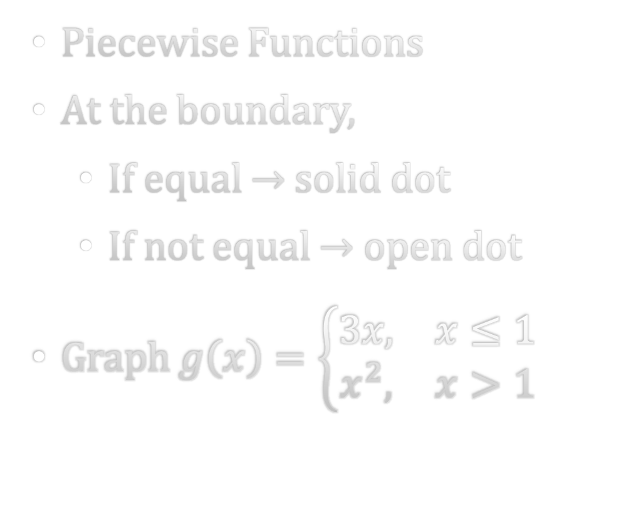
1-06 Graphs of Parent Functions
Piecewise Functions
At the boundary,
  If equal → solid dot
  If not equal → open dot
Graph $g\left(x\right)=\left\{\begin{matrix}3x, & x≤1 \\ x^{2}, & x>1\end{matrix}\right.$

Slide 44
1-07 Transformations of Functions
In this section, you will:
Graph functions with translations.
Graph functions with reflections.
Graph functions with stretches and shrinks.
Perform a sequences of transformations.

Slide 45
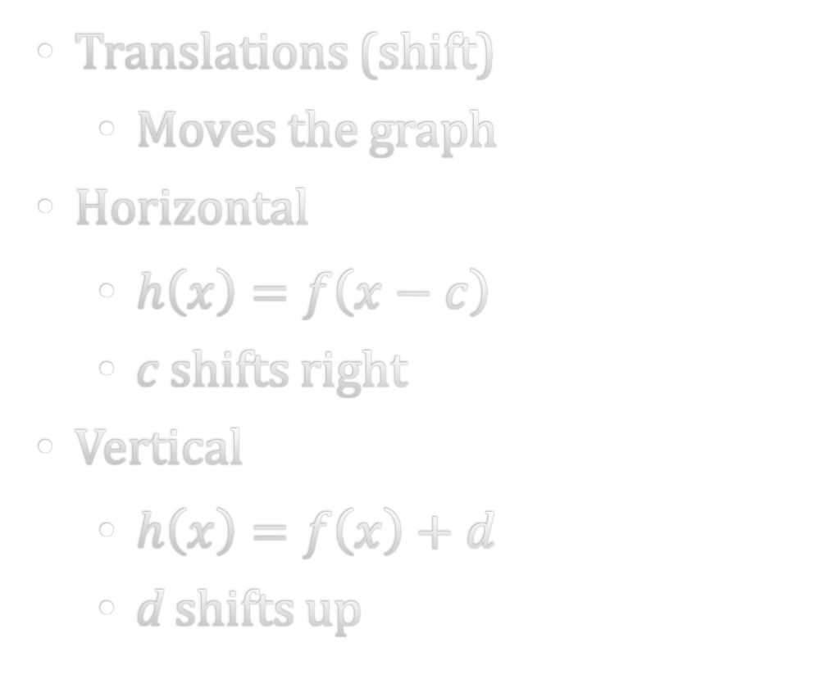

1-07 Transformations of Functions
Translations (shift)
  Moves the graph
Horizontal
  $h\left(x\right)=f\left(x−c\right)$
  c shifts right
Vertical
  $h\left(x\right)=f\left(x\right)+d$
  d shifts up
For $f\left(x\right)=\left|x\right|$, write a function with a vertical shift of 3 down and 2 right.
Notes:
$$h(x)=|x−2|−3$$

Slide 46
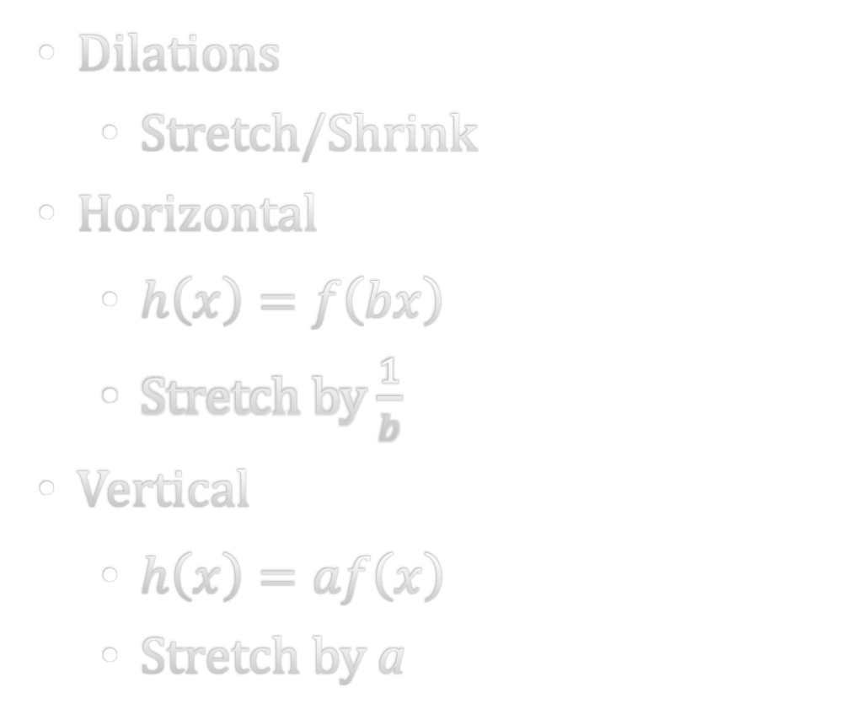
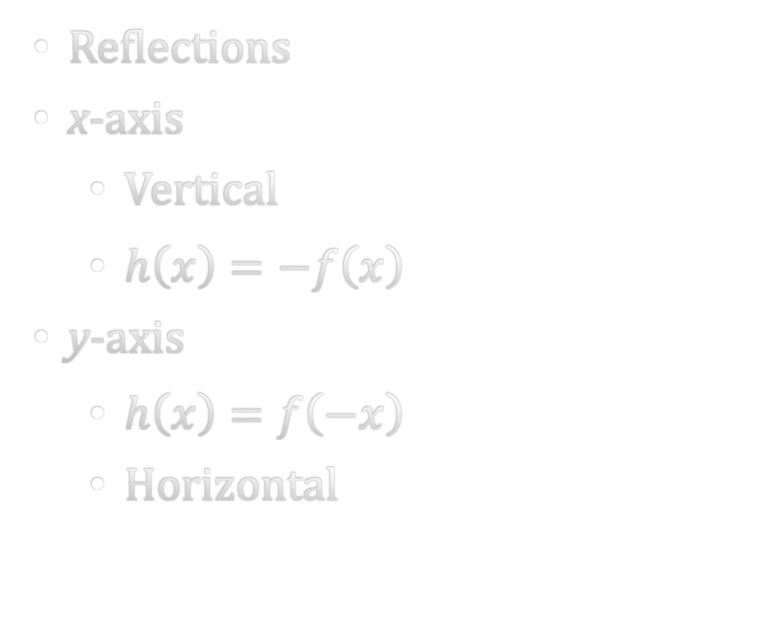
1-07 Transformations of Functions
Reflections
x-axis
  Vertical
  $h\left(x\right)=−f\left(x\right)$
y-axis
  $h\left(x\right)=f\left(−x\right)$
  Horizontal
Dilations
  Stretch/Shrink
Horizontal
  $h\left(x\right)=f\left(bx\right)$
  Stretch by $\frac{1}{b}$
Vertical
  $h\left(x\right)=af\left(x\right)$
  Stretch by a

Slide 47
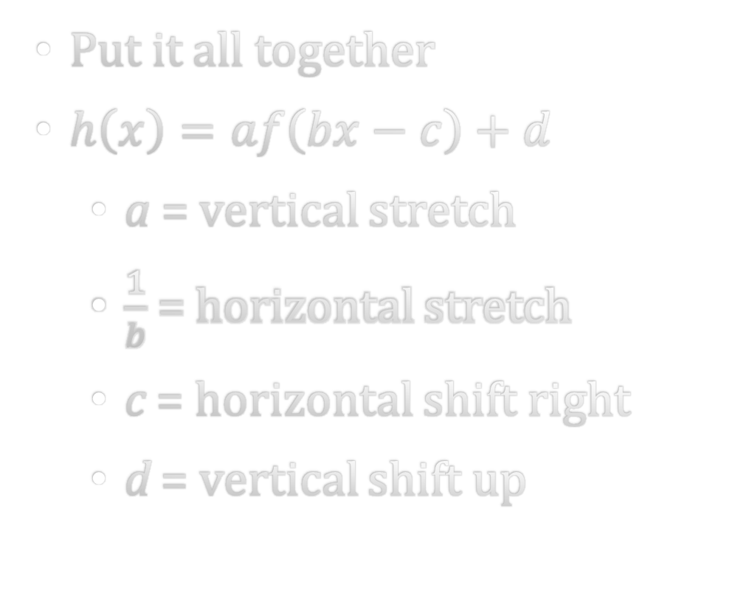
1-07 Transformations of Functions
Put it all together
$h\left(x\right)=af\left(bx−c\right)+d$
  a = vertical stretch
  $\frac{1}{b}$ = horizontal stretch
  c = horizontal shift right
  d = vertical shift up

Slide 48
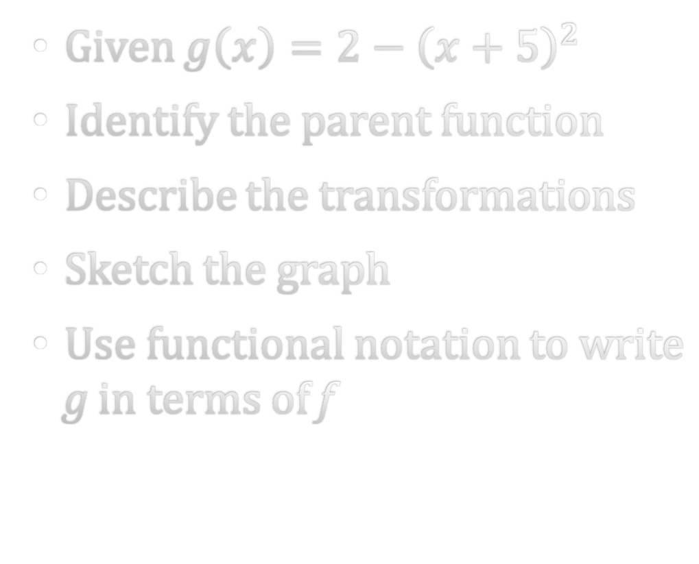
1-07 Transformations of Functions
Given $g\left(x\right)=2−{\left(x+5\right)}^{2}$
Identify the parent function
Describe the transformations
Sketch the graph
Use functional notation to write g in terms of f
Notes:
Quadratic
Reflection over x-axis, shift 5 left, shift 2 up
Graph
$g(x)=−f(x+5)+2$

Slide 49
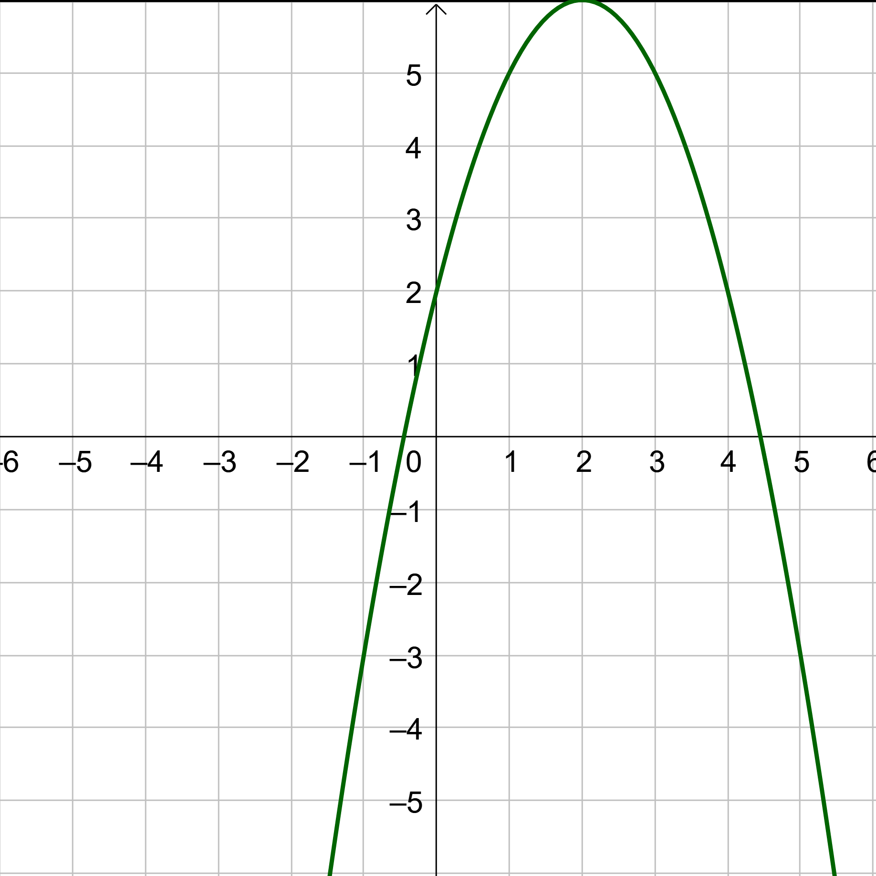
1-07 Transformations of Functions
Write the function for
Notes:
Parent function is f(x)=x²
Shift right 2: c=2
Shift up 6: d=6
Reflect over x-axis: -f(x)
g(x)=-(x-2)²+6

Slide 50
1-08 Combinations of Functions
In this section, you will:
Combine functions using algebraic operations.
Create a composition of functions.

Slide 51
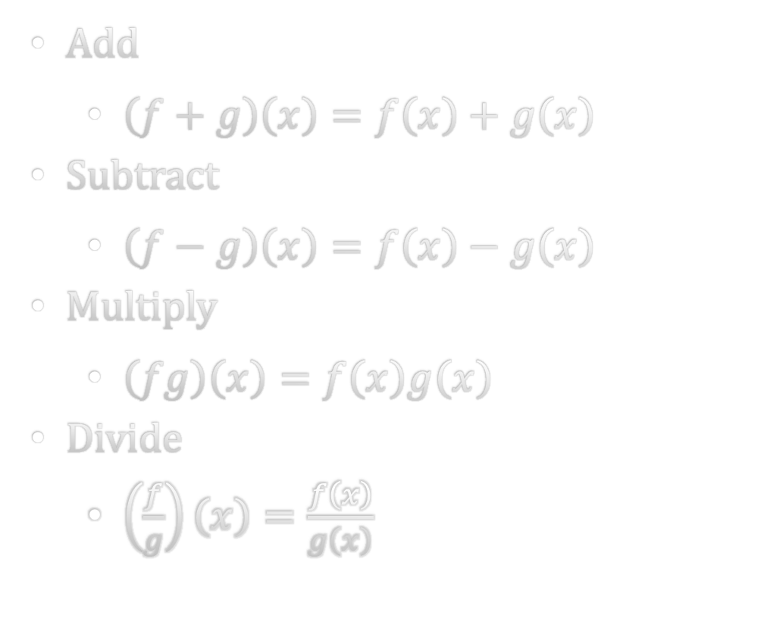
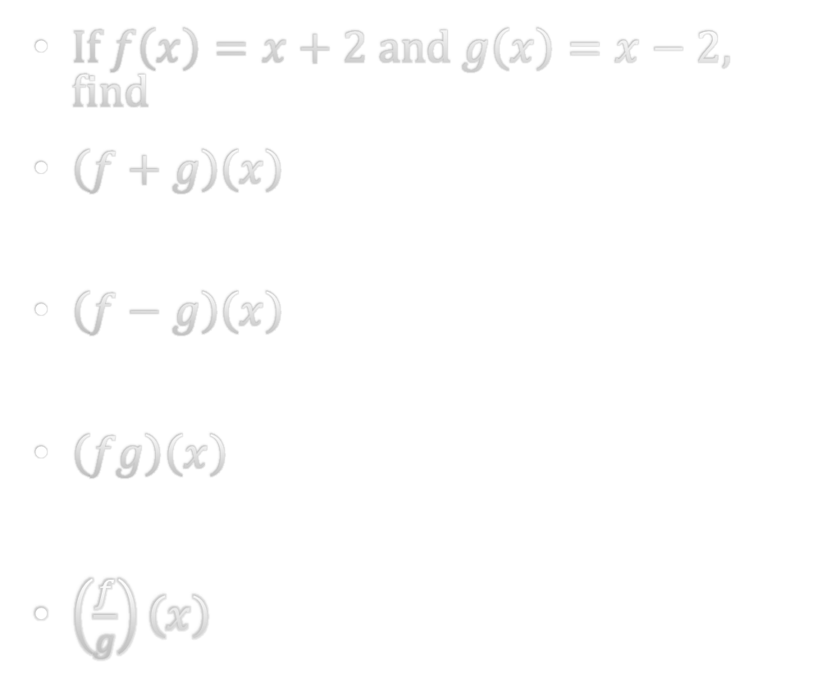
1-08 Combinations of Functions
Add
  $\left(f+g\right)\left(x\right)=f\left(x\right)+g\left(x\right)$
Subtract
  $\left(f−g\right)\left(x\right)=f\left(x\right)−g\left(x\right)$
Multiply
  $\left(fg\right)\left(x\right)=f\left(x\right)g\left(x\right)$
Divide
  $\left(\frac{f}{g}\right)\left(x\right)=\frac{f\left(x\right)}{g\left(x\right)}$
If $f\left(x\right)=x+2$and $g\left(x\right)=x−2$, find
$\left(f+g\right)\left(x\right)$
$\left(f−g\right)\left(x\right)$
$\left(fg\right)\left(x\right)$
$\left(\frac{f}{g}\right)\left(x\right)$
Notes:
2x
4
x²-4
(x+2)/(x-2)

Slide 52
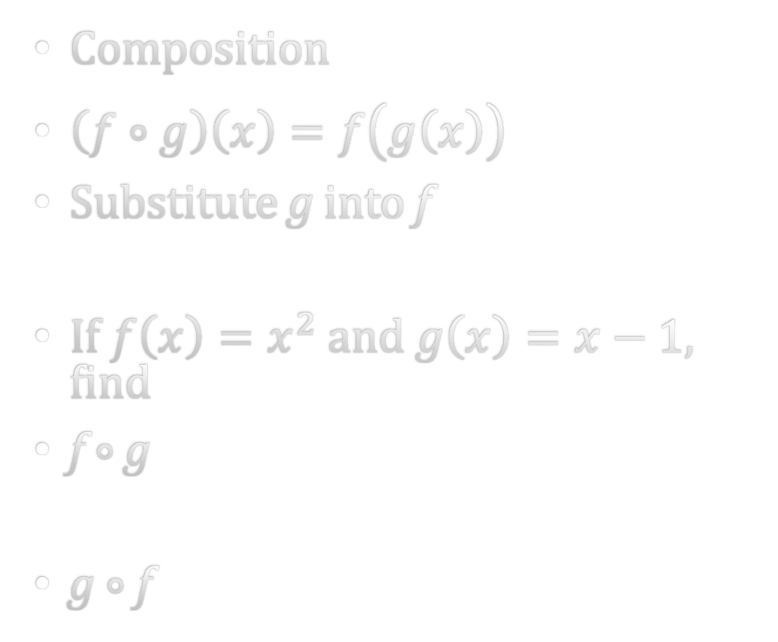
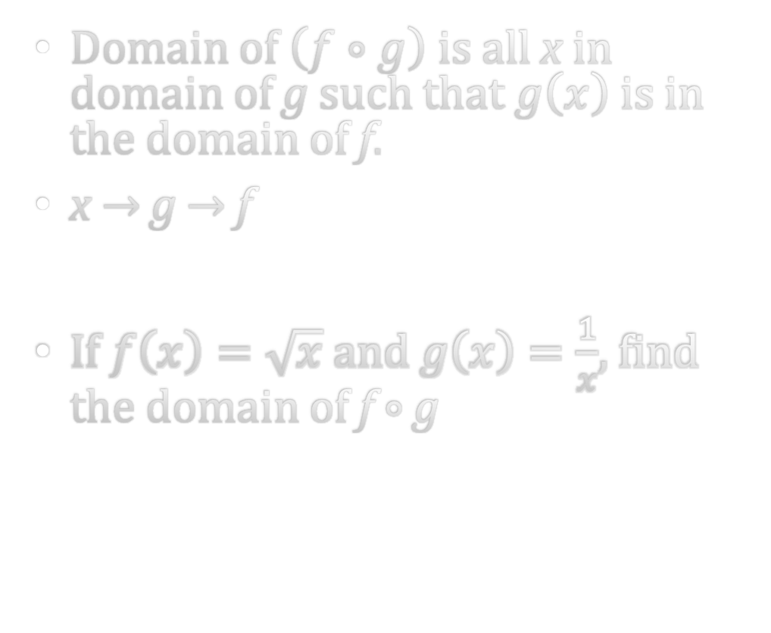
1-08 Combinations of Functions
Composition
$\left(f∘g\right)\left(x\right)=f\left(g\left(x\right)\right)$
Substitute g into f
If $f\left(x\right)=x^{2}$ and $g\left(x\right)=x−1$, find
f ∘ g
g ∘ f
Domain of $\left(f∘g\right)$ is all x in domain of g such that $g\left(x\right)$ is in the domain of f.
x → g → f
If $f\left(x\right)=\sqrt{x}$ and $g\left(x\right)=\frac{1}{x}$, find the domain of f ∘ g
Notes:
x²-2x+1
x²-1
Domain of g: x≠0
Domain of f: x≥0
Let g=domain of f (or excluded domain) and solve for x
1/x≥0 → true when x>0
Answer: x>0

Slide 53
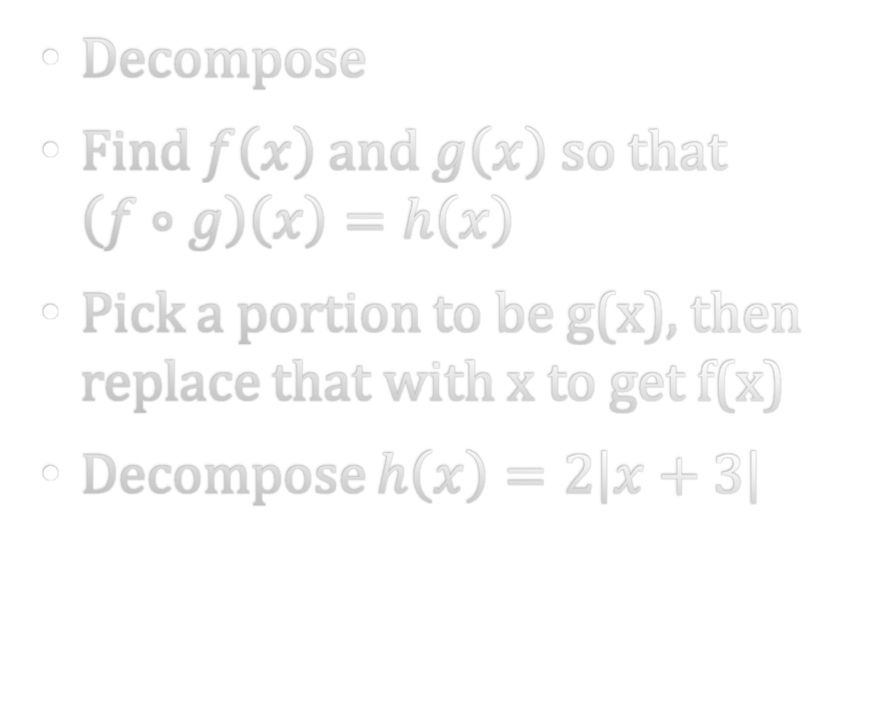
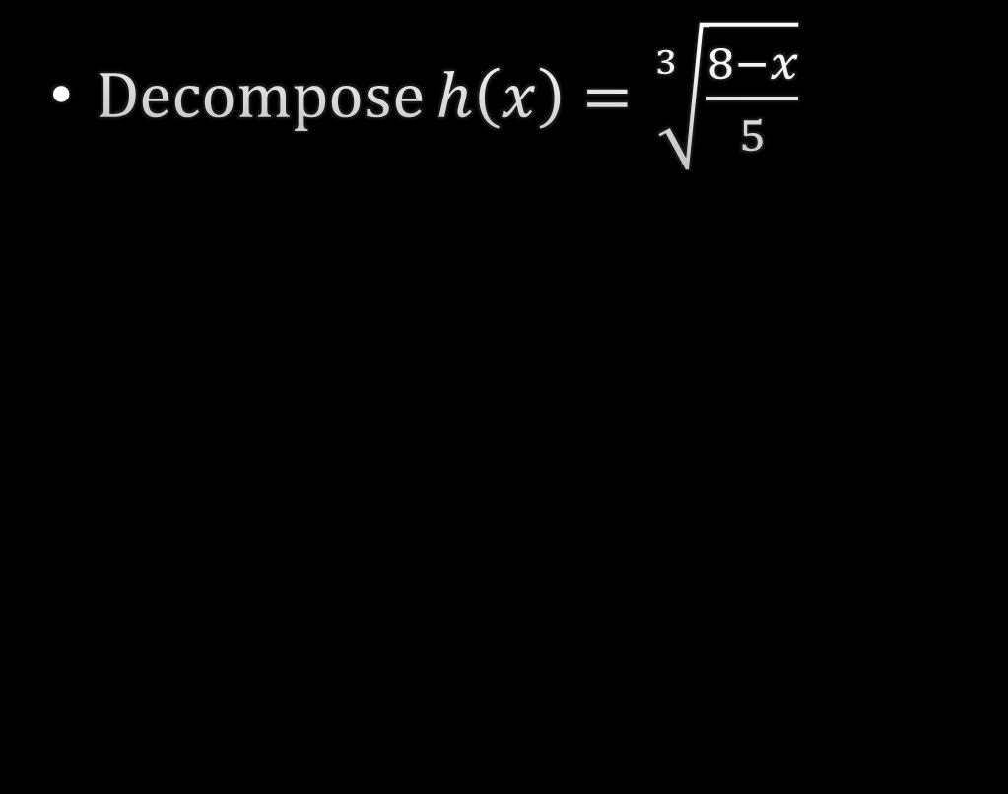
1-08 Combinations of Functions
Decompose
Find $f\left(x\right)$ and $g\left(x\right)$ so that $\left(f∘g\right)\left(x\right)=h\left(x\right)$
Pick a portion to be g(x), then replace that with x to get f(x)
Decompose $h\left(x\right)=2\left|x+3\right|$
Decompose $h\left(x\right)=\sqrt[3]{\frac{8−x}{5}}$
Notes:
g(x)=x+3; f(x)=2|x|
g(x)=(8-x)/5; f(x)=³√(x)

Slide 54
1-09 Inverse Functions
In this section, you will:
Verify that two functions are inverse functions.
Find the domain and range on inverse functions.
Find the inverse of a function.

Slide 55

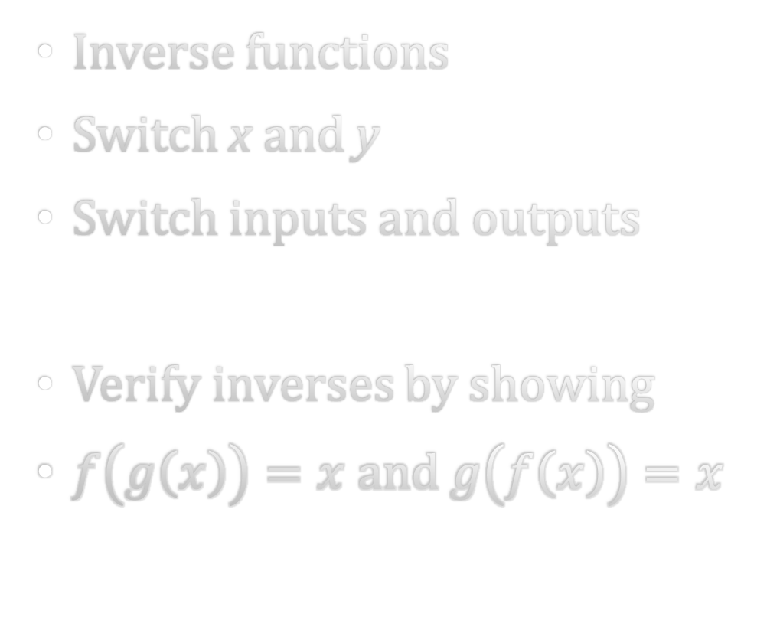
1-09 Inverse Functions
Inverse functions
Switch x and y
Switch inputs and outputs
Verify inverses by showing
$f\left(g\left(x\right)\right)=x$ and $g\left(f\left(x\right)\right)=x$
Verify that $f\left(x\right)=7x−4$ and $g\left(x\right)=\frac{x+4}{7}$ are inverses

Slide 56
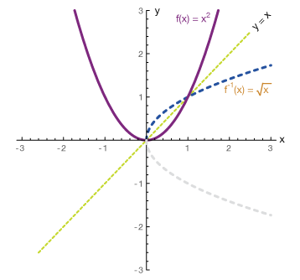
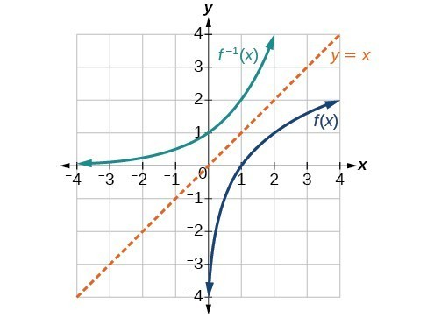
1-09 Inverse Functions
Graphs of inverses
Reflected over line y = x
One-to-one
A function is one-to-one if each y corresponds to exactly one x.
Passes the horizontal line test
Inverse of a 1-to-1 is a function

Slide 57
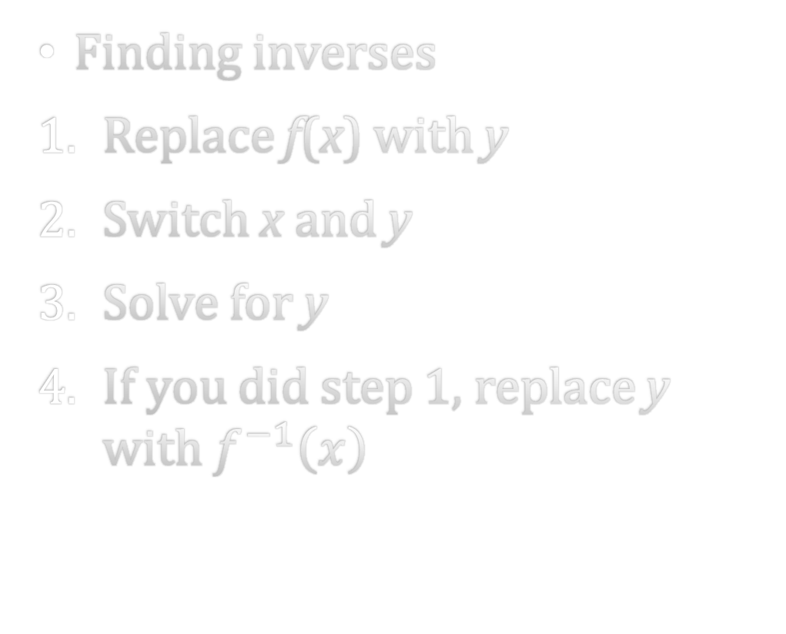

1-09 Inverse Functions
Finding inverses
Replace f(x) with y
Switch x and y
Solve for y
If you did step 1, replace y with $f^{−1}\left(x\right)$
Find the inverse of
$f\left(x\right)=\sqrt[3]{10+x}$
Notes:
f⁻¹(x)=x³-10

Slide 58

1-09 Inverse Functions
Find the inverse of $f\left(x\right)=x^{2}−2, x<0$
Notes:
f⁻¹(x)=-√(x+2)

Slide 59
1-10 Mathematical Modeling
In this section, you will:
Draw and interpret scatter plots.
Find the best-fitting line using a graphing utility.
Calculate variations.

Slide 60
1-10 Mathematical Modeling
Mathematical modeling
Find a function to fit data points
Least squares regression (linear)
Gives the best fitting line
The amount of error is given by the correlation coefficient (r)

Slide 61
1-10 Mathematical Modeling
Number (in 1000s) of female USAF personnel, P, on active duty
Find a model with t=0 being 2000
On TI-graphing
STAT ∨ Edit... and enter data
STAT → CALC ∨ LinReg(ax+b)
Year | 2000 | 2001 | 2002 | 2003 | 2004
P | 66.8 | 67.6 | 71.5 | 73.5 | 73.8
Notes:
P=1.99t+66.7

Slide 62
1-10 Mathematical Modeling
Real-Life Problems
Slope = rate of change
Interpolation
  Within data
  Small error
Extrapolation
  Outside of data
  Possibly huge error

Slide 63

1-10 Mathematical Modeling
Variations
Direct $y=ax$
  $x↑, y↑$
Inverse $y=\frac{a}{x}$
  $x↑, y↓$
Joint $z=axy$
a = constant of variation
A company found the demand for its product varies inversely as the price of the product. When the price is $2.75, the demand is 600 units. Write an equation.
Notes:
Inverse variation
d=1650/p

