Slide 1
Exponential and Logarithmic Functions
Precalculus
Chapter 3

Slide 2
This Slideshow was developed to accompany the textbook
  Precalculus
  By Richard Wright
  https://www.andrews.edu/~rwright/Precalculus-RLW/Text/TOC.html
Some examples and diagrams are taken from the textbook.
Slides created by
Richard Wright, Andrews Academy
rwright@andrews.edu

Slide 3
3-01 Exponential Functions
In this section, you will:
Evaluate exponential functions with base b.
Graph exponential functions with base b.
Evaluate and graph exponential functions with base e.

Slide 4
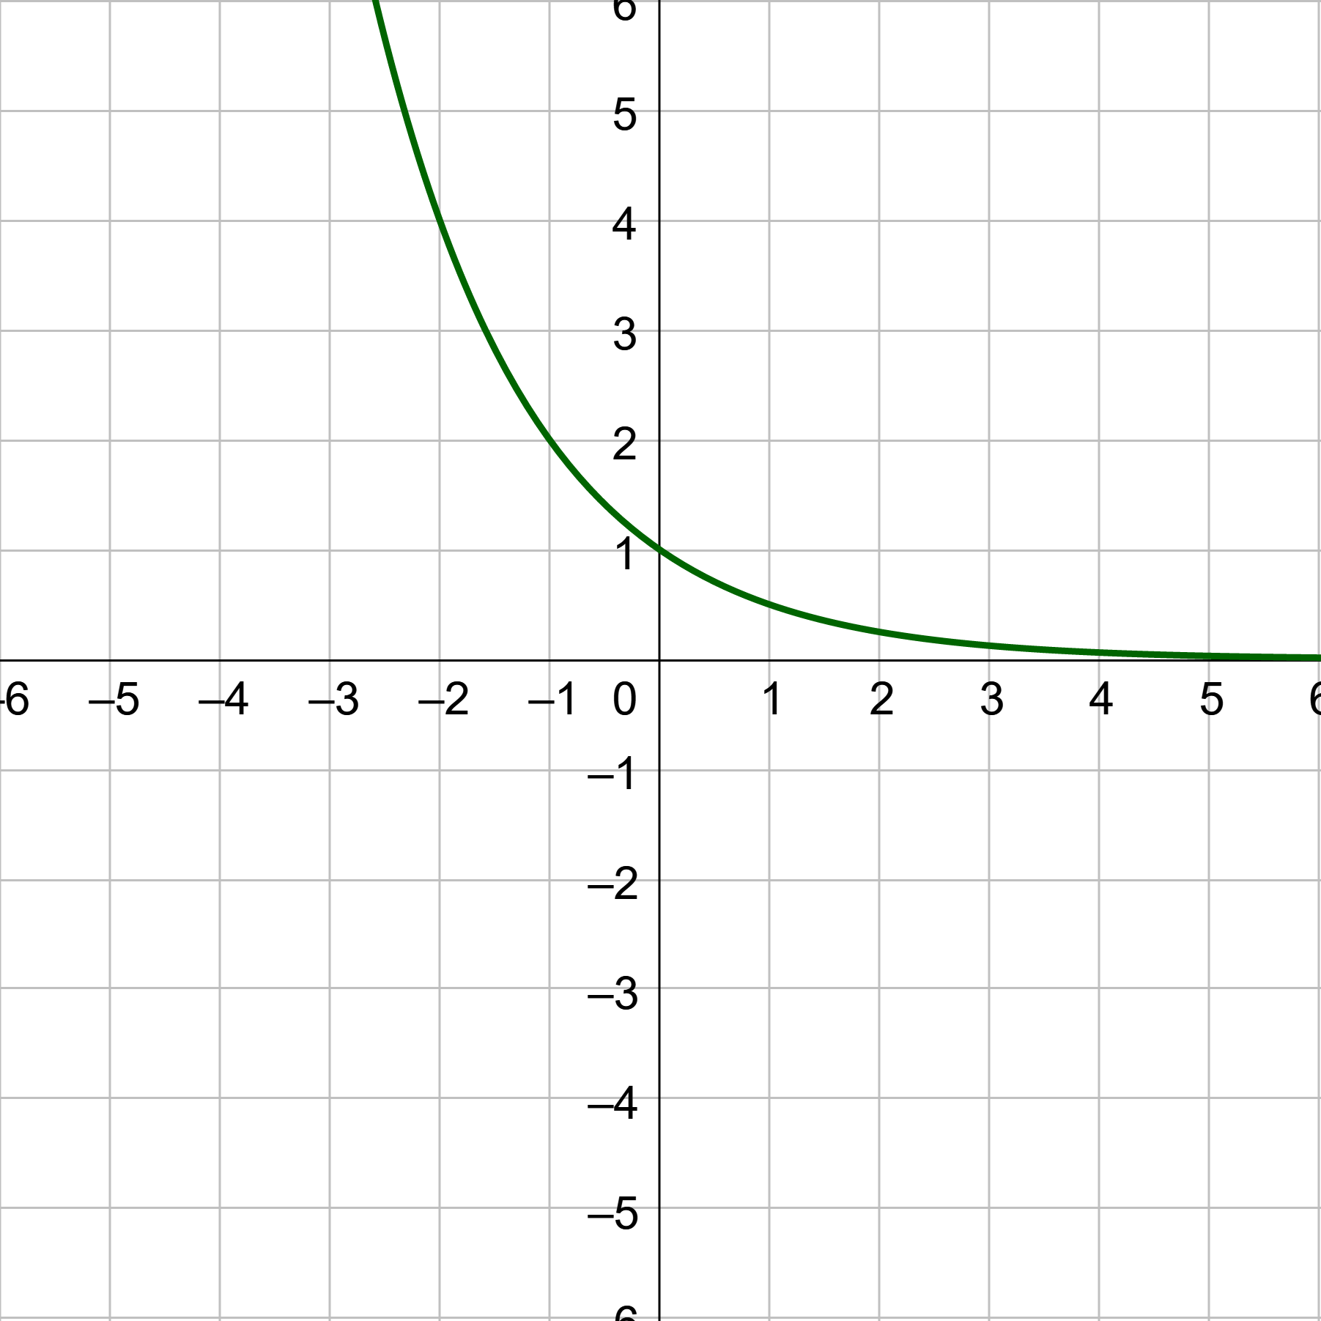
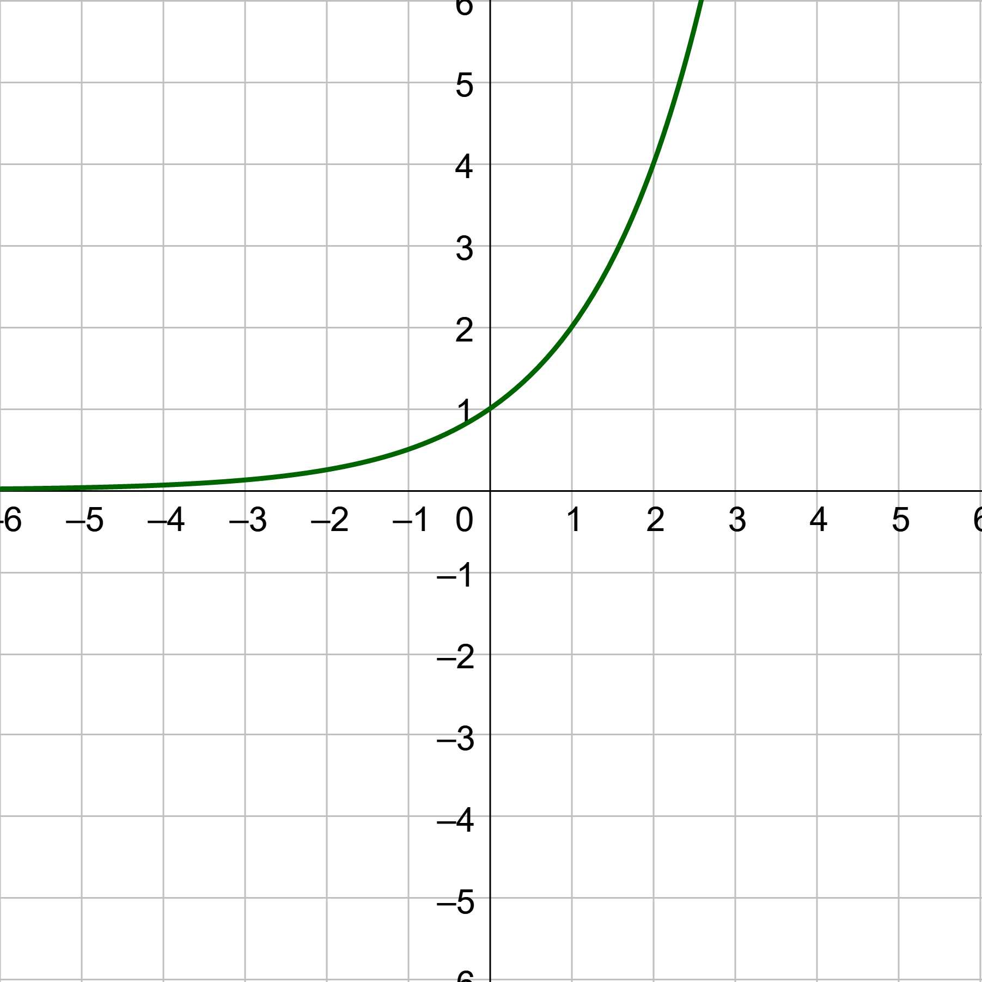

3-01 Exponential Functions
Exponential function
  $y=a∙b^{x}$
  a is initial amount (y-int)
  b is base
  x is exponent
If b > 1
  Exponential Growth
If 0 < b < 1
  Exponential Decay

Slide 5
3-01 Exponential Functions
Domain: All real numbers
Range: (0, ∞)
Horizontal Asymptote:
  y = 0
y-intercept: (0, 1)

Slide 6

3-01 Exponential Functions
Transformations
$y=a∙b^{x−h}+k$
  a vertical stretch
    If a is negative, then reflected over x-axis
  h moves right
  k moves up
Domain: All Real
Range:
  (k, ∞) if a > 0
  (-∞, k) if a < 0
HA: y = k
y-int: (0, a + k) if h = 0

Slide 7

3-01 Exponential Functions
Graph by making a table
Graph $y=4^{−x}+3$
Decay
HA: y = 3

Slide 8

3-01 Exponential Functions
Exponential functions are one-to-one
  Each x gives a unique y
Solve $16=2^{x+2}$
Notes:
$$16=2^{x+2}$$
$$2^{4}=2^{x+2}$$
Exponents must be equal
$$4=x+2$$
$$2=x$$

Slide 9

3-01 Exponential Functions
Solve ${\left(\frac{1}{3}\right)}^{x}=81$
Notes:
$${\left(\frac{1}{3}\right)}^{x}=3^{4}$$
$${\left(\frac{1}{3}\right)}^{x}={\left(\frac{1}{3}\right)}^{−4}$$
Exponents must be equal
$$x=−4$$

Slide 10
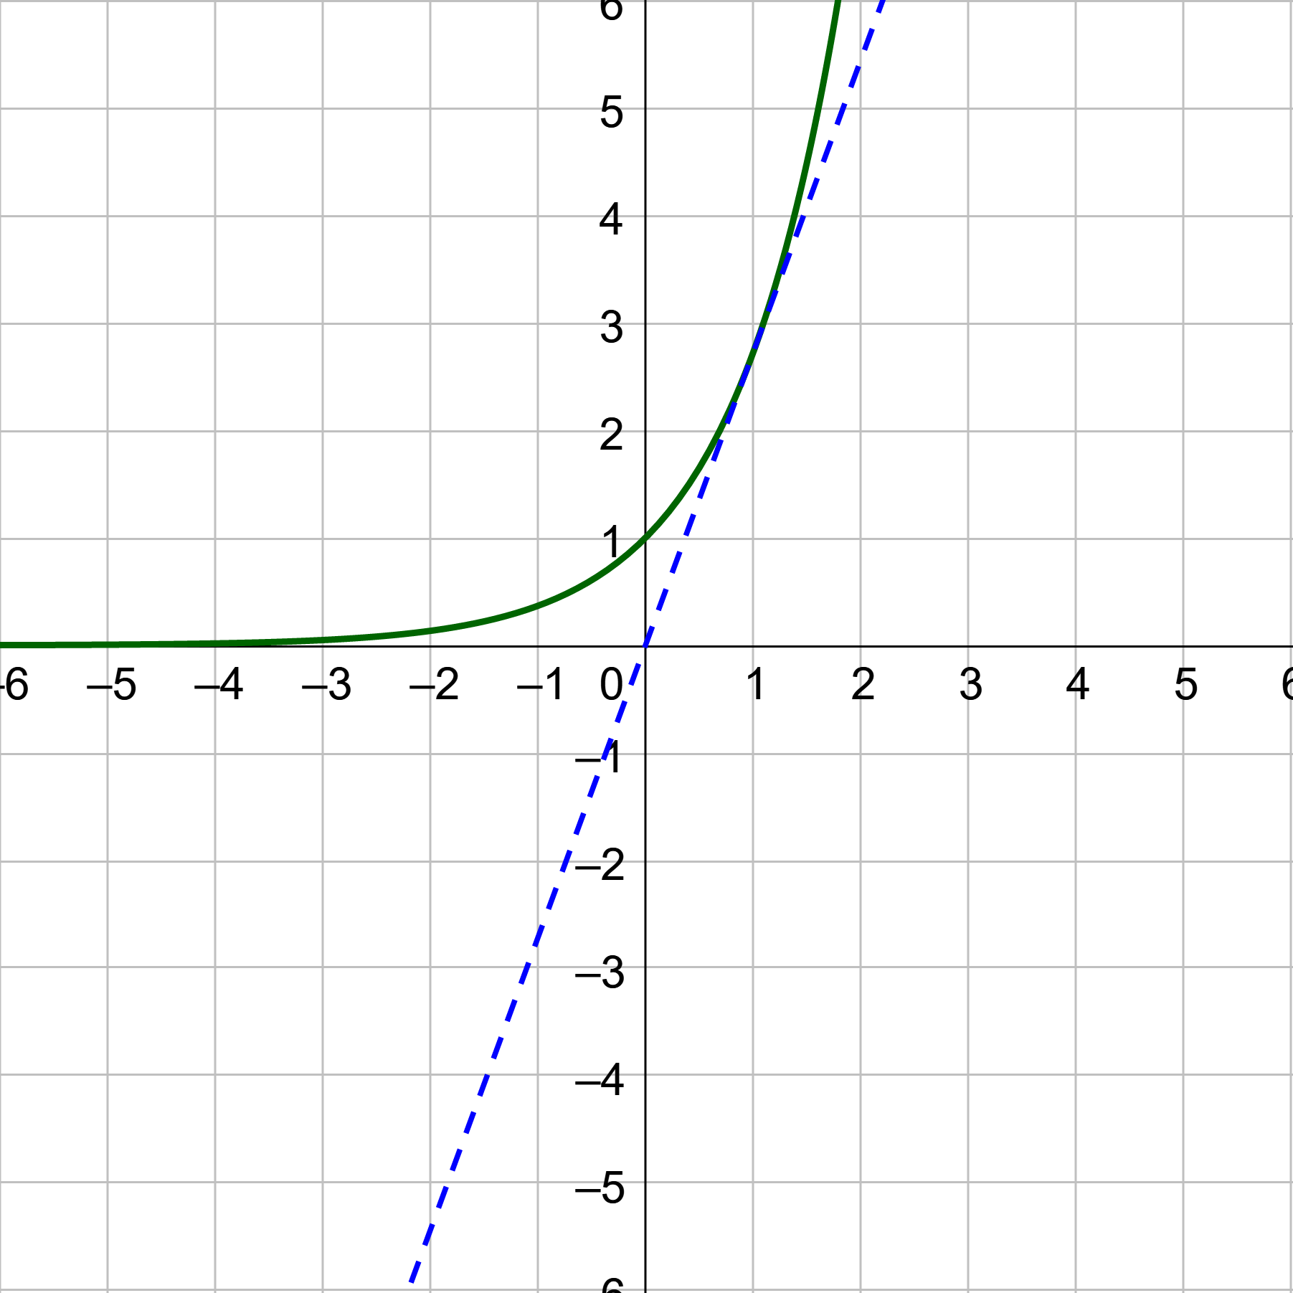

3-01 Exponential Functions
Natural Base
  e ≈ 2.718281828…
$f\left(x\right)=e^{x}$
Notes:
Slope of any tangent line to e^x is e^x

Slide 11


3-01 Exponential Functions
Compound Interest
$A=P{\left(1+\frac{r}{n}\right)}^{nt}$
A = current amount
P = principle (initial amount)
r = yearly interest rate (APR)
n = number of compoundings per year
t = years
Compounded Continuously
$A=Pe^{rt}$
$e={\left(1+\frac{1}{n}\right)}^{n}$
  When $n→∞$

Slide 12
3-02 Logarithmic Functions
In this section, you will:
Evaluate logarithmic functions with base b.
Evaluate logarithmic functions with base e.
Use logarithmic functions to solve real world problems.

Slide 13

3-02 Logarithmic Functions
$f\left(x\right)=\log_{b}{x}$
  “log base b of x”
Logarithms are inverses of exponential functions
  $y=\log_{b}{x}↔x=b^{y}$
Logarithms are exponents!

Slide 14


3-02 Logarithmic Functions
Evaluate
Think “What exponent of the base gives the big number?”
$\log_{5}{125}$
$\log_{2}{\frac{1}{64}}$
Notes:
Think $5^{x}=125$
$5^{3}=125$
So $\log_{5}{125}=3$
Think $2^{x}=\frac{1}{64}$
$2^{−6}=\frac{1}{64}$
So $\log_{2}{\frac{1}{64}}=−6$

Slide 15


3-02 Logarithmic Functions
Calculator
LOG → $\log_{10}{}$ → log
LN → $\log_{e}{}$ → ln
Use your calculator to evaluate $\log{300}$
Notes:
2.477

Slide 16


3-02 Logarithmic Functions
Properties of Logarithms
$\log_{b}{1}=0$
$\log_{b}{b}=1$
$\log_{b}{b^{x}}=x$
If $\log_{b}{x}=\log_{b}{y}$, then $x=y$
Simplify
$\log_{5}{1}$
$\log_{e}{e}$
$8^{\log_{8}{30}}$
Notes:
$$\log_{5}{1}=0$$
$$\log_{e}{e}=\ln{e}=1$$
$$8^{\log_{8}{30}}=x$$
Rewrite as an exponential
$$\log_{8}{x}=\log_{8}{30}$$
$$x=30$$

Slide 17

3-02 Logarithmic Functions
Solve
$\log_{3}\left(x^{2}+4\right)=\log_{3}{29}$
Notes:
Since logs are the same
$$x^{2}+4=29$$
$$x^{2}=25$$
$$x= ±5$$

Slide 18
3-03 Properties of Logarithms
In this section, you will:
Use properties of logarithms to expand logarithmic expressions.
Use properties of logarithms to condense logarithmic expressions.
Use the change-of-base formula to evaluate logarithms.
Graph logarithmic functions.

Slide 19

3-03 Properties of Logarithms
Properties of Logarithms
  Product Property: $\log_{b}\left(uv\right)=\log_{b}{u}+\log_{b}{v}$
  Quotient Property: $\log_{b}\left(\frac{u}{v}\right)=\log_{b}{u}−\log_{b}{v}$
  Power Property: $\log_{b}{u^{n}}=n\log_{b}{u}$

Slide 20

3-03 Properties of Logarithms
Write each log in terms of ln 2 and ln 5.
$\ln{10}$
$\ln{\frac{5}{32}}$
Notes:
$$\ln{10}$$
$$\ln\left(2∙5\right)$$
$$\ln{2}+\ln{5}$$
$$\ln{\frac{5}{32}}$$
$$\ln{\frac{5}{2^{5}}}$$
$$\ln{5}−\ln{2^{5}}$$
$$\ln{5}−5\ln{2}$$

Slide 21


3-03 Properties of Logarithms
Expand
$\log{3x^{2}y}$
$\ln{\frac{\sqrt{4x+1}}{8}}$
Notes:
$$\log{3}+\log{x^{2}}+\log{y}$$
$$\log{3+2\log{x}+\log{y}}$$
$$\ln{{\left(4x+1\right)}^{\frac{1}{2}}−\ln{8}}$$
$$\frac{1}{2}\ln{(4x+1)}−\ln{8}$$

Slide 22


3-03 Properties of Logarithms
Condense
$\frac{1}{3}\log{x}+5\log\left(x−3\right)$
$4\ln\left(x−4\right)−2\ln{x}$
Notes:
$$\log{x^{\frac{1}{3}}}+\log{{\left(x−3\right)}^{5}}$$
$$\log\left(x^{\frac{1}{3}}{\left(x−3\right)}^{5}\right)$$
$$\ln{{\left(x−4\right)}^{4}}−\ln{x^{2}}$$
$$\ln{\frac{{\left(x−4\right)}^{4}}{x^{2}}}$$

Slide 23

3-03 Properties of Logarithms
Condense
$\frac{1}{5}\left(\log_{3}{x}+\log_{3}\left(x−2\right)\right)$
Notes:
$$\frac{1}{5}\left(\log_{3}{x}+\log_{3}\left(x−2\right)\right)$$
$$\frac{1}{5}\left(\log_{3}{x\left(x−2\right)}\right)$$
$$\log_{3}{{\left(x\left(x−2\right)\right)}^{\frac{1}{5}}}$$
$$\log_{3}{\sqrt[5]{x\left(x−2\right)}}$$

Slide 24


3-03 Properties of Logarithms
Change-of-Base Formula
  $\log_{b}{c}=\frac{\log_{a}{c}}{\log_{a}{b}}$
Evaluate
$\log_{3}{17}$
Notes:
$$\frac{\log{17}}{\log{3}}=2.579$$

Slide 25
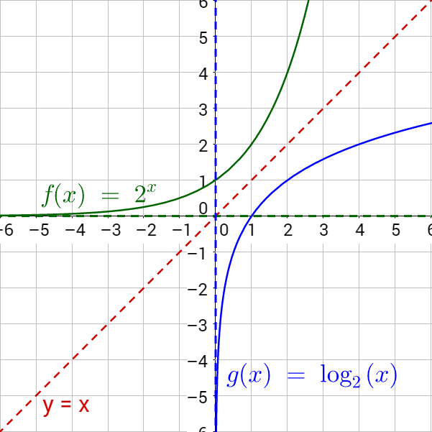

3-03 Properties of Logarithms
Because logs are inverses of exponentials, the x and y is switched and the graph is flipped over the line y = x.
$y=\log_{b}{(x−h)}$
  Domain: $x>h$
  Range: all real
  VA: $x=h$
  x-int: (h + 1, 0)

Slide 26

3-03 Properties of Logarithms
To graph a logarithm
Find and graph the vertical asymptote
Make a table
  Use change-of-base formula
    $\log_{b}{x}=\frac{\log{x}}{\log{b}}$
  Or use the logBASE function on some TI graphing calcs
    MATH → logBASE

Slide 27

3-03 Properties of Logarithms
Graph $y=\log_{2}{(x+1)}$
Notes:
Change-of-base gives $y=\log_{2}\left(x+1\right)→y=\frac{\log\left(x+1\right)}{\log{2}}$
x | y
-1 | Error
0 | 0
| 1
| 1.58
| 2
| 2.32
| 2.58
| 2.81
| 3

Slide 28
3-04 Solving Exponential and Logarithmic Equations
In this section, you will:
Use one-to-one property to solve exponential equations.
Use one-to-one property to solve logarithmic equations.
Solve general exponential equations.
Solve general logarithmic functions.

Slide 29

3-04 Solving Exponential and Logarithmic Equations
Solve Exponential Equations
  Shortcut Method
    1-to-1 method (rewrite with the same base)
${\left(\frac{1}{5}\right)}^{x}=125$
Notes:
$${\left(\frac{1}{5}\right)}^{x}=125$$
$${\left(\frac{1}{5}\right)}^{x}={\left(\frac{1}{5}\right)}^{−3}$$
$$x=−3$$

Slide 30


3-04 Solving Exponential and Logarithmic Equations
General Method
  Take log of both sides
$5−3e^{x}=2$
$6\left(2^{t+5}\right)+4=11$
Notes:
$$5−3e^{x}=2$$
$$−3e^{x}=−3$$
$$e^{x}=1$$
$$\ln{e^{x}}=\ln{1}$$
$$x=0$$
$$6\left(2^{t+5}\right)+4=11$$
$$6\left(2^{t+5}\right)=7$$
$$2^{t+5}=\frac{7}{6}$$
$$\log_{2}{2^{t+5}}=\log_{2}{\frac{7}{6}}$$
$$t+5=\log_{2}{\frac{7}{6}}$$
$$t=−5+\log_{2}{\frac{7}{6}}≈−4.778$$

Slide 31

3-04 Solving Exponential and Logarithmic Equations
$e^{2x}−7e^{x}+12=0$
Notes:
$$\left(e^{x}−3\right)\left(e^{x}−4\right)=0$$
$$e^{x}−3=0 e^{x}−4=0$$
$$e^{x}=3 e^{x}=4$$
$$\ln{e^{x}}=\ln{3} \ln{e^{x}}=\ln{4}$$
$$x=\ln{3}≈1.099 x=\ln{4}≈1.386$$

Slide 32

3-04 Solving Exponential and Logarithmic Equations
Logarithmic Equations
Shortcut Method
  1-to-1 Property
$\ln{x}−\ln{3}=0$
Notes:
$$\ln{x}−\ln{3}=0$$
$$\ln{x}=\ln{3}$$
$$x=3$$

Slide 33


3-04 Solving Exponential and Logarithmic Equations
General Method
  Exponentiate both sides
$6+3\ln{x}=4$
$\log_{4}{x}+\log_{4}{(x−9)}=1$
Notes:
$$6+3\ln{x}=4$$
$$3\ln{x}=−2$$
$$\ln{x}=−\frac{2}{3}$$
$$e^{\ln{x}}=e^{−\frac{2}{3}}$$
$$x=e^{−\frac{2}{3}}≈0.513$$
$$\log_{4}{x}+\log_{4}{(x−9)}=1$$
$$\log_{4}{x\left(x−9\right)}=1$$
$$4^{\log_{4}{x\left(x−9\right)}}=4^{1}$$
$$x\left(x−9\right)=4$$
$$x^{2}−9x−4=0$$
$$x=\frac{9±\sqrt{9^{2}−4\left(1\right)\left(−4\right)}}{2\left(1\right)}$$
$$x=\frac{9±\sqrt{97}}{2}≈9.424, −0.424$$

Slide 34

3-04 Solving Exponential and Logarithmic Equations
Graphical method
  If the other methods don’t apply
  Make = 0
  Find the x-int
Solve $\log_{2}{x}=\ln{2x}$
Notes:
$$\log_{2}{x}−\ln{2x}=0$$
Graph and find x-int
$$x=4.786$$

Slide 35
3-05 Exponential and Logarithmic Models
In this section, you will:
Use exponential growth and decay models.
Use the Gaussian model.
Use the logistic growth model.
Use logarithmic models.

Slide 36
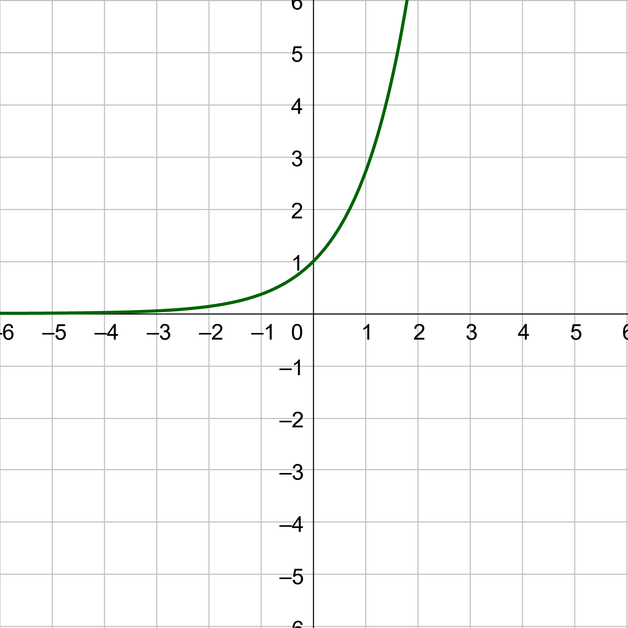
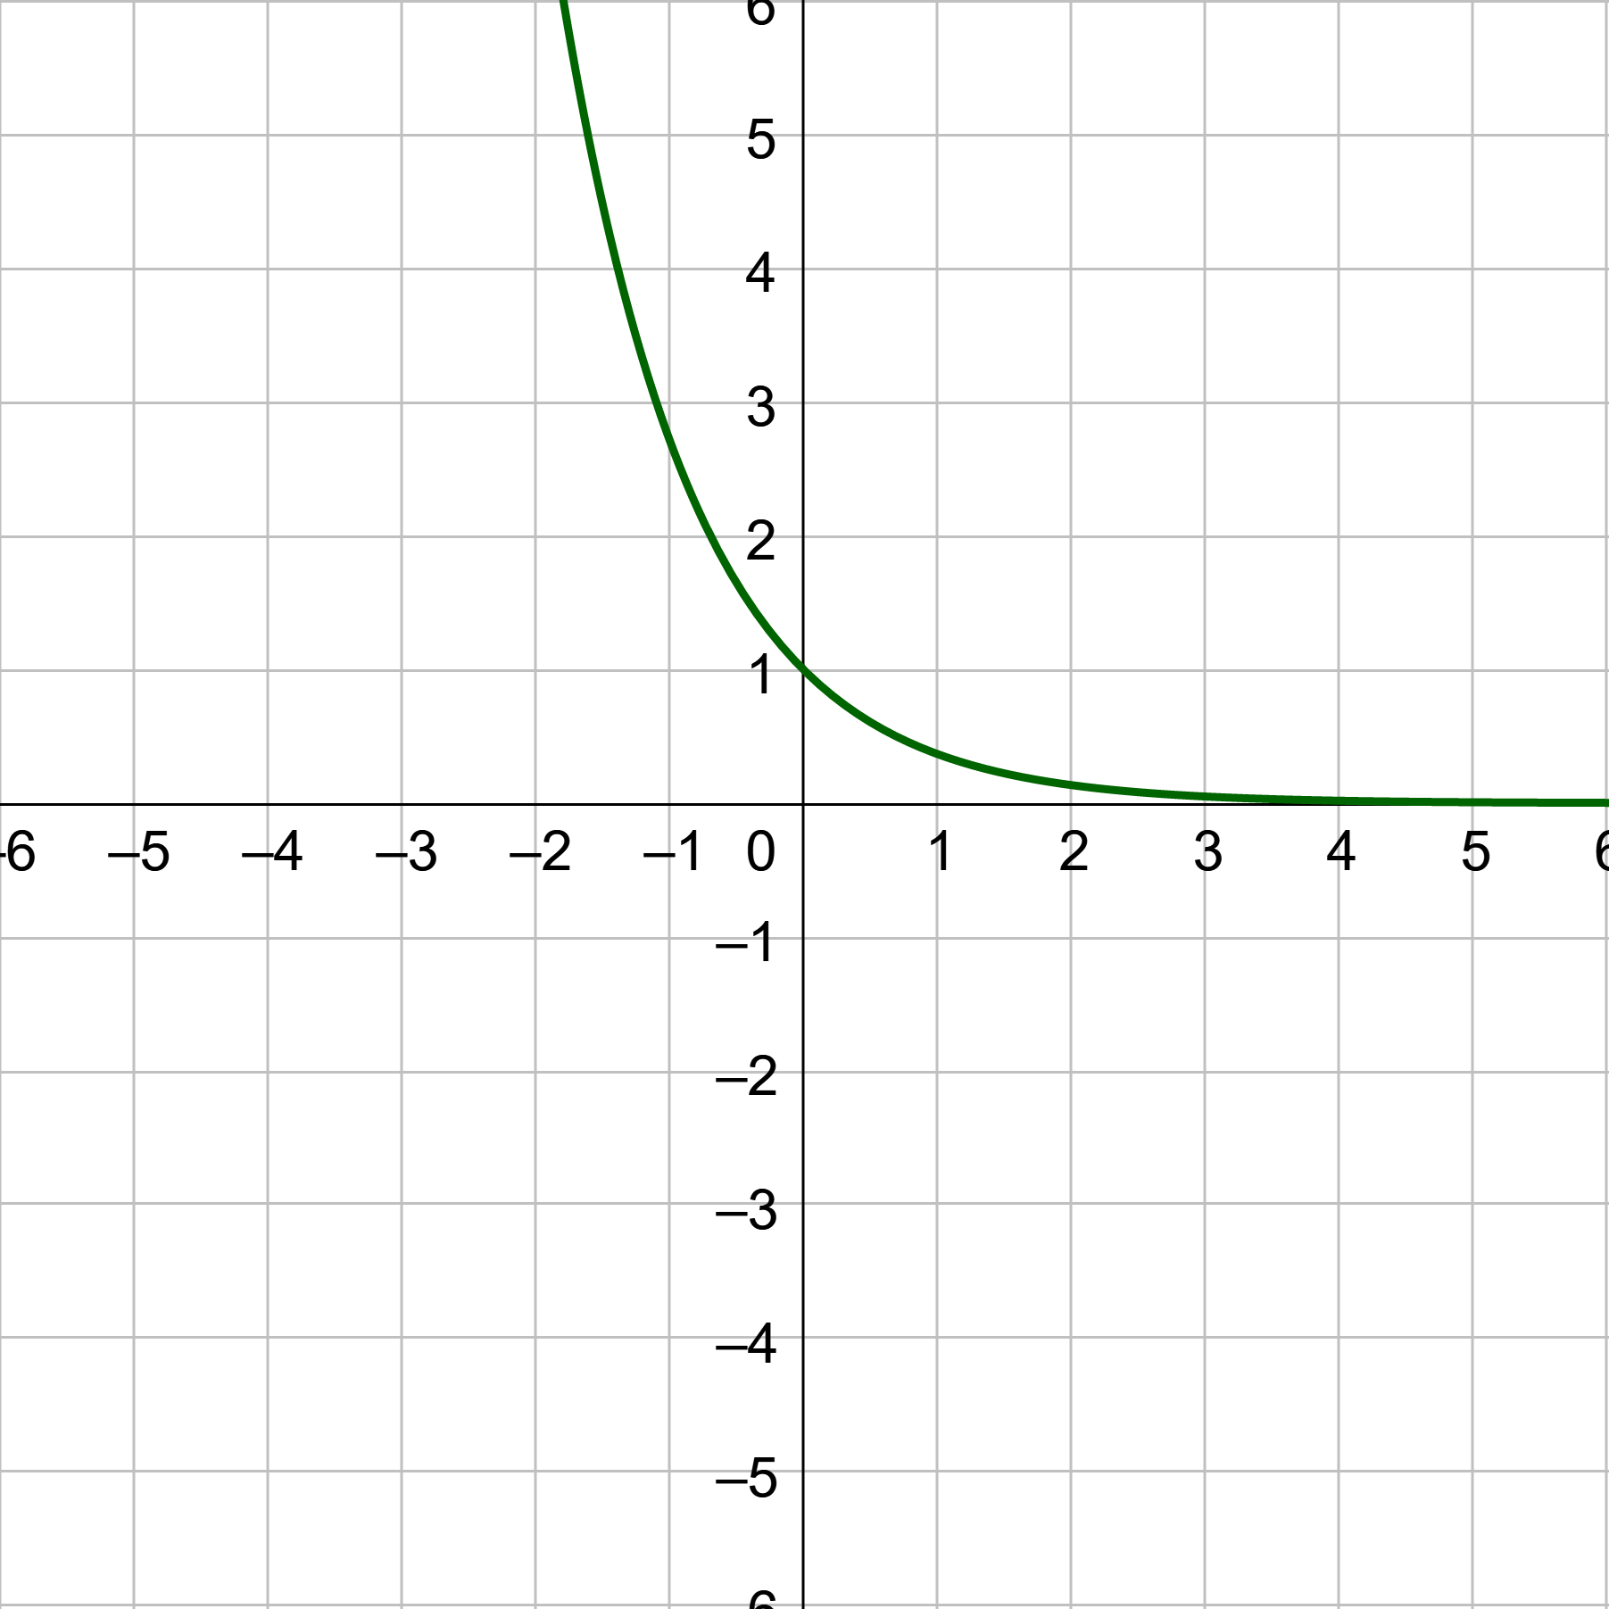


3-05 Exponential and Logarithmic Models
Exponential Growth $y=ae^{bx}$
Exponential Decay $y=ae^{−bx}$

Slide 37

3-05 Exponential and Logarithmic Models
Suppose a population growing according to the model $P=800e^{0.03t}$ where t is in years.
What is the initial size?
How long to double?
Notes:
Let $t=0$.
$$P=800e^{0.05\left(0\right)}=800$$
$$1600=800e^{0.05t}$$
$$2=e^{0.05t}$$
$$\ln{2}=\ln{e^{0.05t}}$$
$$\ln{2}=0.05t$$
$$t=13.86 yrs$$

Slide 38
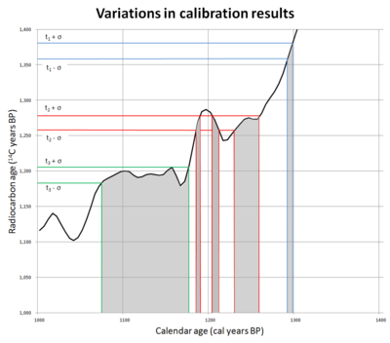

3-05 Exponential and Logarithmic Models
Radioactive decay
  $y=ae^{−bx}$
  $A=A_{0}e^{kt}$
  Half-life
    Time it takes for ½ of the material to decay
Notes:
Very complicated, but we will use a simple model
The dating method depends on the initial conditions. These are not really known for prehistorical situations.

Slide 39
3-05 Exponential and Logarithmic Models
C¹⁴ has a half-life of 5700 years. If a sample starts with 3 g of C¹⁴, how much will remain after 100 years?
Notes:
Find decay constant
$$A=A_{0}e^{kt}$$
$$1.5=3e^{k\left(5700\right)}$$
$$\frac{1}{2}=e^{k\left(5700\right)}$$
$$\ln{\frac{1}{2}}=\ln{e^{k\left(5700\right)}}$$
$$\ln{\frac{1}{2}}=k\left(5700\right)$$
$$k≈−1.216×{10}^{−4}$$
Find model
$$A=3e^{\left(−1.216×{10}^{−4}\right)t}$$
Plug in 100 years
$$A=3e^{\left(−1.216×{10}^{−4}\right)(100)}≈2.97 g$$

Slide 40
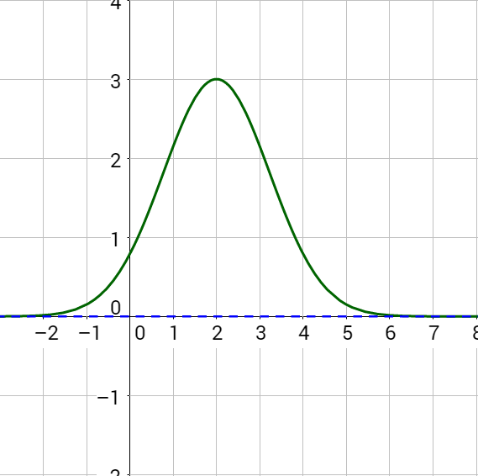

3-05 Exponential and Logarithmic Models
Gaussian Model “The Curve”
Normal Distribution
$y=ae^{−\frac{{\left(x−b\right)}^{2}}{c}}$
Average

Slide 41
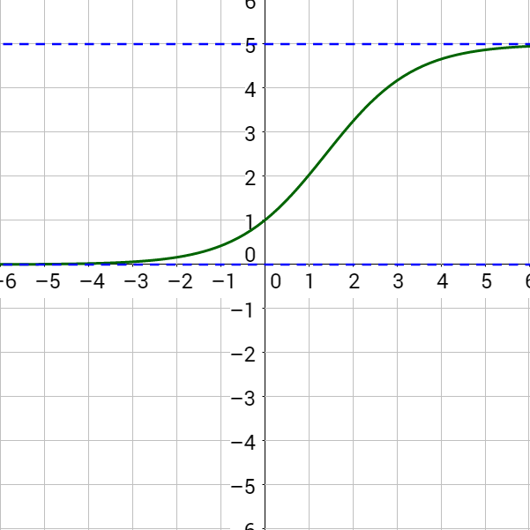

3-05 Exponential and Logarithmic Models
Logistic Growth Model
Used for population
$y=\frac{a}{1+be^{−rx}}$

Slide 42

3-05 Exponential and Logarithmic Models
Logarithmic Models
  $y=a+b\ln{x}$
  $y=a+b\log{x}$
Richter Scale
  Earthquake magnitude
Decibels
  Loudness of sound

