Slide 1
Trigonometry
Precalculus
Chapter 4

Slide 2
This Slideshow was developed to accompany the textbook
  Precalculus
  By Richard Wright
  https://www.andrews.edu/~rwright/Precalculus-RLW/Text/TOC.html
Some examples and diagrams are taken from the textbook.
Slides created by
Richard Wright, Andrews Academy
rwright@andrews.edu

Slide 3
4-01 Angle Measures
In this section, you will:
Draw angles in standard position.
Convert between degrees and radians.
Find coterminal angles.
Use applications of angles.

Slide 4
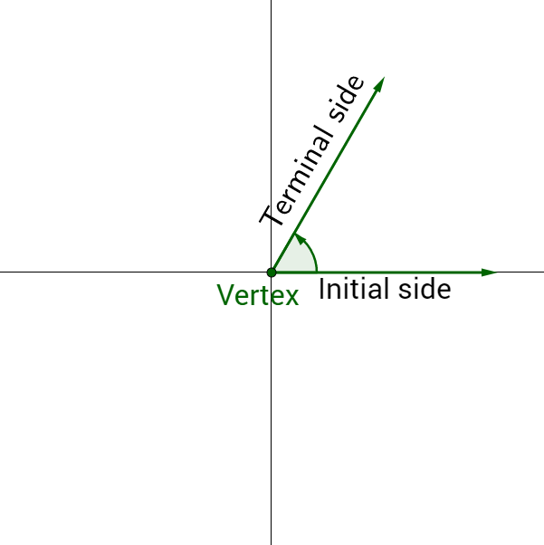
4-01 Angle Measures
Angles in standard position
  Vertex at origin
  Initial side on positive x-axis
  Terminal side rotates counterclockwise

Slide 5
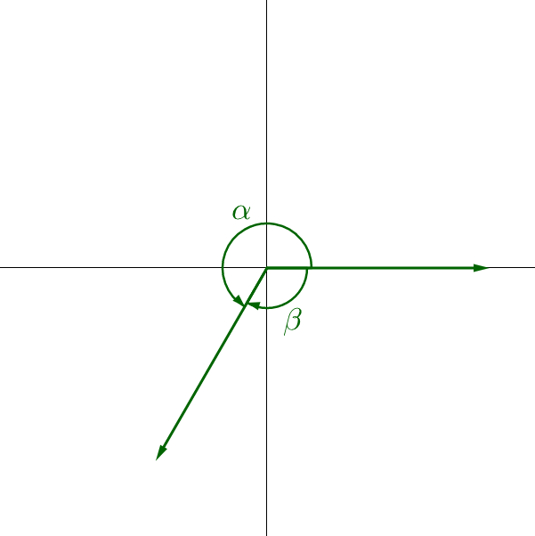
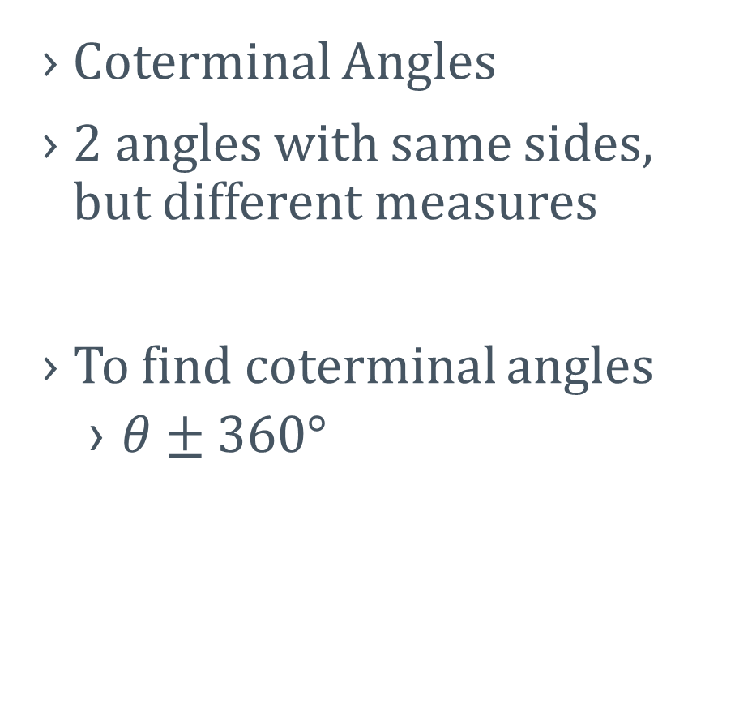
4-01 Angle Measures
Coterminal Angles
2 angles with same sides, but different measures
To find coterminal angles
  $θ±360°$

Slide 6
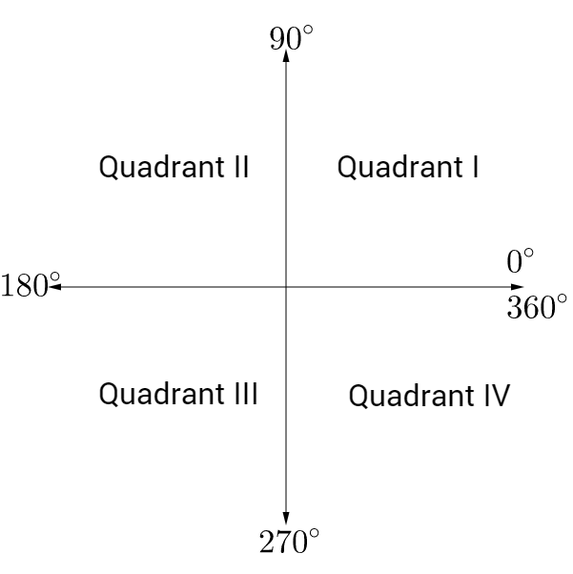
4-01 Angle Measures
Degree Measures

Slide 7
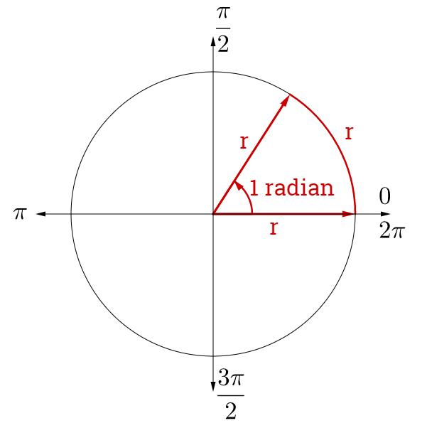
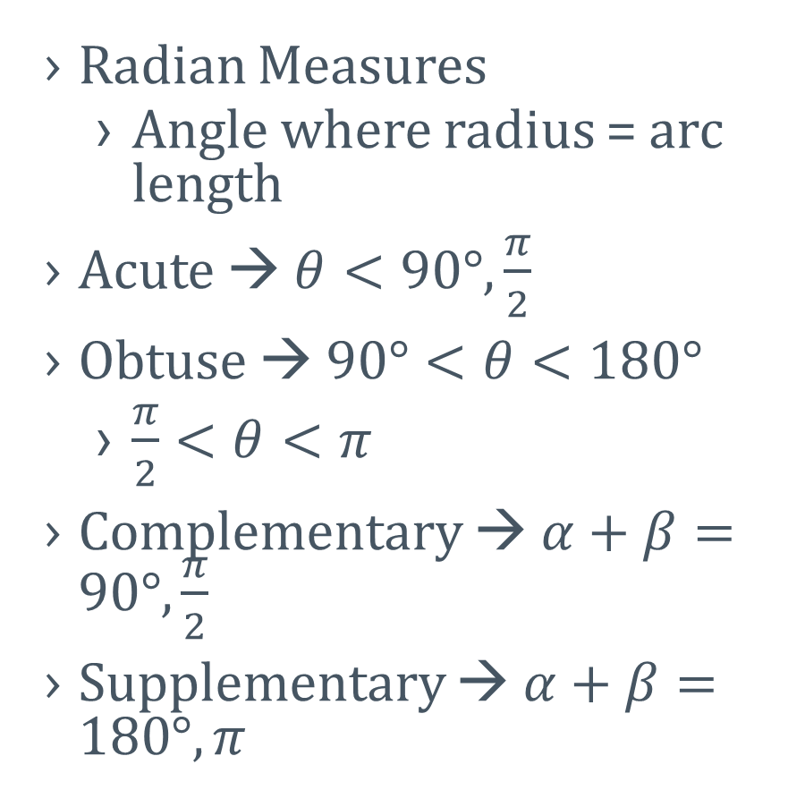
4-01 Angle Measures
Radian Measures
  Angle where radius = arc length
Acute → $θ<90°,\frac{π}{2}$
Obtuse → $90°<θ<180°$
  $\frac{π}{2}<θ<π$
Complementary → $α+β=90°,\frac{π}{2}$
Supplementary → $α+β=180°, π$

Slide 8
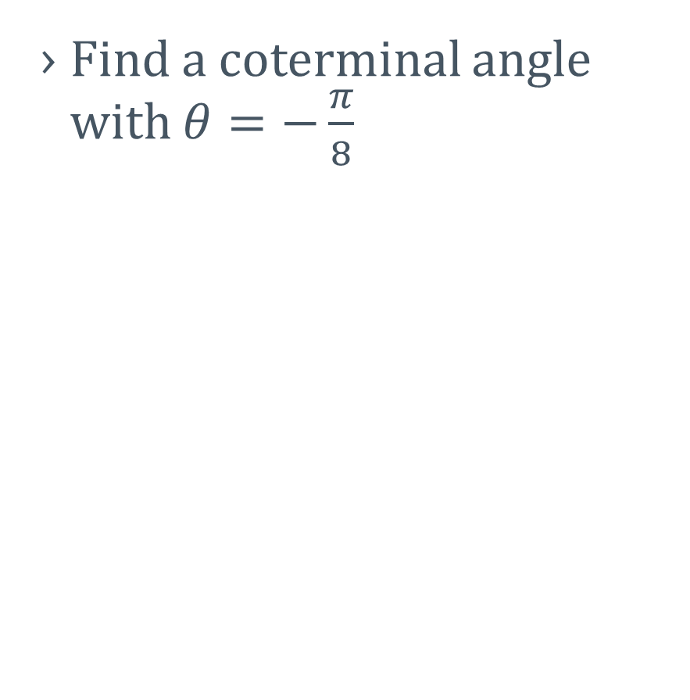
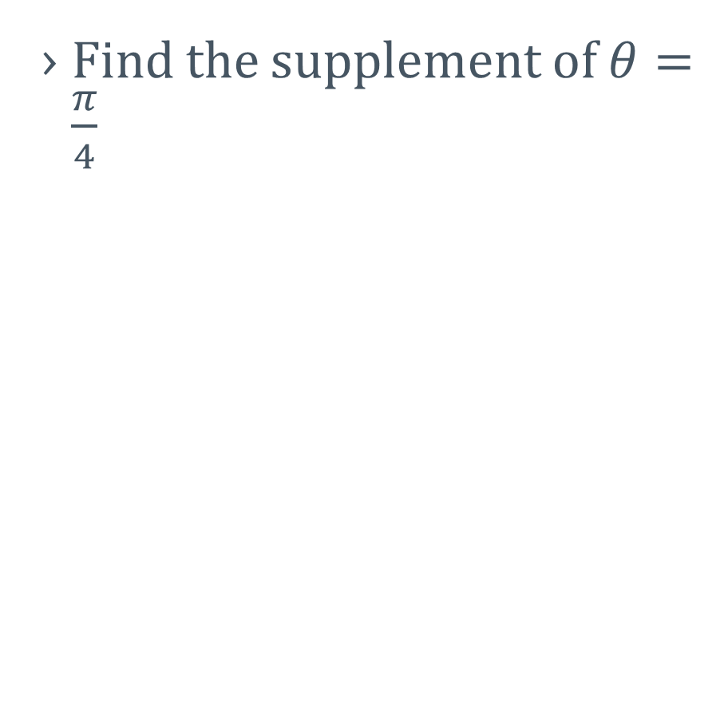
4-01 Angle Measures
Find a coterminal angle with $θ=−\frac{π}{8}$
Find the supplement of $θ=\frac{π}{4}$
Notes:
Coterminal
$$−\frac{π}{8}±2π=−\frac{π}{8}±\frac{16π}{8}=−\frac{17π}{8},\frac{15π}{8}$$
Supplement
$$S+\frac{π}{4}=π$$
$$S=π−\frac{π}{4}=\frac{3π}{4}$$

Slide 9
4-01 Angle Measures
Convert radians to degrees
  180° = π
Convert 120° to radians
Notes:
$$120°\left(\frac{π}{180°}\right)=\frac{120π}{180}=\frac{2π}{3}$$

Slide 10
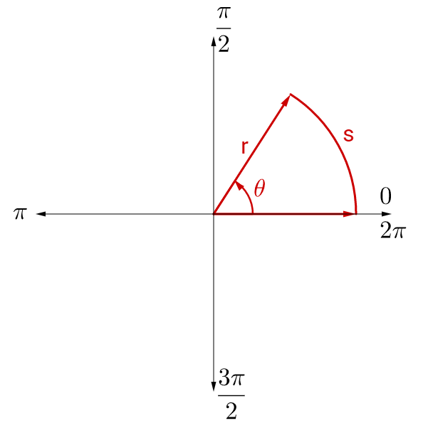
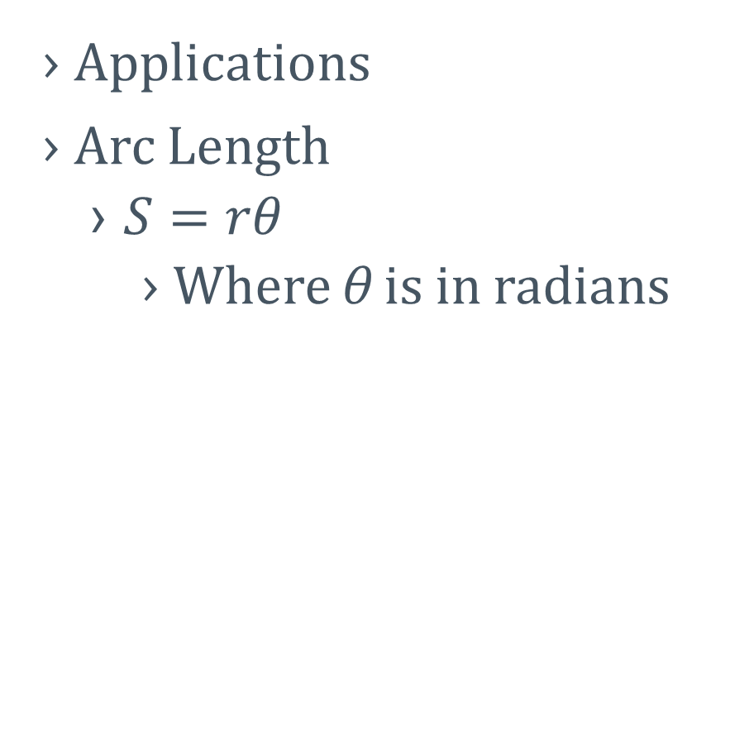
4-01 Angle Measures
Applications
Arc Length
  $S=rθ$
    Where θ is in radians

Slide 11
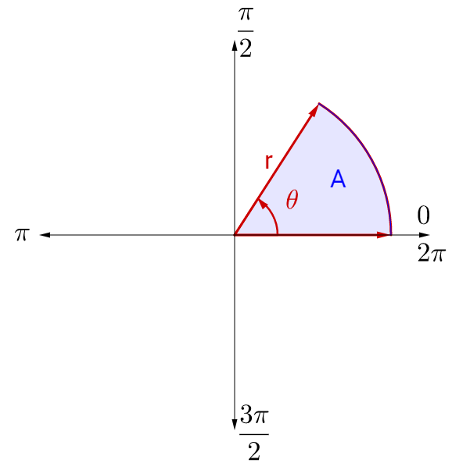
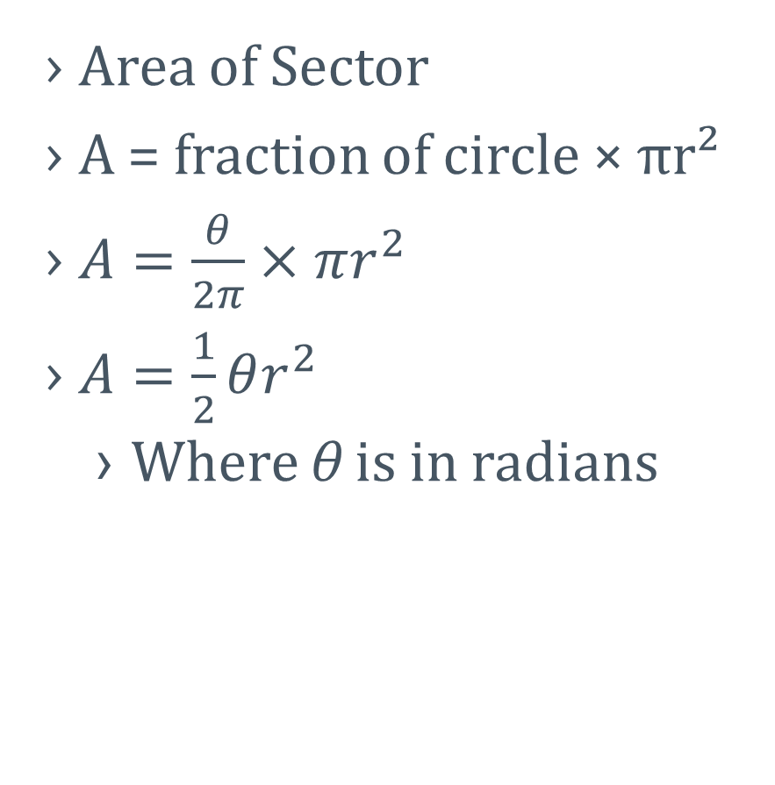
4-01 Angle Measures
Area of Sector
A = fraction of circle × πr²
$A=\frac{θ}{2π}×πr^{2}$
$A=\frac{1}{2}θr^{2}$
  Where θ is in radians

Slide 12
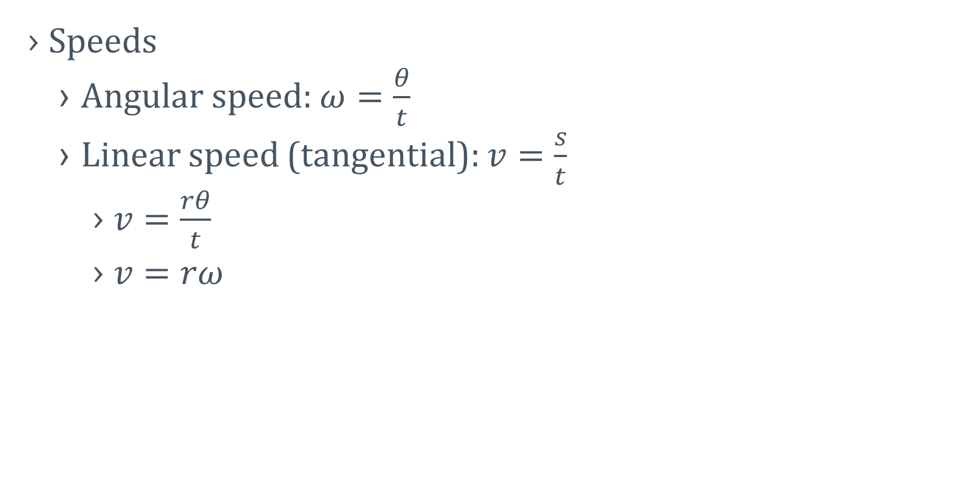
4-01 Angle Measures
Speeds
  Angular speed: $ω=\frac{θ}{t}$
  Linear speed (tangential): $v=\frac{s}{t}$
    $v=\frac{rθ}{t}$
    $v=rω$

Slide 13
4-01 Angle Measures
A 6-inch diameter gear makes 2.5 revolutions per second. Find the angular speed in radians per second.
How fast is a tooth at the edge of the gear moving in in./s?
Notes:
$$\frac{2.5 rev}{s}\left(\frac{2π rad}{1 rev}\right)=5π\frac{rad}{s}$$
$$v=rw$$
$$v=\left(3 in.\right)\left(5π\frac{rad}{s}\right)=15π in./s$$

Slide 14
4-02 Unit Circle
In this section, you will:
Understand the unit circle.
Use the unit circle to evaluate trigonometric functions.
Use even and odd trigonometric functions.
Use a calculator to evaluate trigonometric functions.

Slide 15
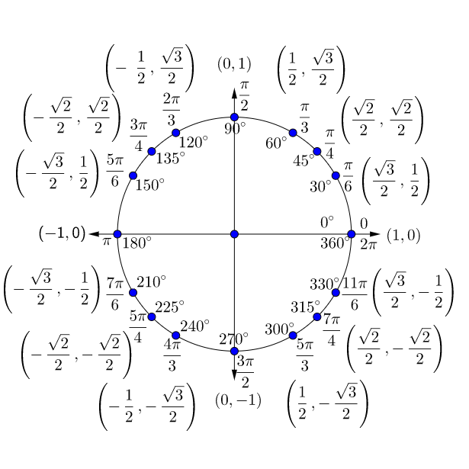
4-02 Unit Circle
Unit circle
  r = 1
  x² + y² = 1

Slide 16
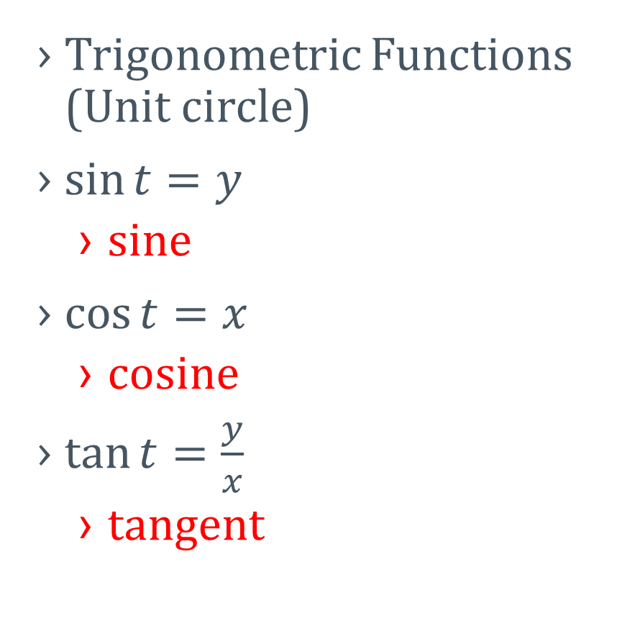
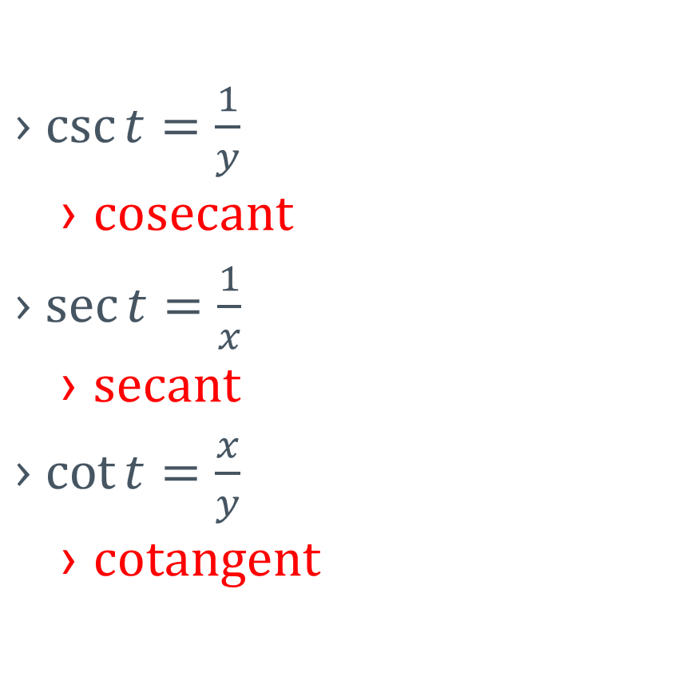
4-02 Unit Circle
Trigonometric Functions (Unit circle)
$\sin{t}=y$
  sine
$\cos{t}=x$
  cosine
$\tan{t}=\frac{y}{x}$
  tangent
$\csc{t}=\frac{1}{y}$
  cosecant
$\sec{t}=\frac{1}{x}$
  secant
$\cot{t}=\frac{x}{y}$
  cotangent

Slide 17
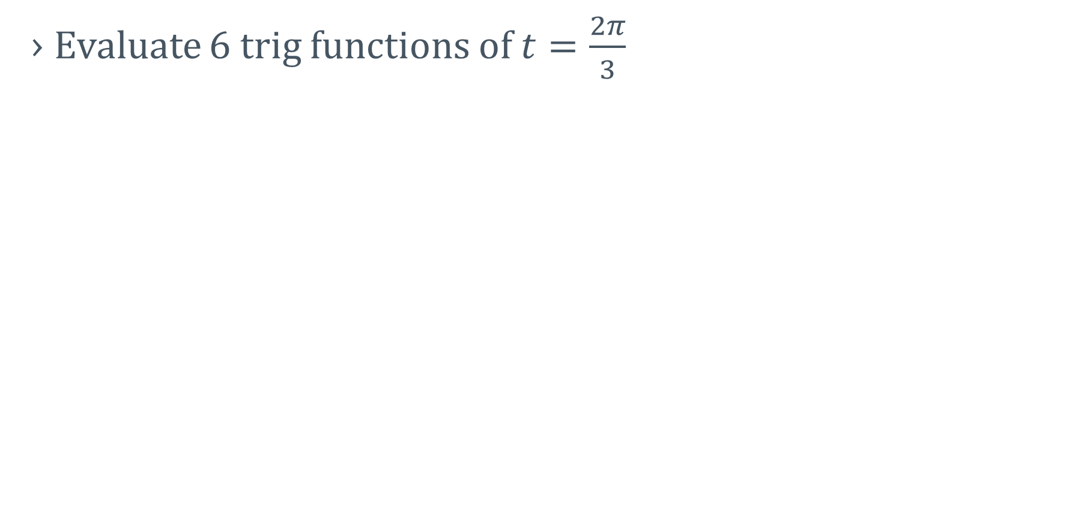
4-02 Unit Circle
Evaluate 6 trig functions of $t=\frac{2π}{3}$
Notes:
$$\sin{\frac{2π}{3}}=\frac{\sqrt{3}}{2}$$
$$\cos{\frac{2π}{3}}=−\frac{1}{2}$$
$$\tan{\frac{2π}{3}}=\frac{\frac{\sqrt{3}}{2}}{−\frac{1}{2}}=−\sqrt{3}$$
$$\csc{\frac{2π}{3}}=\frac{1}{\frac{\sqrt{3}}{2}}=\frac{2}{\sqrt{3}}=\frac{2\sqrt{3}}{3}$$
$$\sec{\frac{2π}{3}}=\frac{1}{−\frac{1}{2}}=−2$$
$$\cot{\frac{2π}{3}}=\frac{−\frac{1}{2}}{\frac{\sqrt{3}}{2}}=−\frac{1}{\sqrt{3}}=−\frac{\sqrt{3}}{3}$$

Slide 18
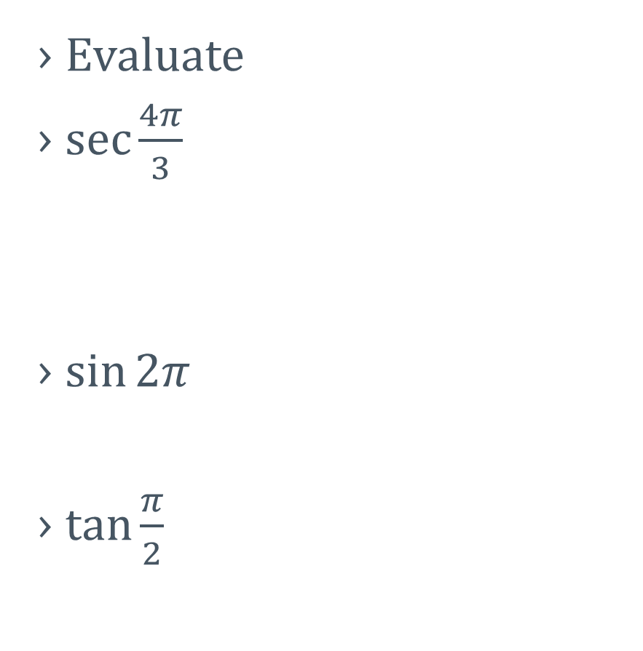
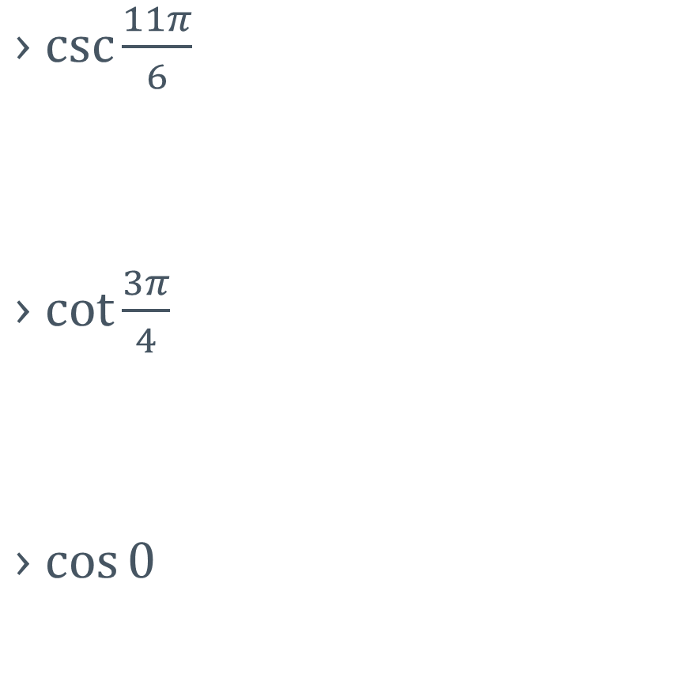
4-02 Unit Circle
Evaluate
$\sec{\frac{4π}{3}}$
$\sin{2π}$
$\tan{\frac{π}{2}}$
$\csc{\frac{11π}{6}}$
$\cot{\frac{3π}{4}}$
$\cos{0}$
Notes:
Draw angles on unit circle for reference
$$\sec{\frac{4π}{3}}=\frac{1}{x}=\frac{1}{−\frac{1}{2}}=−2$$
$$\sin{2π}=y=0$$
$$\tan{\frac{π}{2}}=\frac{y}{x}=\frac{1}{0}=undefined$$
$$\csc{\frac{11π}{6}}=\frac{1}{y}=\frac{1}{−\frac{1}{2}}=−2$$
$$\cot{\frac{3π}{4}}=\frac{x}{y}=\frac{−\frac{\sqrt{2}}{2}}{\frac{\sqrt{2}}{2}}=−1$$
$$\cos{0}=x=1$$

Slide 19
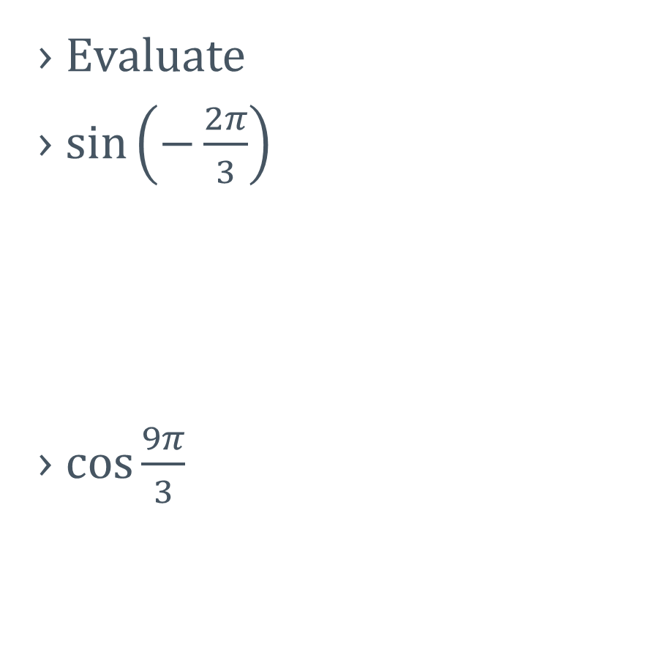
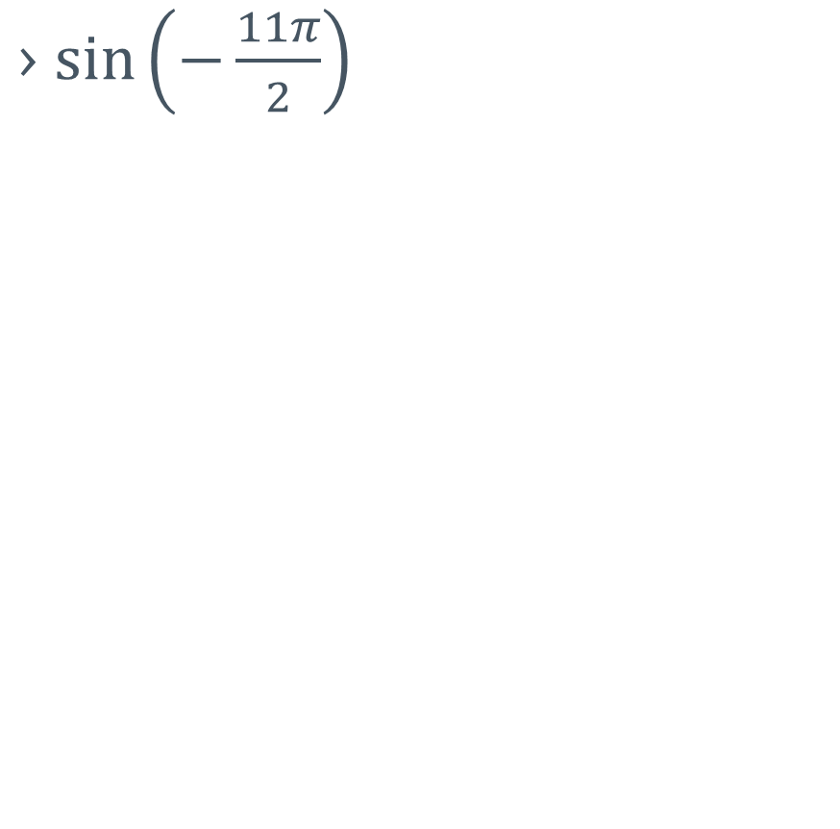
4-02 Unit Circle
Evaluate
$\sin\left(−\frac{2π}{3}\right)$
$\cos{\frac{9π}{3}}$
$\sin\left(−\frac{11π}{2}\right)$
Notes:
Find coterminal angles between 0 and 2π
$$\sin\left(−\frac{2π}{3}\right)=\sin\left(\frac{4π}{3}\right)=y=−\frac{\sqrt{3}}{2}$$
$$\cos{\frac{9π}{3}}=\cos{π}=x=−1$$
$$\sin\left(−\frac{11π}{2}\right)=\sin{\frac{π}{2}}=y=1$$

Slide 20
4-03 Right Triangle Trigonometry
In this section, you will:
Use right triangles to evaluate trigonometric functions.
Use special right triangles to evaluate trigonometric functions of common angles.

Slide 21
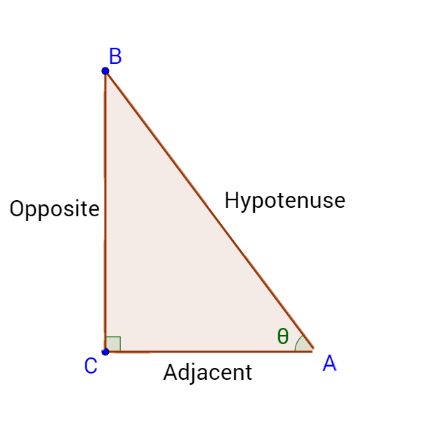
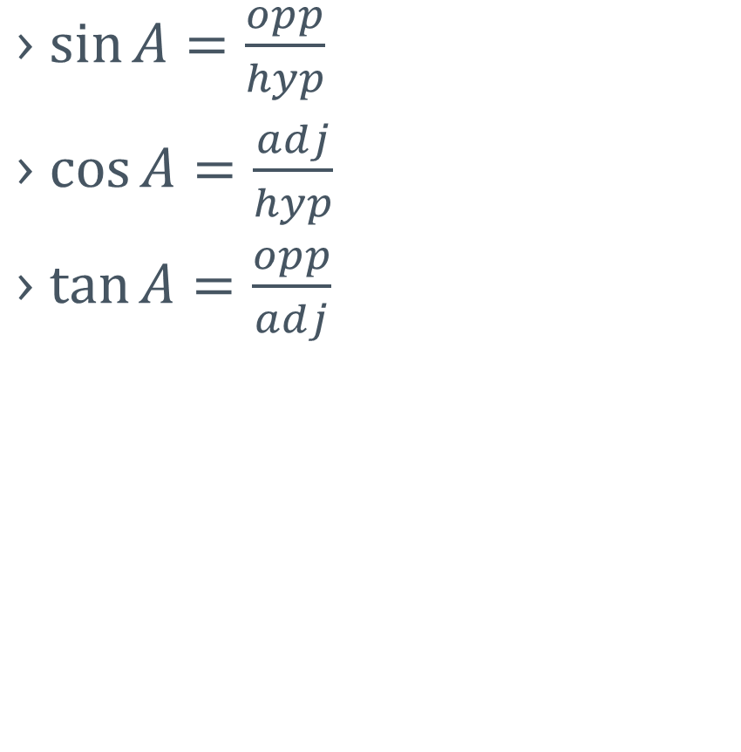
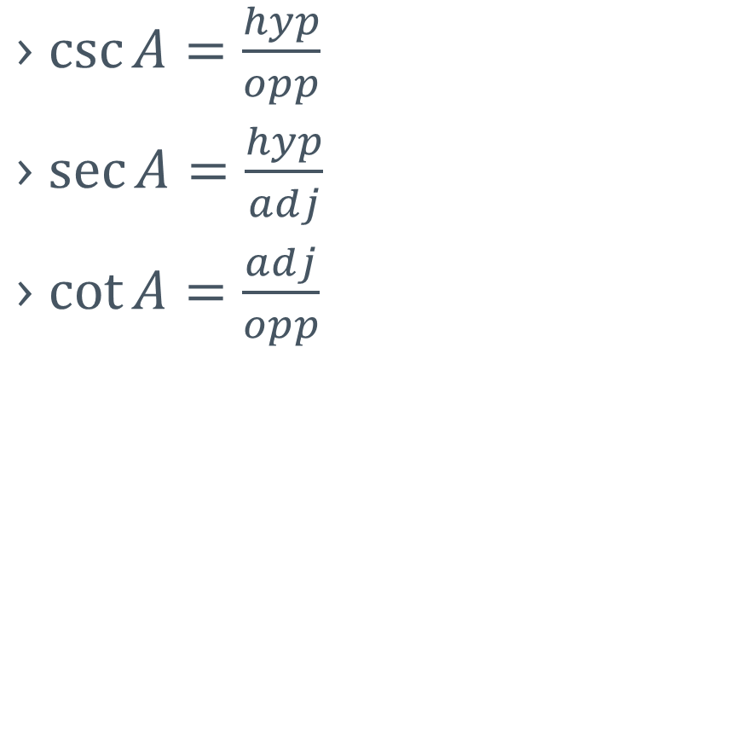
4-03 Right Triangle Trigonometry
$\sin{A}=\frac{opp}{hyp}$
$\cos{A}=\frac{adj}{hyp}$
$\tan{A}=\frac{opp}{adj}$
$\csc{A}=\frac{hyp}{opp}$
$\sec{A}=\frac{hyp}{adj}$
$\cot{A}=\frac{adj}{opp}$
SOH
CAH
TOA
Notes:
SOH
CAH
TOA

Slide 22
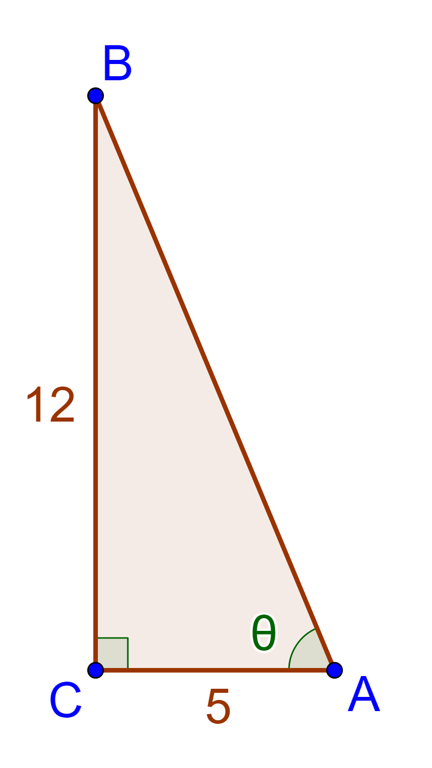
4-03 Right Triangle Trigonometry
Find the values of the six trig functions
Notes:
$$hyp=\sqrt{5^{2}+{12}^{2}}=13$$
$$\sin{θ}=\frac{12}{13}$$
$$\cos{θ}=\frac{5}{13}$$
$$\tan{θ}=\frac{12}{5}$$
$$\csc{θ}=\frac{13}{12}$$
$$\sec{θ}=\frac{13}{5}$$
$$\cot{θ}=\frac{5}{12}$$

Slide 23
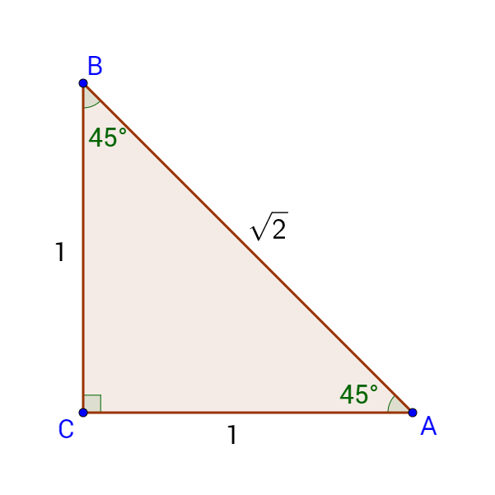
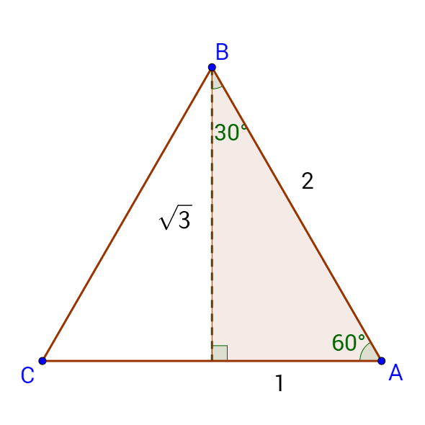
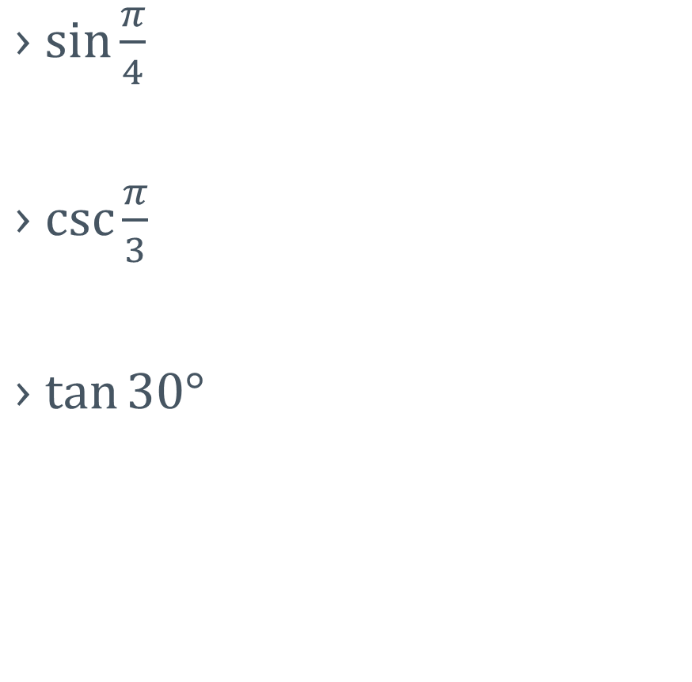
4-03 Right Triangle Trigonometry
Special right triangles
$\sin{\frac{π}{4}}$
$\csc{\frac{π}{3}}$
$\tan{30°}$
Notes:
$$\sin{\frac{π}{4}}=\frac{1}{\sqrt{2}}=\frac{\sqrt{2}}{2}$$
$$\csc{\frac{π}{3}}=\frac{2}{\sqrt{3}}=\frac{2\sqrt{3}}{3}$$
$$\tan{30°}=\frac{1}{\sqrt{3}}=\frac{\sqrt{3}}{3}$$

Slide 24
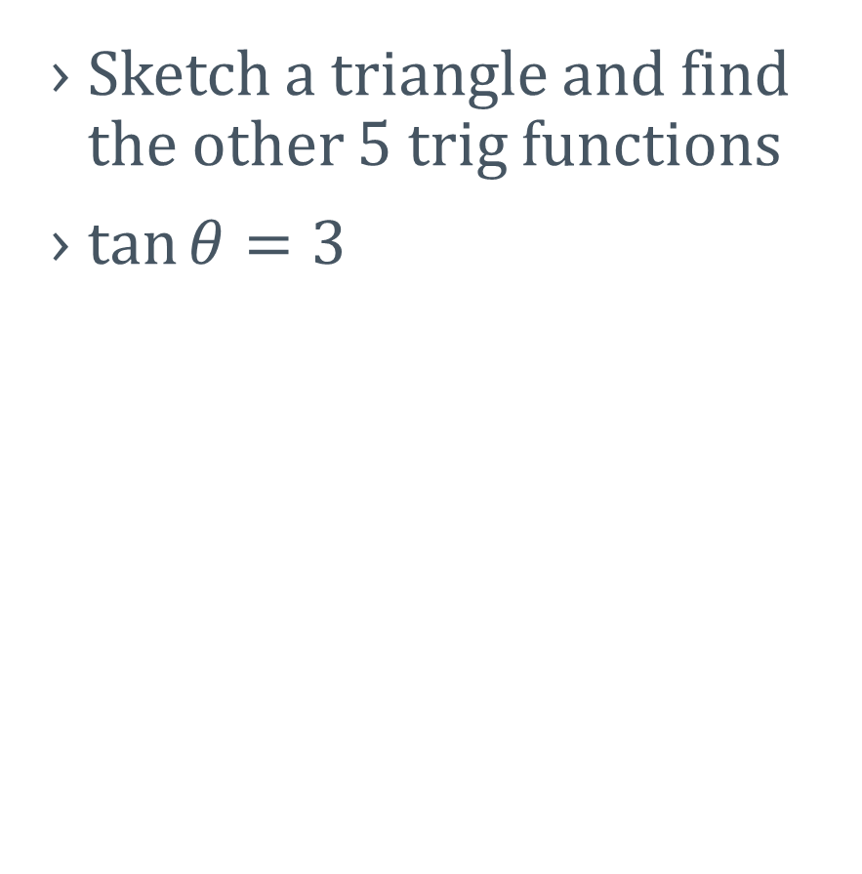
4-03 Right Triangle Trigonometry
Sketch a triangle and find the other 5 trig functions
$\tan{θ}=3$
Notes:
$$\tan{θ}=3=\frac{3}{1}=\frac{opp}{adj}$$
$$\sin{θ}=\frac{3}{\sqrt{10}}=\frac{3\sqrt{10}}{10}$$
$$\cos{θ}=\frac{1}{\sqrt{10}}=\frac{\sqrt{10}}{10}$$
$$\tan{θ}=3$$
$$\csc{θ}=\frac{\sqrt{10}}{3}$$
$$\sec{θ}=\frac{\sqrt{10}}{1}=\sqrt{10}$$
$$\cot{θ}=\frac{1}{3}$$

Slide 25
4-04 Right Triangle Trigonometry and Identities
In this section, you will:
Use right triangles to evaluate trigonometric functions.
Use special right triangles to evaluate trigonometric functions of common angles.

Slide 26
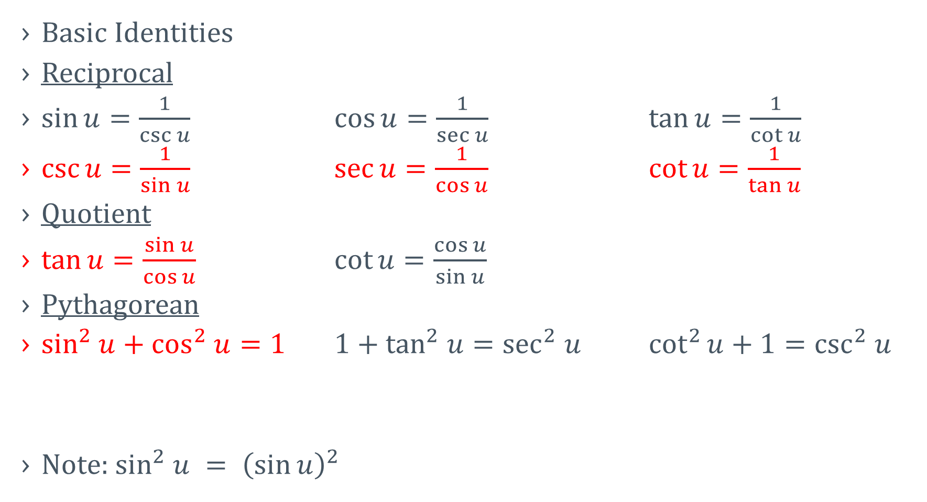
4-04 Right Triangle Trigonometry and Identities
Basic Identities
Reciprocal
$\sin{u}=\frac{1}{\csc{u}}$ $\cos{u}=\frac{1}{\sec{u}}$ $\tan{u}=\frac{1}{\cot{u}}$
$\csc{u}=\frac{1}{\sin{u}}$ $\sec{u}=\frac{1}{\cos{u}}$ $\cot{u}=\frac{1}{\tan{u}}$
Quotient
$\tan{u}=\frac{\sin{u}}{\cos{u}}$ $\cot{u}=\frac{\cos{u}}{\sin{u}}$
Pythagorean
$\sin^{2} u+\cos^{2} u=1$ $1+\tan^{2} u=\sec^{2} u$ $\cot^{2}{u}+1=\csc^{2} u$
Note: $\sin^{2} u = {\left(\sin{u}\right)}^{2}$

Slide 27
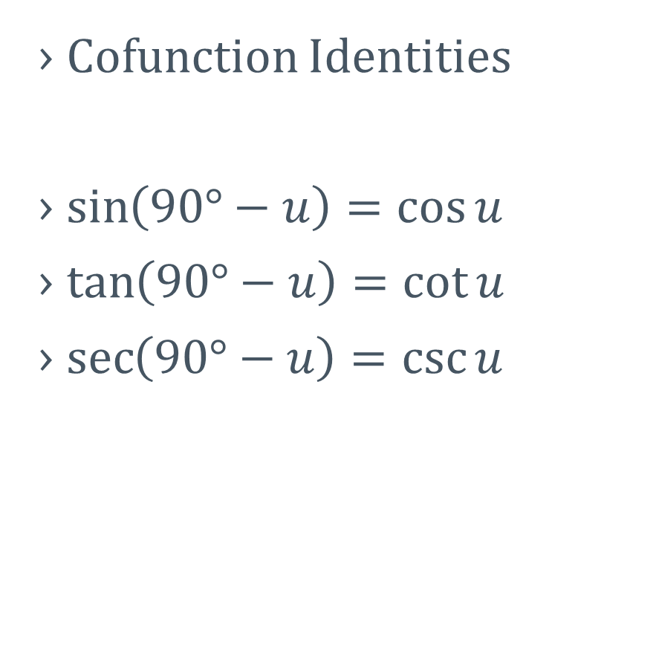
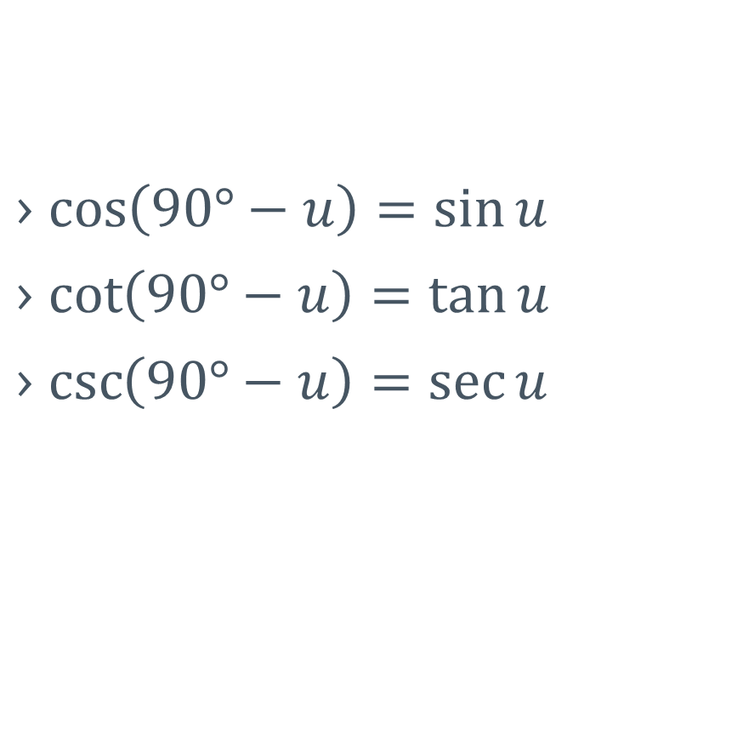
4-04 Right Triangle Trigonometry and Identities
Cofunction Identities
$\sin\left(90°−u\right)=\cos{u}$
$\tan\left(90°−u\right)=\cot{u}$
$\sec\left(90°−u\right)=\csc{u}$
$\cos\left(90°−u\right)=\sin{u}$
$\cot\left(90°−u\right)=\tan{u}$
$\csc\left(90°−u\right)=\sec{u}$

Slide 28
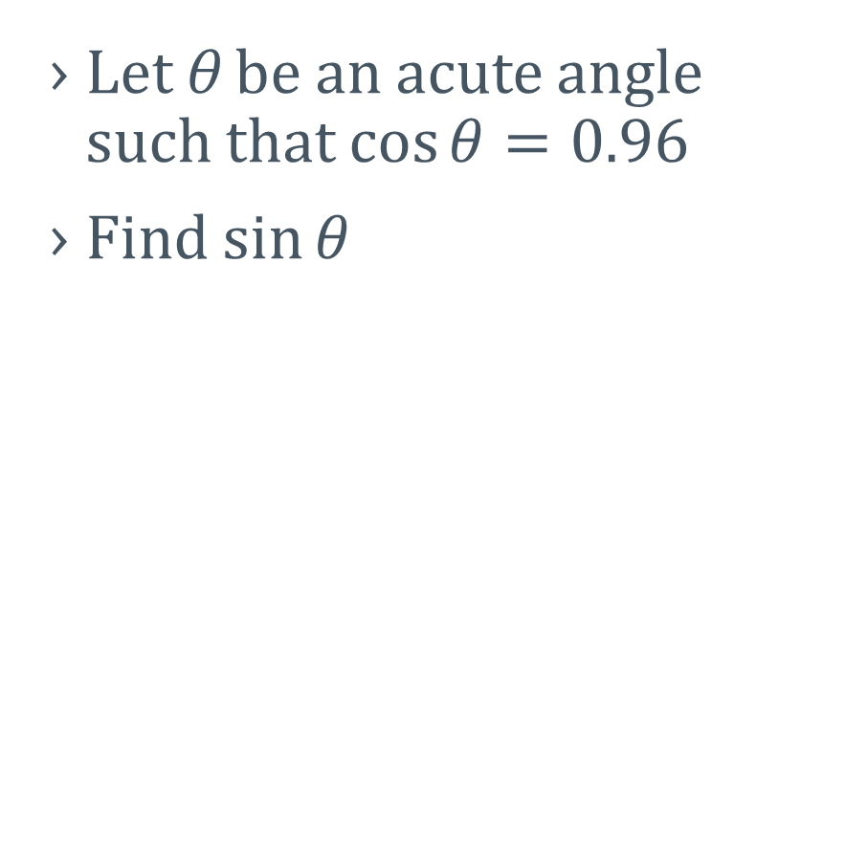

4-04 Right Triangle Trigonometry and Identities
Let θ be an acute angle such that $\cos{θ}=0.96$
Find $\sin{θ}$
Find $\tan{θ}$
Notes:
$$\sin^{2}{θ}+\cos^{2}{θ}=1$$
$$\sin^{2}{θ}+{0.96}^{2}=1$$
$$\sin^{2}{θ}+0.9216=1$$
$$\sin^{2}{θ}=0.0784$$
$$\sin{θ}=0.28$$
$$\tan{θ}=\frac{\sin{θ}}{\cos{θ}}$$
$$=\frac{0.28}{0.96}$$
$$=0.2917$$
These could also have been solved using right triangles

Slide 29
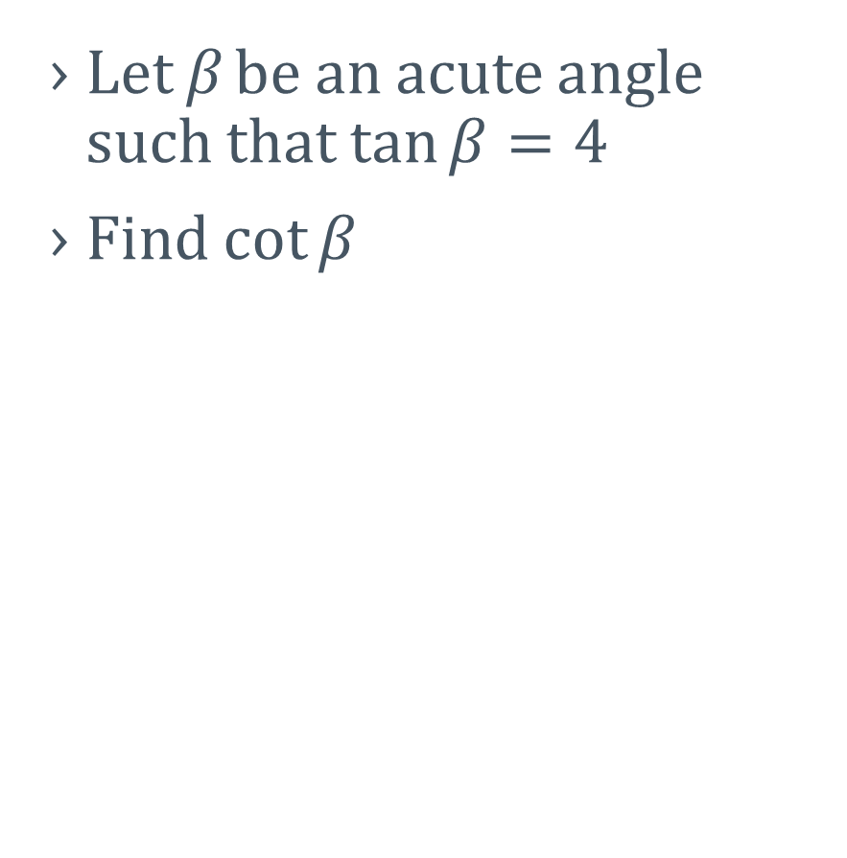
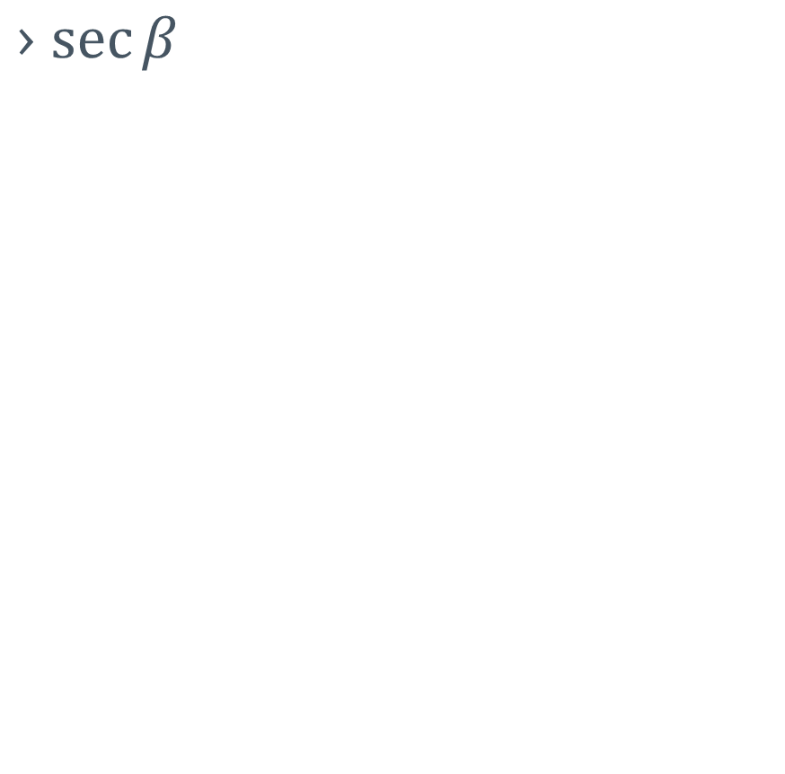
4-04 Right Triangle Trigonometry and Identities
Let β be an acute angle such that $\tan{β}=4$
Find $\cot{β}$
$\sec{β}$
Notes:
$$\cot{β}=\frac{1}{\tan{β}}$$
$$\cot{β}=\frac{1}{4}$$
$$1+\tan^{2}{β}=\sec^{2}{β}$$
$$1+4^{2}=\sec^{2}{β}$$
$$\sqrt{17}=\sec{β}$$

Slide 30
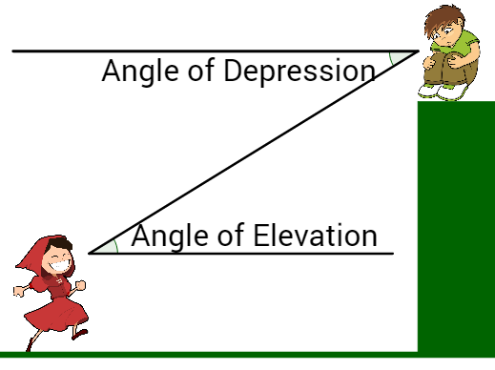
4-04 Right Triangle Trigonometry and Identities
Angles of Elevation and Depression
Both are measured from the horizontal

Slide 31
4-04 Right Triangle Trigonometry and Identities
A 12-meter flagpole casts a 6-meter shadow. Find the angle of elevation of the sun.
Notes:
$$\tan{θ}=\frac{12}{6}$$
$$\tan{θ}=2$$
$$θ≈63.4°$$

Slide 32
4-05 Trigonometric Functions of Any Angle
In this section, you will:
Evaluate trigonometric functions of any angle.
Find reference angles.

Slide 33
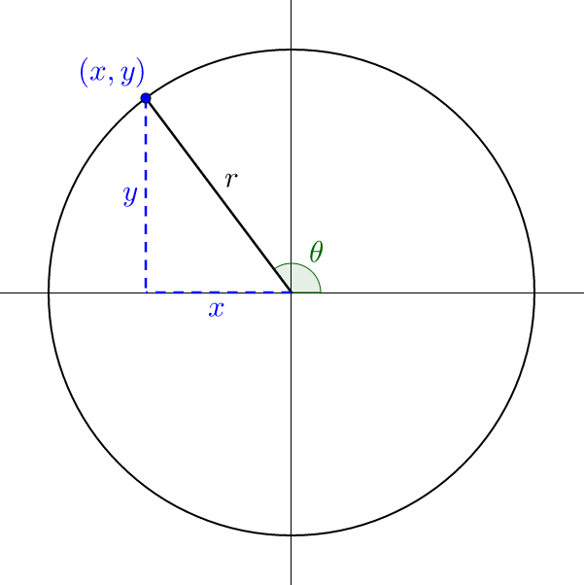
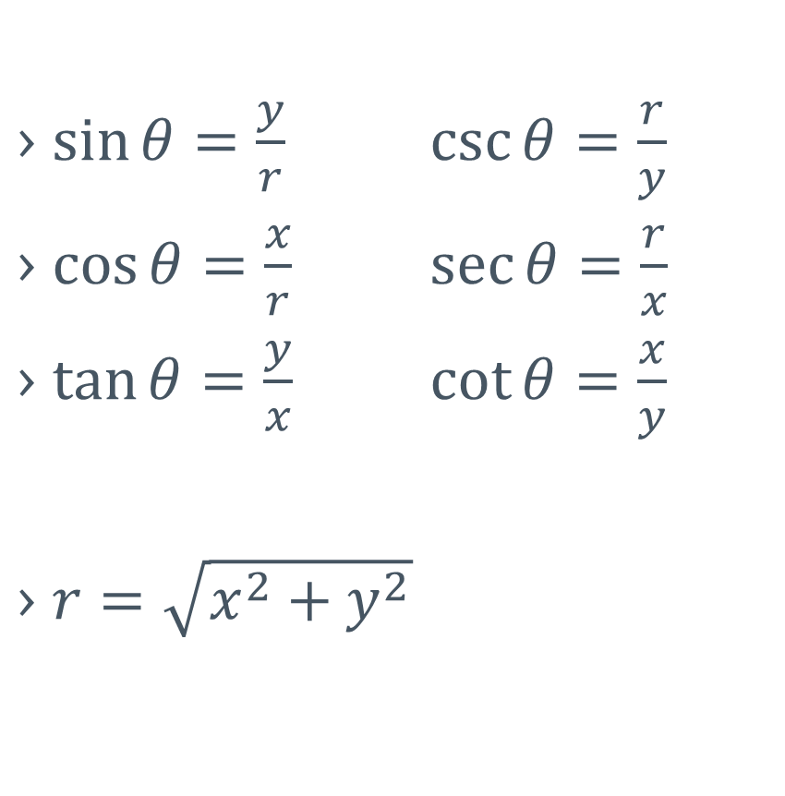
4-05 Trigonometric Functions of Any Angle
$\sin{θ}=\frac{y}{r}$ $\csc{θ}=\frac{r}{y}$
$\cos{θ}=\frac{x}{r}$ $\sec{θ}=\frac{r}{x}$
$\tan{θ}=\frac{y}{x}$ $\cot{θ}=\frac{x}{y}$
$r=\sqrt{x^{2}+y^{2}}$

Slide 34
4-05 Trigonometric Functions of Any Angle
Let (-2, 3) be a point on the terminal side of θ. Find sine, cosine, and tangent of θ.
Notes:
Use Pythagorean Theorem to find r
$$r=\sqrt{{\left(−2\right)}^{2}+3^{2}}=\sqrt{13}$$
$$\sin{θ}=\frac{3}{\sqrt{13}}=\frac{3\sqrt{13}}{13}$$
$$\cos{θ}=−\frac{2}{\sqrt{13}}=−\frac{2\sqrt{13}}{13}$$
$$\tan{θ}=−\frac{3}{2}$$

Slide 35
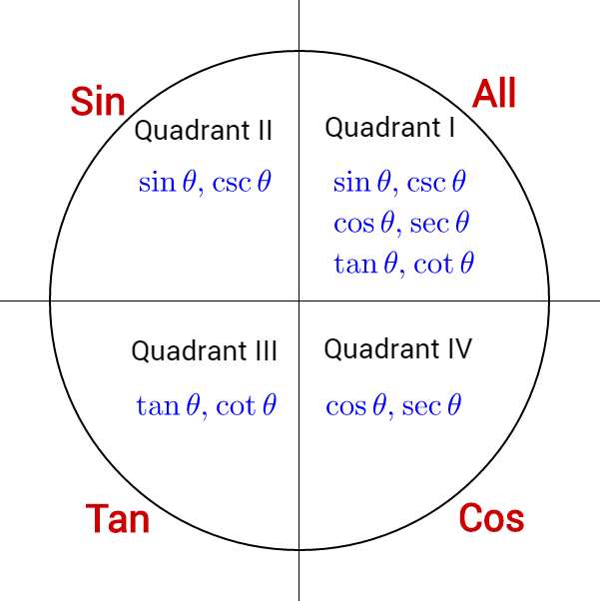
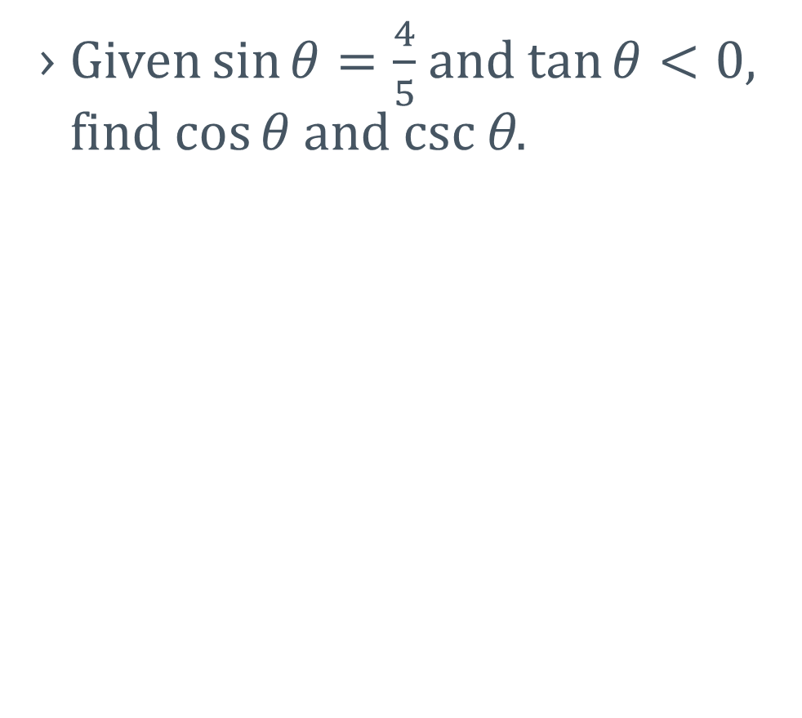
4-05 Trigonometric Functions of Any Angle
Given $\sin{θ}=\frac{4}{5}$ and $\tan{θ}<0$, find $\cos{θ}$ and csc θ.
Notes:
Quadrant II (sine +, tangent -)
$$\sin{θ}=\frac{4}{5}=\frac{y}{r}$$
Use Pythagorean theorem to find r = -3
$$\cos{θ}=−\frac{3}{5}$$
$$\csc{θ}=\frac{5}{4}$$

Slide 36
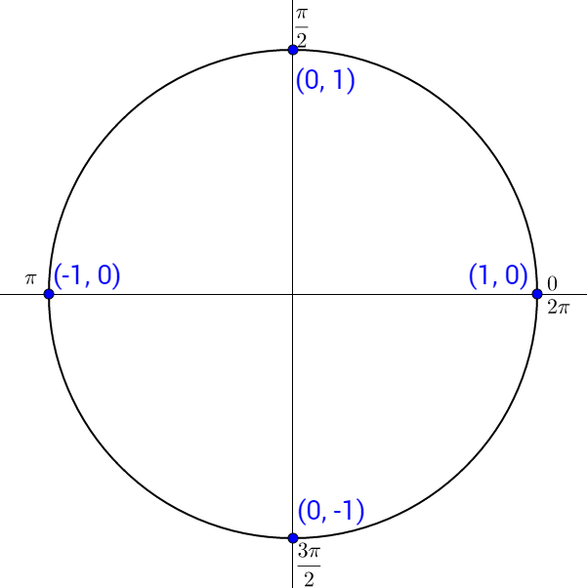
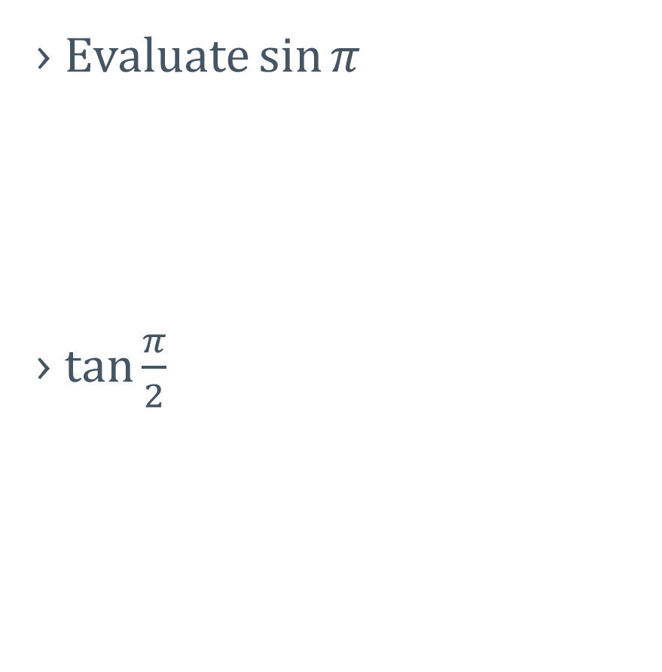
4-05 Trigonometric Functions of Any Angle
Evaluate $\sin{π}$
$\tan{\frac{π}{2}}$
Notes:
$$\sin{π}=\frac{y}{r}=\frac{0}{1}=0$$
$$\tan{\frac{π}{2}}=\frac{y}{x}=\frac{1}{0}=undefined$$

Slide 37
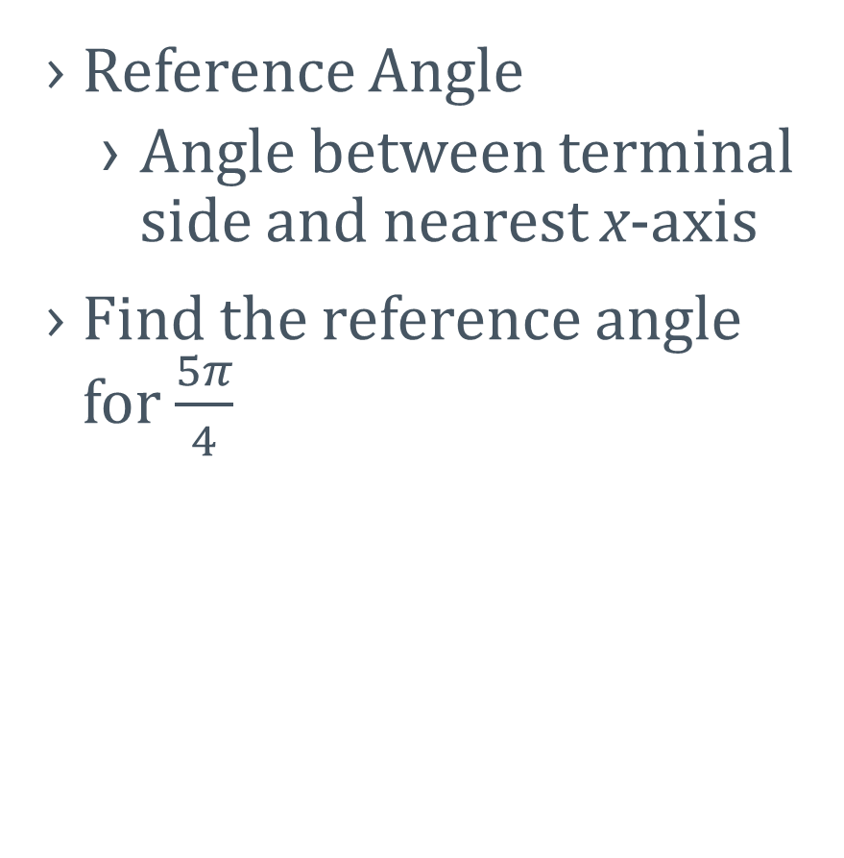
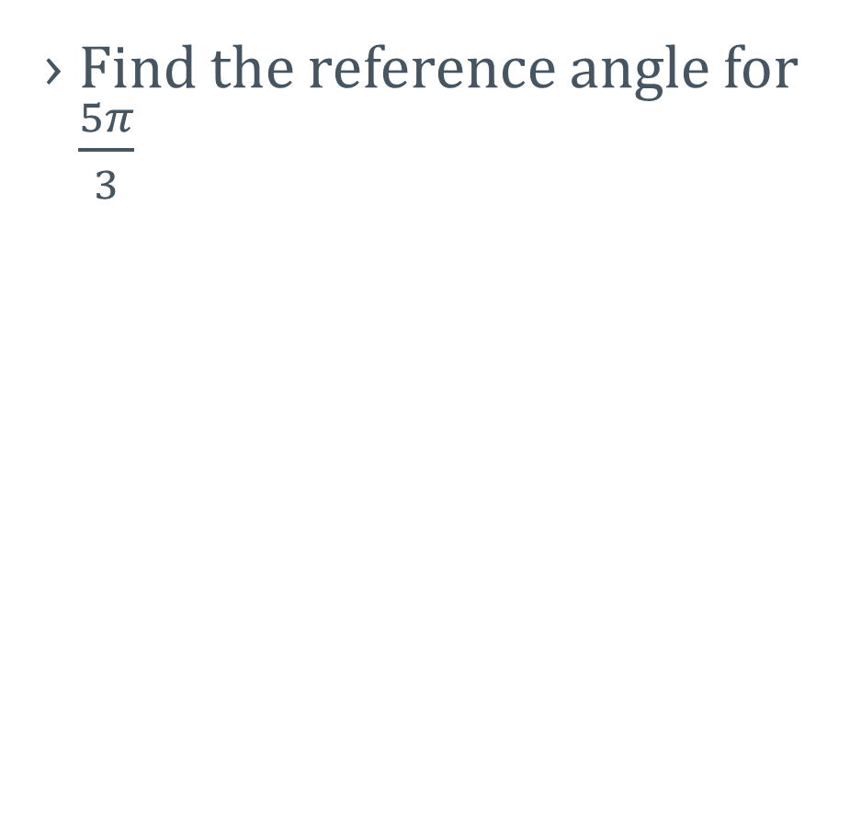
4-05 Trigonometric Functions of Any Angle
Reference Angle
  Angle between terminal side and nearest x-axis
Find the reference angle for $\frac{5π}{4}$
Find the reference angle for $\frac{5π}{3}$

Slide 38
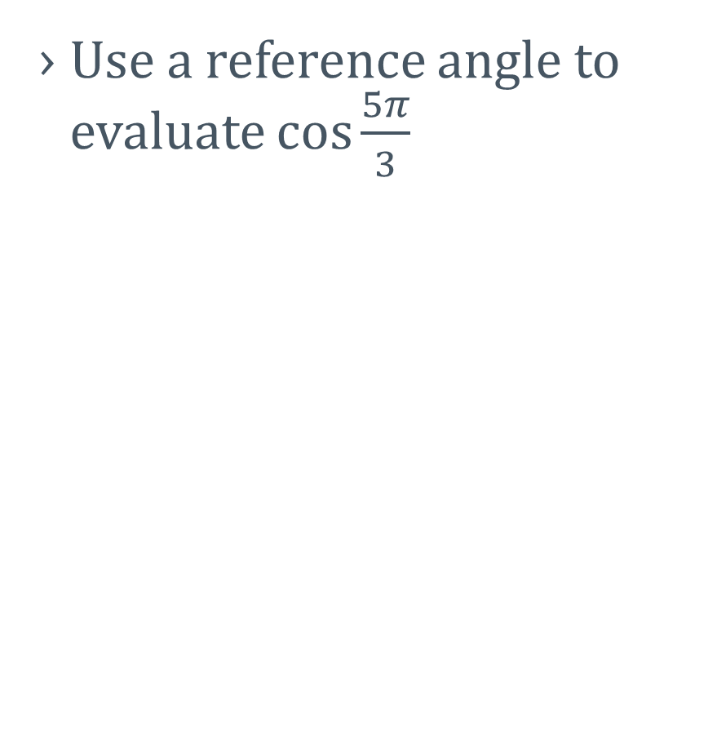
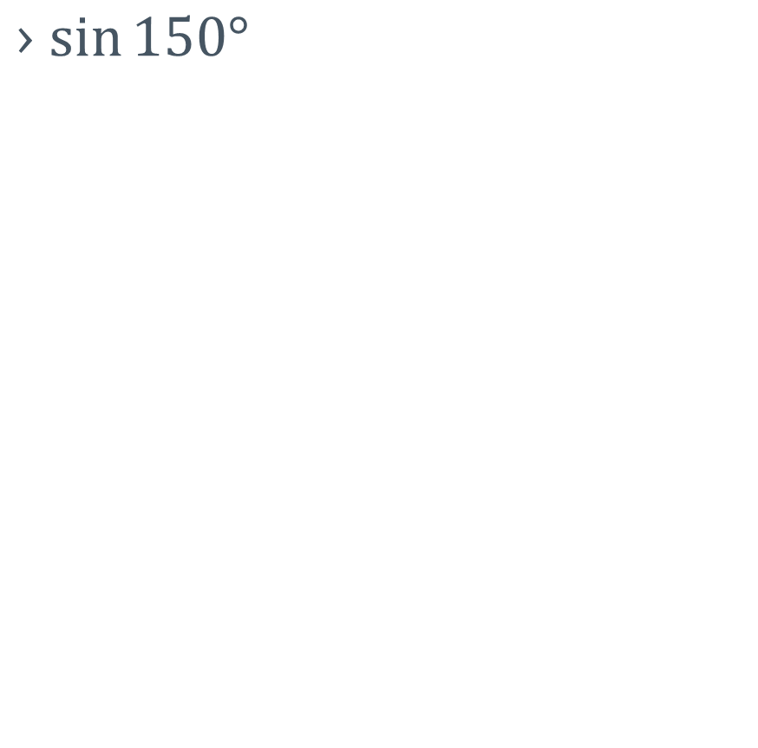
4-05 Trigonometric Functions of Any Angle
Use a reference angle to evaluate $\cos{\frac{5π}{3}}$
$\sin{150°}$
Notes:
Reference angle is $\frac{π}{3}$
$$\cos{\frac{π}{3}}=\frac{1}{2}$$
Quadrant IV where cos is +
Reference angle is 30°
$$\sin{30°}=\frac{1}{2}$$
Quadrant II where sin is +

Slide 39
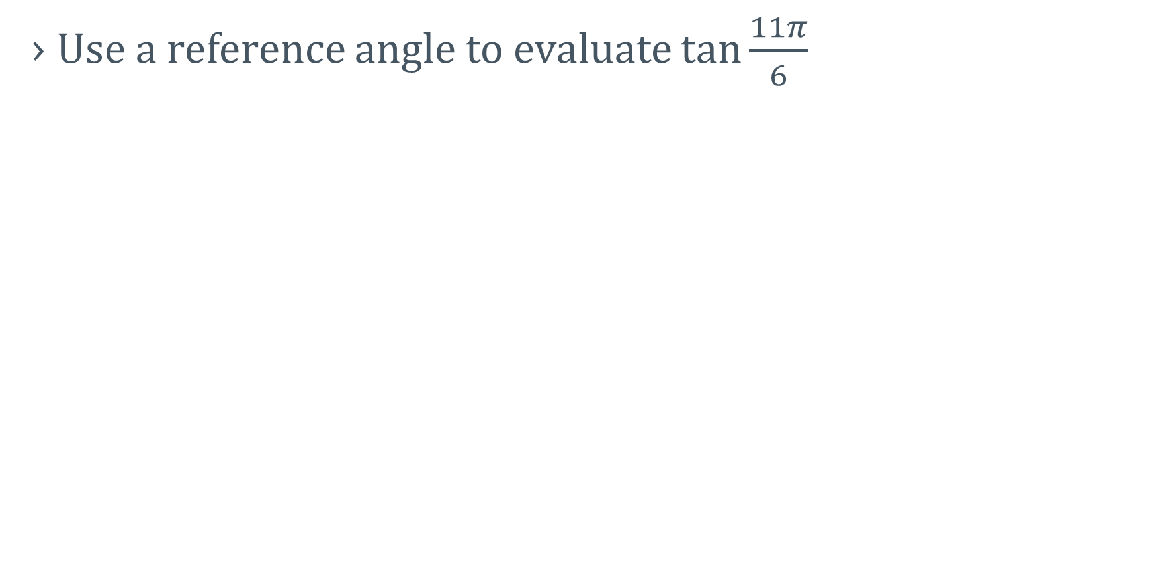
4-05 Trigonometric Functions of Any Angle
Use a reference angle to evaluate $\tan{\frac{11π}{6}}$
Notes:
Reference angle is $\frac{π}{6}$
$$\tan{\frac{π}{6}}=−\frac{1}{\sqrt{3}}=−\frac{\sqrt{3}}{3}$$
Quadrant IV where tan is -

Slide 40
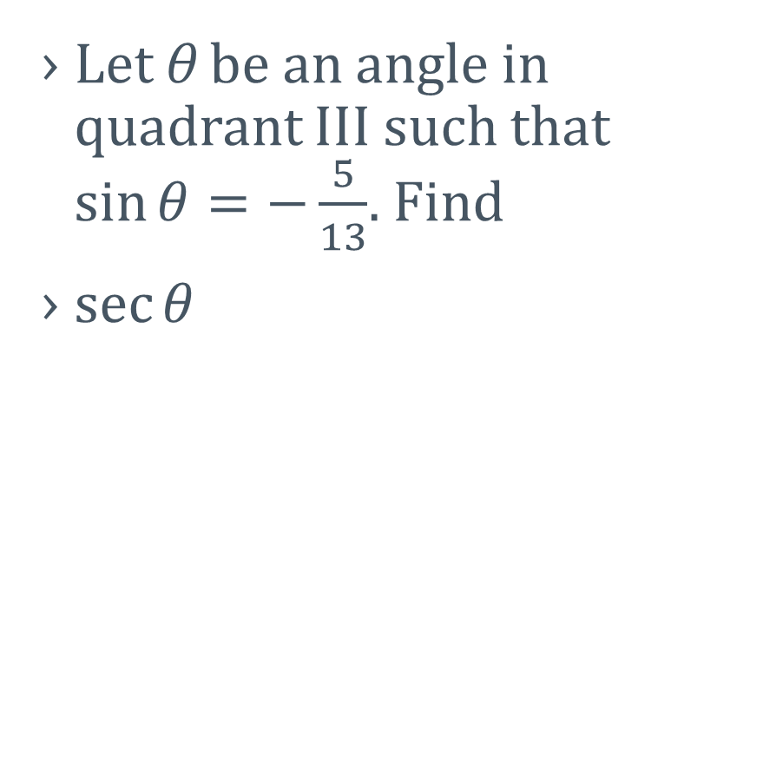

4-05 Trigonometric Functions of Any Angle
Let θ be an angle in quadrant III such that $\sin{θ}=−\frac{5}{13}$. Find
$\sec{θ}$
$\tan{θ}$
Notes:
$$\sin{θ}=−\frac{5}{13}=\frac{y}{r}$$
$$y=−5, r=13$$
Use Pythagorean theorem to find $x=−12$
$$\sec{θ}=\frac{r}{x}=−\frac{13}{12}$$
$$\tan{θ}=\frac{y}{x}=\frac{−5}{−12}=\frac{5}{12}$$

Slide 41
4-06 Graphs of Sine and Cosine
In this section, you will:
Graph y = sin x and y = cos x.
Graph transformations of sine and cosine graphs.
Write mathematical models using sine and cosine.

Slide 42
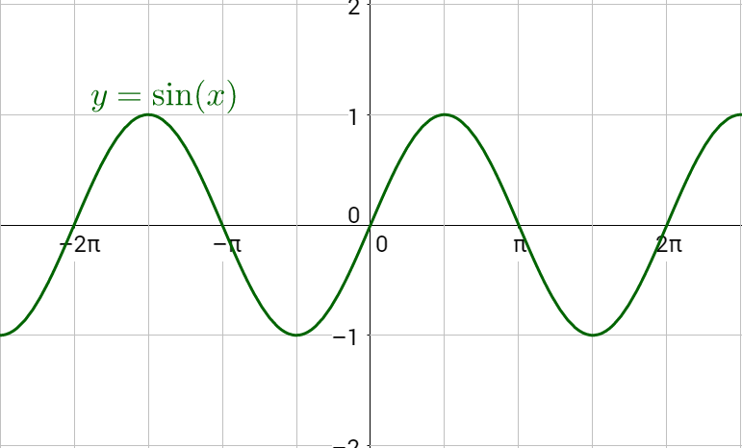
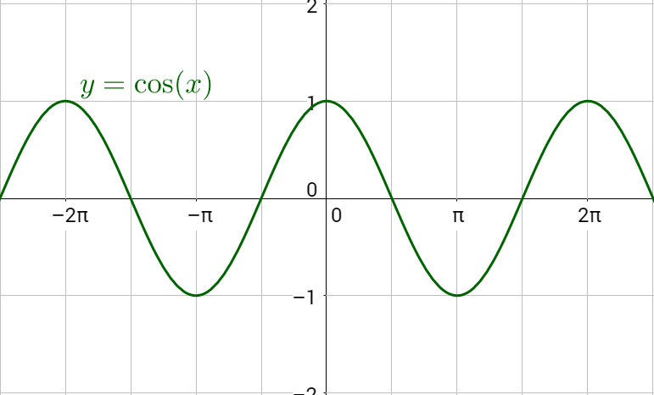

4-06 Graphs of Sine and Cosine
$y=\sin{x}$
  Starts at 0
  Amplitude = 1
  Period = 2π
$y=\cos{x}$
  Starts at 1
  Amplitude = 1
  Period = 2π
Notes:
Point out
Amplitude
period
key points

Slide 43

4-06 Graphs of Sine and Cosine
Transformations
$y=a\sin\left(bx−c\right)+d$
  a = amplitude = vertical stretch
  b = horizontal shrink
    Period $T=\frac{2π}{b}$
  c = horizontal shift
    Phase shift $PS=\frac{c}{b}$ (Right if c is positive)
  d = vertical shift
    Midline $y=d$
Notes:
c is like h
d is like k

Slide 44


4-06 Graphs of Sine and Cosine
Graph $f\left(x\right)=2\sin{x}$
Notes:
Same as sine, but amp = 2

Slide 45

4-06 Graphs of Sine and Cosine
Graph $y=\cos{\frac{x}{2}}$
Notes:
Period $T=\frac{2π}{b}$
$$T=\frac{2π}{\frac{1}{2}}=4π$$

Slide 46

4-06 Graphs of Sine and Cosine
Graph $y=2\sin\left(x−\frac{π}{2}\right)$
Notes:
$$a=2$$
$$b=1 →T=2π$$
$$h=\frac{π}{2}→PS=\frac{h}{b}=\frac{\frac{π}{2}}{1}=\frac{π}{2} to right$$
Draw $2\sin{x}$ first and then do the phase shift

Slide 47

4-06 Graphs of Sine and Cosine
Graph
$y=−\frac{1}{2}\sin\left(πx+π\right)+1$
Notes:
$$a=−\frac{1}{2}=amp$$
$$b=π→T=\frac{2π}{b}→\frac{2π}{π}=2$$
$$h=−π→PS=\frac{h}{b}→−\frac{π}{π}=−1$$
PS left 1
$$k=1$$
Shift up 1
Graph $\frac{1}{2}\sin{πx}$ first labeling the key points with a period of 2
Reflect over the x-axis because a is negative
Shift left 1 and up 1

Slide 48
4-07 Graphs of Other Trigonometric Functions
In this section, you will:
Graph tangent, secant, cosecant, and cotangent
Graph a damped trigonometric function

Slide 49


4-07 Graphs of Other Trigonometric Functions
$y=\tan{x}$
  Period = π
    $T=\frac{π}{b}$
  Asymptotes where tangent undefined, $\frac{π}{2},\frac{3π}{2}$

Slide 50


4-07 Graphs of Other Trigonometric Functions
$y=\cot{x}$
  Period = π
    $T=\frac{π}{b}$
  Asymptotes at 0, π, 2π

Slide 51

4-07 Graphs of Other Trigonometric Functions
Graph $y=\tan{\frac{x}{4}}$
Notes:
$$b=\frac{1}{4}$$
$$T=\frac{π}{b}=\frac{π}{\frac{1}{4}}=4π$$
$$a=1$$

Slide 52


4-07 Graphs of Other Trigonometric Functions
$y=\csc{x}$
  Period = 2π
  Asymptotes where sine = 0
    $0, π, 2π$

Slide 53


4-07 Graphs of Other Trigonometric Functions
$y=\sec{x}$
  Period = 2π
  Asymptotes where cosine = 0
    $\frac{π}{2},\frac{3π}{2}$

Slide 54

4-07 Graphs of Other Trigonometric Functions
Graph $y=2\csc\left(x+\frac{π}{2}\right)$
Notes:
$$a=2$$
$$b=1$$
$$T=\frac{2π}{b}=\frac{2π}{1}=2π$$
$$c=−\frac{π}{2}$$
$$PS=\frac{c}{b}=\frac{−\frac{π}{2}}{1}=−\frac{π}{2}$$
$$k=0$$
Start by graphing $2\sin{x}$
Then shift left $\frac{π}{2}$
Then draw asymptotes at the x-intercepts
Then draw csc graph

Slide 55


4-07 Graphs of Other Trigonometric Functions
Damped Trig Functions
$y=\boxed{x}\sin{x}$
  The x is the damping function
  Graph the damping function and its reflection over x-axis
  Graph the trig between

Slide 56
4-08 Inverse Trigonometric Functions
In this section, you will:
Use the inverse sine, cosine, and tangent functions
Evaluate inverse trigonometric functions

Slide 57

4-08 Inverse Trigonometric Functions
Inverses switch x and y
  Reflects graph over y = x
$y=\sin{x}↔x=\sin^{−1}{y}$
Inverse trig functions give the angle

Slide 58




4-08 Inverse Trigonometric Functions
Inverse Sine
  $y=\sin^{−1}{x}$
  $y=\arcsin{x}$
Domain: [-1, 1]
Range: $\left[−\frac{π}{2},\frac{π}{2}\right]$
$\arcsin\left(−1\right)$
Notes:
$$\arcsin{(−1)}=−\frac{π}{2}$$
$$\sin{θ}=y=−1$$

Slide 59



4-08 Inverse Trigonometric Functions
Inverse Cosine
  $y=\cos^{−1}{x}$
  $y=\arccos{x}$
Domain: [-1, 1]
Range: [0, π]
$\arccos{\frac{1}{2}}$
Notes:
Think $\cos{θ}=\frac{1}{2}$
$$\arccos{\frac{1}{2}}=\frac{π}{3}$$

Slide 60


4-08 Inverse Trigonometric Functions
Inverse Tangent
  $y=\tan^{−1}{x}$
  $y=\arctan{x}$
Domain: (-∞, ∞)
Range: $\left(−\frac{π}{2},\frac{π}{2}\right)$

Slide 61


4-08 Inverse Trigonometric Functions
Evaluate
$\sin^{−1}\left(\frac{1}{2}\right)$
$\arcsin{\sqrt{3}}$
Notes:
Think $\sin{θ}=\frac{1}{2}→θ=\frac{π}{6}$
Think $\sin{θ}=\sqrt{3} →$ Not possible

Slide 62


4-08 Inverse Trigonometric Functions
Evaluate
$\cos^{−1}{\frac{\sqrt{3}}{2}}$
$\arctan{\frac{\sqrt{3}}{3}}$
Notes:
Think $\cos{θ}=\frac{\sqrt{3}}{2}→θ=\frac{π}{6}$
Think $\tan{θ}=\frac{\sqrt{3}}{3}=\frac{1}{\sqrt{3}}=\frac{y}{x}=\frac{\frac{1}{2}}{\frac{\sqrt{3}}{2}}→θ=\frac{π}{6}$

Slide 63
4-09 Compositions involving Inverse Trigonometric Functions
In this section, you will:
Evaluate compositions of inverse functions

Slide 64

4-09 Compositions involving Inverse Trigonometric Functions
If $−1≤x≤1$ and $−\frac{π}{2}≤y≤\frac{π}{2}$, then $\sin\left(\arcsin{x}\right)=x$ and $\arcsin{(\sin{y})}=y$
$\tan\left(\arctan\left(−14\right)\right)$
$$\sin{(\arcsin{π})}$$
Notes:
Check domain of inner: arctan domain $x≠\frac{π}{2}n$ so -14 is in domain.
Check range of outer: tan range (-∞, ∞) so -14 is in range
Ans: -14
Check domain of inner: arcsin domain [-1, 1]
π is not in domain, so not possible

Slide 65


4-09 Compositions involving Inverse Trigonometric Functions
$\arcsin\left(\sin{\frac{5π}{3}}\right)$
$\arccos\left(\cos{\frac{7π}{6}}\right)$
Notes:
Check domain of inner: sin domain (-∞, ∞) so $\frac{5π}{3}$ is included
Check range of outer: arcsin range $\left[−\frac{π}{2},\frac{π}{2}\right]$ so use coterminal angle
Ans $−\frac{π}{3}$
Check domain of inner: cos domain (-∞, ∞) so $\frac{7π}{6}$ is included
Check range of outer: arccos range [0, π] so use reference angle to find another angle with same sign and reference angle
Ans $\frac{5π}{6}$

Slide 66


4-09 Compositions involving Inverse Trigonometric Functions
$\tan^{−1}\left(\cos{π}\right)$
$\cos^{−1}\left(\sin\left(\frac{π}{6}\right)\right)$
Notes:
Check domain of inner: cos domain (-∞, ∞) so π is in domain.
Use the unit circle to find inner: $\cos{π}=−1$
Evaluate outer $\tan^{−1}\left(−1\right)=−\frac{π}{4}$
Check domain of inner: sin domain (-∞, ∞) so $\frac{π}{6}$ is in domain.
Use the unit circle to find inner: $\sin{\frac{π}{6}}=\frac{1}{2}$
Evaluate outer $\cos^{−1}\left(\frac{1}{2}\right)=\frac{π}{3}$

Slide 67


4-09 Compositions involving Inverse Trigonometric Functions
$\cos\left(\tan^{−1}\left(−\frac{3}{4}\right)\right)$
$\sin\left(\cos^{−1}\left(\frac{2}{3}\right)\right)$
Notes:
The input is in arctan so they are ratio of sides. Use those to make a triangle.
Use Pythagorean theorem to find r
Evaluate cos of that angle in the triangle
Ans: $\frac{4}{5}$
The input is in arccos so they are ratio of sides. Use those to make a triangle.
Use Pythagorean theorem to find y
Evaluate sin of that angle in the triangle
Ans: $\frac{\sqrt{5}}{3}$

Slide 68

4-09 Compositions involving Inverse Trigonometric Functions
$\sec\left(\arctan{x}\right)$
Notes:
The input is in arctan so they are ratio of sides. Use those to make a triangle.
Use Pythagorean theorem to find $r =\sqrt{x^{2}+1}$
Evaluate sec of that angle in the triangle
Ans: $\frac{\sqrt{x^{2}+1}}{1}$

Slide 69
4-10 Applications of Right Triangle Trigonometry
In this section, you will:
Solve problems with right triangles and trigonometry

Slide 70
4-10 Applications of Right Triangle Trigonometry
Right triangle trigonometry
Draw a triangle and label it
Solve

Slide 71
4-10 Applications of Right Triangle Trigonometry
A ladder leaning against a house reaches 24 ft up the side of the house. The ladder makes a 60° angle with the ground. How far is the base of the ladder from the house?
Notes:
Draw picture
$$\tan{60°}=\frac{24}{x}$$
$$\sqrt{3}=\frac{24}{x}$$
$$x=\frac{24}{\sqrt{3}}=\frac{24\sqrt{3}}{3}=8\sqrt{3}≈13.86 ft$$

Slide 72
4-11 Bearings and Simple Harmonic Motion
In this section, you will:
Solve problems involving bearings
Solve problems involving simple harmonic motion

Slide 73


4-11 Bearings and Simple Harmonic Motion
Bearings show direction
E 30° N
W 30° S

Slide 74
4-11 Bearings and Simple Harmonic Motion
A sailboat leave a pier and heads due west at 8 knots. After 15 minutes the sailboat tacks, changing course to N 16° W at 10 knots. Find the sailboat’s bearing and distance from the pier after 12 minutes on this course.
Notes:
Draw a diagram and find all components of the N 16° W
Add the x components
Add the y components
Draw a new triangle with those sums
Use Pythagorean theorem to find the hypotenuse
Use inverse tangent to find the angle
3.19 mi at W 37.0° N

Slide 75


4-11 Bearings and Simple Harmonic Motion
Simple Harmonic Motion (SHM)
$y=a\sin{ωx}$
$y=a\cos{ωx}$
Period $T=\frac{2π}{ω}$
Frequency (cycles per second) $f=\frac{ω}{2π}$
Equilibrium is the centerline

Slide 76

4-11 Bearings and Simple Harmonic Motion
Find a model for simple harmonic motion with displacement at $t=0$ is 0, amplitude of 4 cm, and period of 6 sec.
Notes:
$$a=4 cm$$
$$T=\frac{2π}{ω}→6=\frac{2π}{ω}→ω=\frac{π}{3}$$
Starts at 0 so use sine
$$y=a\sin{ωt}$$
$$y=4\sin\left(\frac{π}{3}t\right)$$

Slide 77

4-11 Bearings and Simple Harmonic Motion
Given the equation for simple harmonic motion
$d=4\cos{6πt}$
Find maximum displacement
Find frequency
Find value of d when $t=4$
Find the least positive value of t for which $d=0$
Notes:
4 (amplitude)
$f=\frac{ω}{2π}=\frac{6π}{2π}=3$
$d=4\cos{6π4}=4$
$0=4\cos{6πt}→0=\cos{6πt}→\frac{π}{2}=6πt →\frac{1}{12}=t$

