Slide 1

Analytical Geometry in Three Dimensions
Precalculus
Chapter 11

Slide 2
This Slideshow was developed to accompany the textbook
  Precalculus
  By Richard Wright
  https://www.andrews.edu/~rwright/Precalculus-RLW/Text/TOC.html
Some examples and diagrams are taken from the textbook.
Slides created by
Richard Wright, Andrews Academy
rwright@andrews.edu

Slide 3
11-01 3-D Coordinate System
In this section, you will:
Plot a point in 3-dimensions.
Calculate 3-dimensional distance and midpoint.
Find and graph the equation of a sphere.
Find a trace of a sphere.

Slide 4
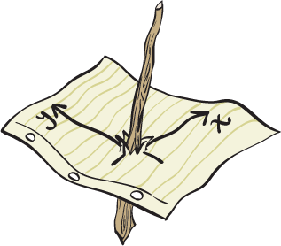
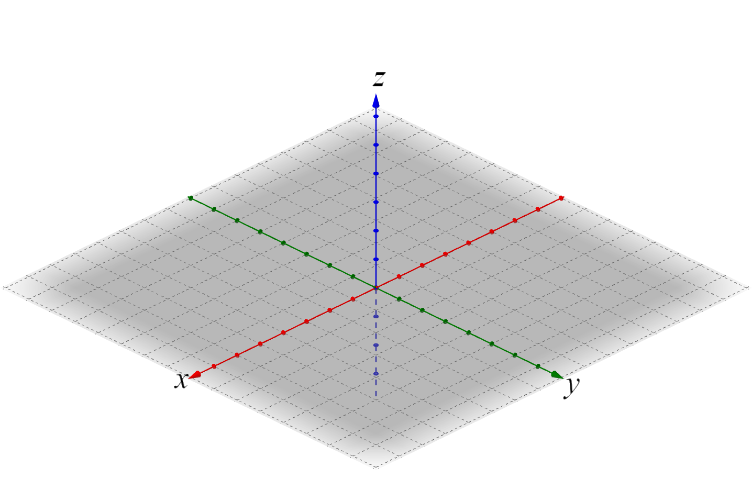
11-01 3-D Coordinate System
Points in 3 dimensions
  (x, y, z)
Graph by moving out the x, over the y, then up the z.
  Graph A(5, 6, 3)
  Graph B(-2, -4, 0)

Slide 5

11-01 3-D Coordinate System
Distance Formula
  In 2-D:
    $d=\sqrt{{\left(x_{2}−x_{1}\right)}^{2}+{\left(y_{2}−y_{1}\right)}^{2}}$
  In 3-D: (just add the z)
    $d=\sqrt{{\left(x_{2}−x_{1}\right)}^{2}+{\left(y_{2}−y_{1}\right)}^{2}+{\left(z_{2}−z_{1}\right)}^{2}}$

Slide 6

11-01 3-D Coordinate System
Midpoint Formula
  In 2-D:
    $M=\left(\frac{x_{1}+x_{2}}{2},\frac{y_{1}+y_{2}}{2}\right)$
  In 3-D: (just add the z)
    $M=\left(\frac{x_{1}+x_{2}}{2},\frac{y_{1}+y_{2}}{2},\frac{z_{1}+z_{2}}{2}\right)$

Slide 7

11-01 3-D Coordinate System
Equation of Circle (2-D)
  ${\left(x−h\right)}^{2}+{\left(y−k\right)}^{2}=r^{2}$
Equation of Sphere (3-D) (just add z)
  ${\left(x−h\right)}^{2}+{\left(y−k\right)}^{2}+{\left(z−j\right)}^{2}=r^{2}$
  Center is (h, k, j), r = radius
  Graph by plotting the center and moving each direction the radius
  Graph
  ${\left(x−2\right)}^{2}+{\left(y+1\right)}^{2}+{\left(z+1\right)}^{2}=16$
Notes:
Center (2, -1, -1)
$r^{2}=16$ so $r=4$

Slide 8

11-01 3-D Coordinate System
Trace (like intercepts for a sphere)
  Draw the xy trace for
  ${\left(x−2\right)}^{2}+{\left(y+1\right)}^{2}+{\left(z+1\right)}^{2}=16$
Notes:
Since xy trace, let $z=0$
$${\left(x−2\right)}^{2}+{\left(y+1\right)}^{2}+{\left(1\right)}^{2}=16$$
$${\left(x−2\right)}^{2}+{\left(y+1\right)}^{2}=15$$
Center (2, -1)
$$r=\sqrt{15}≈3.9$$
Looks funny because a perspective drawing

Slide 9
11-02 Vectors in space
In this section, you will:
Use vector operations in three dimensions.
Find the angle between vectors.

Slide 10


11-02 Vectors in space
Vectors in 2-D
  $\overset{⃑}{v}= \left\langle v_{1},v_{2}\right\rangle$
Vectors in 3-D (just add z)
  $\overset{⃑}{v}=\left\langle v_{1},v_{2},v_{3}\right\rangle$
To find a vector from the initial point $\left(p_{1},p_{2},p_{3}\right)$ to the terminal point $\left(q_{1},q_{2},q_{3}\right)$
  $\overset{⃑}{v}=\left\langle q_{1}−p_{1},q_{2}−p_{2},q_{3}−p_{3}\right\rangle$
If $\overset{⃑}{v}=\left\langle v_{1},v_{2},v_{3}\right\rangle$ and $\overset{⃑}{u}=\left\langle u_{1},u_{2},u_{3}\right\rangle$,
Addition
  Add corresponding elements
  $\overset{⃑}{v}+\overset{⃑}{u}=\left\langle v_{1}+u_{1},v_{2}+u_{2},v_{3}+u_{3}\right\rangle$
Scalar multiplication
  Distribute
  $c\overset{⃑}{v}=\left\langle cv_{1},cv_{2},cv_{3}\right\rangle$

Slide 11

11-02 Vectors in space
If $\overset{⃑}{v}=\left\langle v_{1},v_{2},v_{3}\right\rangle$ and $\overset{⃑}{u}=\left\langle u_{1},u_{2},u_{3}\right\rangle$,
Dot Product
  $\overset{⃑}{v}⋅\overset{⃑}{u}=v_{1}u_{1}+v_{2}u_{2}+v_{3}u_{3}$
Magnitude
  $\left\|\overset{⃑}{v}\right\|=\sqrt{v_{1}^{2}+v_{2}^{2}+v_{3}^{2}}$
Unit vector in the direction of $\overset{⃑}{v}$
  $\frac{\overset{⃑}{v}}{\left\|\overset{⃑}{v}\right\|}$

Slide 12








11-02 Vectors in space
Angle between vectors
  $\overset{⃑}{u}⋅\overset{⃑}{v}=\left\|\overset{⃑}{u}\right\|\left\|\overset{⃑}{v}\right\|\cos{θ}$
  If $θ=90°$ (and $\overset{⃑}{u}⋅\overset{⃑}{v}=0$)
    Then vectors are orthogonal
  If $\overset{⃑}{u}=c\overset{⃑}{v}$
    Then vectors are parallel

Slide 13


11-02 Vectors in space
Let $\overset{⃑}{m}=\left\langle 1, 0, 3\right\rangle$ and $\overset{⃑}{n}=\left\langle −2, 1, −4\right\rangle$
Find $\left\|\overset{⃑}{m}\right\|$
Find unit vector in direction of $\overset{⃑}{m}$
Find $\overset{⃑}{m}+2\overset{⃑}{n}$
Notes:
$$\left\|\overset{⃑}{m}\right\|=\sqrt{m_{1}^{2}+m_{2}^{2}+m_{3}^{2}}$$
$$=\sqrt{1^{2}+0^{2}+3^{2}}$$
$$=\sqrt{10}$$
$$\frac{\overset{⃑}{m}}{\left\|\overset{⃑}{m}\right\|}=\frac{\left\langle 1, 0, 3\right\rangle }{\sqrt{10}}$$
$$=\left\langle \frac{1}{\sqrt{10}},\frac{0}{\sqrt{10}},\frac{3}{\sqrt{10}}\right\rangle$$
$$=\left\langle \frac{\sqrt{10}}{10}, 0,\frac{3\sqrt{10}}{10}\right\rangle$$
$$\left\langle 1, 0, 3\right\rangle +2\left\langle −2, 1, −4\right\rangle$$
$$\left\langle 1, 0, 3\right\rangle +\left\langle −4, 2, −8\right\rangle$$
$$\left\langle −3, 2, −5\right\rangle$$

Slide 14


11-02 Vectors in space
Let $\overset{⃑}{m}=\left\langle 1, 0, 3\right\rangle$ and $\overset{⃑}{n}=\left\langle −2, 1, −4\right\rangle$
Find $\overset{⃑}{m}⋅\overset{⃑}{n}$
Find the angle between $\overset{⃑}{m}$ and $\overset{⃑}{n}$
Notes:
$$\left\langle 1, 0, 3\right\rangle ⋅\left\langle −2, 1, −4\right\rangle$$
$$1\left(−2\right)+0\left(1\right)+3\left(−4\right)$$
$$−14$$
$$\overset{⃑}{m}⋅\overset{⃑}{n}=\left\|\overset{⃑}{m}\right\|\left\|\overset{⃑}{n}\right\|\cos{θ}$$
$$−14=\sqrt{1^{2}+0^{2}+3^{2}}\sqrt{{\left(−2\right)}^{2}+1^{2}+{\left(−4\right)}^{2}}\cos{θ}$$
$$−14=\sqrt{10}\sqrt{21}\cos{θ}$$
$$\frac{−14}{\sqrt{10}\sqrt{21}}=\cos{θ}$$
$$θ≈165.0°$$

Slide 15


11-02 Vectors in space
Are $\overset{⃑}{p}=\left\langle 1, 5, −2\right\rangle$ and $\overset{⃑}{q}=\left\langle −\frac{1}{5}, −1,\frac{2}{5}\right\rangle$ parallel, orthogonal, or neither?
Parallel if $\overset{⃑}{p}=c\overset{⃑}{q}$
Notes:
Orthogonal if $\overset{⃑}{p}⋅\overset{⃑}{q}=0$
$$\left\langle 1, 5, −2\right\rangle ⋅\left\langle −\frac{1}{5}, −1,\frac{2}{5}\right\rangle$$
$$1\left(−\frac{1}{5}\right)+5\left(−1\right)+\left(−2\right)\left(\frac{2}{5}\right)$$
$$−\frac{1}{5}−5−\frac{4}{5}=−6$$
Not 0, so not orthogonal
$$\left\langle 1, 5, −2\right\rangle =c\left\langle −\frac{1}{5},−1,\frac{2}{5}\right\rangle$$
Check x
$$1=c\left(−\frac{1}{5}\right)→c=−5$$
Check y
$$5=c\left(−1\right)→c=−5$$
Check z
$$−2=c\left(\frac{2}{5}\right)→c=−5$$
c is always the same, so they are parallel

Slide 16

11-02 Vectors in space
Are $P\left(1, −1, 3\right)$, $Q\left(0, 4, −2\right)$, and $R\left(6, 13, −5\right)$ collinear?
Notes:
Find $\overset{⃑}{PQ}$ and $\overset{⃑}{QR}$. If they are parallel, then they go in same direction.
Since they would share a point, then they would be the same line.
$$\overset{⃑}{PQ}=\left\langle 0−1, 4−\left(−1\right), −2−3\right\rangle$$
$$=\left\langle −1, 5, −5\right\rangle$$
$$\overset{⃑}{QR}=\left\langle 6−0, 13−4, −5−\left(−2\right)\right\rangle$$
$$=\left\langle 6, 9, −3\right\rangle$$
These are not parallel because $\overset{⃑}{PQ}≠c\overset{⃑}{QR}$
They are not going same direction, so not collinear

Slide 17
11-03 Cross Products
In this section, you will:
Evaluate a cross product.
Use a cross product to solve area and volume problems.

Slide 18

11-03 Cross Products
$\hat{i}$is unit vector in x, $\hat{j}$ is unit vector in y, and $\hat{k}$ is unit vector in z
$\overset{⃑}{u}=u_{1}\hat{i}+u_{2}\hat{j}+u_{3}\hat{k}$ and $\overset{⃑}{v}=v_{1}\hat{i}+v_{2}\hat{j}+v_{3}\hat{k}$
$\overset{⃑}{u}×\overset{⃑}{v}=\left|\begin{matrix}\hat{i} & \hat{j} & \hat{k} \\ u_{1} & u_{2} & u_{3} \\ v_{1} & v_{2} & v_{3}\end{matrix}\right|$
If $\overset{⃑}{u}=\left\langle −2, 3, −3\right\rangle$ and $\overset{⃑}{v}=\left\langle 1, −2, 1\right\rangle$, find $\overset{⃑}{u}×\overset{⃑}{v}$
Notes:
$$\overset{⃑}{u}×\overset{⃑}{v}=\left|\begin{matrix}\hat{i} & \hat{j} & \hat{k} \\ −2 & 3 & −3 \\ 1 & −2 & 1\end{matrix}\right|\begin{matrix}\hat{i} & \hat{j} \\ −2 & 3 \\ 1 & −2\end{matrix}$$
$$=3\hat{i}+\left(−3\right)\hat{j}+4\hat{k}−3\hat{k}−6\hat{i} −\left(−2\right)\hat{j}$$
$$=−3\hat{i}−\hat{j}+\hat{k}=\left\langle −3, −1, 1\right\rangle$$

Slide 19


11-03 Cross Products
Properties of Cross Products
$\overset{⃑}{u}×\overset{⃑}{v}=−\left(\overset{⃑}{v}×\overset{⃑}{u}\right)$
$\overset{⃑}{u}×\left(\overset{⃑}{v}+\overset{⃑}{w}\right)=\left(\overset{⃑}{u}×\overset{⃑}{v}\right)+\left(\overset{⃑}{u}×\overset{⃑}{w}\right)$
$c\left(\overset{⃑}{u}×\overset{⃑}{v}\right)=c\overset{⃑}{u}×\overset{⃑}{v}=\overset{⃑}{u}×c\overset{⃑}{v}$
$\overset{⃑}{u}×\overset{⃑}{u}=0$
  If $\overset{⃑}{u}×\overset{⃑}{v}=0$, then $\overset{⃑}{u}$ and $\overset{⃑}{v}$ are parallel
$\overset{⃑}{u}⋅\left(\overset{⃑}{v}×\overset{⃑}{w}\right)=\left(\overset{⃑}{u}×\overset{⃑}{v}\right)⋅\overset{⃑}{w}$
$\overset{⃑}{u}×\overset{⃑}{v}$ is orthogonal to $\overset{⃑}{u}$ and $\overset{⃑}{v}$
$\left\|\overset{⃑}{u}×\overset{⃑}{v}\right\|=\left\|\overset{⃑}{u}\right\|\left\|\overset{⃑}{v}\right\|\sin{θ}$

Slide 20
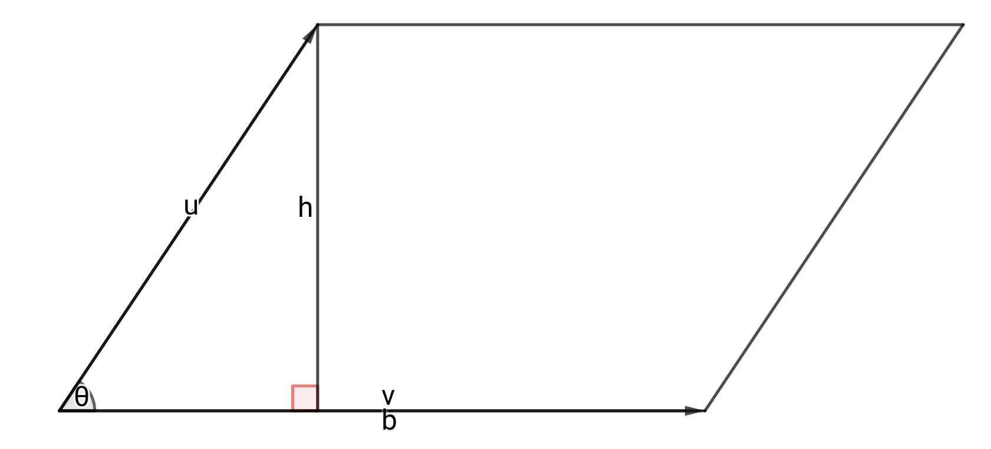

11-03 Cross Products
$A=bh$
$h=\left\|\overset{⃑}{u}\right\|\sin{θ}$
$A=\left\|\overset{⃑}{v}\right\|\left\|\overset{⃑}{u}\right\|\sin{θ}$
Area of a Parallelogram
  $\left\|\overset{⃑}{u}×\overset{⃑}{v}\right\|$ where $\overset{⃑}{u}$ and $\overset{⃑}{v}$ represent adjacent sides

Slide 21
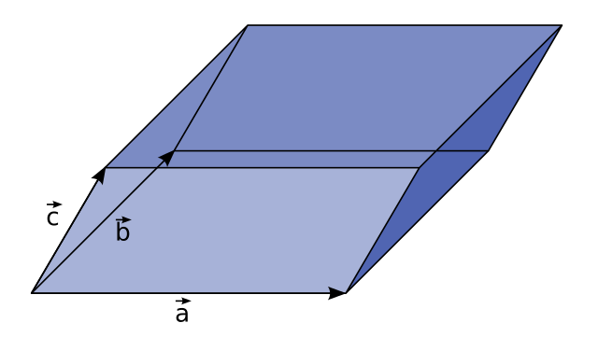

11-03 Cross Products
Triple Scalar Product (shortcut)
$\overset{⃑}{u}⋅\left(\overset{⃑}{v}×\overset{⃑}{w}\right)=\left|\begin{matrix}u_{1} & u_{2} & u_{3} \\ v_{1} & v_{2} & v_{3} \\ w_{1} & w_{2} & w_{3}\end{matrix}\right|$
Volume of Parallelepiped
  (3-D parallelogram)
  $V=\left|\overset{⃑}{u}⋅\left(\overset{⃑}{v}×\overset{⃑}{w}\right)\right|$ where $\overset{⃑}{u}$, $\overset{⃑}{v}$, and $\overset{⃑}{w}$ represent adjacent edges

Slide 22
11-04 Lines and Planes in Space
In this section, you will:
Write an equation for a line in three dimensions.
Write an equation for a plane.
Find the angle between two planes.
Graph a plane.

Slide 23
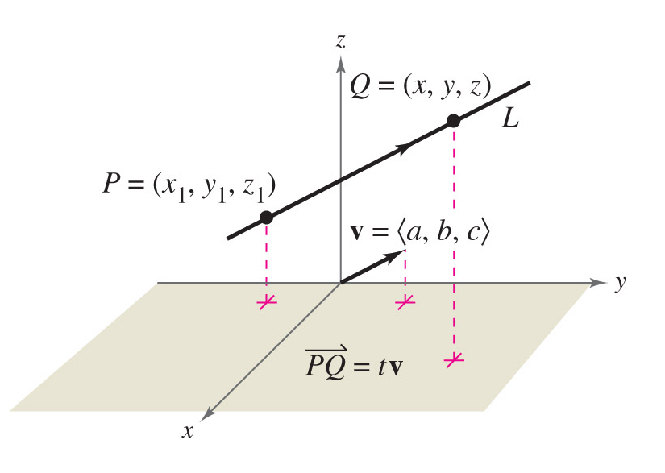

11-04 Lines and Planes in Space
Lines
  Line L goes through points P and Q
  $\overset{⃑}{v}$ is a direction vector for L
  Start at P and move any distance in direction $\overset{⃑}{v}$ to get some point Q
  $\overset{⃑}{PQ}=t\overset{⃑}{v}$ because they are parallel
  $\left\langle x−x_{1}, y−y_{1}, z−z_{1}\right\rangle =\left\langle at, bt, ct\right\rangle$
    General form

Slide 24


11-04 Lines and Planes in Space
Parametric Equations of Line
  Take each component of the general form and solve for x, y, or z.
  $\begin{matrix}x=at+x_{1} \\ y=bt+y_{1} \\ z=ct+z_{1}\end{matrix}$
  We used these when we solved 3-D systems of equations and got many solutions
Symmetric Equation of Line
  Solve each equation in parametric equations for t
  $\frac{x−x_{1}}{a}=\frac{y−y_{1}}{b}=\frac{z−z_{1}}{c}$

Slide 25
11-04 Lines and Planes in Space
Find a set of parametric equations of the line that passes through (1, 3, -2) and (4, 0, 1).
Notes:
Find the direction vector between those two points.
$$\overset{⃑}{v}=\left\langle 4−1, 0−3,1−\left(−2\right)\right\rangle$$
$$=\left\langle 3, −3, 3\right\rangle$$
$$=\left\langle a, b, c\right\rangle$$
Let’s call the first point $\left(1, 3, −2\right)=\left(x_{1}, y_{1}, z_{1}\right)$
Plug it in
$$\begin{matrix}x=at+x_{1} \\ y=bt+y_{1} \\ z=ct+z_{1}\end{matrix}$$
$$\begin{aligned}x&=3t+1 \\ y&=−3t+3 \\ z&=3t−2\end{aligned}$$

Slide 26
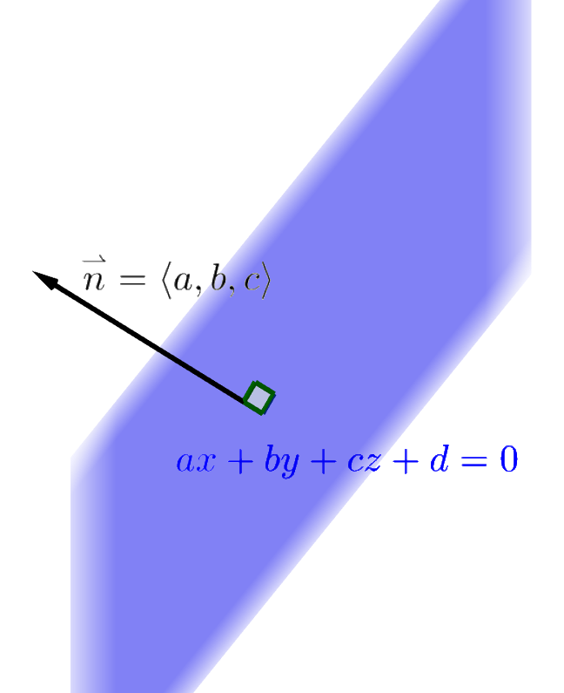

11-04 Lines and Planes in Space
Planes
$\overset{⃑}{PQ}⋅\overset{⃑}{n}=0$ because they are perpendicular
Standard form
$a\left(x−x_{1}\right)+b\left(y−y_{1}\right)+c\left(z−z_{1}\right)=0$
General form
$ax+by+cz+d=0$

Slide 27

11-04 Lines and Planes in Space
Find the general equation of plane passing through $A\left(3, 2, 2\right)$, $B\left(1, 5, 0\right)$, and $C\left(1, −3, 1\right)$
Notes:
We need to find the normal vector to the plane.
Find two vectors in the plane
$$\overset{⃑}{AB}=\left\langle 1−3,5−2,0−2\right\rangle =\left\langle −2,3,−2\right\rangle$$
$$\overset{⃑}{BC}=\left\langle 1−1,−3−5,1−0\right\rangle =\left\langle 0, −8, 1\right\rangle$$
Find the cross product to get a perpendicular (normal) vector
$$\overset{⃑}{n}=\overset{⃑}{AB}×\overset{⃑}{BC}$$
$$\overset{⃑}{n}=\left|\begin{matrix}\overset{⃑}{i} & \overset{⃑}{j} & \overset{⃑}{k} \\ −2 & 3 & −2 \\ 0 & −8 & 1\end{matrix}\right|\begin{matrix}\overset{⃑}{i} & \overset{⃑}{j} \\ −2 & 3 \\ 0 & −8\end{matrix}$$
$$=3\overset{⃑}{i}+0\overset{⃑}{j}+16\overset{⃑}{k}−0\overset{⃑}{k}−16\overset{⃑}{j}−2\overset{⃑}{j}$$
$$=−13\overset{⃑}{i}+2\overset{⃑}{j}+16\overset{⃑}{k}=\left\langle a, b, c\right\rangle$$
Fill in the general form
I chose $B\left(1, 5, 0\right)=\left(x_{1},y_{1}, z_{1}\right)$
$$a\left(x−x_{1}\right)+b\left(y−y_{1}\right)+c\left(z−z_{1}\right)=0$$
$$−13\left(x−1\right)+2\left(y−5\right)+16\left(z−0\right)=0$$
Simplify to get general form
$$−13x+2y+16z+3=0$$

Slide 28
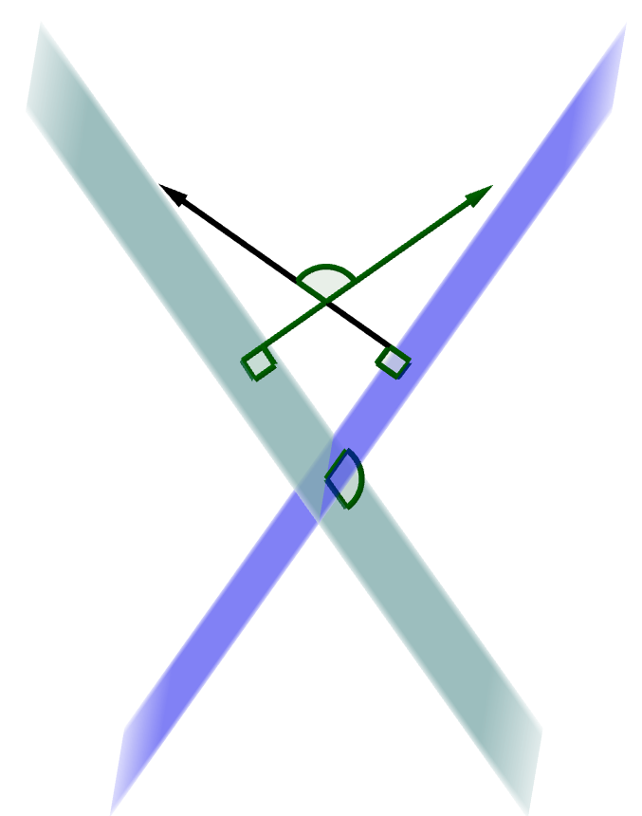

11-04 Lines and Planes in Space
Angle between two planes
  Find the angle between normal vectors
  Normal vectors are coefficients in the equations of the plane
  $\left|\overset{⃑}{n_{1}}⋅\overset{⃑}{n_{2}}\right|=\left\|\overset{⃑}{n_{1}}\right\|\left\|\overset{⃑}{n_{2}}\right\|\cos{θ}$

Slide 29
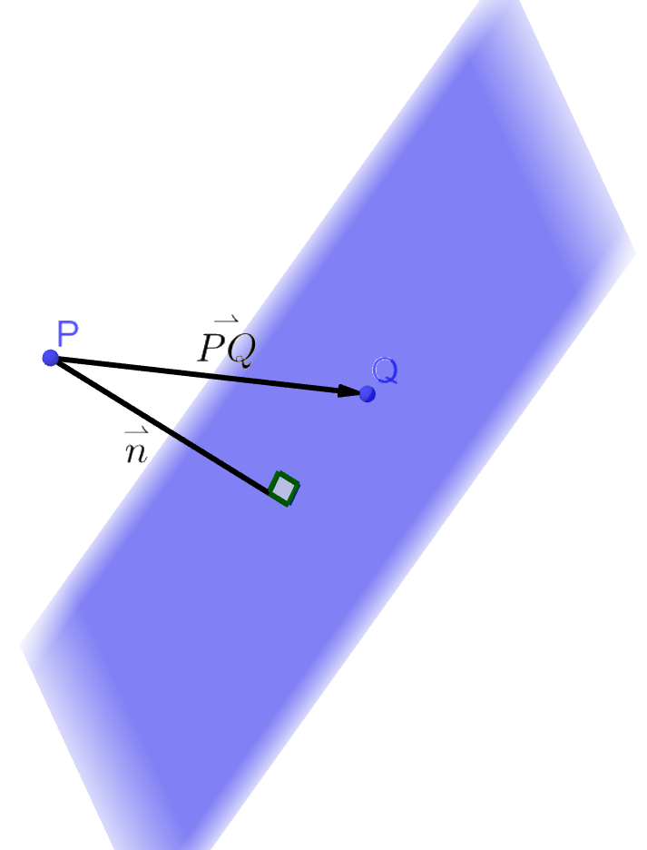

11-04 Lines and Planes in Space
Distance between a Point and a Plane
$D=\left\|proj_{\overset{⃑}{n}} \overset{⃑}{PQ}\right\|$
$D=\frac{\left|\overset{⃑}{PQ}⋅\overset{⃑}{n}\right|}{\left\|\overset{⃑}{n}\right\|}$

Slide 30

11-04 Lines and Planes in Space
Graphing planes in space
  Find the intercepts
  Plot the intercepts
  Draw a triangle to represent the plane
Sketch $3x+4y+6z=24$
Notes:
x-int $3x=24→x=8$
y-int $4y=24→y=6$
z-int $6z=24→z=4$

